Slide 1
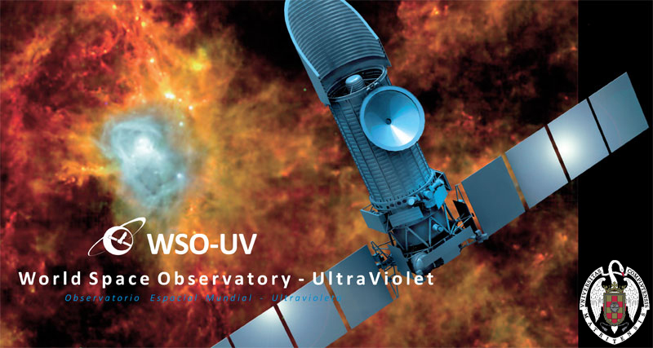
Instrumental performance of the
WSO-UV Field Camera Unit
EWASS, 27th July 2017
Pablo Marcos-Arenal
AEGORA Research Group
UCM

Slide 2
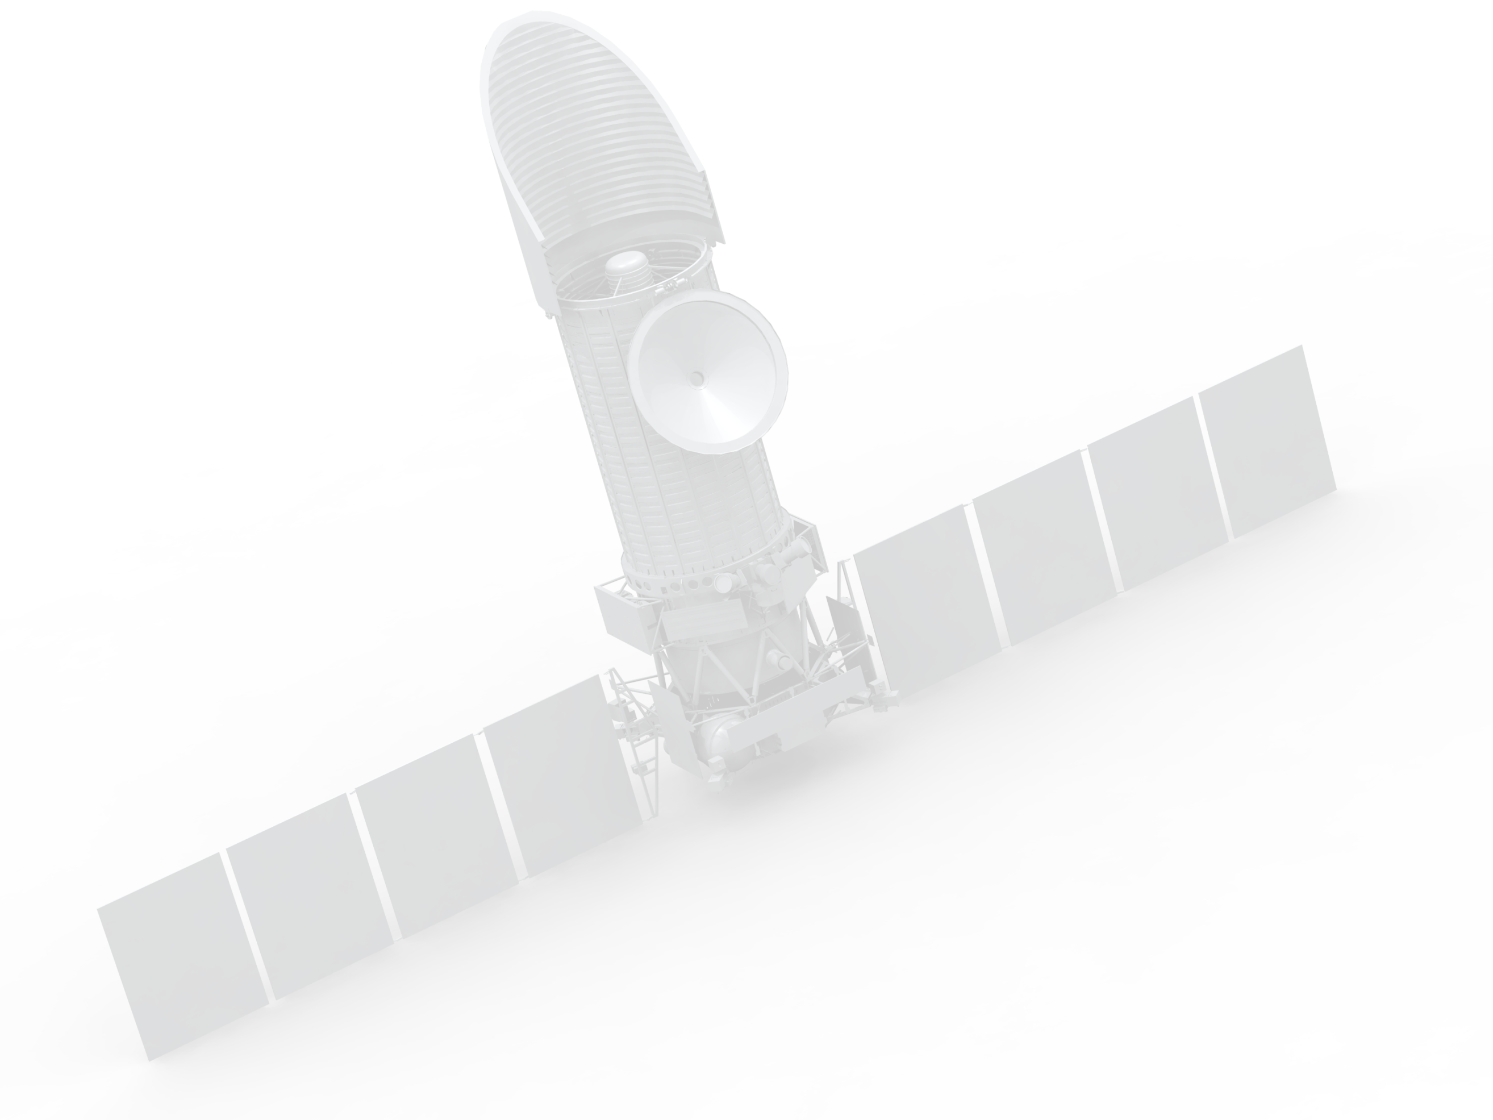


WSO-UV Space Telescope
Optical System | Ritchey-Chrétien
Aperture diameter | 1.7 m
Focal length | 17 m (primary mirror)
Field of View (FoV) | 30 arcmin (150 mm in diameter)
Wavelength range | 102-320 nm
Launch date | 2022
Launcher | Proton medium-class rocket
Operation lifespan | 5+5 years
Orbit | Geosynchronous
EWASS, 27th July 2017

Slide 3
WSO-UV instrumentation
WUVS: WSO Ultraviolet Spectrographs
  VUVES: Far UV 1020-1800 Å, R~55000
  UVES: Near UV 1740-3100 Å, R~55000
  LSS: Long Slit 1020-3200 Å, R=1500-4500
FCU: Field Camera Unit
  UVO Channel: 1740-3100 Å CCD
  FUV Channel: 1150-1750 Å MCP
EWASS, 27th July 2017
Notes:
Presentación de la instrumentación

Slide 4
PLATO Simulator
WSO Simulator
An end-to-end simulation software-tool designed to be used in different space missions.
Simulates photometric time-series of images by including realistic models of the noise sources.
EWASS, 27th July 2017
Notes:
ASTROID is the architectural design of a multi-detector simulator. …e2e……photometric…
->This simulator was built in the framework of the PLATO mission developed in Leuven University.
->This simulator is being adapted for the WSO instrumentation

Slide 5
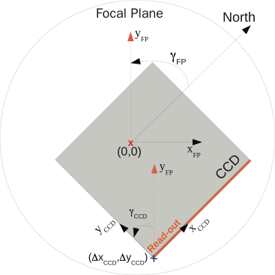
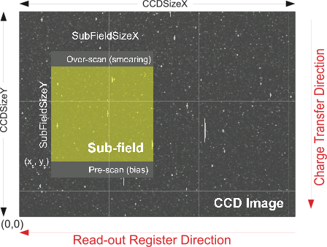
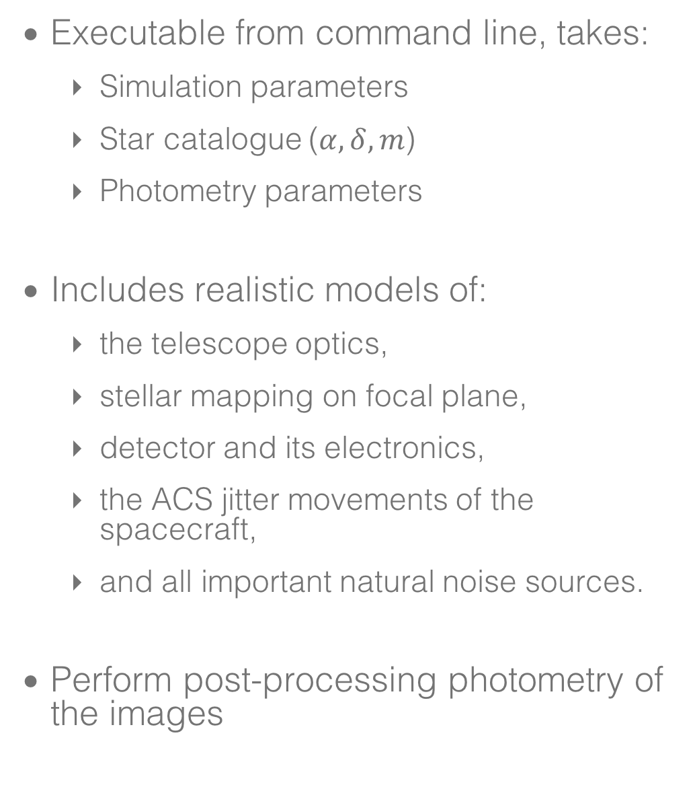
How does it work?
Executable from command line, takes:
    Simulation parameters
    Star catalogue ($α,δ,m$)
    Photometry parameters
Includes realistic models of:
    the telescope optics,
    stellar mapping on focal plane,
    detector and its electronics,
    the ACS jitter movements of the spacecraft,
    and all important natural noise sources.
Perform post-processing photometry of the images
EWASS, 27th July 2017
Notes:
Includes realistic models of:
1.- the telescope optics,
2.- Imaging FoV: CCD rotation and resizing; Mapping stars on the CCD;
3.- including appropriate models of the CCDs and their electronics...

Slide 6
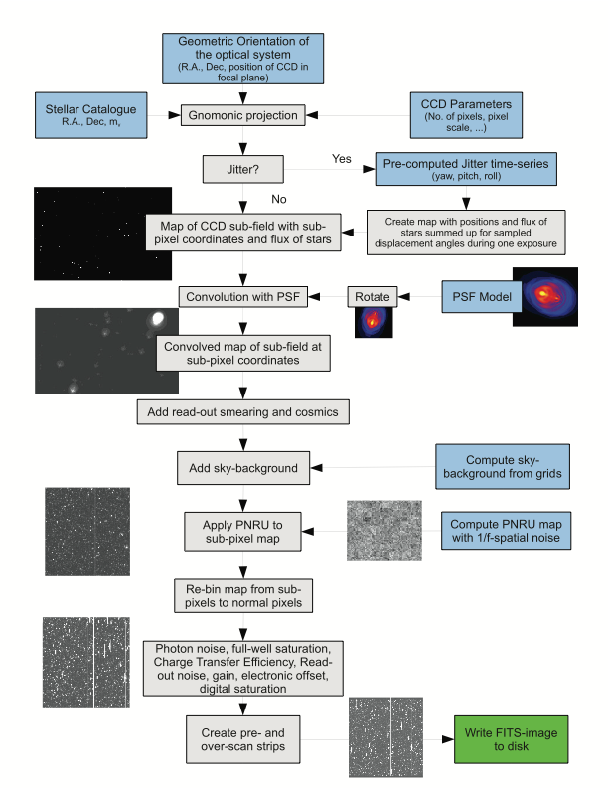
How does it work?
Noise sources:
  PSF Convolution;
  High-energy particle hits;
  Charge-transfer smearing;
  Sky background;
  CCD Sensitivity variations;
  Photon noise;
  Full-well saturation;
  Charge-transfer efficiency;
  Read-out noise;
  Gain;
  Electronic offset;
  Digital saturation.
EWASS, 27th July 2017

Slide 7
Some simulation parameters…
Input Parameter | Value | Input Parameter | Value
CCD Size | 4096 × 3112 px | Collecting area | 90792 cm²
Sub-Field size | 400 × 400 px | Digital saturation | 16384 ADU
Pixel resolution | 1/64 | Full well pixel capacity | 16000 e⁻
Transmision efficiency | 0.638466 | Gain | 1 e⁻/ADU
Quantum efficiency | 25% | Electronic offset | 100 ADU
Number of exposures | 6000 | Readout noise | 3 e⁻
Exposure time | 165 s | Flatfield pixel-to-pixel noise | 1.8 %
Charge transfer time | 63 s | Mean Charge Transfer Efficiency | 0.999999
Pixel scale | 0.145 arcsec/px | Pixel size | 12 μm
EWASS, 27th July 2017

Slide 8
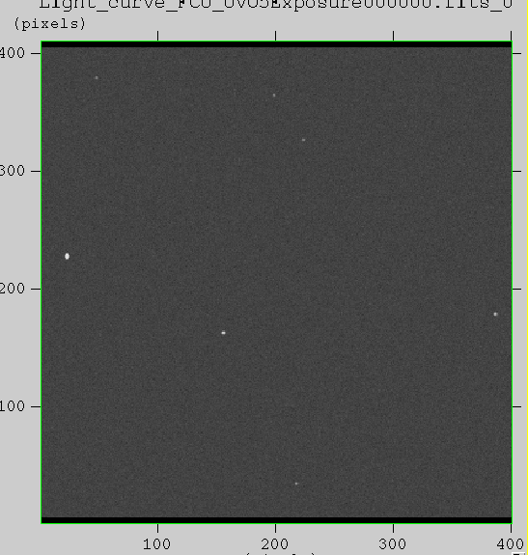
FCU performance evaluation
UVO Channel:
    Estimation of observable stars at specific noise levels
EWASS, 27th July 2017

Slide 9
FCU performance evaluation
UVO Channel:
    Estimation of observable stars at specific noise levels
    Jitter effect on the overall noise budget
EWASS, 27th July 2017

Slide 10
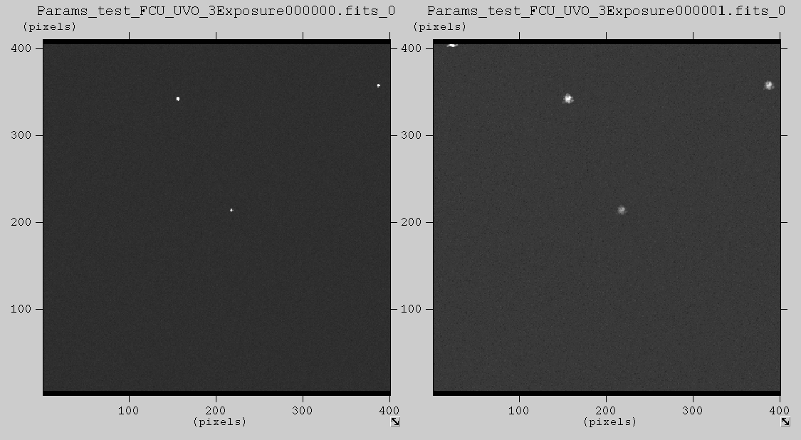
FCU performance evaluation
UVO Channel:
    CCD Detector
    Spacecraft jittering
    Aperture pixels
    Exposure calculator
    Exoplanets transits
    Ad hoc photometry
FUV Channel:
    MCP Detector (work in progress)
EWASS, 27th July 2017

Slide 11
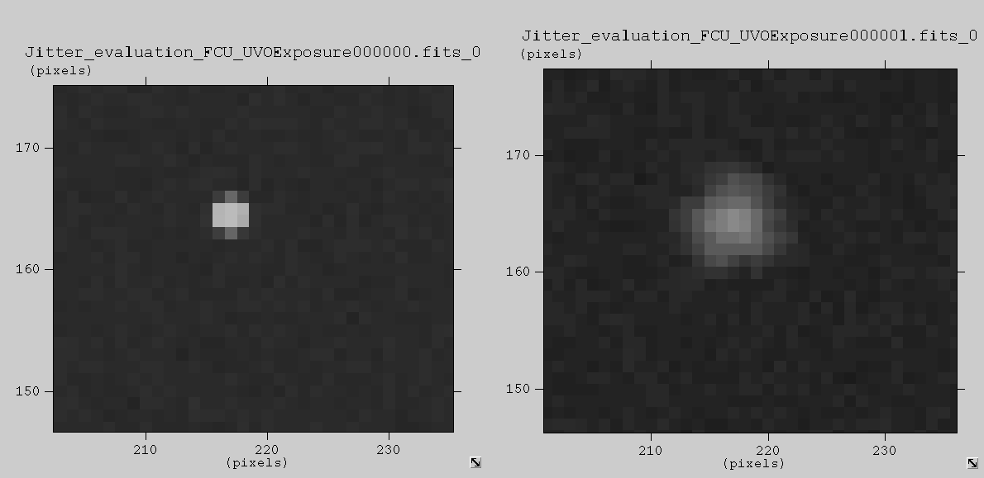
FCU performance evaluation
EWASS, 27th July 2017

Slide 12
FCU performance evaluation
UVO Channel:
    Estimation of observable stars at specific noise levels
    Jitter effect on the overall noise budget
    Performance test of prototype detectors
    Optical design performance
    Exoplanets transits
EWASS, 27th July 2017

Slide 13
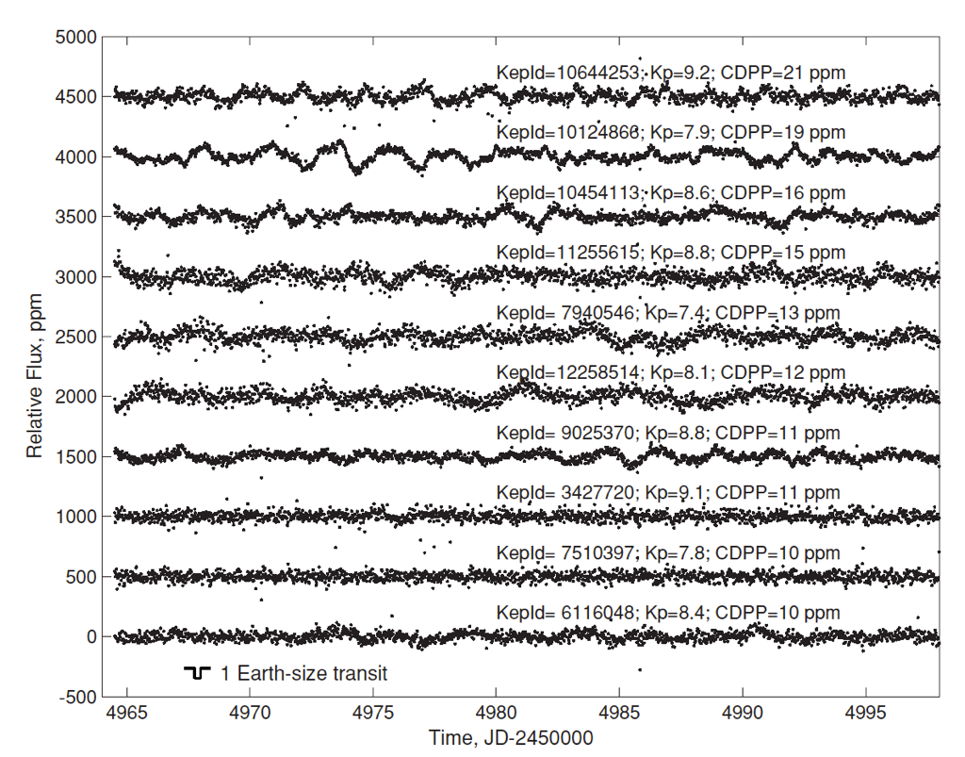
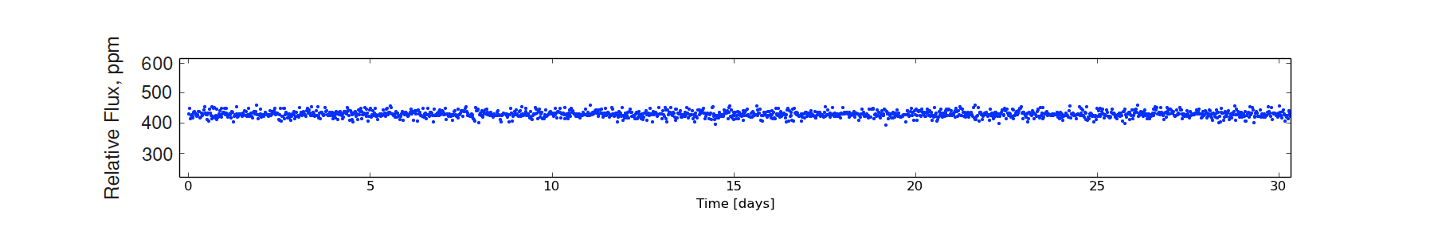
FCU performance evaluation
UVO Channel:
    Estimation of observable stars at specific noise levels
    Jitter effect on the overall noise budget
    Performance test of prototype detectors
    Optical design performance
    Exoplanets transits
EWASS, 27th July 2017

Slide 14
FCU performance evaluation
UVO Channel:
    Estimation of observable stars at specific noise levels
    Jitter effect on the overall noise budget
    Performance test of prototype detectors
    Optical design performance
    Exoplanets transits
FUV Channel:
    MCP Detector (work in progress)
EWASS, 27th July 2017

Slide 15
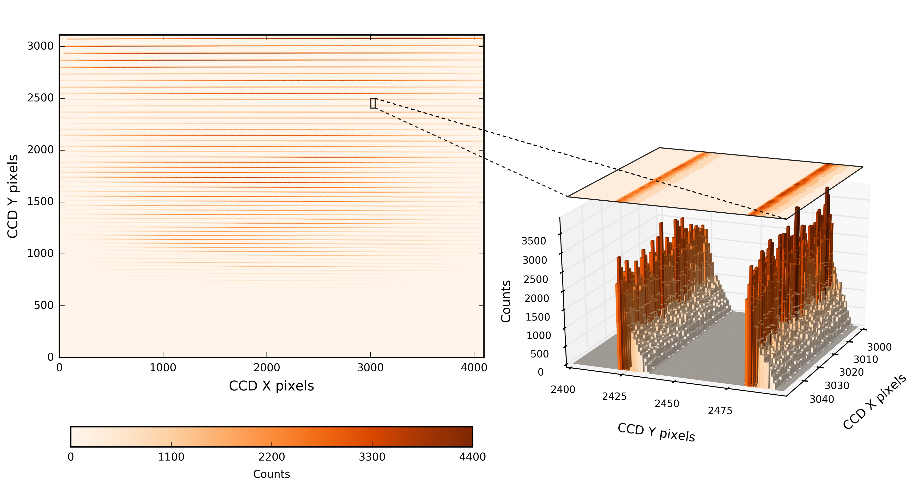

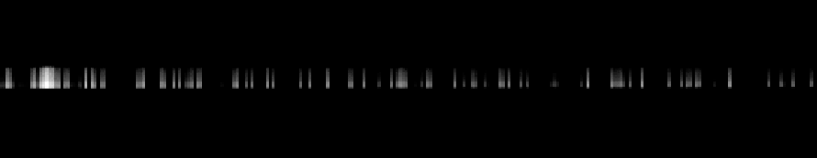
WUVS performance evaluation
Application: spectral lines detectability
Select actual spectrum
    STIS E140 grating similar spectral wavelength and resolution
    Resampling STIS spectral resolution to WUVS spectral resolution
    Setting the STIS orders into the WUVS pixel map
Input file: Flat spectrum
DG Tau spectrum from STIS in WUVS pixel map
EWASS, 27th July 2017

Slide 16
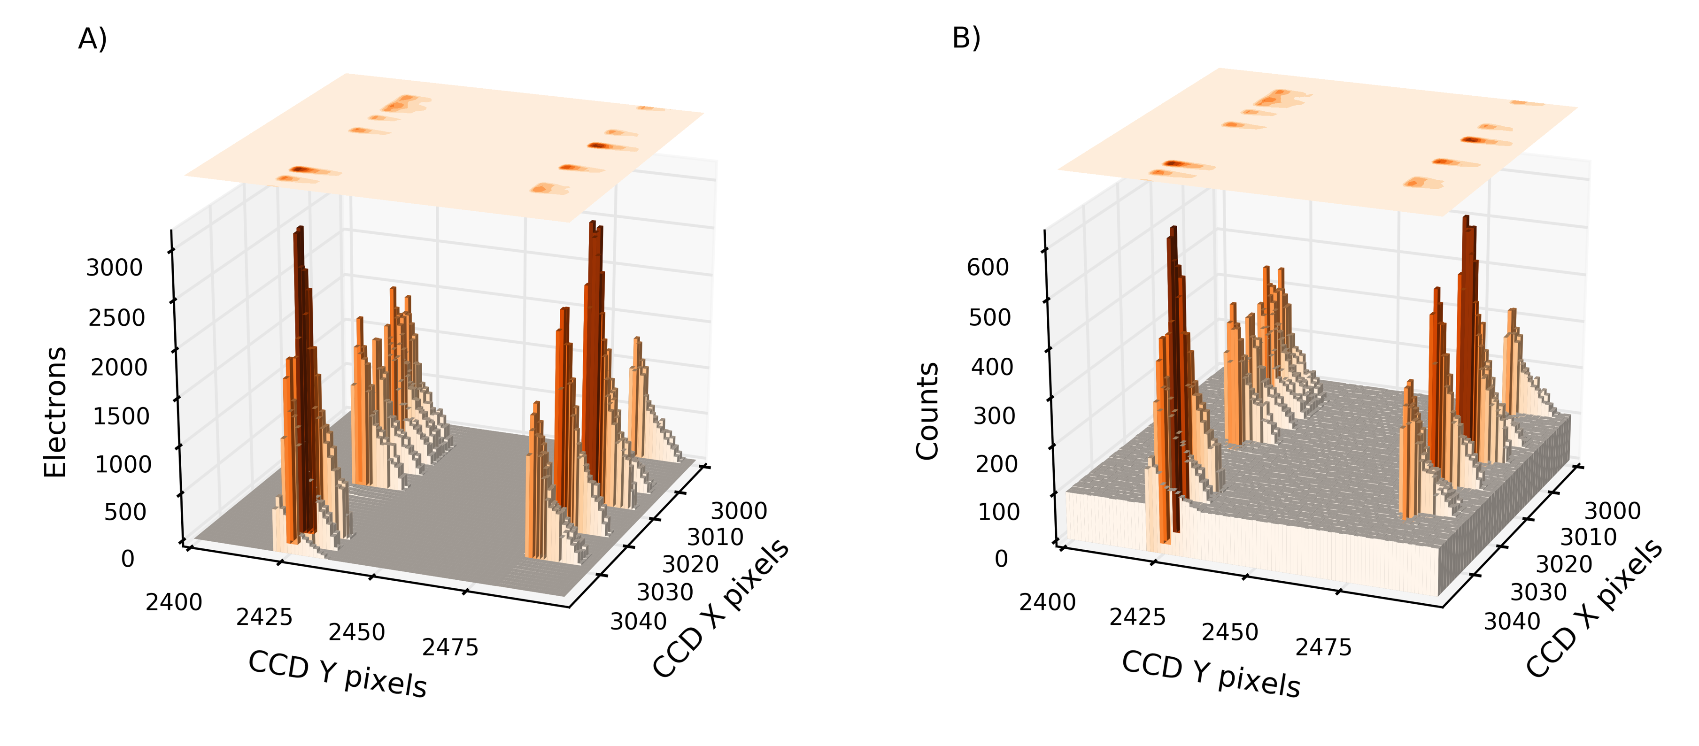
WUVS performance evaluation
Input image vs Simulated image
EWASS, 27th July 2017
Notes:
Electronic offset and gain

Slide 17
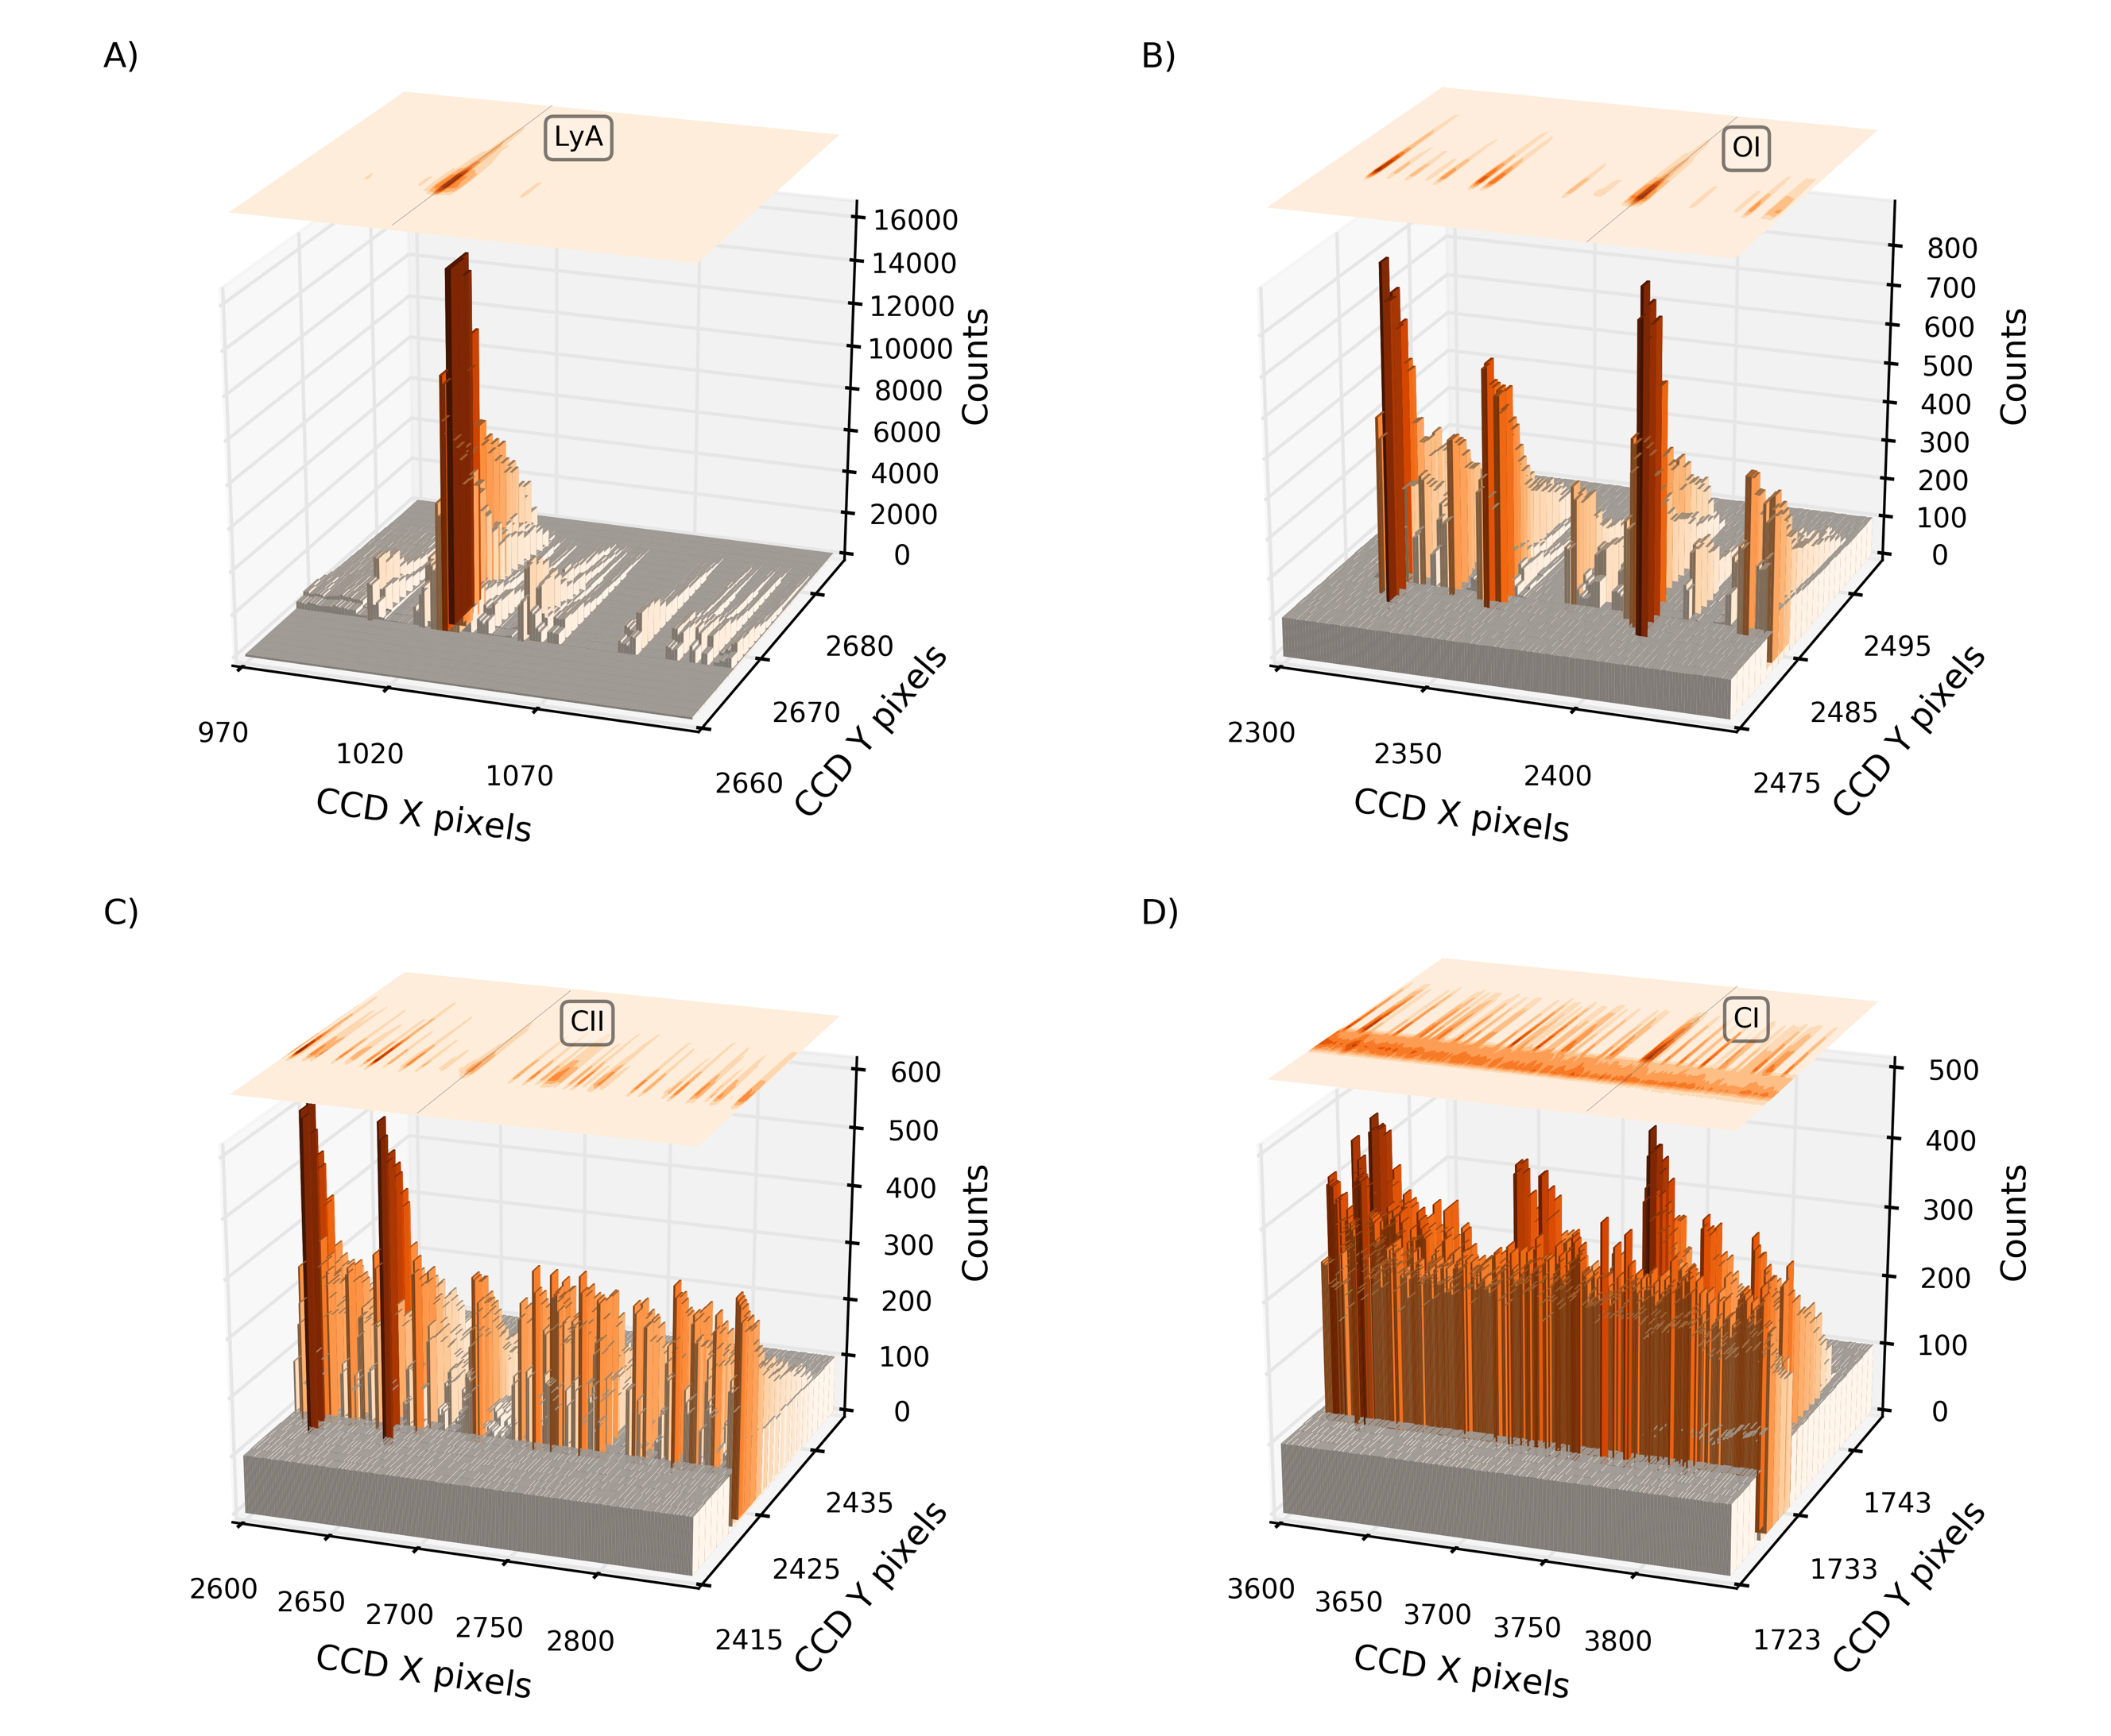
WUVS performance evaluation
(Marcos-Arenal et al. 2017)
EWASS, 27th July 2017
Notes:
LyA shows effect of digital saturation
Carbon one shows the degradation in the extremes

Slide 18
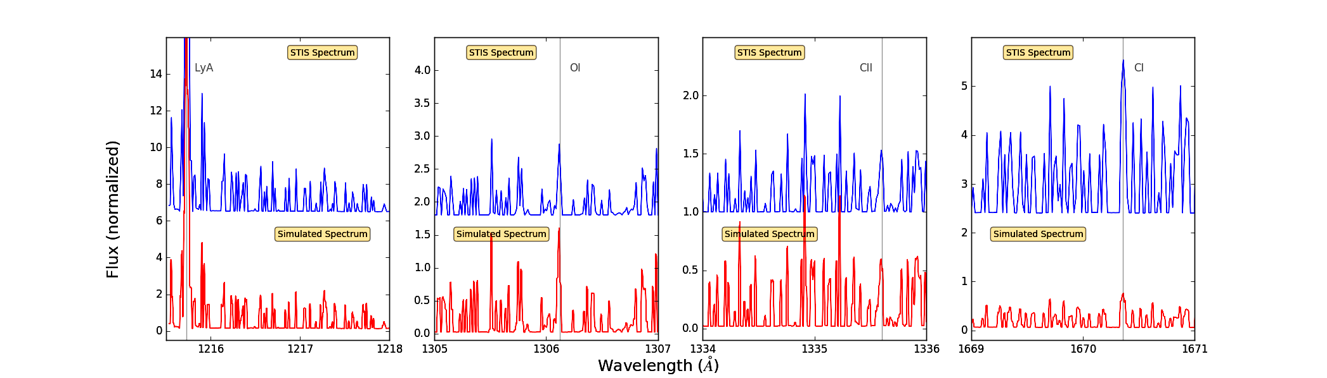
WUVS performance evaluation
Original vs simulated spectra
(Marcos-Arenal et al. 2017)
EWASS, 27th July 2017

Slide 19
Final remarks
Validation of the WSO-UV instrumental behaviour (applicable to different missions)
Transiting exoplanets simulations
Photometry post-processing workbench
Detection of spectral lines in WUVS to evaluate exoplanets’ atmospheres detectability
EWASS, 27th July 2017
Notes:
In the future to come we are planning on applying the simulator to different
astronomical sources in a wide range of brightness and spectral types.
There are many improves to be done to this simulator in order to ease its
usability and performance. Source to echelle spectra transformation, satellite
jitter and graphical user interface and code parallelization among others.

Slide 20
Thanks for your attention!
EWASS, 27th July 2017

