Slide 1
Mysterious eclipses of Boyajian's star: a possible explanation
Ľuboš Neslušan & Ján Budaj
Astronomical Institute, Tatranská Lomnica
Slovak Republic
Prague, Jun 27, 2017

Slide 2
Content
Discovery
Lightcurves and observational constraints
Models and their problems
Comet scenario
Massive object scenario
Future

Slide 3
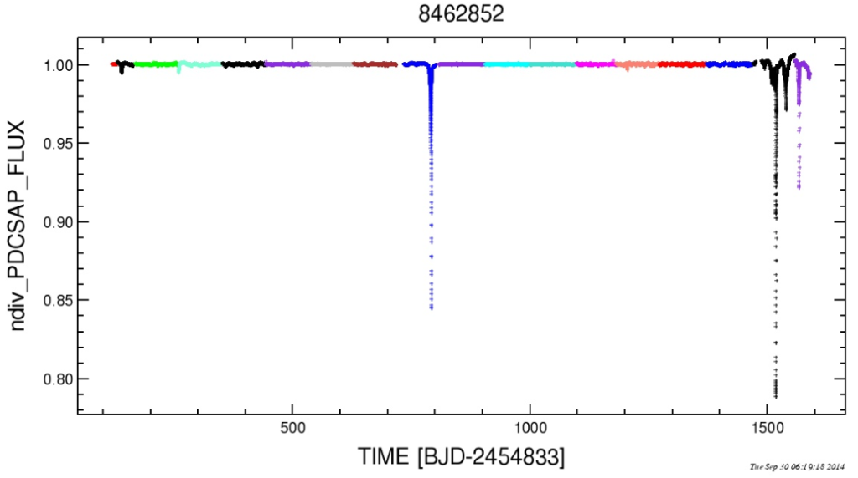
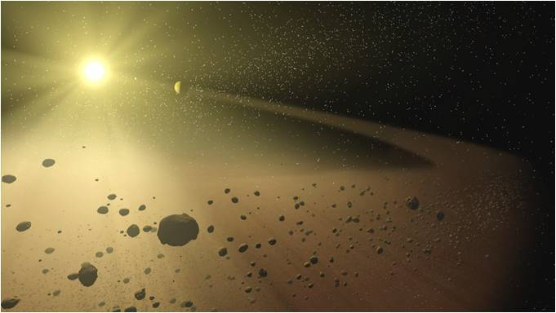
KIC 8462852
Boyajian et al.(2016), Kepler data, normal 12 mag F3V(IV) star
M=1.43Msol, R=1.58Rsol, Teff=6750K
Irregular dips with peculiar shapes, up to 20% deep
06:24

Slide 4
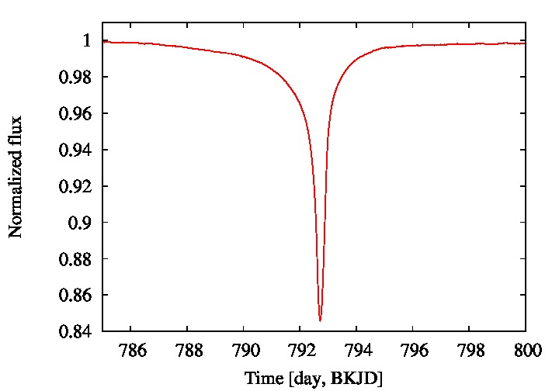
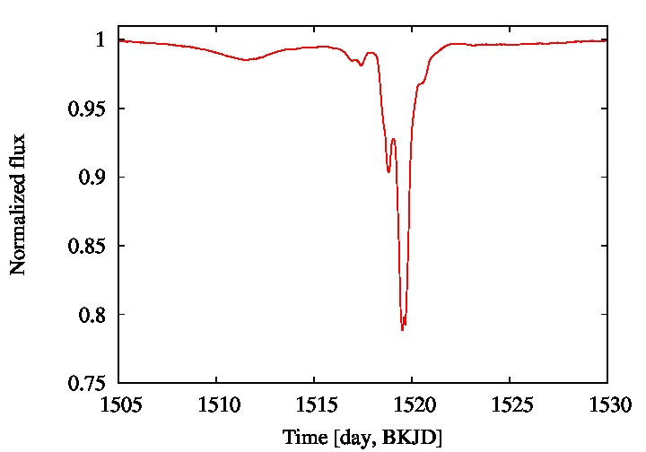
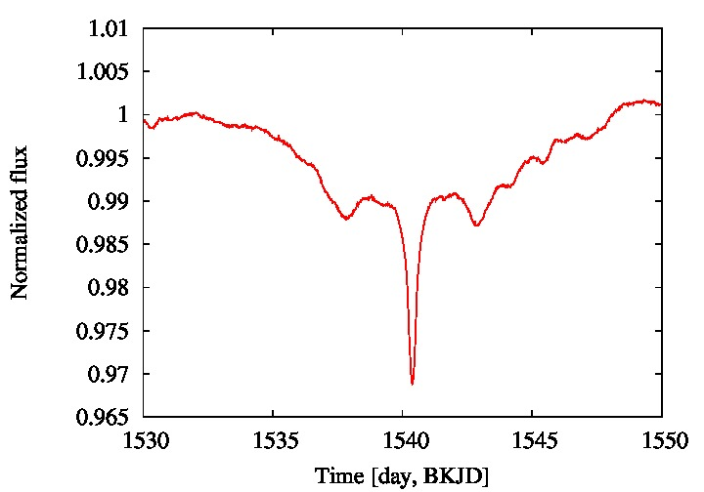
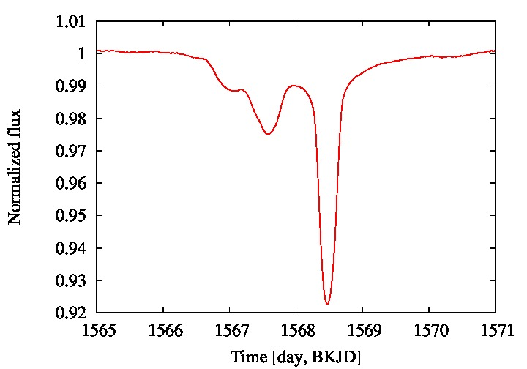
Shapes of four main events
06:24

Slide 5
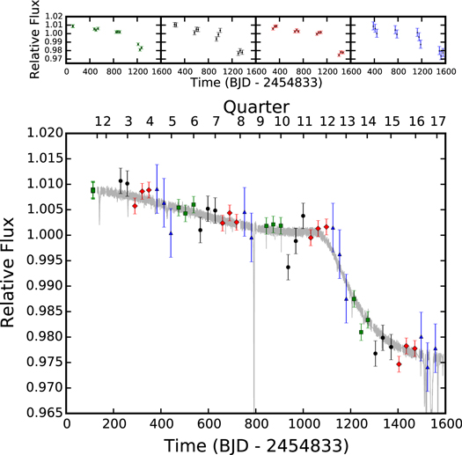
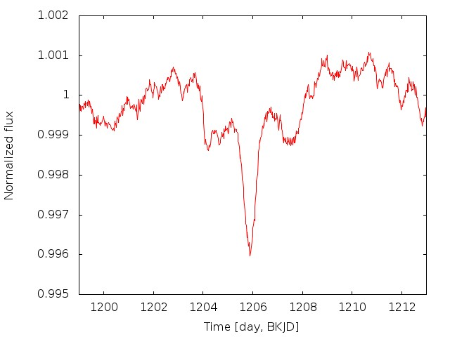
IR,sub-mm,mm,GAIA
Long term trend
Another event
Boyajian et al.2016, Marengo et al. 2016
Lisse et al. 2015, Thompson et al. 2016
Hippke & Angerhausen 2017 (GAIA, 390pc)
Nondetection, not young object
Dust <7.7 M_Earth within 200au
Dust in occultation < 10^-3 M_Earth
Montet & Simon (2016)
06:24

Slide 6
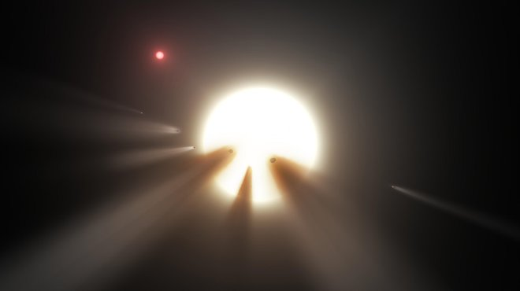
Comet scenario
Bodman & Quillen (2016)
a swarm of 70-700 comets
highly eccentric orbits
Pros:
Fits most of the features very well
Satisfies the IR limits
Such comets are known to exist and have high probability of transit
Cons:
cannot reproduce smooth 800d feature
produce shallower eggress with tails (obs. have the opposite trend)
many free parameters can fit anything, hence the model may not necesarily be correct even if the fit is perfect
Symmetric 'ring like' feature at BKJD 1540 would be an accidental constellation of comets
Another symmetric feature at BKJD 1210 would be another accidental constellation of comets
06:24

Slide 7
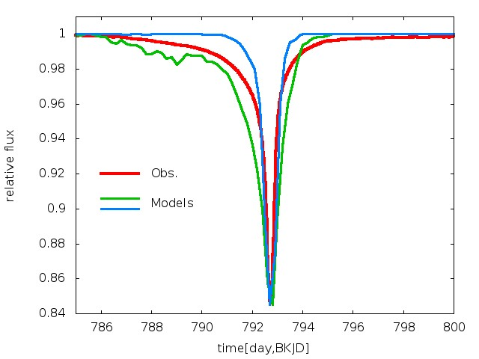
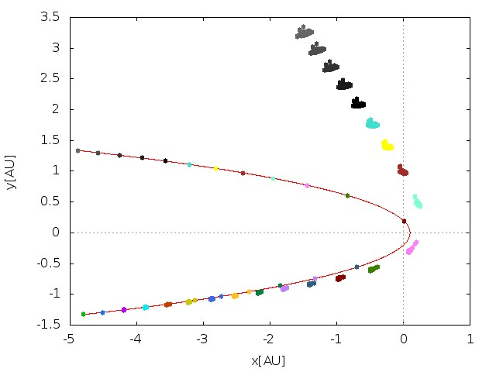
Massive bodies with dust clouds
Neslusan & Budaj (2017)
star & 4+ massive bodies with dust clouds
Assumptions: initial dust cloud model, gravity (star+body), P-R drag
Example solution found: 4 objects on almost identical orbits:
i=90 deg, p=0.1 AU, a=50 AU and identical particles with beta=0.63
Spherical cloud (blue: M=10^-10 Mstar, green: 10^-8 Mstar
06:24

Slide 8
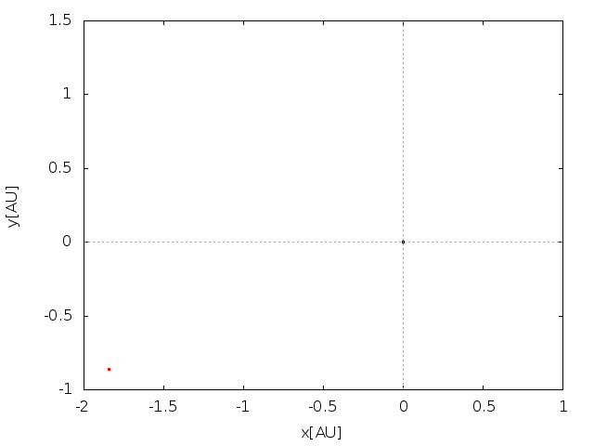
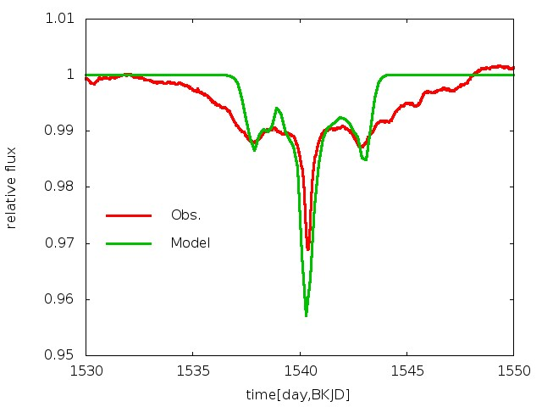
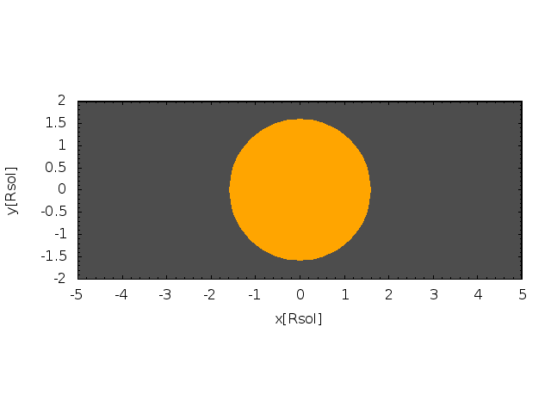
Massive bodies with dust clouds
An initial ring-like cloud,
Inclination=45deg, R=5000-10000km,
M=10^-8 Mstar
06:24

Slide 9
Pros: -problems of the comet scenario are gone -low number of free parameters Cons: -fits are not perfect (but surprisingly good given only a few free param) -how to get a massive body on such eccentric orbit -how to form a dust cloud around it Metzger, Shen & Stone 2017: Lidov-Kozai oscillations due to outer M dwarf companion can get a massive object on such orbits. The object may be disrupted, consumed by the star, star gets brighter and then fades back what could explain the long term fading problem. Granvik et al. 2016: Super-catastrophic disruption of asteroids at small perihelion distances.

Slide 10
May 19, 2017 Boyajian's star is waking up ... to be continued ...
Thank you!

