Slide 1
Detecting and Characterising Planets with
Direct Imaging
Beth Biller, University of Edinburgh
Notes:
To talk to you about the Rapidly growing field of direct imaging of exoplanets
Direct imaging has huge potential for revolutionizing our understanding of the properties of extrasolar giant planets and planetary systems
(i.e. comparative exoplanetology)
For instance, what you’re looking at here – PZ Tel
Brown dwarf, tearing through its inner solar system, bad news for planets

Slide 2
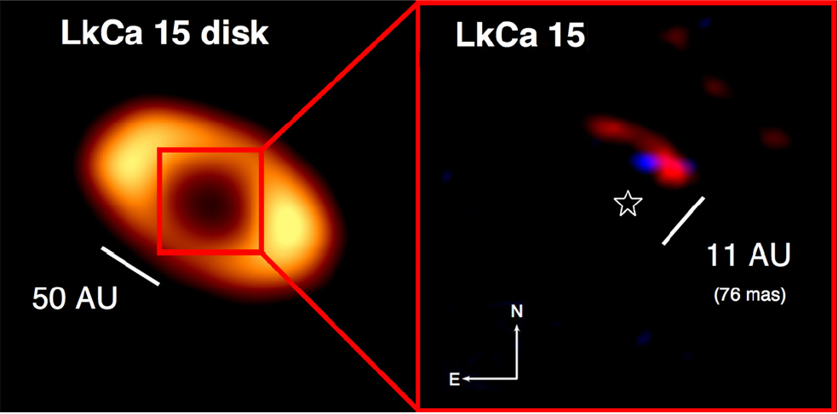
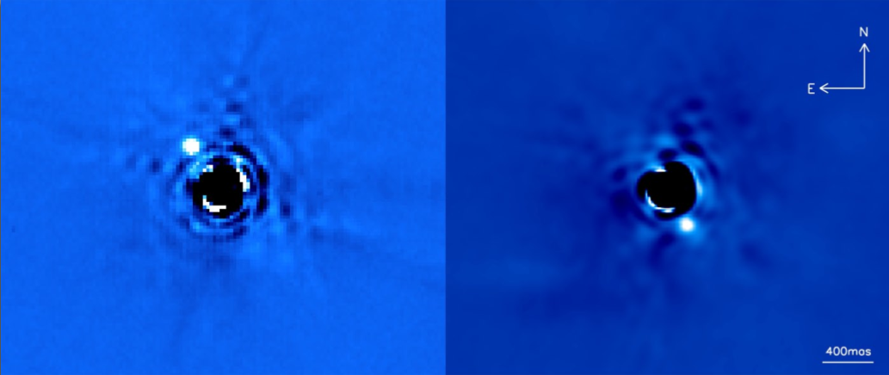
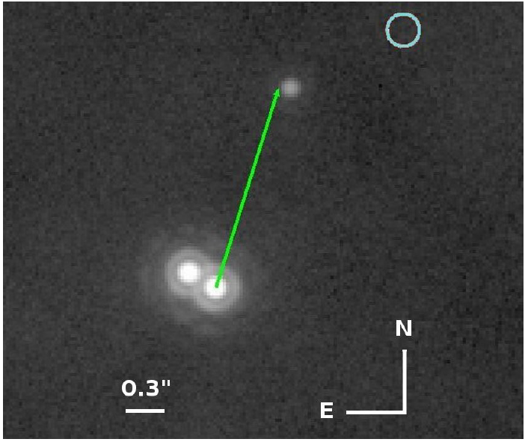
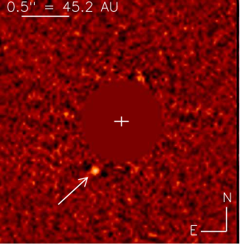
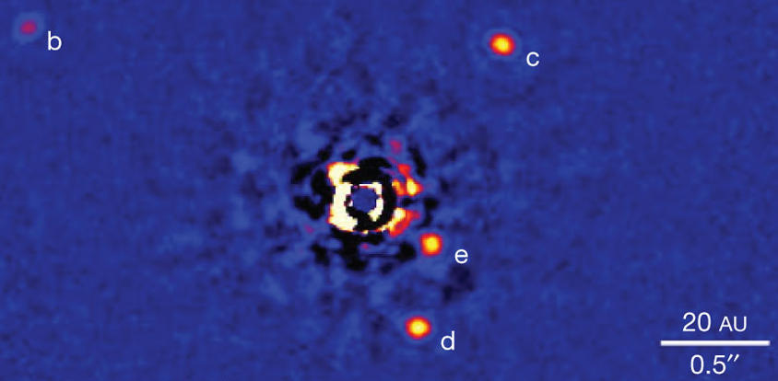
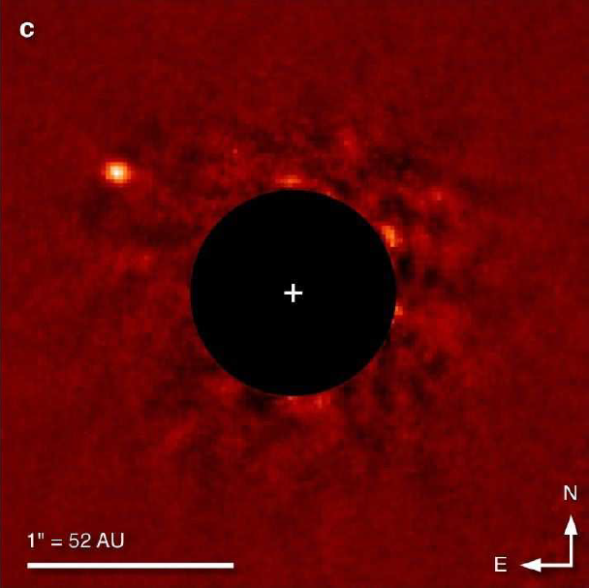
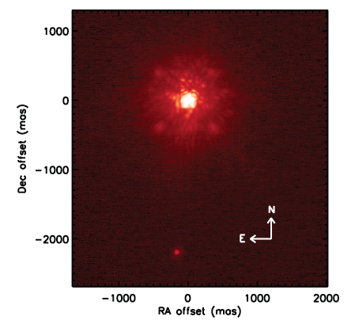
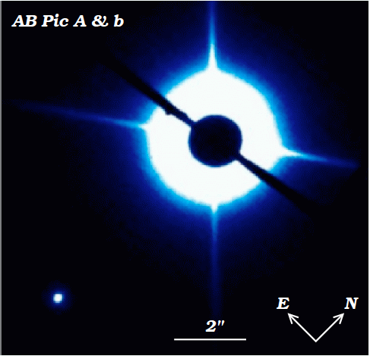
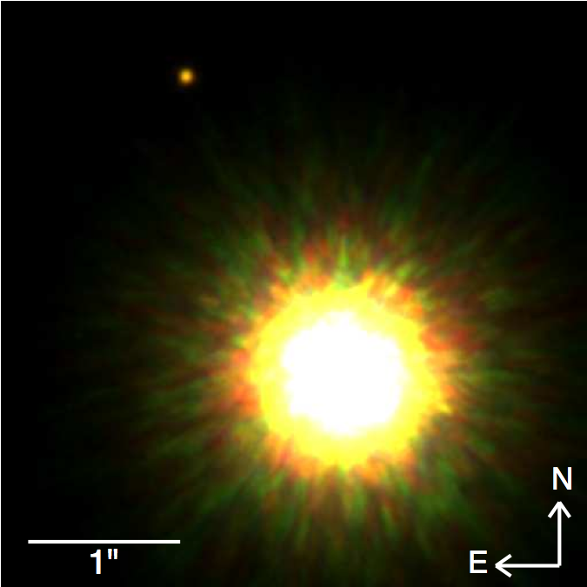
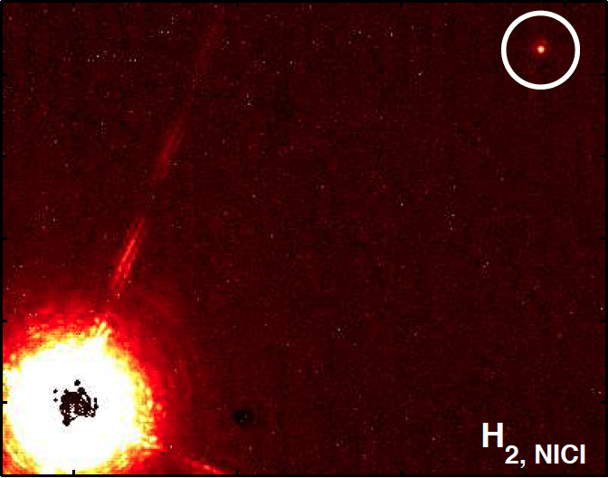
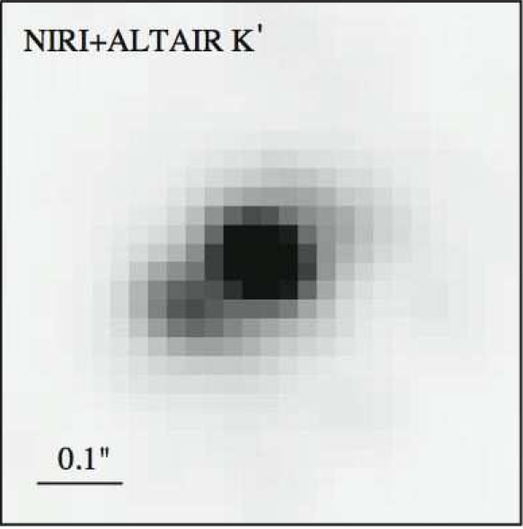
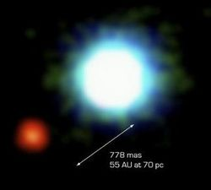
Directly Imaged Planetary (or Nearly Planetary) Companions
Delorme
et al. 2013
Kraus and Ireland 2012
Lagrange et al. 2008,2010
Ireland et al. 2011,
Bowler et al. 2011
Carson et al. 2013
Marois et al.
2008,2010v
Chauvin et al. 2005
Rameau et al. 2013
Chauvin
et al. 2004, 2005
Bailey et al. 2013
Lafrenière et al. 2008,2010
Kalas et al. 2008
Todorov et al. 2010
Notes:
Young objects studied in the infrared
Age – luminosity mass degeneracy
Ages estimated primarily from MG membership
Often similar Teff as hot Jupiters
Until 20 years ago, we only knew about one planetary system – our own. So we made the only natural assumption we could make at the time, which is that our system is typical.. We can only now begin to assess whether our system is indeed typical, and in Fact we are finding quite a lot that looks nothing like our own solar system. Eventually studying exoplanets will tell us not only the physical properties of these
planets, but information about life elsewhere in the universe. Characterizing massive gas giant planets now and starting to discover exo-Neptunes and super-Earths, Eventually we’ll be doing this for exo-earths too… Direct Imaging of Extrasolar Earths and search for Biosignatures
----- Meeting Notes (4/13/13 22:09) -----
Characterizing massive gas giant planets now and starting to discover exo-Neptunes and super-Earths, Eventually we’ll be doing this for exo-earths too… Direct Imaging of Extrasolar Earths and search for Biosignatures
----- Meeting Notes (4/13/13 22:10) -----
Characterizing massive gas giant planets now and starting to discover exo-Neptunes and super-Earths, Eventually we’ll be doing this for exo-earths too… Direct Imaging of Extrasolar Earths and search for Biosignatures

Slide 3
Directly Imaged Planetary Companions
β Pic b
Lagrange et al. 2008,2010
HR 8799 bcde
Marois et al.
2008,2010
Notes:
Until 20 years ago, we only knew about one planetary system – our own. So we made the only natural assumption we could make at the time, which is that our system is typical.. We can only now begin to assess whether our system is indeed typical, and in Fact we are finding quite a lot that looks nothing like our own solar system. Eventually studying exoplanets will tell us not only the physical properties of these
planets, but information about life elsewhere in the universe. Characterizing massive gas giant planets now and starting to discover exo-Neptunes and super-Earths, Eventually we’ll be doing this for exo-earths too… Direct Imaging of Extrasolar Earths and search for Biosignatures
----- Meeting Notes (4/13/13 22:09) -----
Characterizing massive gas giant planets now and starting to discover exo-Neptunes and super-Earths, Eventually we’ll be doing this for exo-earths too… Direct Imaging of Extrasolar Earths and search for Biosignatures
----- Meeting Notes (4/13/13 22:10) -----
Characterizing massive gas giant planets now and starting to discover exo-Neptunes and super-Earths, Eventually we’ll be doing this for exo-earths too… Direct Imaging of Extrasolar Earths and search for Biosignatures

Slide 4
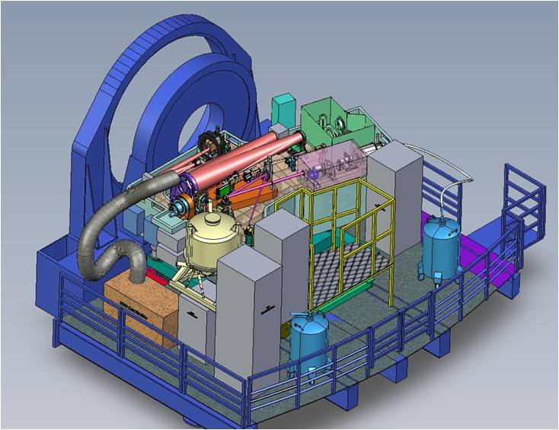
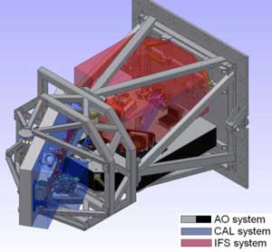
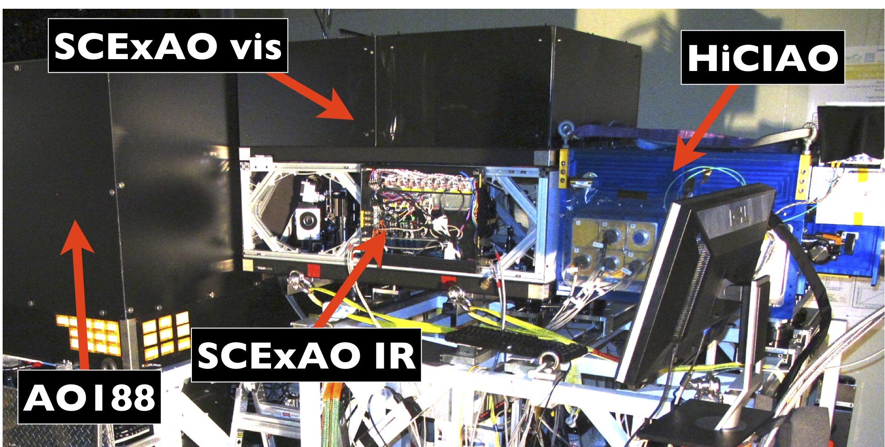
New Era of Ground-Based Direct Imaging
See also:
Talks by:
Oppenheimer,
Absil, Feldt, Groff,
Guyon
Posters by:
Claude,
SPHERE @ VLT
GPI @ Gemini
Project
1640
SCExAO
Notes:
What will we learn from upcoming instruments?

Slide 5
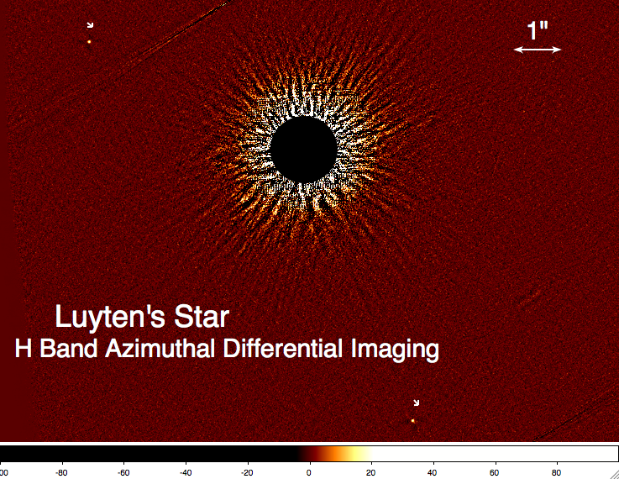
Why direct imaging?
Test of Planet Formation Theories
Direct imaging allows us to observe young planets in formation
Physical Properties
Direct spectra = direct probe of atmospheres
Notes:
– architecture important – for instant, if there’s lots of migrating planets not great prospects for formation of terrestrial planets
Determining physical properties for superjupiters now lets us refine techniques for earths later – eventually look for biomarkers…

Slide 6
Test of Planet Formation Theories
Direct imaging allows us to observe young planets in formation
Physical Properties
Direct spectra and photometry = direct probe of atmospheres
Notes:
– architecture important – for instant, if there’s lots of migrating planets not great prospects for formation of terrestrial planets
Determining physical properties for superjupiters now lets us refine techniques for earths later – eventually look for biomarkers…

Slide 7
Direct Imaging Surveys test giant planet formation mechanisms
Core accretion – rocky core accretes first from planetesimals, followed by gas envelope, cf. Ida et al. 2013
Gravitational instability – if disc is massive enough to experience self-gravity, bits can fragment and quickly form giant planets, cf. Forgan et al. 2013, 2015

Slide 8
Gravitational Instability vs. Core Accretion
Mass (M_{jup})
Vigan, Bonavita, Biller
et al. 2017
Semi-major Axis (AU)

Slide 9
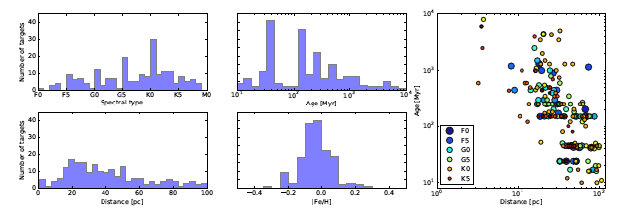
200 star survey sample taken from high contrast imaging studies with the VLT, Gemini, and HST
Vigan, Bonavita, Biller
et al. 2017
Age (Myr)
Distance (pc)

Slide 10
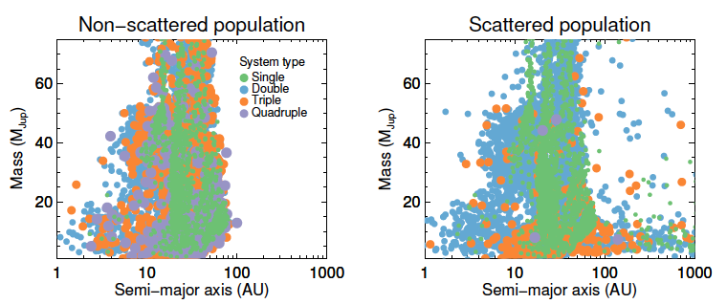
GI population from Forgan et al. 2013, 2015
Mass (M_{jup})
Mass (M_{jup})
Semi-major Axis (AU)
Semi-major Axis (AU)
Vigan, Bonavita, Biller
et al. 2017

Slide 11
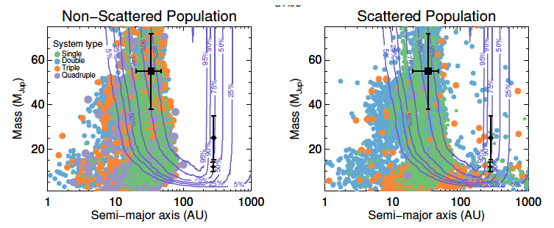
...combined with survey sensitivity limits and companion detections
Mass (M_{jup})
Mass (M_{jup})
Semi-major Axis (AU)
Semi-major Axis (AU)
Vigan, Bonavita, Biller
et al. 2017

Slide 12
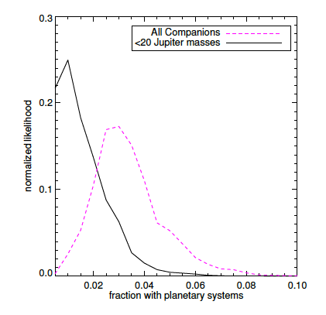
This allows us to strongly constrain the fraction of stars that host GI planetary systems
Wide directly
imaged planets likely formed via GI, but GI still only occurs relatively rarely
Normalised Likelihood
Vigan, Bonavita, Biller
et al. 2017
Fraction with Planetary Systems

Slide 13
Test of Planet Formation Theories
Direct imaging allows us to observe young planets in formation
Physical Properties
Direct spectra and photometry = direct probe of atmospheres
Notes:
– architecture important – for instant, if there’s lots of migrating planets not great prospects for formation of terrestrial planets
Determining physical properties for superjupiters now lets us refine techniques for earths later – eventually look for biomarkers…

Slide 14
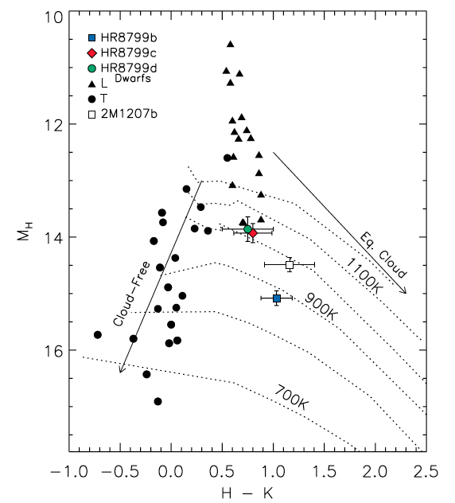
Colors = Atmospheric Information
Red Colors =
Dusty Clouds
Brighter
Infrared Brightness
Fainter
Blue
Infrared Color
Red
Barman et al. 2011
Notes:
We know 8799bcd formed differently than T brown dwarfs – is this difference recorded in their redder colors?

Slide 15
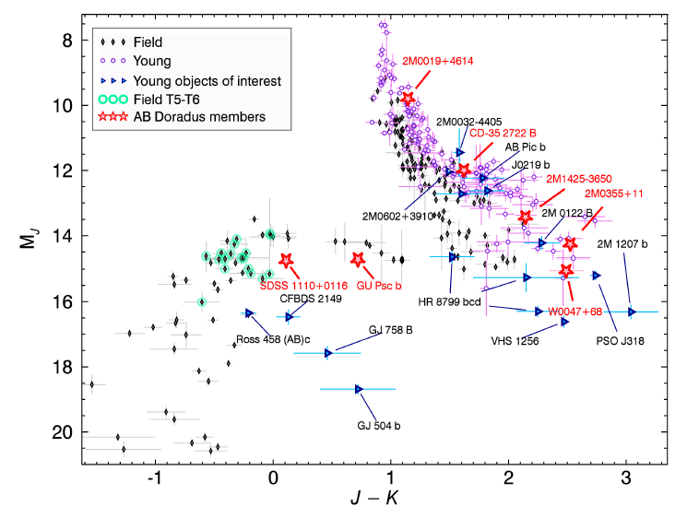
Low Surface Gravity Objects
Gagne
et al.
2015,
M_{J}
J-K

Slide 16
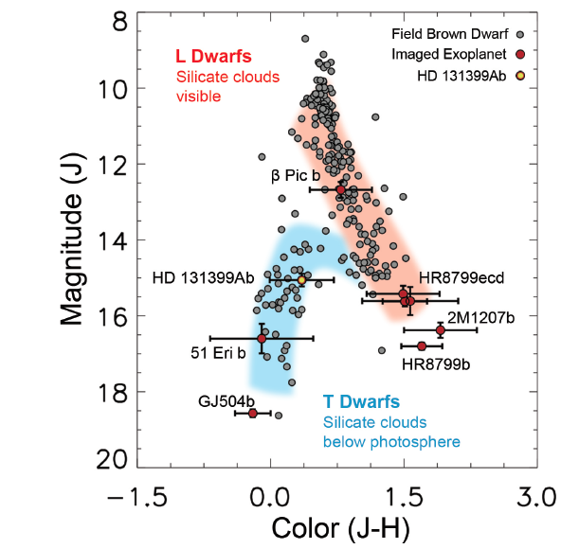
~1600 K
600-900 K
1100-1300K
Wagner et al.
2016
Notes:
Primary variables:
Mass
Teff
Composition
Surface Gravity

Slide 17
β Pic b – 1650+150 K
(Bonnefoy et al. 2014)
Lagrange et al. 2008, 2010

Slide 18
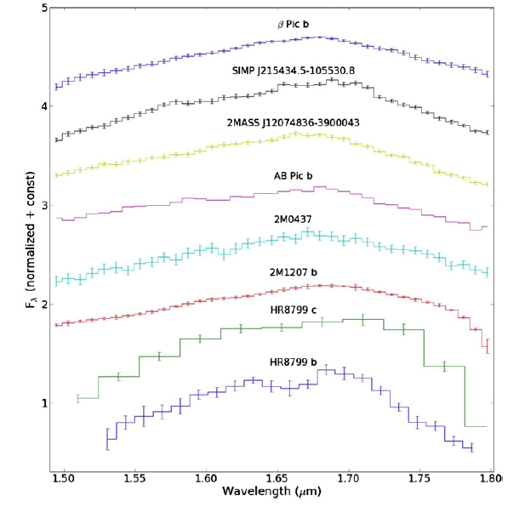
β Pic b:
Spectroscopy
Chilcote et al. 2015
Wavelength (μm)

Slide 19
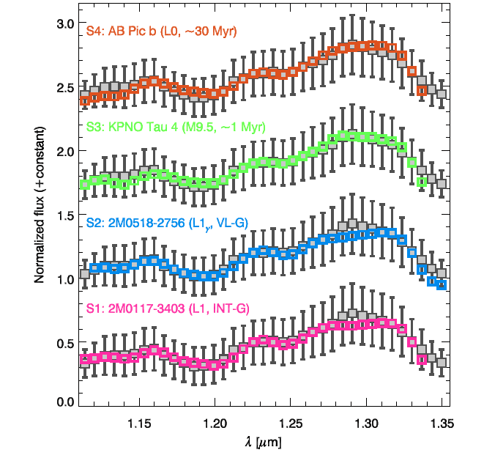
β Pic b:
Spectroscopy
Bonnefoy et al. 2014
Wavelength (μm)

Slide 20
HR8799bcde:L/T transition planets,
1100-1300 K

Slide 21
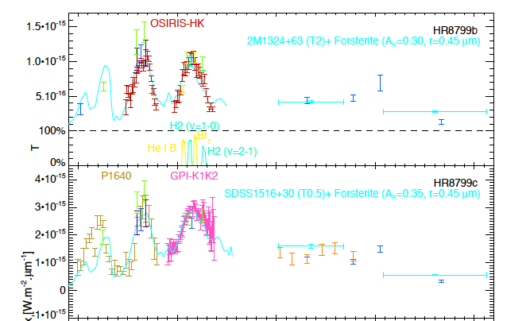
HR8799bcde:L/T SpT, 1100-1300 K
Bonnefoy et al. 2016, with
data from Oppenheimer et al. 2013,
Skemer et al. 2012, 2014,
and Ingraham et al. 2014
Wavelength (μm)

Slide 22
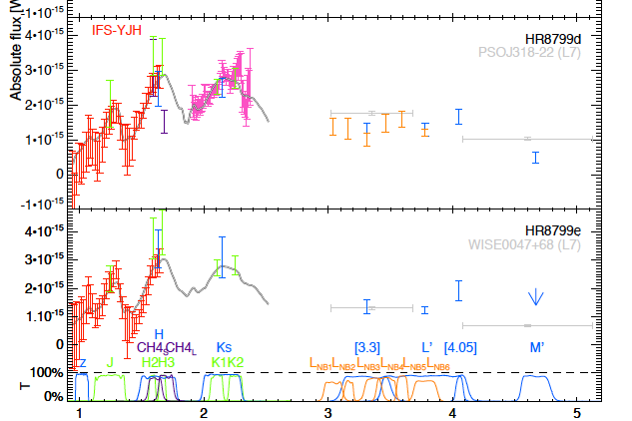
HR8799bcde:L/T SpT, 1100-1300 K
Bonnefoy et al. 2016, with
data from Oppenheimer et al. 2013,
Skemer et al. 2012, 2014,
and Ingraham et al. 2014
Wavelength (μm)

Slide 23
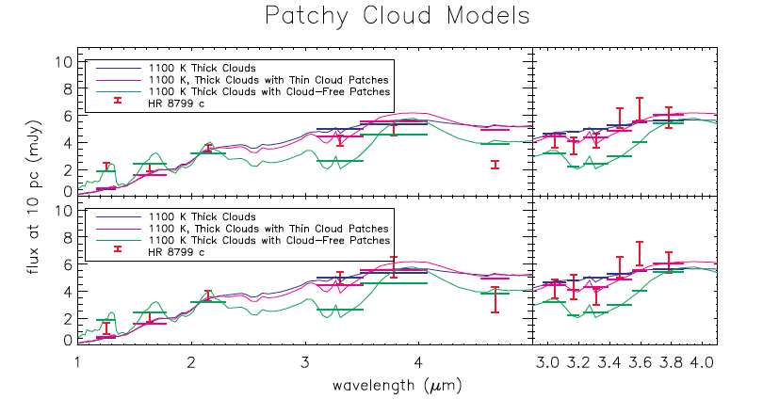
Wavelength in microns
Skemer et al. 2014

Slide 24
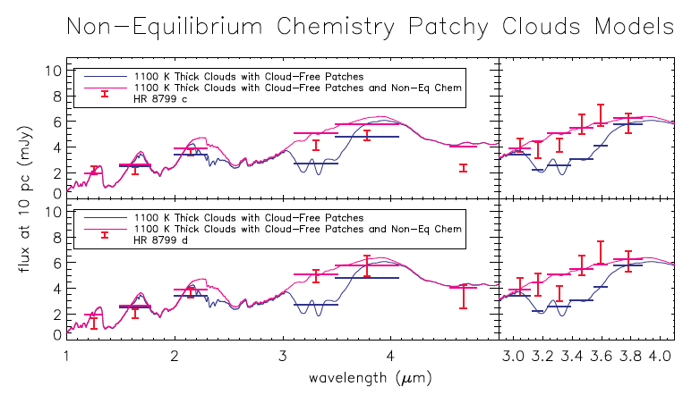
Wavelength in microns
Skemer et al. 2014

Slide 25
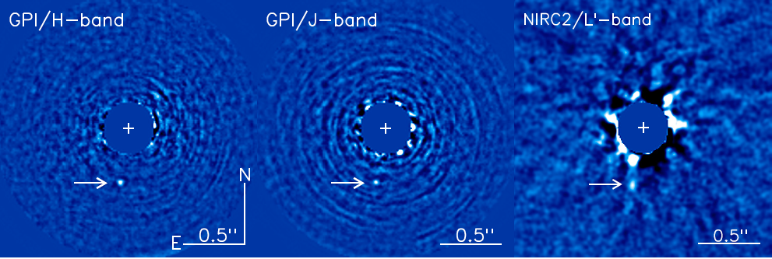
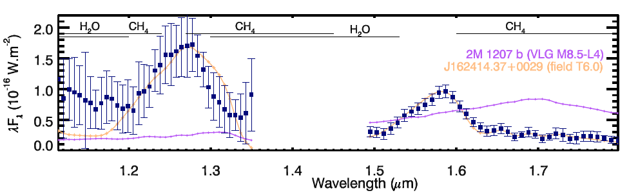
51 Eri b: a 600-750 K young Jupiter
Macintosh et al. 2015
Wavelength (μm)

Slide 26
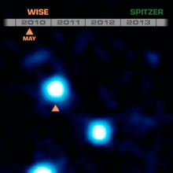
WISE 0855 – the coldest object imaged outside the solar system

Slide 27
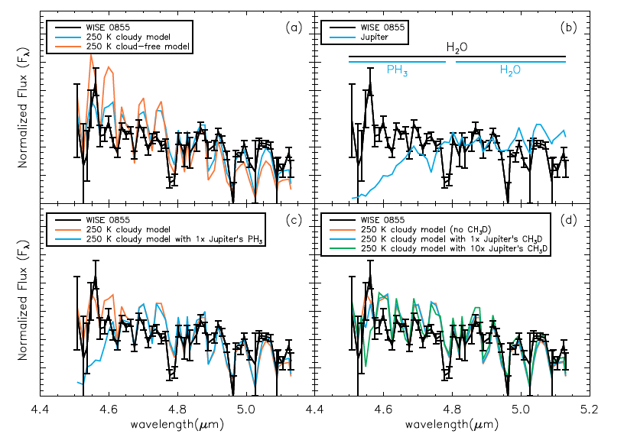
WISE 0855 – water clouds
Skemer et al . 2016

Slide 28
Time Domain

Slide 29
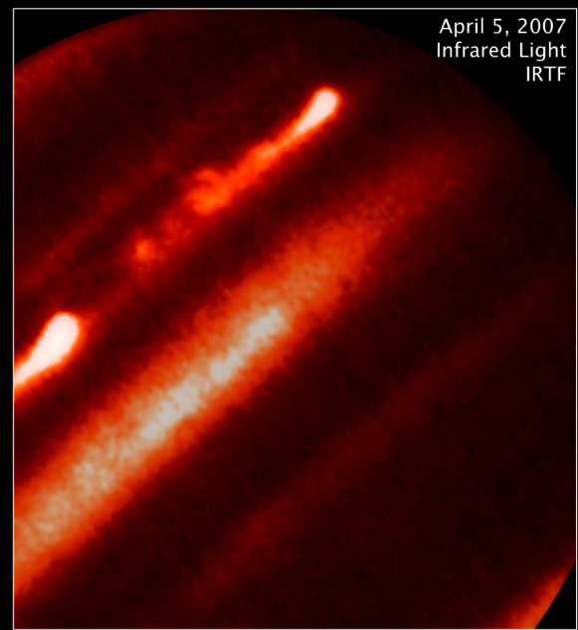
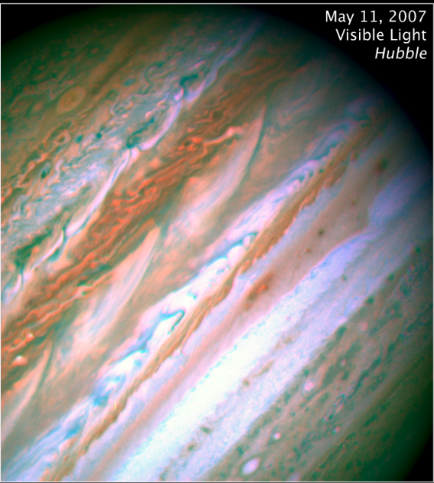
Cloud-Driven Variability
Sanchez-Lavega et al. 2008
Notes:
Lightcurve from Artigau et al. 2009?
2-4 hr periods
L’s cloudy, T’s clear
Lots of early L’s and T’s surveyed, but no late L’s
Great project for WIYN or 0.9 m telescope

Slide 30
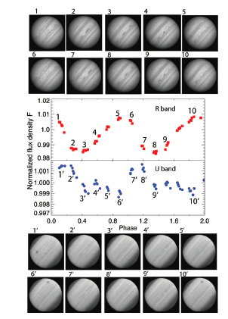
Karalidi et al. 2016

Slide 31
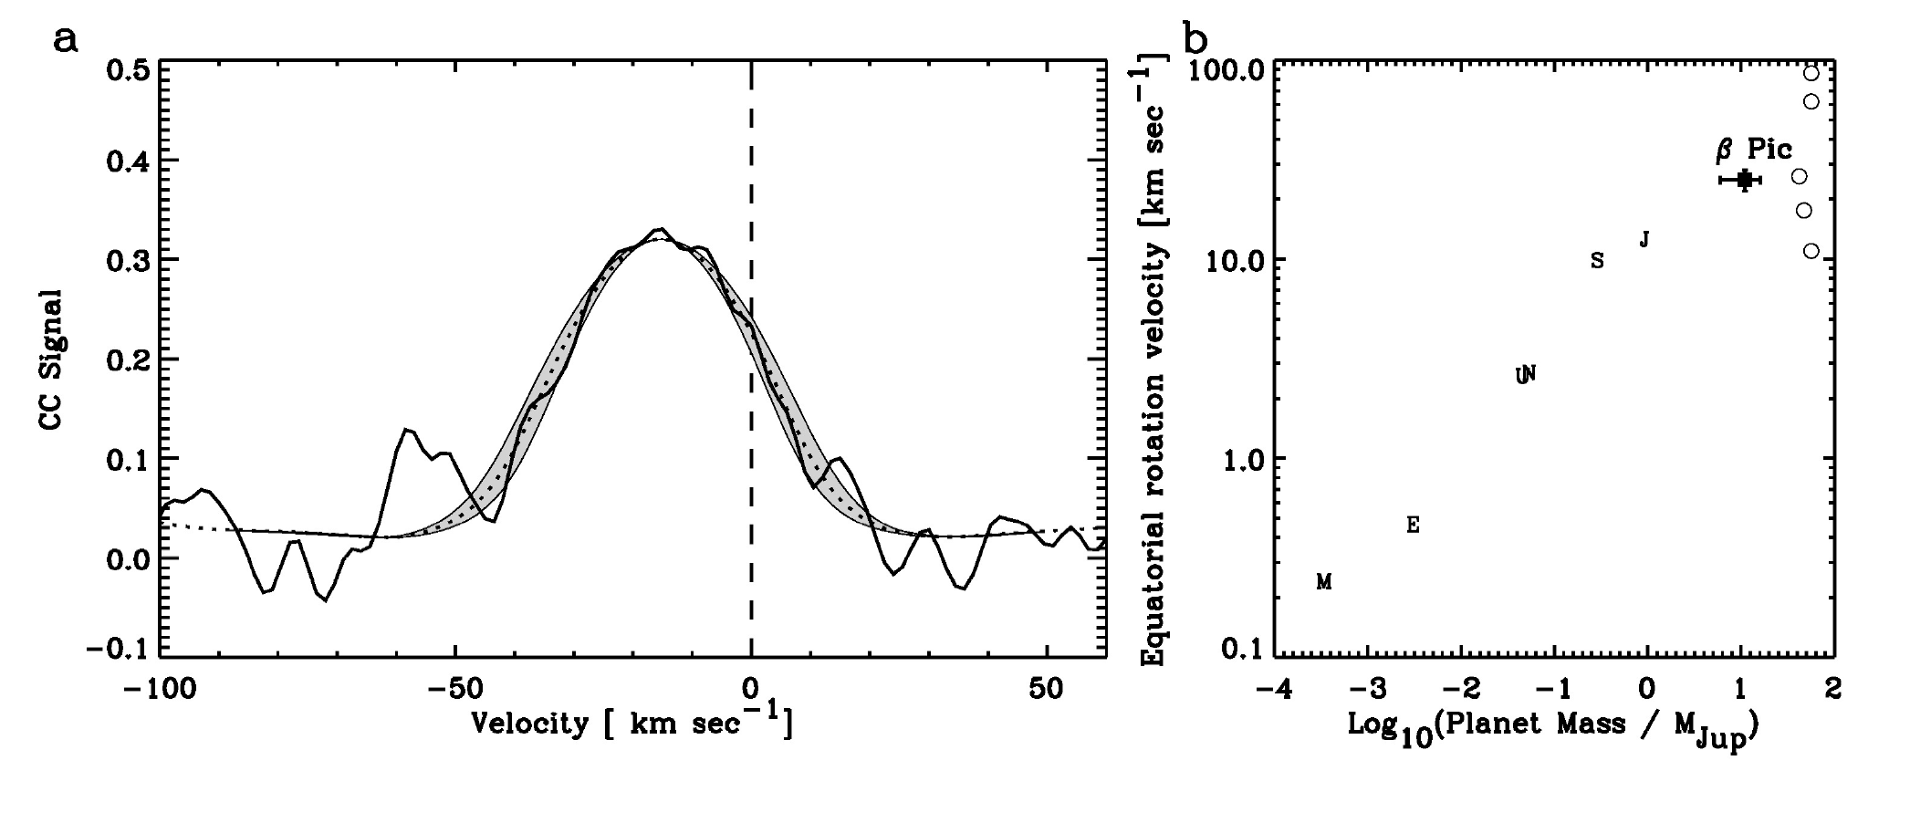
β Pic b – a rapid rotator
Equatorial velocity
Cross correlation signal
Velocity (km/s)
Log(Planet Mass)
Snellen et al. 2014

Slide 32
First Survey of Low Surface Gravity Objects with NTT SOFI and UKIRT
Vos et al. in prep, ~40 L0-T2
objects
observed
(mostly from Gagné
et al. 2014,
2015)

Slide 33
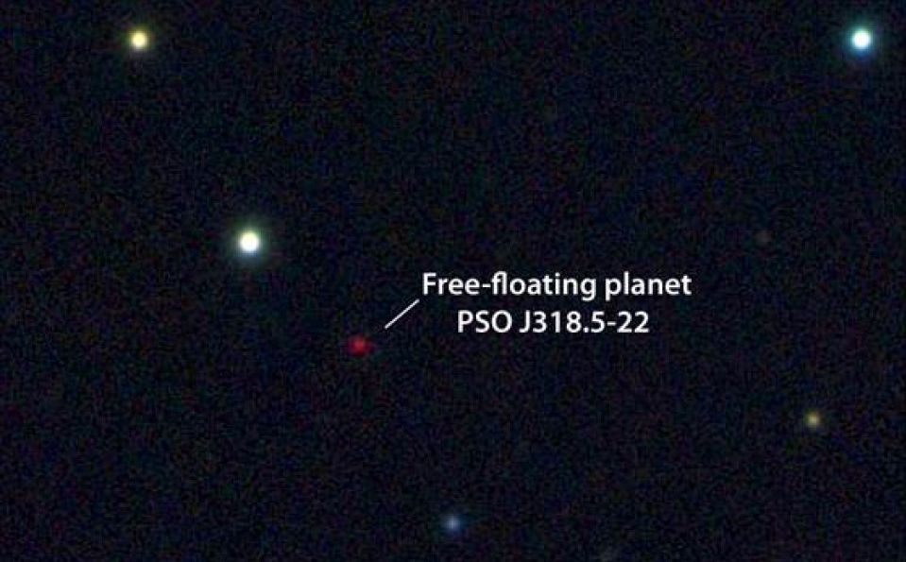
Weather on a
Free-Floating Planet
Liu et al. 2013

Slide 35
Case Study: PSO J318.5-22
8.5+0.5 M_{Jup} member of the ~23 Myr β Pic MG (Liu et al. 2013, Allers et al. 2016)
Biller et al. 2015

Slide 36
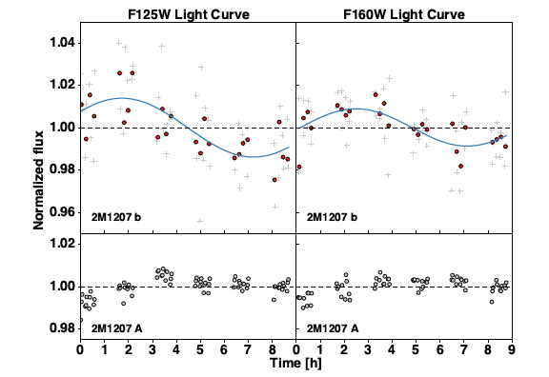
Planetary mass companion
2M 1207b is also variable
Zhou
et al.
2016
Time (hours)

Slide 37
Cold planetary mass brown dwarf WISE 0855 is also variable
Esplin
et al. 2016

Slide 38
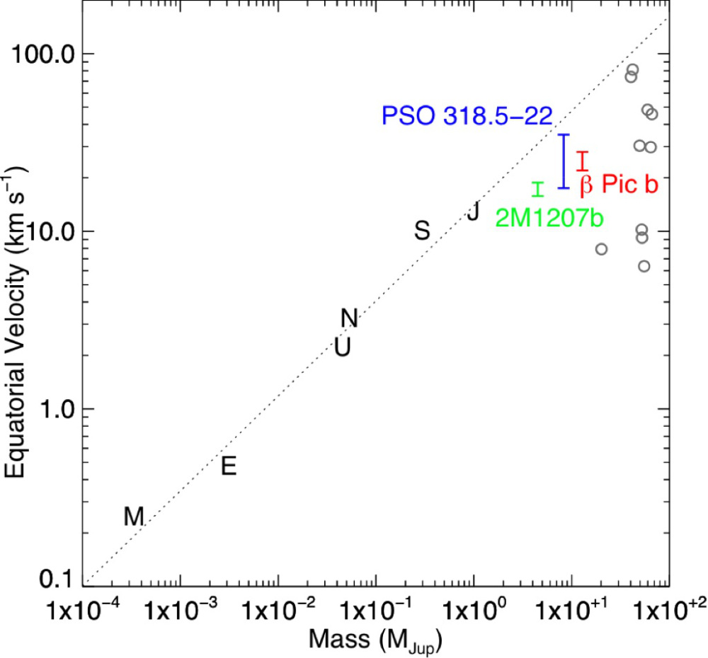
Young planetary mass objects with measured periods are fast rotators
Equatorial velocity
Allers et al. 2016
Log(Planet Mass)

Slide 39
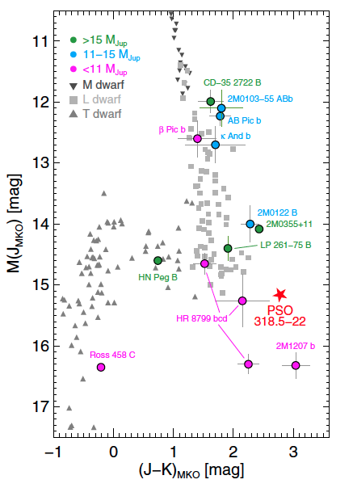
PSO 318 is a free-floating analogue to the HR 8799 planets
Liu et al. 2013

Slide 40
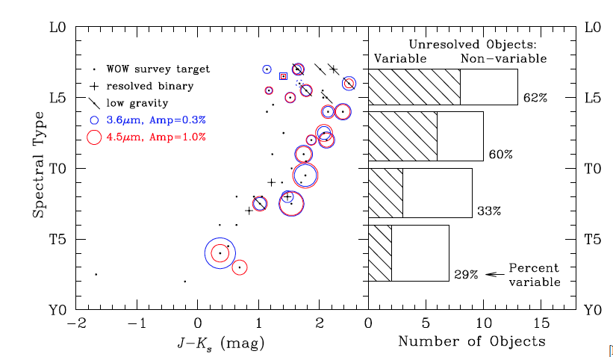
Variability in Exoplanets with NIRCam and MIRI
Metchev et al. 2014
Tentative association (92%
confidence) between low surface gravity and high-amplitude variability among L3–L5.5 dwarfs.

Slide 41
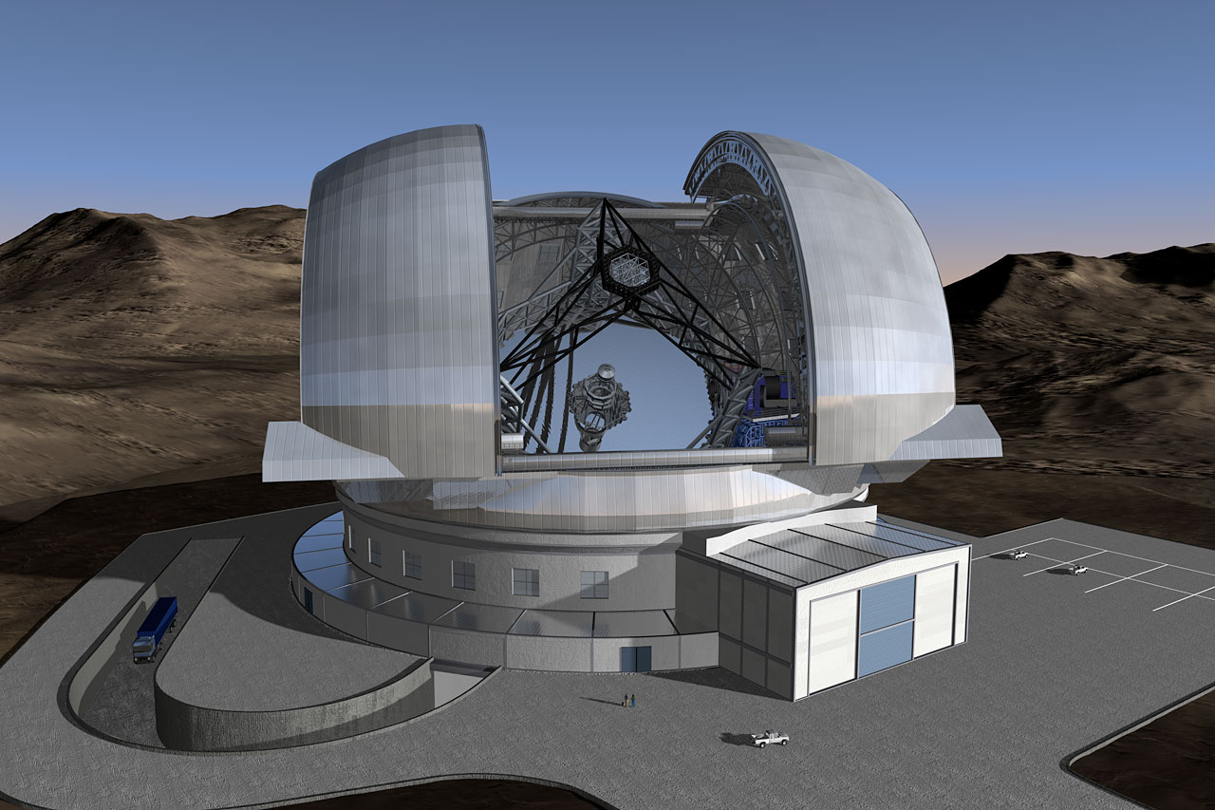
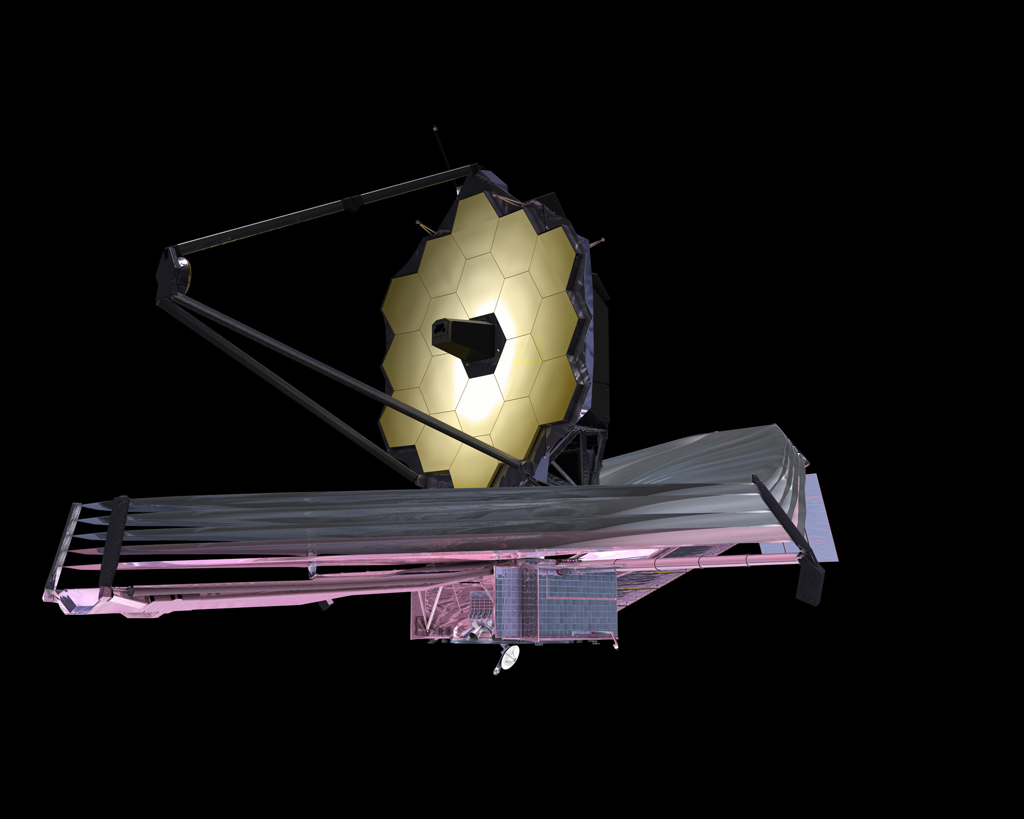
On the horizon –
JWST, WFIRST-AFTA, and the ELTs

Slide 42
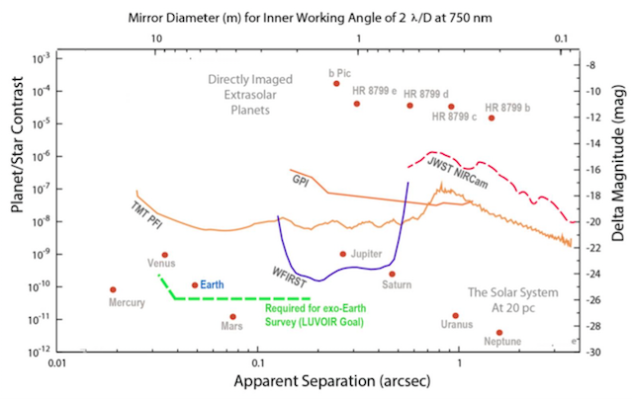
Direct Imaging of Proxima Centauri b?
http://asd.gsfc.nasa.gov/luvoir
Prox Cen b

Slide 43
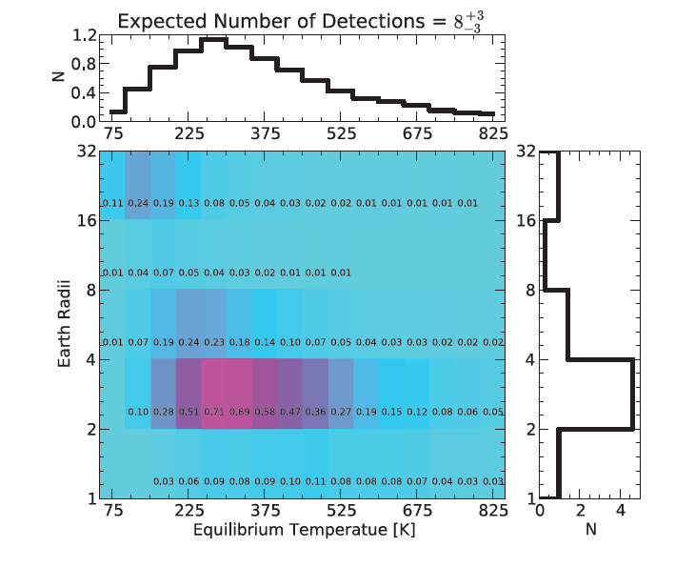
Direct Imaging of Super Earths around Nearby M Stars
Earth Radii
Crossfield 2013,
Guyon
et al. 2013
Equilibrium Temperature (K)

Slide 44

Crossfield, Biller, et al., Nature, 2014

Slide 45
We will learn much more about these worlds in the next few years!
Delorme
et al. 2013
Kraus and Ireland 2012
Lagrange et al. 2008,2010
Ireland et al. 2011,
Bowler et al. 2011
Carson et al. 2013
Marois et al.
2008,2010v
Chauvin et al. 2005
Rameau et al. 2013
Chauvin
et al. 2004, 2005
Bailey et al. 2013
Lafrenière et al. 2008,2010
Kalas et al. 2008
Todorov et al. 2010
Notes:
Until 20 years ago, we only knew about one planetary system – our own. So we made the only natural assumption we could make at the time, which is that our system is typical.. We can only now begin to assess whether our system is indeed typical, and in Fact we are finding quite a lot that looks nothing like our own solar system. Eventually studying exoplanets will tell us not only the physical properties of these
planets, but information about life elsewhere in the universe. Characterizing massive gas giant planets now and starting to discover exo-Neptunes and super-Earths, Eventually we’ll be doing this for exo-earths too… Direct Imaging of Extrasolar Earths and search for Biosignatures
----- Meeting Notes (4/13/13 22:09) -----
Characterizing massive gas giant planets now and starting to discover exo-Neptunes and super-Earths, Eventually we’ll be doing this for exo-earths too… Direct Imaging of Extrasolar Earths and search for Biosignatures
----- Meeting Notes (4/13/13 22:10) -----
Characterizing massive gas giant planets now and starting to discover exo-Neptunes and super-Earths, Eventually we’ll be doing this for exo-earths too… Direct Imaging of Extrasolar Earths and search for Biosignatures

Slide 48
Chilcote et al. 2015

Slide 49
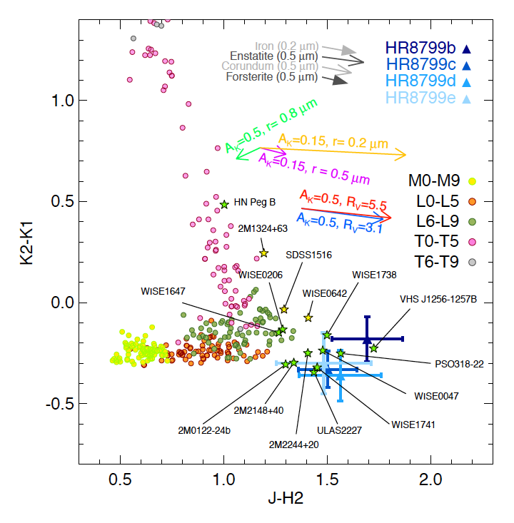
Low Surface Gravity Objects
K2 – K1
Bonnefoy
et al. 2016
J-H

Slide 50
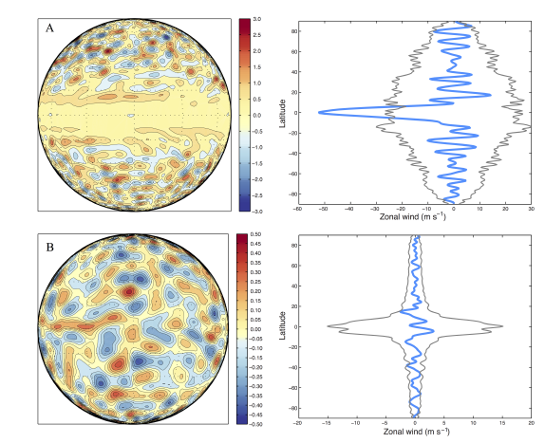
Zhang &
Showman
2014

Slide 51
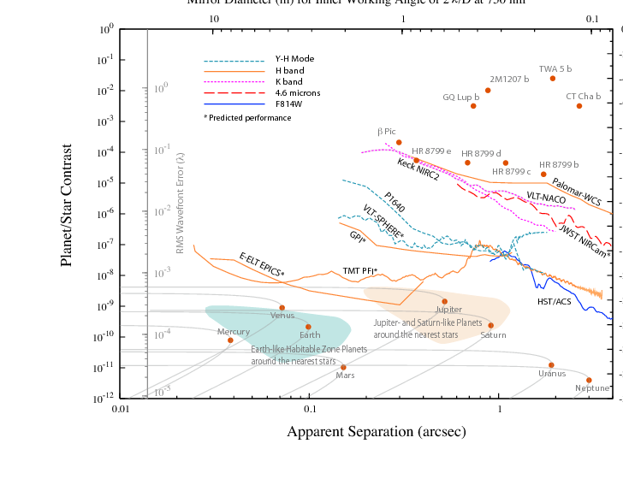
Mawet et al. 2012

