Slide 1
Constraining the Orbital Decay of Exoplanets through Transit Observations
Ing-Guey Jiang
Institute of Astronomy & Department of Physics
National Tsing Hua University
Taiwan

Slide 2
Coauthors
National Tsing Hua University, Taiwan: Devesh Sariya, Li-Hsin Su, He-Feng Hsieh
Crimean Astrophysical Observatory, Crimea: Vasilii Moskvin, Aleksey Shlyapnikov
Guru Ghasidas Vishwavidyalaya, India: Parijat Thakur, Vineet Kumar
NARIT, Thailand: David Mkrtichian
Ben-Gurion University, Israel: Uri Griv

Slide 3
Outline
A Network of Transit Survey
Close-in Planet: WASP-43b
Observations
Results
Conclusions

Slide 4
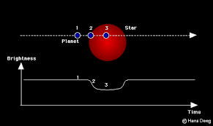
Transit Observation

Slide 5
NETS Project
A NEtwork of Transit Survey To monitor known planetary systems
Multiple Sites: More light curves could be obtained
Scientific Goal: To study orbital configurations and possible transit timing variations

Slide 6
Telescopes
CrAO 0.8m, 1.25m, Crimea
ARIES 130 cm, 104 cm, India
HCT 2 meter, India
WISE 46cm, Israel
Purple Mountain Observatory 1.2 m, P.R.China
P60, Palomar Observatory, U.S.A.
Tenagra II 0.8m, Arizona, U.S.A.

Slide 7
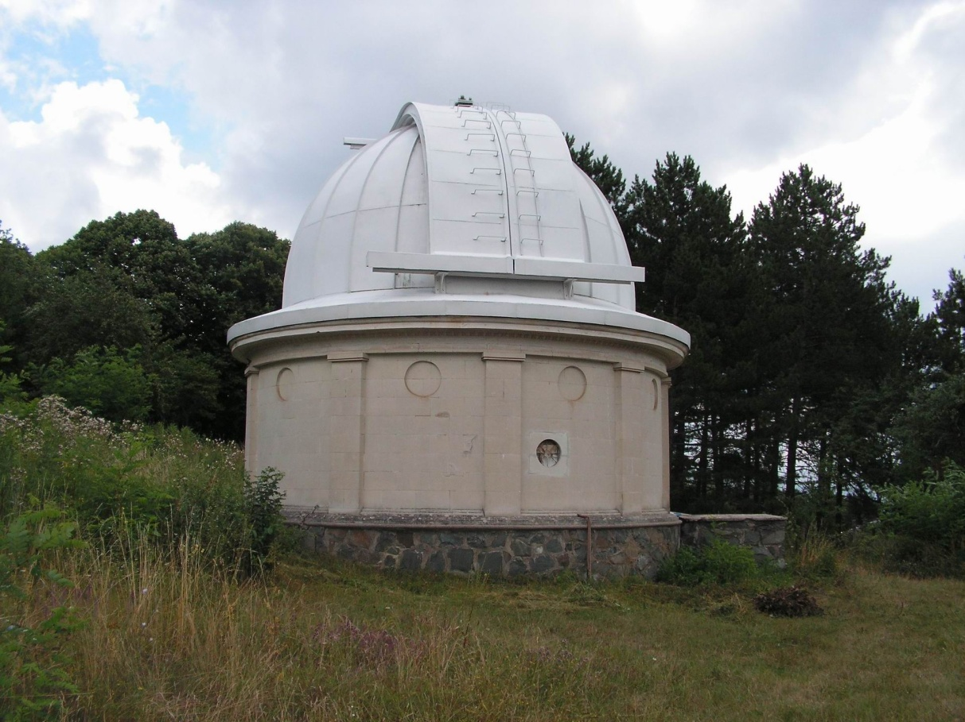
0.8m Telescope: CrAO, Crimea

Slide 8
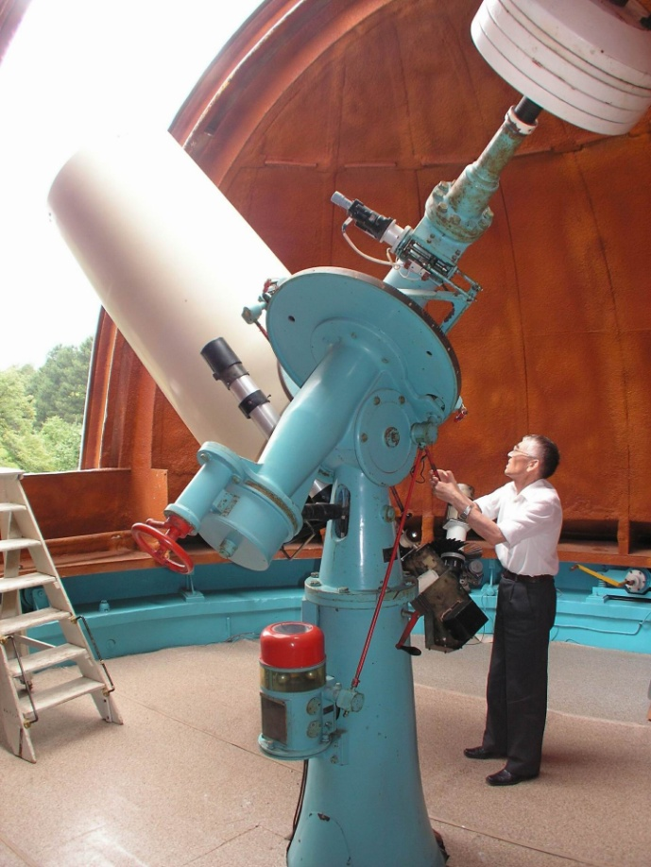

Slide 10
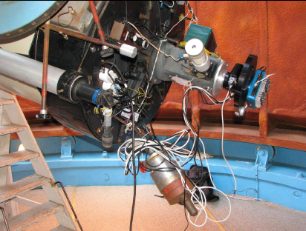

Slide 12
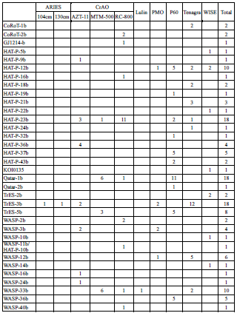

Slide 13
Data Summary
170 light curves
30 targets

Slide 14
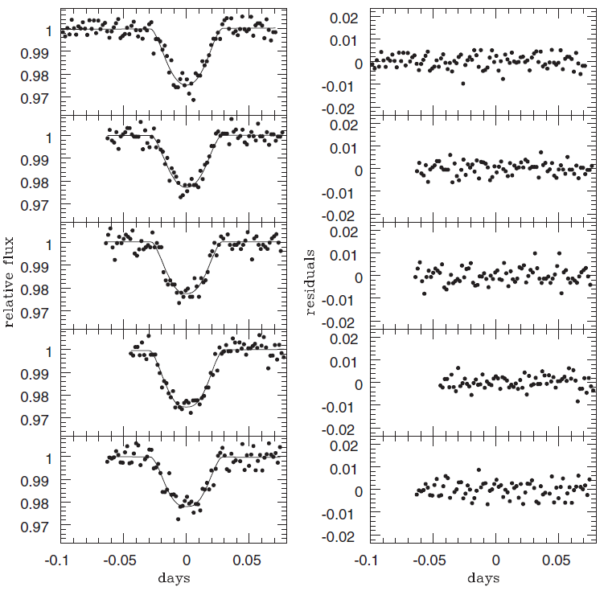
Our TrES-3 Light Curves

Slide 15
WASP-43b
discovered by Hellier et al. (2011)
with a mass of 1.8 Jupiter mass
period is about 0.8 days
semi-major axis a = 0.015 AU
a hot Jupiter
one of the most massive exoplanets on an extremely close orbit.

Slide 16
Previous Work
Wang et al. (2013) confirmed the thermal emission from the planet
Chen et al. (2014) detected the day-side thermal emission in the K band
Kreidberg et al. (2014) determined the water abundance in the atmosphere
Czesla et al. (2013) showed an X-ray detection from WASP-43 star, could be from tidal interactions with the planet

Slide 17
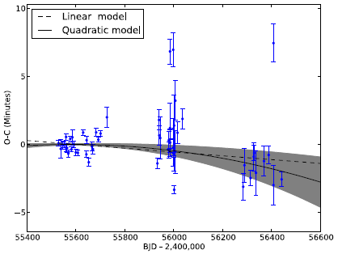
Blecic et al. (2014)

Slide 18
Possible Orbital Decay
Blecic et al. (2014) : orbital period is decreasing about 0.095 s per year
Murgas et al. (2014): orbital period is decreasing about 0.15 s per year
The above rates imply stellar tidal dissipation factor, Q, to be about 10^4
This value contradicts with theoretical values (10^5 to 10^7, see Levrard et al. 2009)

Slide 19
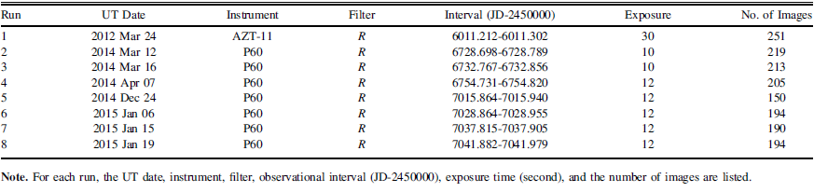
The Log of Our Observations

Slide 20
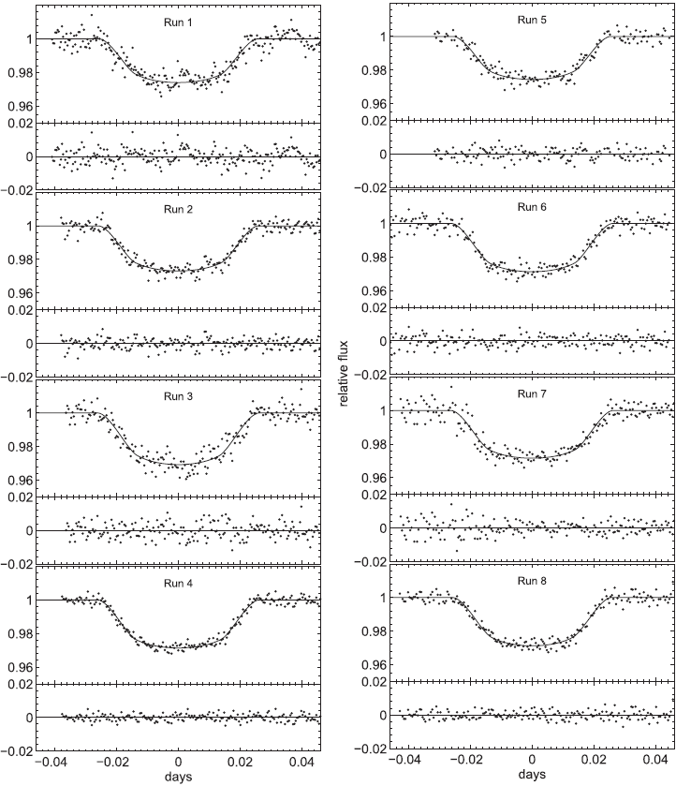
Our WASP-43 Light Curves

Slide 21

Timing

Slide 22
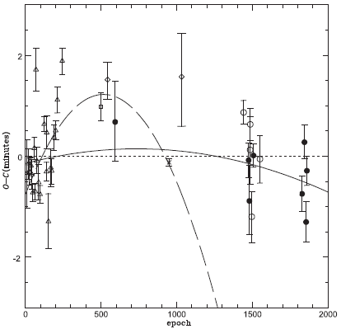
O-C Diagram

Slide 23
A Smaller Decay Rate
Orbital period is decreasing at a rate 0.028 s per year
This gives a stellar tidal dissipation factor about 10^5
It is within the theoretical range
The contradiction is resolved !
Later paper (Hoyer et al. 2016 ) reconfirms our result with a smaller rate

Slide 24
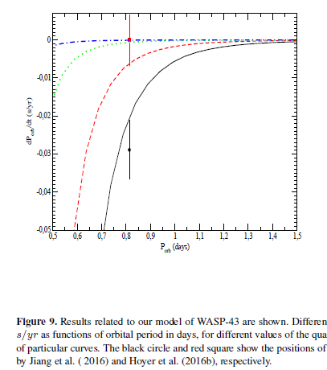
Chernov et al. (2017)

Slide 25
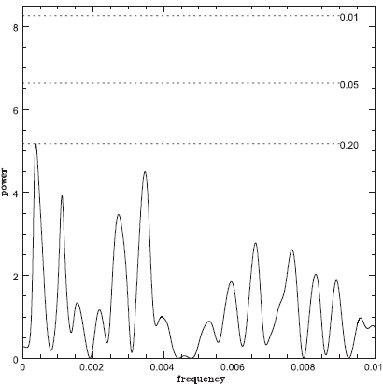
Frequency Analysis

Slide 26
Conclusions
Eight new transit light curves are presented
Possible transit timing variation is studied
A new orbital decay rate is obtained
A more reasonable value of the stellar tidal dissipation factor Q = 10^5 is determined
We seek for more survey collaborations
We expect more interesting results to come

