Slide 1
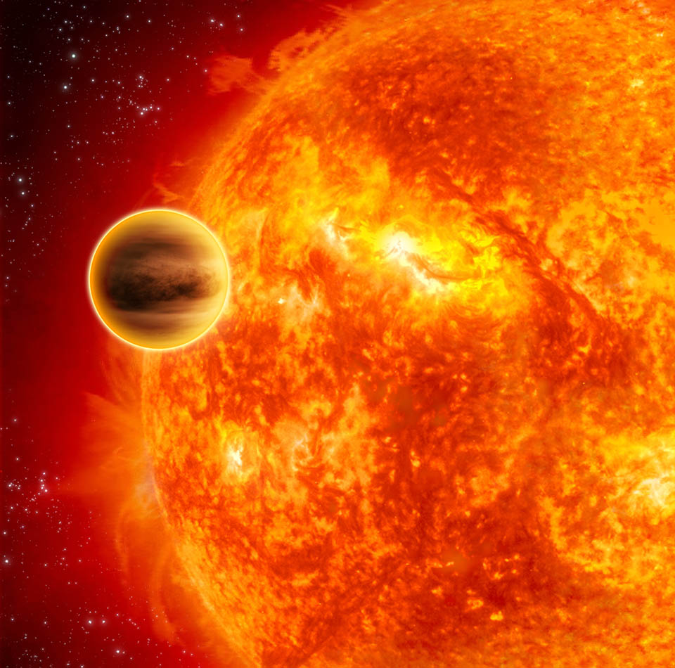
Exoplanet Atmospheric Modeling:
From giant planets to super-Earths
Nikku Madhusudhan
Institute of Astronomy, Cambridge
Image Credits: ESA – C. Carreau

Slide 2
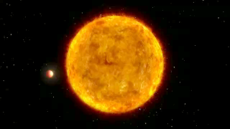
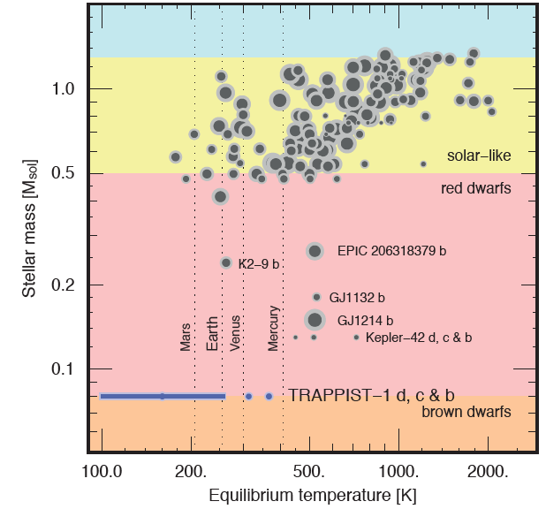
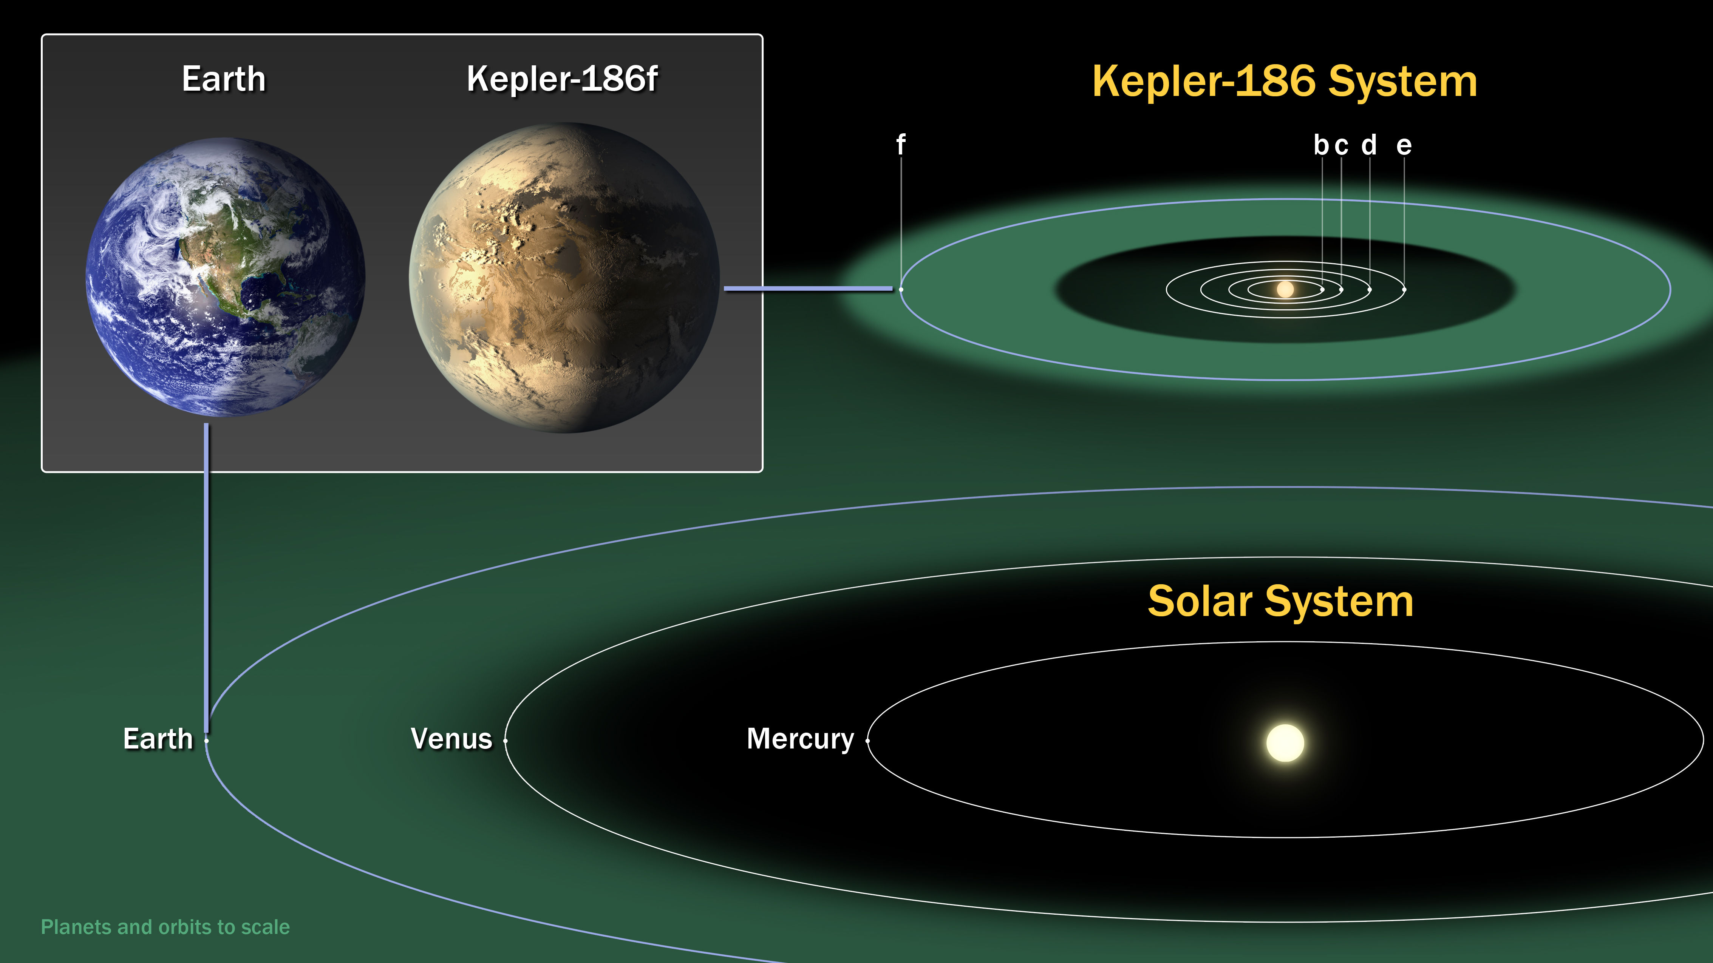
Hot Jupiter 51 Peg b (Mayor and Queloz 1995)
.
Proxima b
Quintana et al. 2014
NASA Kepler Mission
Gillon et al. 2016, Anglada-Escude et al. 2016

Slide 3
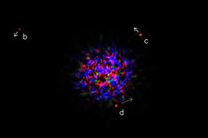
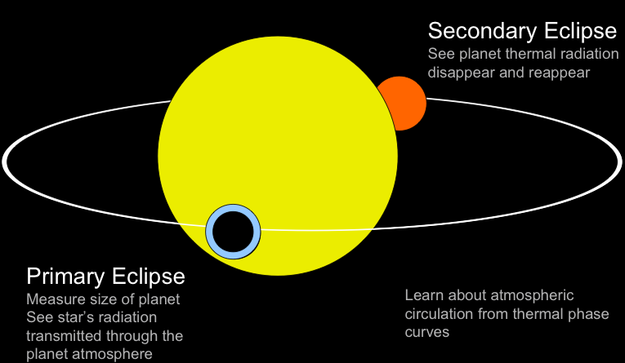
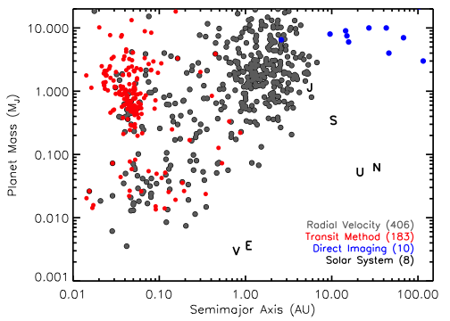
Exoplanets Conducive for Atmospheric Characterization
Directly imaged planets
Marois et al. 2008
Transiting planets
Transiting Planets
RV Planets
Directly Imaged Planets

Slide 4
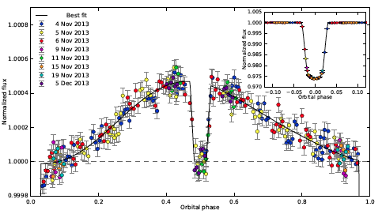
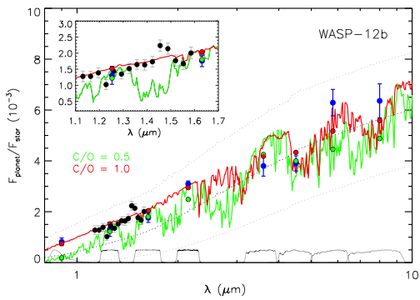
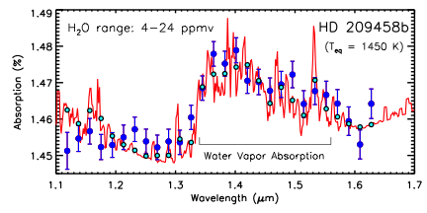
Atmospheric Spectra of Transiting Planets
Madhusudhan 2012
Madhusudhan et al. 2014
Stevenson et al. 2014

Slide 5
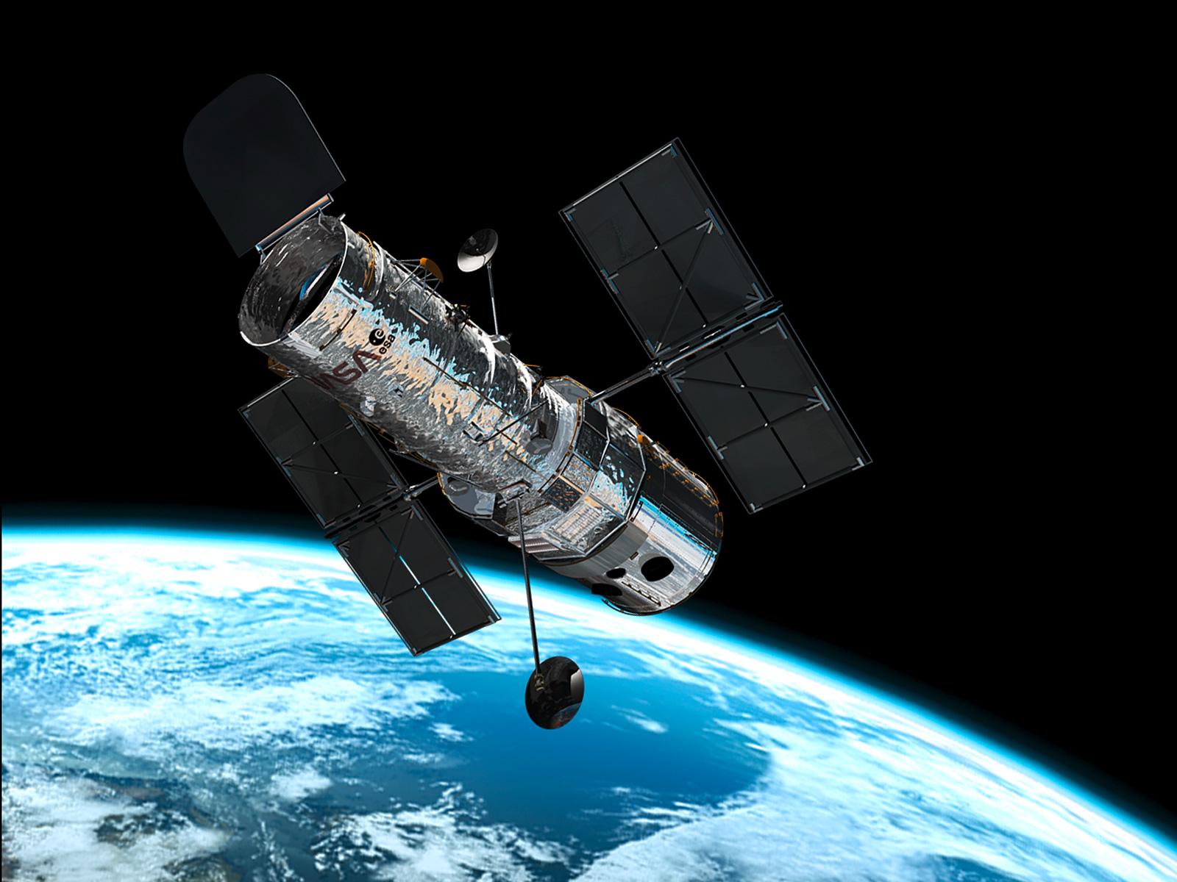
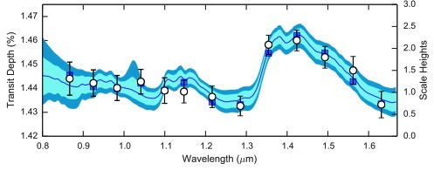
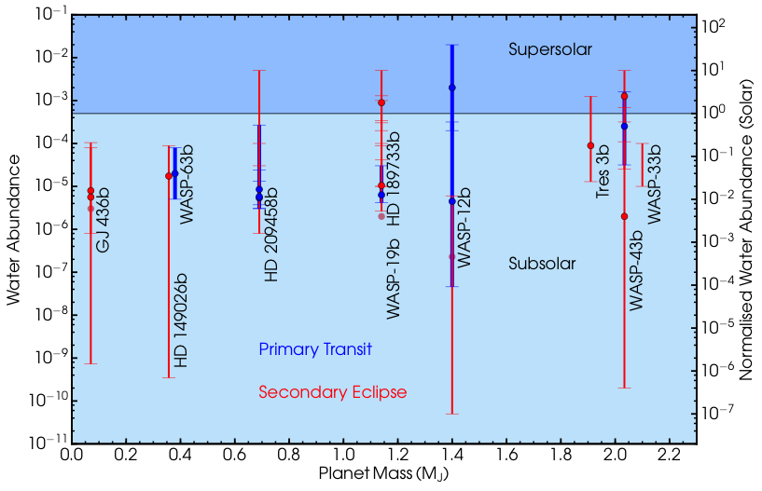
New Advances with HST Transit Spectroscopy
Deming et al. 2013, McCullough et al. 2014, Madhusudhan et al. 2014, Kreidberg et al. 2015, etc.
Notes:
Hot Jupiter orbiting a K star in a 20 hr orbit.

Slide 6
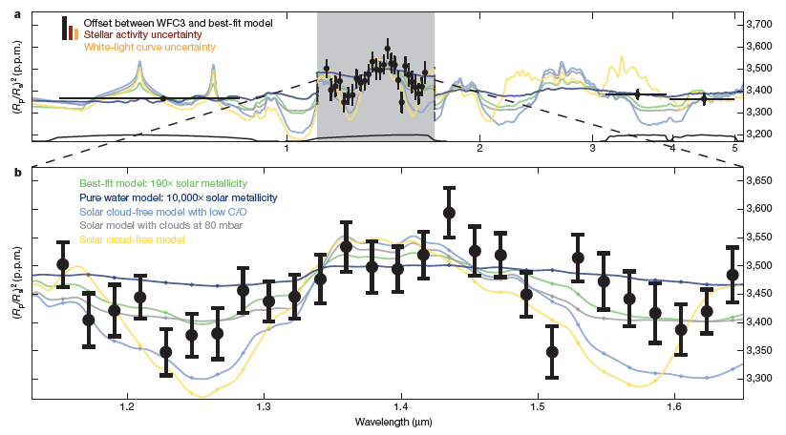
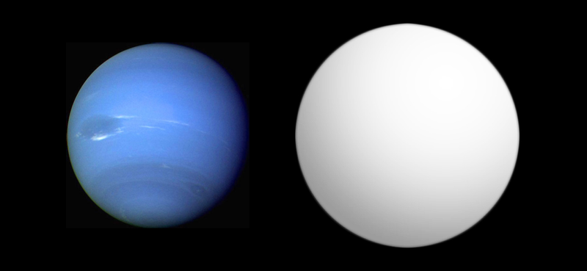
First Detection of H₂O in an Exo-Neptune
Transmission Spectrum of HAT-P-11b
Fraine et al. 2014, Nature
GJ 436b

Slide 7
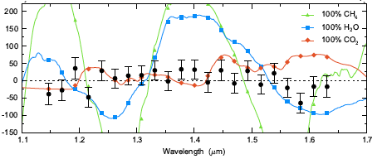
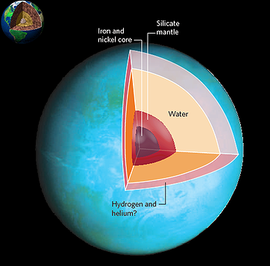
Spectrum of a Super-Earth GJ 1214b
Kreidberg et al. 2014
M_{p} = 6.55 ± 0.98 M_{E}
R_{p} = 2.678 ± 0.13 R_{E}
T_{eq} = 400 - 550 K
60 HST orbits
Key Merit: Orbits an M Dwarf
(M = 0.16 M_{s}, R = 0.2 R_{s})

Slide 8
Theory of Exoplanetary Atmospheres
Spectral models (equilibrium models vs retrieval)
Equilibrium and non-equilibrium chemical processes
Temperature structures (thermal inversions, etc)
Aerosols: Clouds/hazes
Atmospheric dynamics
Exospheres and atmospheric escape
Super-Earths, Habitable zones, Biosignatures
Key Interdisciplinary Areas
Connecting Atmospheric Compositions to Formation
Understanding habitability and biosignatures
Understanding planetary diversity

Slide 9
Outline
Self-consistent Equilibrium 1D Models
Atmospheric Retrieval Techniques
Clouds/Hazes
Super-Earth Atmospheres
Future outlook

Slide 10
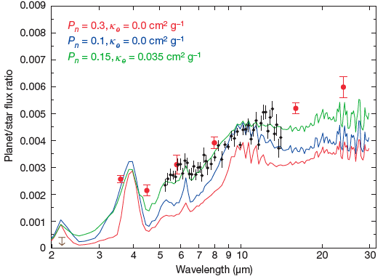
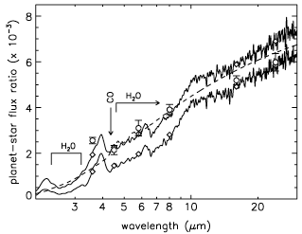
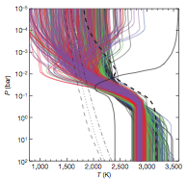
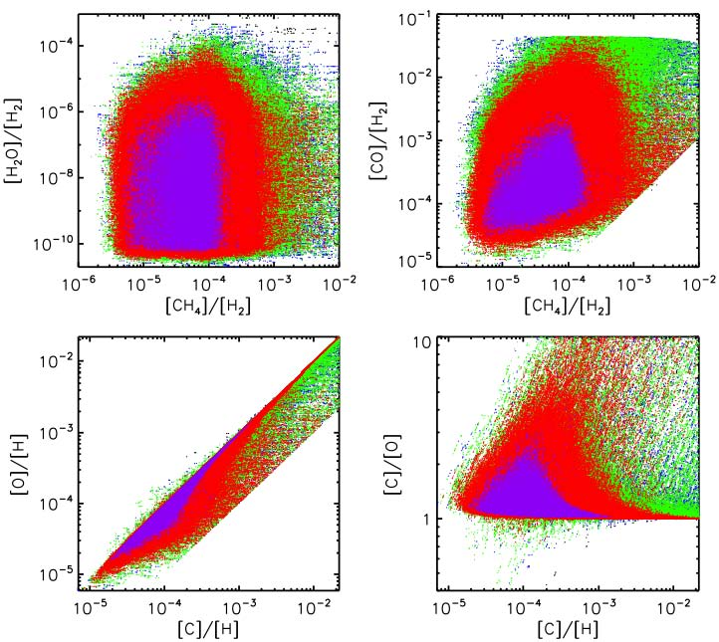
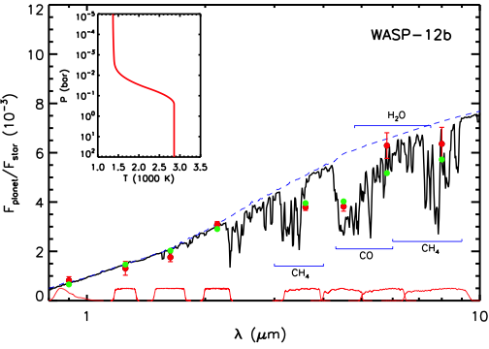
Two Approaches to 1D Atmospheric Modeling
Self-consistent Forward Models
Inverse Methods (Retrieval)
Grillmair et al. 2008 (Burrows)
Charbonneau et al. 2008 (Barman)
Madhusudhan et al. 2011

Slide 11
Outline
Self-consistent Equilibrium 1D Models
Atmospheric Retrieval Techniques
Clouds/Hazes
Super-Earth Atmospheres
Future outlook

Slide 12
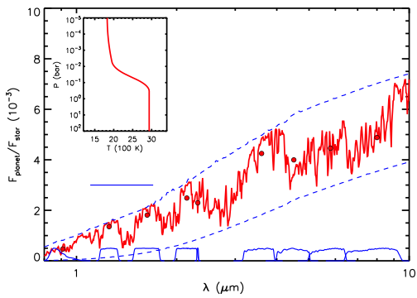
Self-Consistent Equilibrium Models
H₂O
HST WFC3
H₂O
CO
H₂O
H₂O
CH₄
H₂O
CH₄
CO₂
CO
H₂O
TiO
CO₂
Ground-based Facilities
Spitzer IRAC

Slide 13













Exoplanetary Atmosphere Models
1-D models of irradiated atmospheres with line-by-line radiative transfer
Boundary Conditions
Stellar Irradiation (Kurucz Model)
Intrinsic Energy source
LTE
−
ξ_{λ}
Chemical Equilibrium
Day-night redistribution:
Extra absorber:
Composition ( ) + clouds, etc.
Model Parameters
Parameters
Chemical equilibrium and compositions
Computation time
Artificial sources and sinks
Details
Seager & Sasselov 1998, Sudarsky et al. 2003
Fortney et al. 2006, Burrows et al. 2007

Slide 14
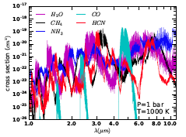
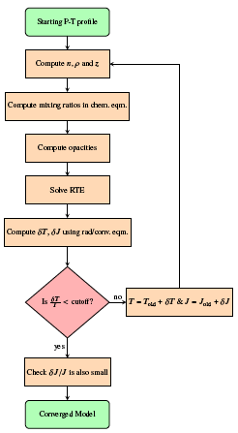
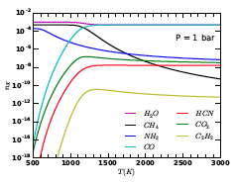
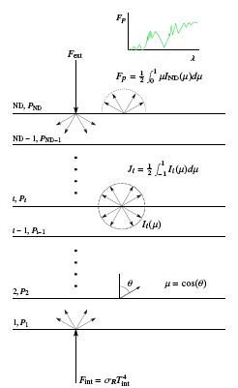
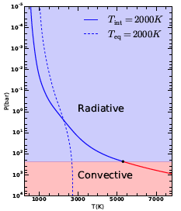
Schematic of self-Consistent Models
Opacities
Chemistry
Radiative Transfer
Radiative-Convective Equib.
Gandhi and Madhusudhan 2017

Slide 15


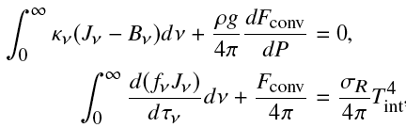

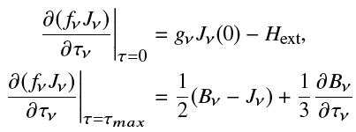
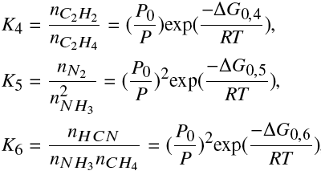
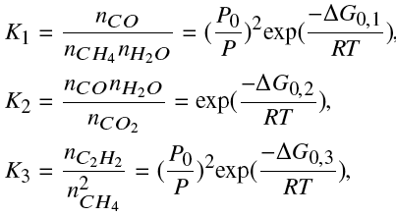
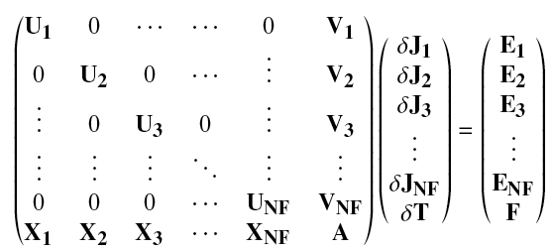







Schematic of GENESIS Models
Line-by-line Radiative Transfer
Radiative-Convective Equilibrium
Chemical Equilibrium
Line-by-Line Cross sections

Slide 16
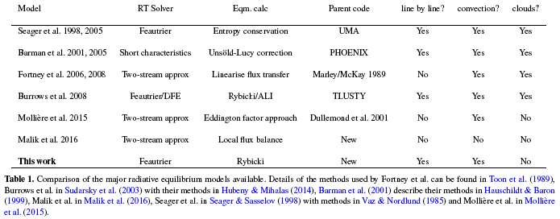
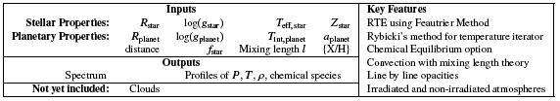
Self-Consistent Models
Gandhi and Madhusudhan (MNRAS, in press, on arXiv)

Slide 17
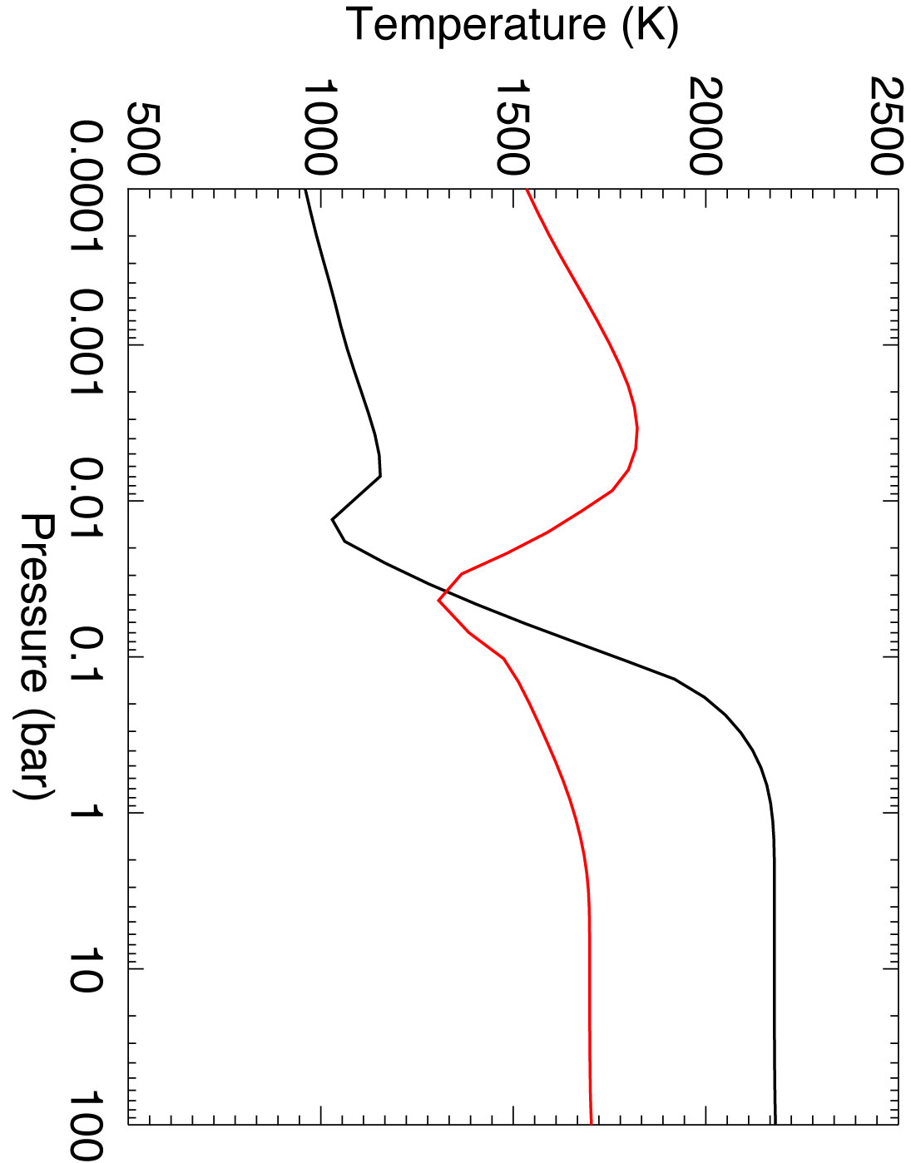
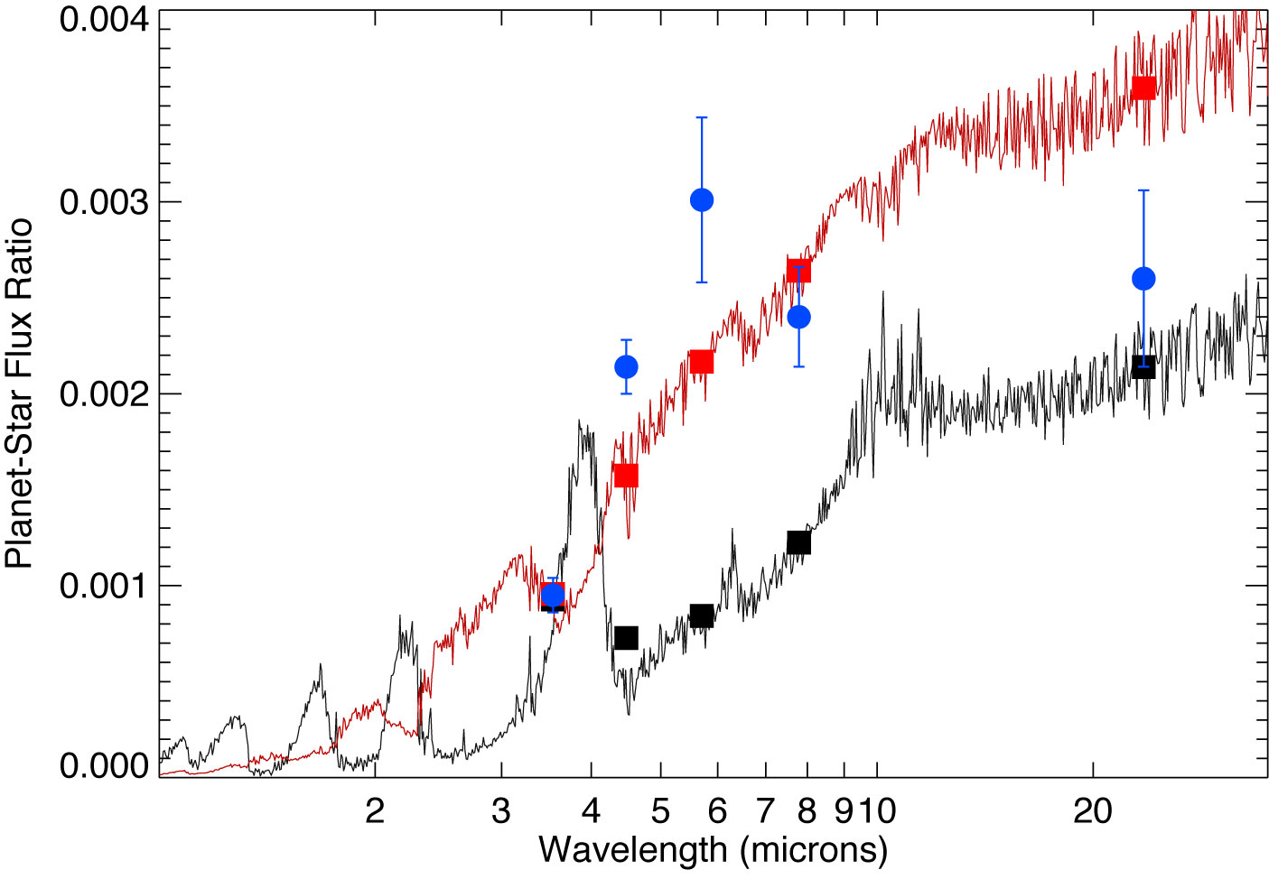
Self-Consistent Equilibrium Models
HD 209458b
Data: Knutson et al. 2008, ApJ, 673, 526
Models: Burrows et al. 2007, ApJ, 668, L171
Fortney et al. 2008, ApJ, 678, 1419
Notes:
Let me go back to this excellent plot by Fortney et al. (2008), and now plot only those systems for which a respectable amount of data is now available.

Slide 18
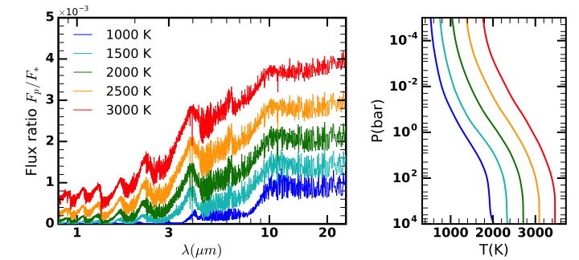
Effect of Stellar Irradiation
Burrows et al. 2008, Fortney et al. 2008, Molliere et al. 2016, Gandhi and Madhusudhan 2017

Slide 19
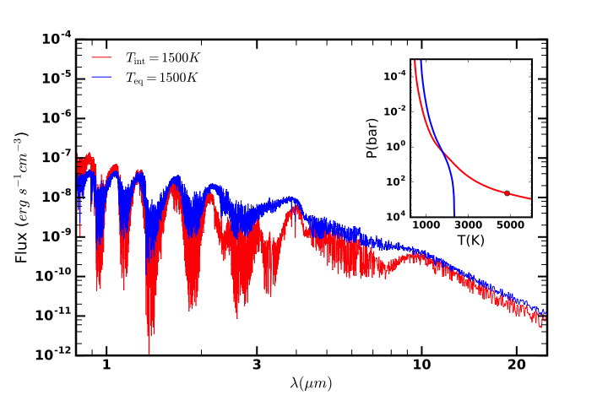
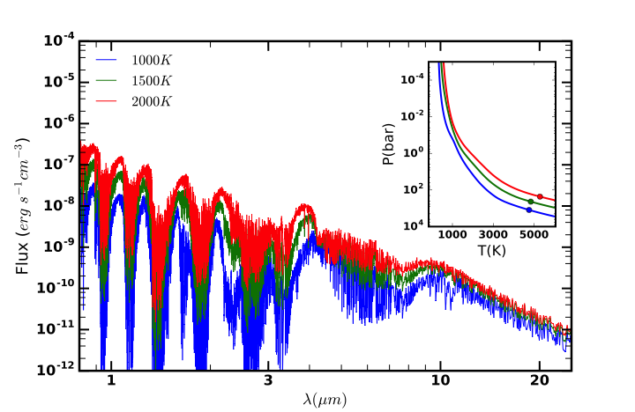
Irradiated vs Non-Irradiated Atmospheres
Sudarsky et al. 2003, Burrows et al. 2008, Fortney et al. 2008, Molliere et al. 2016,
Gandhi and Madhusudhan 2017, Barman et al. 2011, Marley et al. 2011

Slide 20
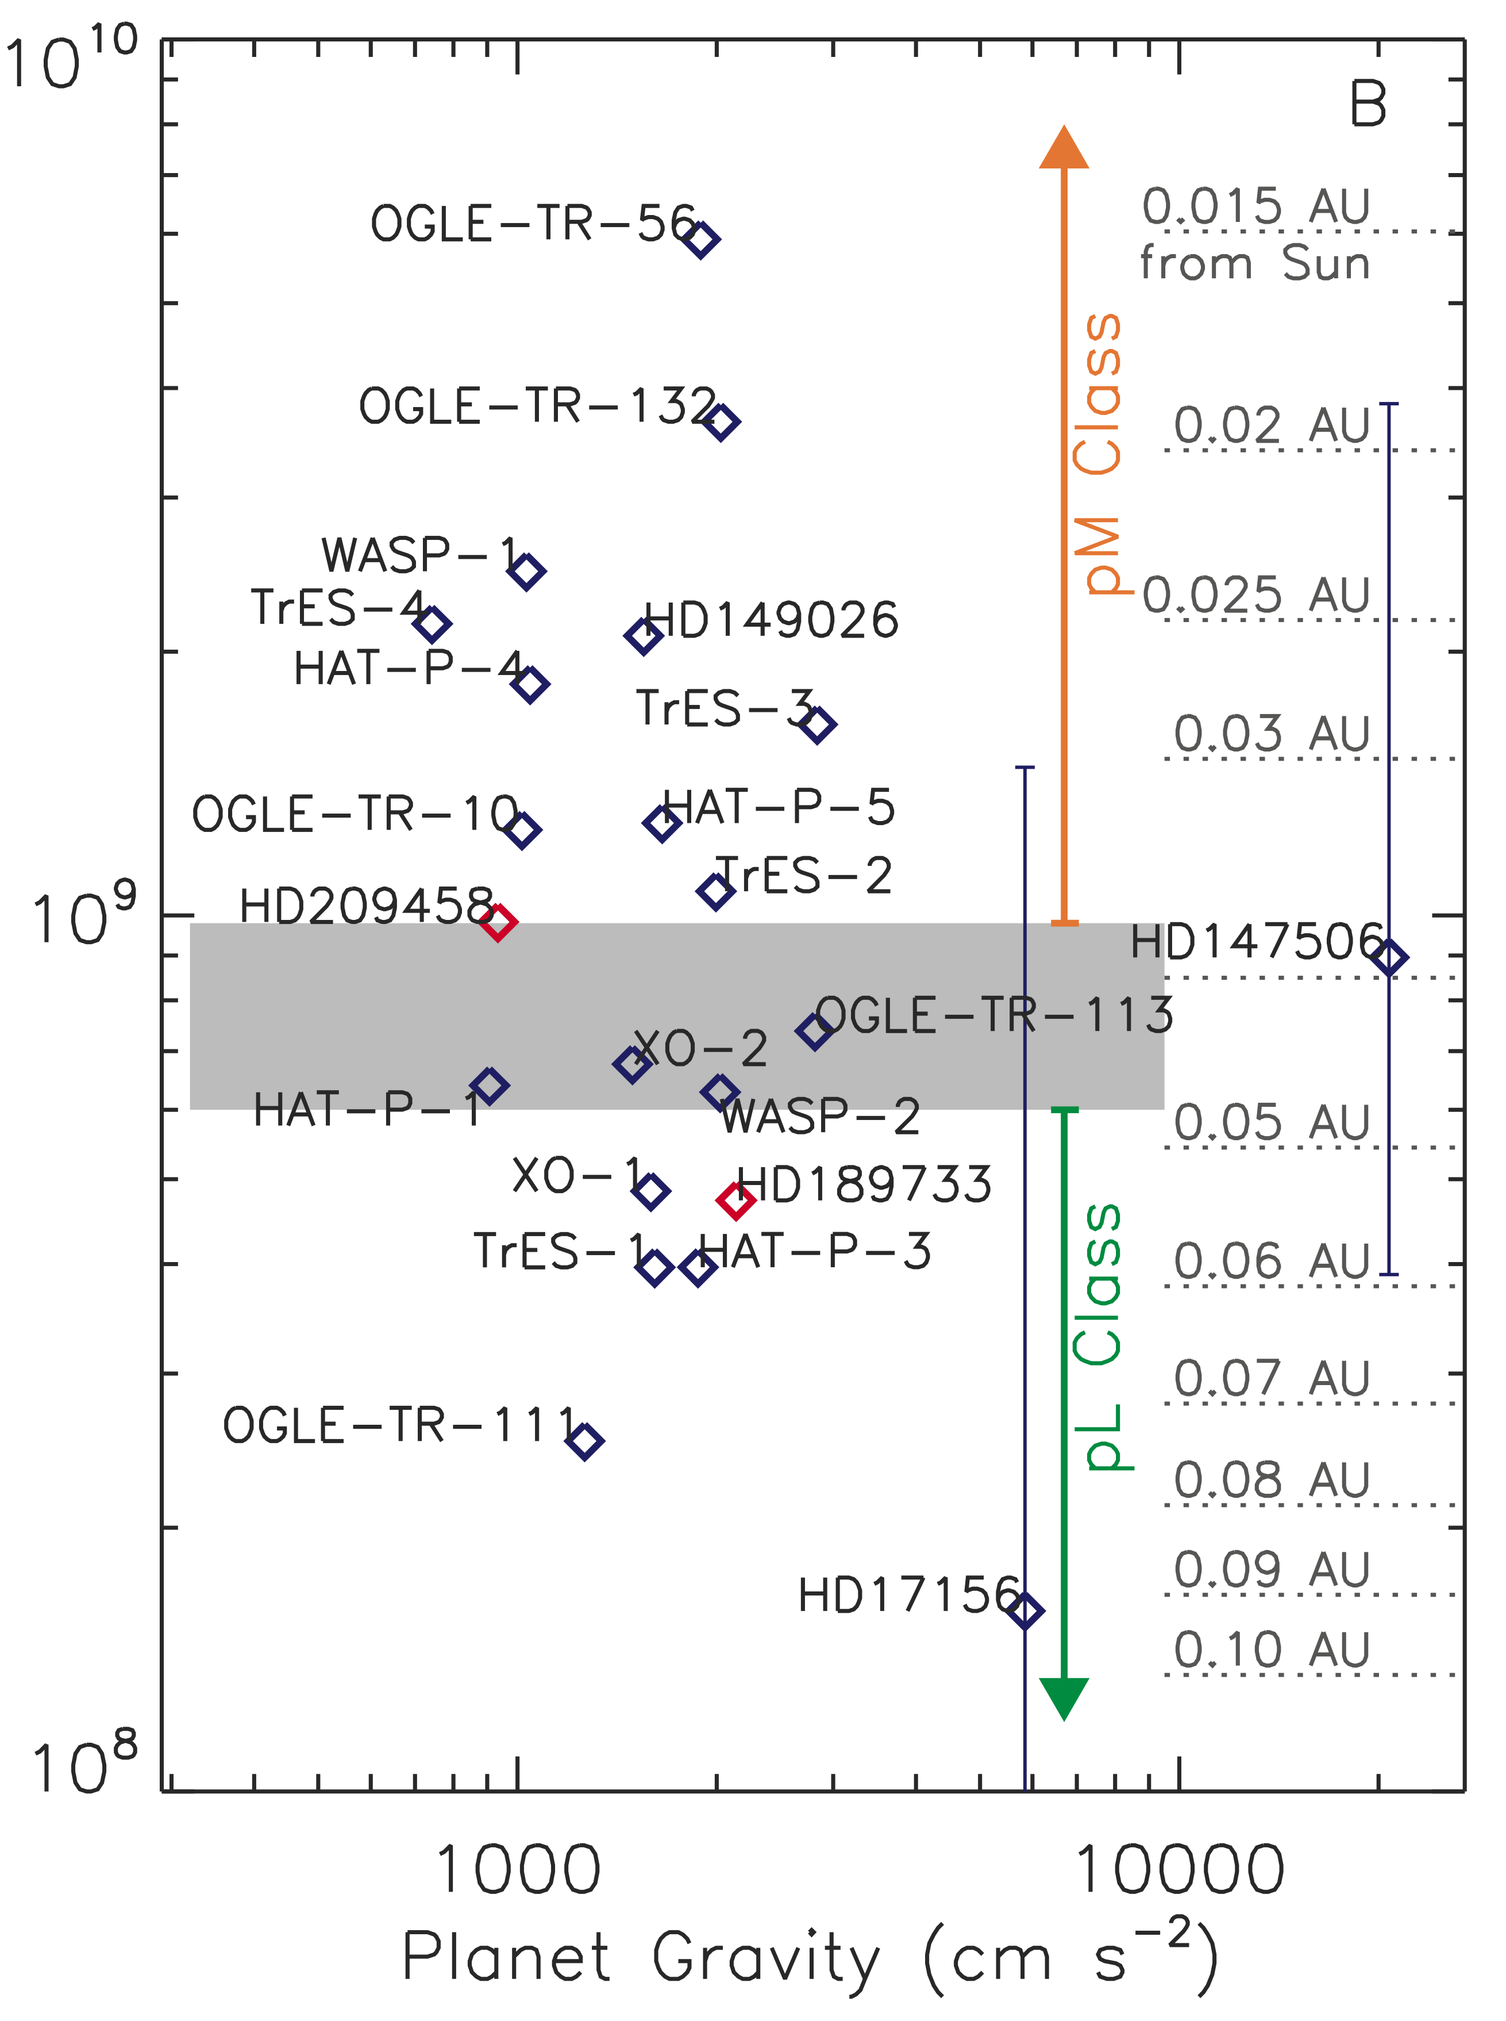
Self-Consistent Equilibrium Models
Inversion
Incident Flux (ergs s⁻¹ cm⁻²)
HD 209458b
No Inversion
Data: Knutson et al. 2008, ApJ, 673, 526
Models: Burrows et al. 2007, ApJ, 668, L171
Planet Gravity (cm s⁻²)
Fortney et al. 2008, ApJ, 678, 1419
Notes:
Let me go back to this excellent plot by Fortney et al. (2008), and now plot only those systems for which a respectable amount of data is now available.

Slide 21
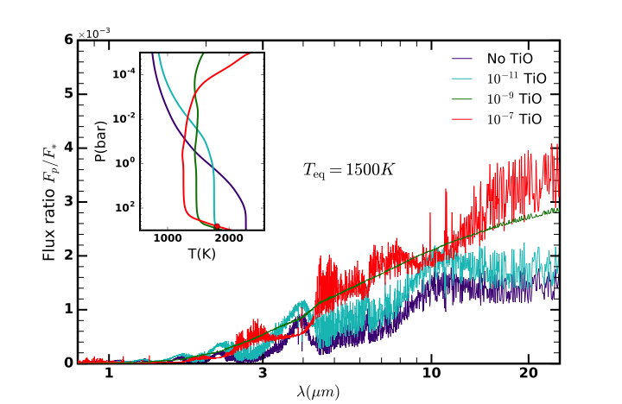
Effect of TiO – Thermal Inversions
Burrows et al. 2008, Fortney et al. 2008, Gandhi and Madhusudhan 2017

Slide 22
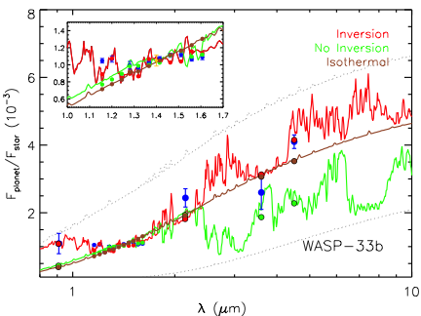
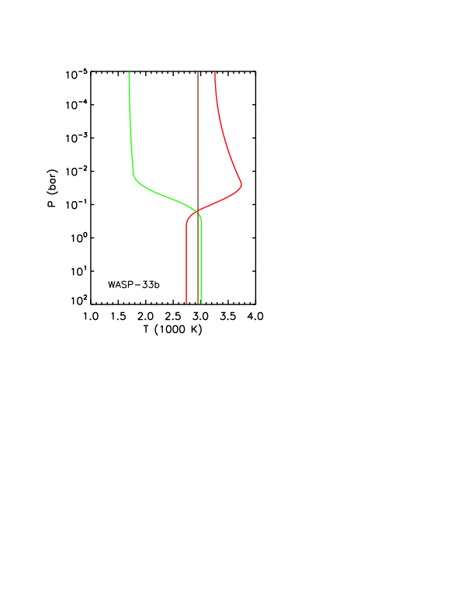
Evidence for Thermal Inversion in Hot Jupiter
Haynes et al. 2015

Slide 23
Outline
Self-consistent Equilibrium 1D Models
Atmospheric Retrieval Techniques
Clouds/Hazes
Super-Earth Atmospheres
Future outlook

Slide 24
From Detections to Abundances
(Atmospheric Retrieval)
Madhusudhan & Seager 2009, Madhusudhan et al. 2011, 2014
Line et al. 2012, Lee et al. 2012, Benneke et al. 2015, Waldmann et al. 2012, Lavie et al. 2016, etc.

Slide 25
Exoplanetary Atmosphere Models
1-D models of irradiated atmospheres with line-by-line radiative transfer
Boundary Conditions
Stellar Irradiation (Kurucz Model)
Intrinsic Energy source
LTE
−
ξ_{λ}
Chemical Equilibrium
Day-night redistribution:
Extra absorber:
Composition ( ) + clouds, etc.
Model Parameters
Parameters
Chemical equilibrium and compositions
Computation time
Artificial sources and sinks
Caveats
Seager & Sasselov 1998, Sudarsky et al. 2003
Fortney et al. 2006, Burrows et al. 2007

Slide 26

Atmospheric Retrieval
1-D parametric models of exoplanet atmospheres
Boundary Conditions
Stellar Irradiation (Kurucz Model)
Intrinsic Energy source
LTE
ξ_{λ}
Chemical Equilibrium
Perturbations to equilibrium or uniform mixing
Day-night redistribution:
Extra absorber:
Composition ( ) + clouds, etc.
Model Parameters
Parameters
Chemical equilibrium and compositions
Computation time
Artificial sources and sinks
Caveats
Madhusudhan & Seager 2009; Madhusudhan et al. 2011
Lee et al. 2012, Line et al. 2012; Benneke et al. 2012

Slide 27






Atmospheric Retrieval
Boundary Conditions
Global Energy Balance (Kurucz Model)
Intrinsic Energy source (negligible)
−
Perturbations to Chemical Equilibrium
Parameters
clouds, etc.
Features
Computationally fast (can explore parameter space)
Can explore non-equilibrium concentrations
Day-night energy redistribution as output
Madhusudhan & Seager 2009; Madhusudhan et al. 2011
Also see Lee et al. 2012, Line et al. 2012, Benneke et al. 2012

Slide 28
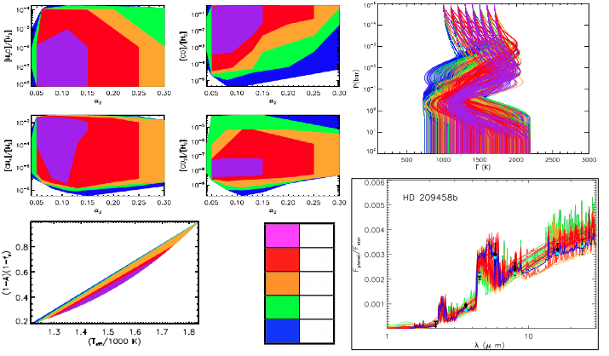

Atmospheric Retrieval for Exoplanets
Madhusudhan and Seager (2009)
Notes:
So now, we have the observations and the tools to extract the compositions from the data.

Slide 29
First MCMC Retrievals and Constraints on C/O Ratios
Key Molecular Constraints
H₂O/H₂ ≤ 6 × 10⁻⁶
CH₄ /H₂ ≥ 8 × 10⁻⁶
C/O ≥ 1
Madhusudhan et al. 2011, Nature, 469, 64
Notes:
The point is not so much whether WASP-12b has a C/O ratio greater than or less than 1. The more fundamental point is that it is in principle possible to measure C/O ratios in hot Jupiters. Let me tell you why this is important. First, atmospheric chemistry, second planet formation.

Slide 30
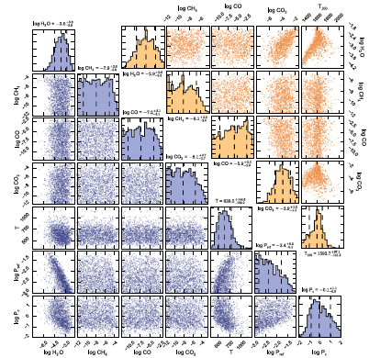
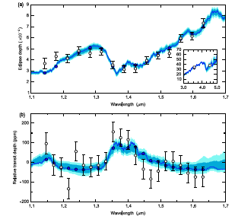
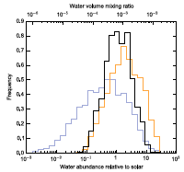
MCMC Retrievals for WASP-43b
Kreidberg et al. 2014 (Line et al retrievals)

Slide 31
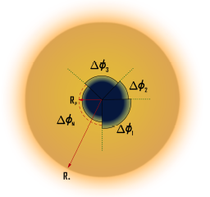
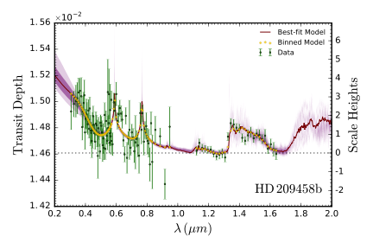

Super Retrievals
(MultiNest, Patchy Clouds, Detailed Chemistry)
10⁸ Models
Patchy Clouds
N chemistry
Na/K
High-altitude hazes
MacDonald & Madhusudhan 2017, MNRAS

Slide 32


Posteriors
MacDonald & Madhusudhan 2017, MNRAS

Slide 33

Atmospheric Retrieval Codes

Slide 34



Ultra-precise Retrievals
Line et al. 2015, 2016
Madhusudhan, Apai, Gandhi (2016, Submitted)

Slide 35

Atmospheric Retrievals of Brown dwarfs
Madhusudhan, Apai, Gandhi (2016, Submitted)
Line et al. 2015, 2016
Line et al. (2016, Submitted)

Slide 36



Future Landscape
The James Webb Space Telescope
JWST: NIRSpec and MIRI (0.6-24 μm), R~3000
E-ELT: METIS (2.9-5.3 μm) R -> 10⁵ + N-band
The Future from Ground:
European – Extremely Large Telescope

Slide 37
Importance of C/O Ratio
Madhusudhan 2012; Also see Moses et al. 2013, Kopparapu et al. 2013

Slide 38

Implications for Planet Formation and Migration
Mousis et al. 2009, 2011, Oberg et al. 2011,
Madhusudhan et al. 2011, 2014, 2017
Helling et al. 2014, Marbouef et al. 2014,
Thiabauld et al. 2015, Mordasini et al. 2016,
Venturini et al. 2016, Cridland et al. 2016,2017,
Booth et al. 2017
Image Credits: NASA

Slide 39




Chemical Signatures of Giant Planet Formation and Migration
Oberg et al. 2011
Madhusudhan et al. 2014,2016

Slide 40
Outline
Self-consistent Equilibrium 1D Models
Atmospheric Retrieval Techniques
Clouds/Hazes
Super-Earth Atmospheres
Future outlook

Slide 41



Clouds and Hazes
Pont et al. 2008, Sing et al. 2011
Sing et al. 2016
Notes:
Hot Jupiter orbiting a K star in a 20 hr orbit.

Slide 42



Clouds and Hazes
Morley et al. 2015, Wakeford et al. 2017, Wakeford & Sing 2016, Pinhas & Madhusudhan 2017
Notes:
Hot Jupiter orbiting a K star in a 20 hr orbit.

Slide 43
Outline
Self-consistent Equilibrium 1D Models
Atmospheric Retrieval Techniques
Clouds/Hazes
Super-Earth Atmospheres
Future outlook

Slide 44
Spectrum of a Super-Earth GJ 1214b
Kreidberg et al. 2014
M_{p} = 6.55 ± 0.98 M_{E}
R_{p} = 2.678 ± 0.13 R_{E}
T_{eq} = 400 - 550 K
60 HST orbits
Key Merit: Orbits an M Dwarf
(M = 0.16 M_{s}, R = 0.2 R_{s})

Slide 45




1. Clouds and Hazes in SE Atmospheres
Morley et al. 2015, Mbarek & Kempton 2016

Slide 46



2. Atmospheric Circulation in SEs
55 Cancri e
(2500 K)
Demory et al. 2016

Slide 47


Atmospheric Circulation in Super Earths
Case Study of GJ 1214b (550 K)
Kataria et al. 2016

Slide 48

3. Habitable Planets and Biosignatures
.
Proxima b
Gillon et al. 2016
Anglada-Escude et al. 2016

Slide 49


Habitable Zones and Biosignatures
Kopparapu et al. 2014, 2017
Seager et al. 2013, 2016

Slide 50
Outline
Self-consistent Equilibrium 1D Models
Atmospheric Retrieval Techniques
Clouds/Hazes
Super-Earth Atmospheres
Future outlook

Slide 51

Madhusudhan, Knutson, Fortney, and Barman, 2014,
`Exoplanetary Atmospheres’ , Protostars and Planets VI

Slide 52




The Future of Exoplanet Science
CHEOPS (ESA)
TESS (NASA)
Detection of small planets orbiting nearby stars
PLATO (ESA)
The James Webb Space Telescope
The future from ground
E-ELT, GMT, TMT
Characterization of atmospheres and interiors of
exoplanets
Notes:
The Golden Age of Exoplanet Science is ahead of us. If we as a community can come together, we can reap the benefits in a major way.

