Slide 1
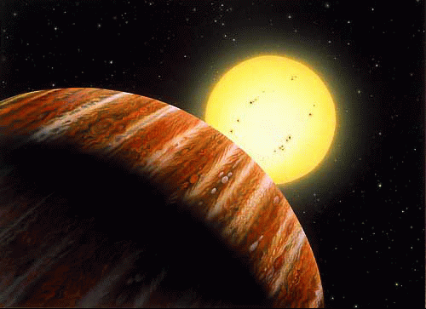


Prospects of ESPRESSO for exoplanet research
The Echelle SPectrograph for Rocky Exoplanets and Stable Spectroscopic Observations
EWASS 2017 - Prague
1

Slide 2
ESPRESSO
Francesco A. Pepe, Stefano Cristiani, Rafael Rebolo Lopez, Nuno C. Santos, Antonio Amorim, Gerardo Avila, Willy Benz, Piercarlo Bonifacio, Alexandre Cabral, Pedro Carvas, Roberto Cirami, João Coelho, Maurizio Comari, Igor Coretti, Vincenzo De Caprio, Hans Dekker, Bernard Delabre, Paolo Di Marcantonio, Valentina D'Odorico, Michel Fleury, Ramòn Garcia Lòpez,
  José Miguel Herreros Linares, Ian Hughes, Olaf Iwert, Jorge Lima, Jean-Louis Lizon, Gaspare Lo Curto, Christophe Lovis, Antonio Manescau, Carlos Martins, Denis Mégevand, André Moitinho, Paolo Molaro, Mario Monteiro, Manuel Monteiro, Christoph Mordasini, Luca Pasquini, Didier Queloz, José Luis Rasilla, Jose Manuel Rebordão, Samuel Santana Tschudi, Paolo Santin, Danuta Sosnowska, Paolo Spanò, Fabio Tenegi, Stéphane Udry, Eros Vanzella, Matteo Viel, Maria Rosa Zapatero Osorio, Filippo Zerbi
1

Slide 3

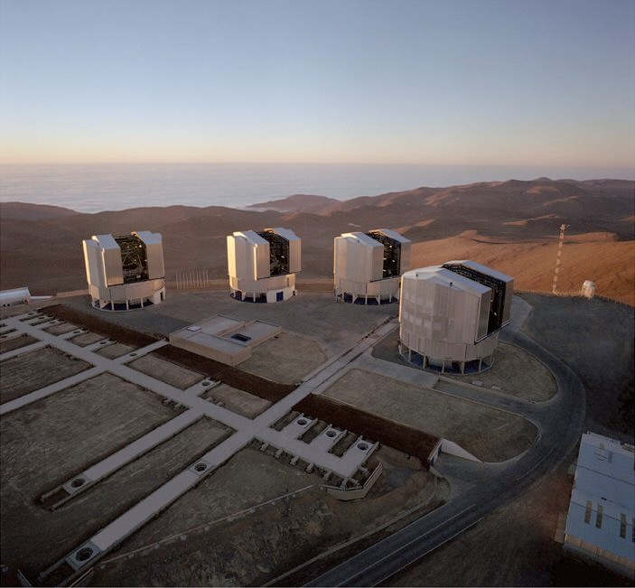
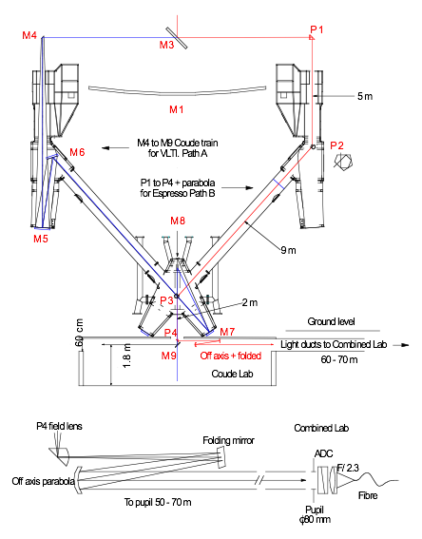
A spectrograph on a 16 m telescope,
Foreseen by ESO since ....

Slide 4
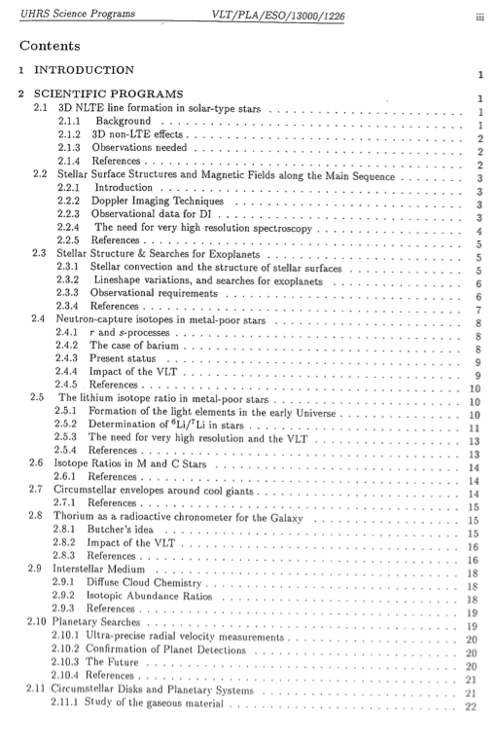
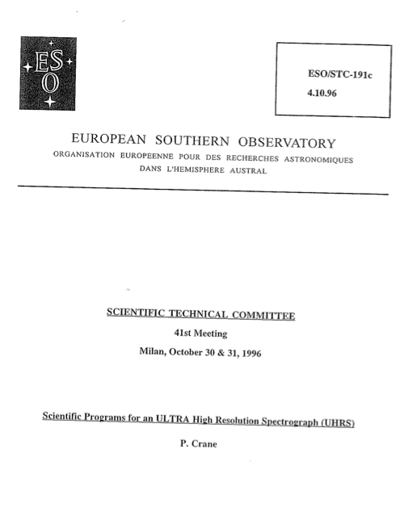
‘UHRS’ at VLT
1996 by Crane et al., Combined Coudé of VLT

Slide 5
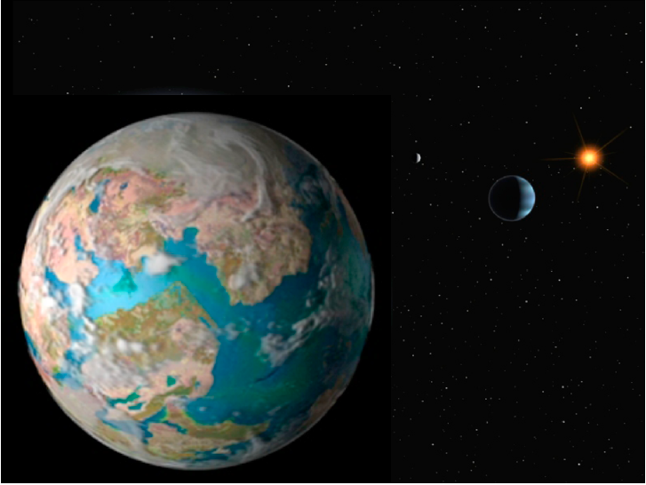
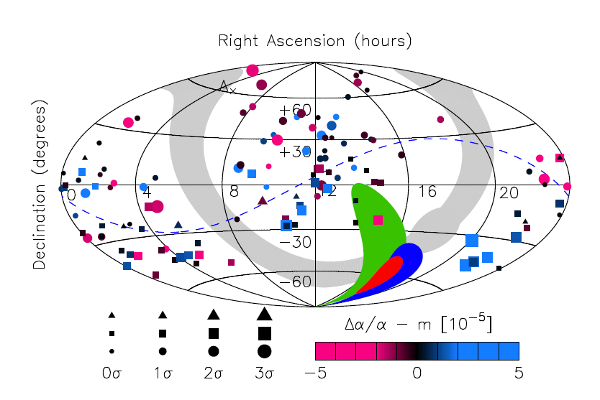
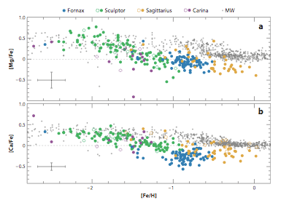
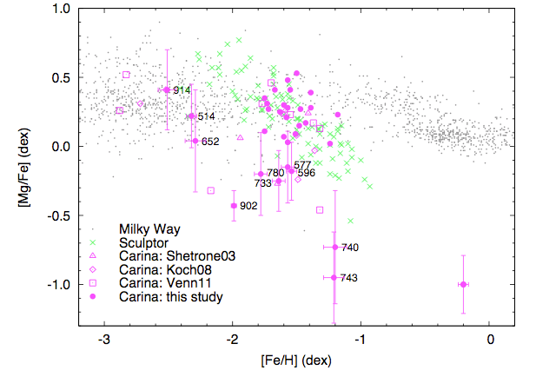
Science drivers
  Rocky planets of
  Earth-size ( 8 cm/s)
Webb et al 2011
Variability of fundamental constants
    Abundances in local group galaxies
Tolstoy et al 2009

Slide 6
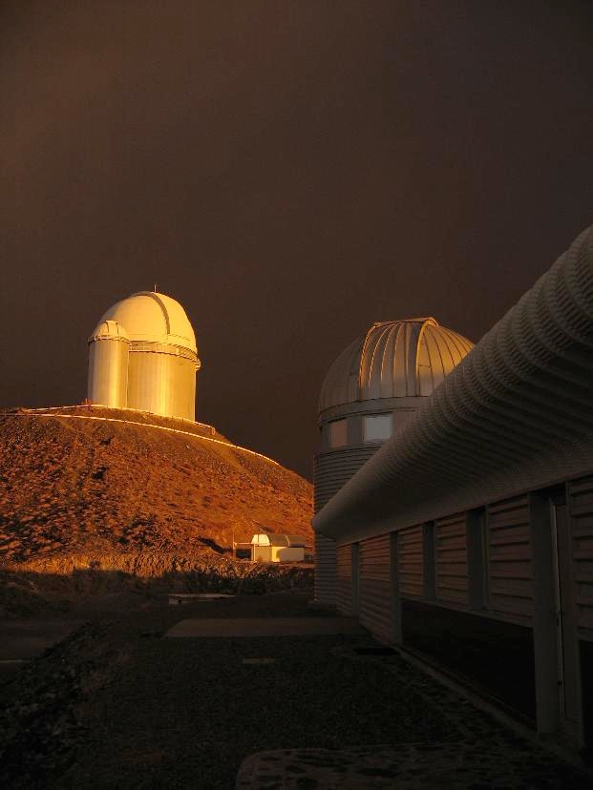
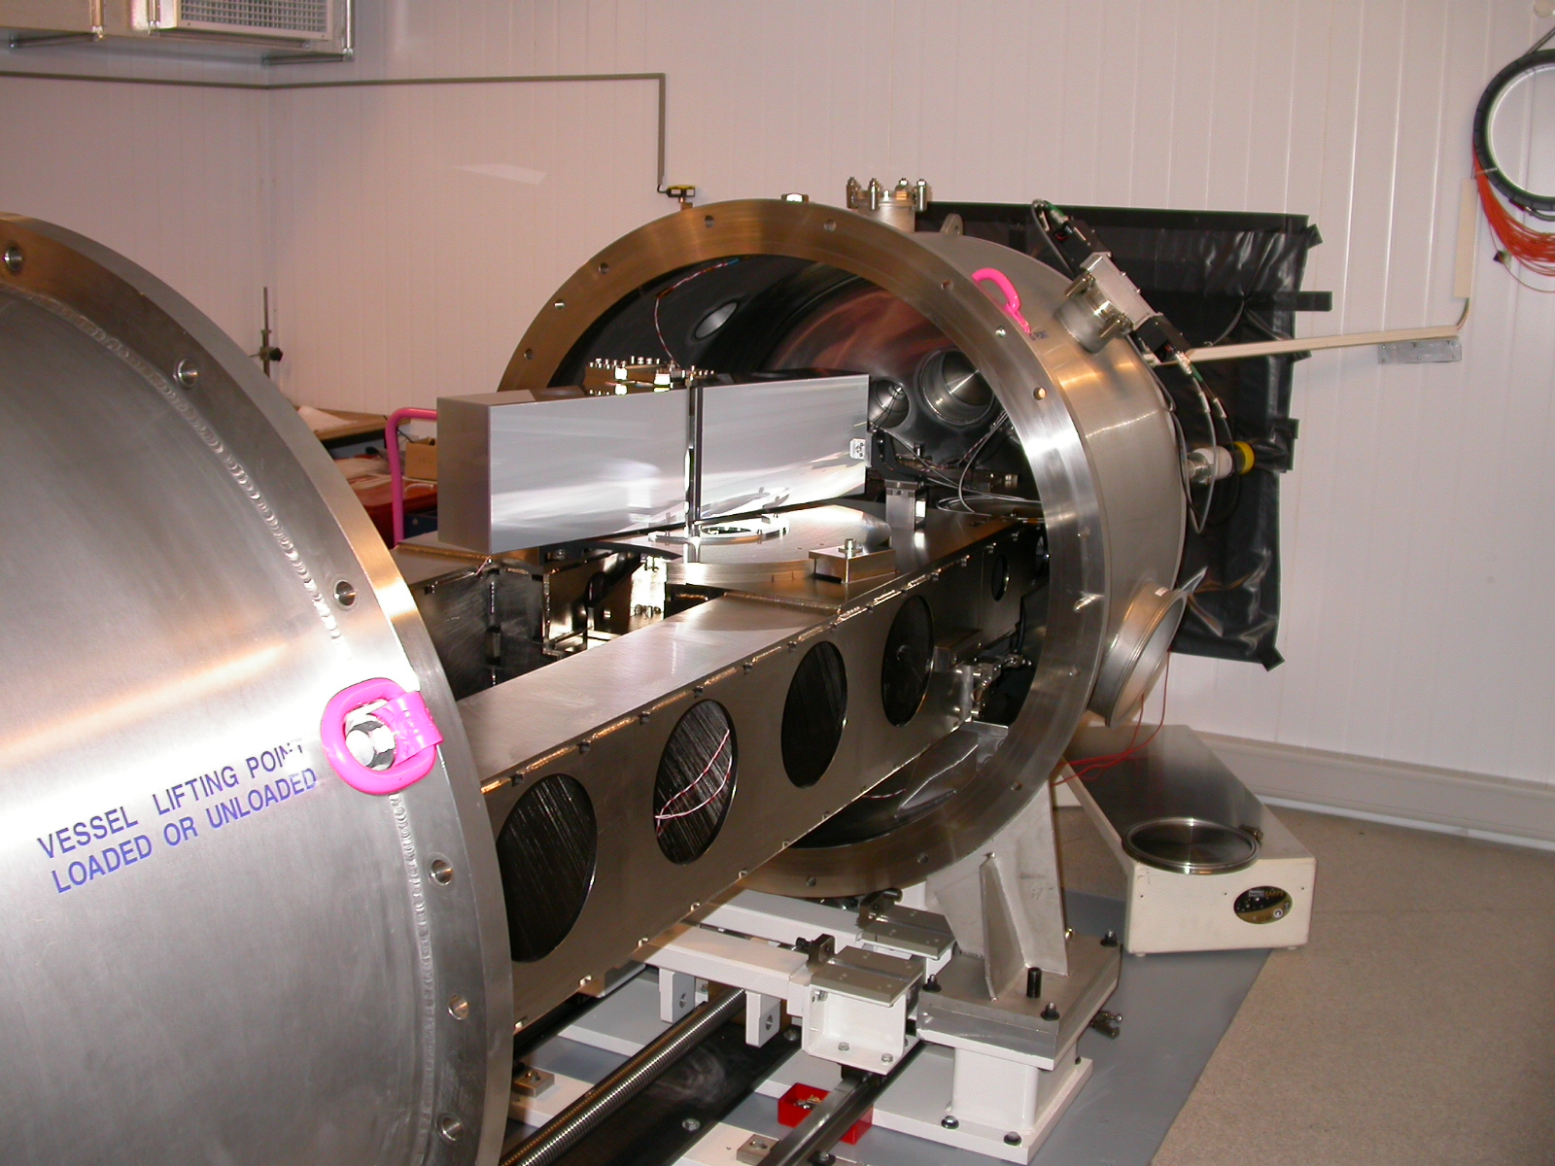

The HARPS Legacy
since 2003
ΔRV =1 m/s
‘Super-Earths’
discovered > 80% of RV-planets with Mp < 10 MEarth
Notes:
Mention features
Extremely stable since in vacuum and controlled in temperature, no drifts
Simultaneous ThAr used, image scrambler to stabilize input image
Deliver highly resolved spectra, well suited also for spectroscopy

Slide 7
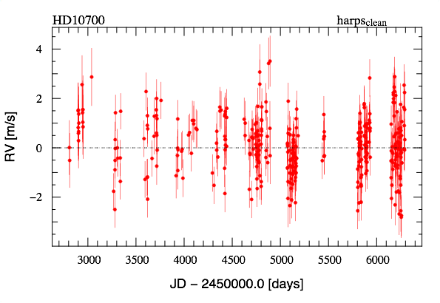
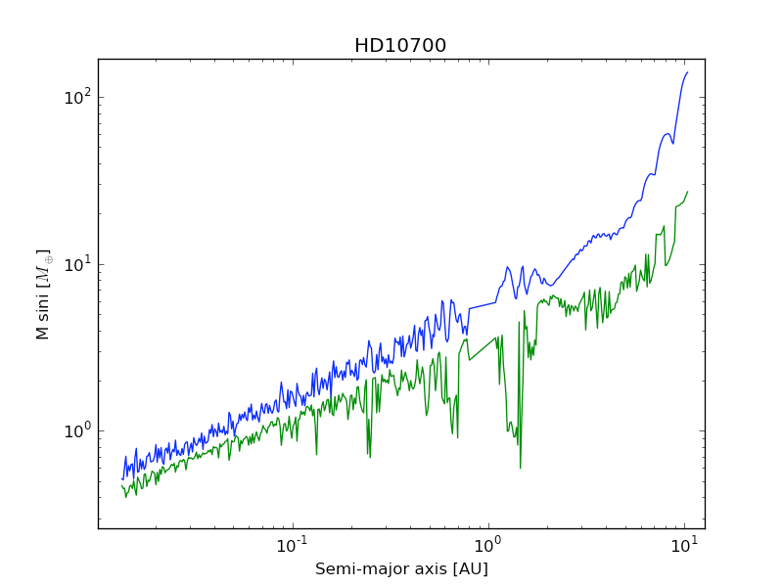
HARPS Detection Limits
Tau Ceti:
11 years of measurements
rms = 1.0 m/s
We would have detected:
- an Earth @ 0.1 AU
- a super-Earth (5 M⊕) @ 1 AU
- a Neptune @ 5 AU
- a Saturn @ 10 AU

Slide 8
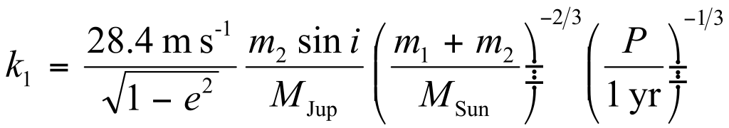
Planet detectability with RV’s
(M1 = Sun)
Jupiter @ 1 AU : 28.4 m s⁻¹
Jupiter @ 5 AU : 12.7 m s⁻¹
Neptune @ 0.1 AU : 4.8 m s⁻¹
Neptune @ 1 AU : 1.5 m s⁻¹
Super-Earth (5 M⊕) @ 0.1 AU : 1.4 m s⁻¹
Super-Earth (5 M⊕) @ 1 AU : 0.45 m s⁻¹
Earth @ 1 AU : 9 cm s⁻¹
Planètes géantes
Premières exoplanète
e.g. Jupiters jusqu’à 5 AU
Neptunes et Superterres
Accessibles avec HARPS
Terres et Superterres
Accessibles avec Espresso
(M1 = Sun)

Slide 9
What we need from ESPRESSO
Reduce errors and noise
Instrumental effects -> better scrambling, better calibration sources, better detectors, improved software
Photon noise -> Better efficiency, high spectral resolution, larger telescope(s), efficient observations
Stellar noise -> Better understanding, pre-selection, observation strategy, activity indicators, modelling (need for photons and precision)

Slide 10
Why should ESPRESSO do better?
Larger Telescope (up to 4 of them! Wow!)
Monolithic and stabilised detectors (9k9 e2v)
Octagonal fibers (limitation in HARPS!)
An adequate calibration source (limitation in HARPS?)
A fully integrated DRS which showed its capabilities
New operational flexibility (fast switching between telescopes)! -> Efficiency, time sampling.
Translate the lessons learned from HARPS into ESPRESSO

Slide 11
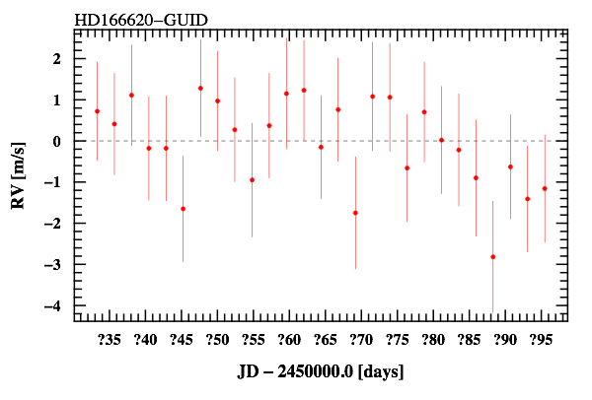
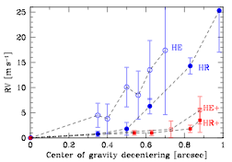

Illumination effects: guiding tests
Cosentino et al. 2014
Bouchy et al. 2013
HARPS-N@TNG

Slide 12
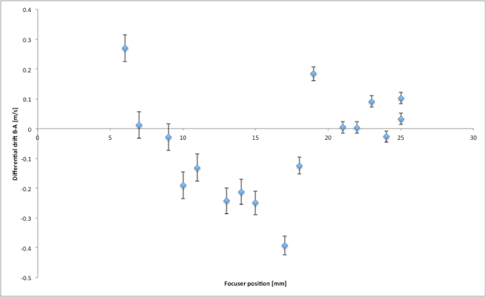
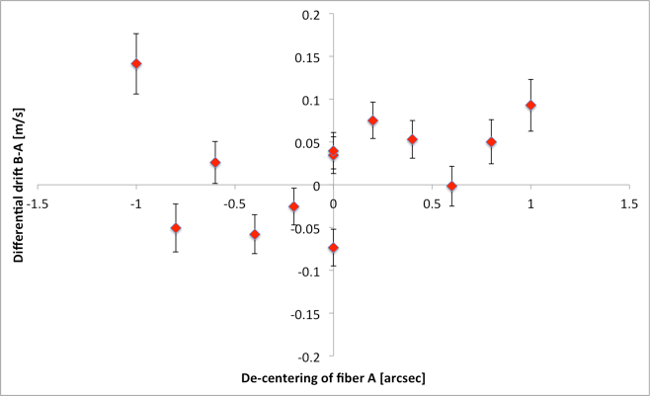
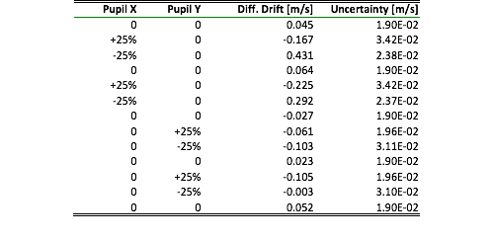
SCRAMBLING:
GUIDING/FOCUS/PUPIL
De-focusing
De-centering
Pupil motion
Always within 10 cm/s rms !!!

Slide 13
Notes:
The optical elements are assembled on a Nickel-plated structural Steel optical bench
The dimensions of the bench are 3.5 x 1.4 x 1.5 meters, its weight is almost 3 tons
CLICK
This bench is placed in a Vacuum Vessel, where the pressure is maintained to less than5 x 10⁻³ mbar and the temperature is stabilized to 0.001 ºK.
No dissipative or moving parts are located in the Vacuum Vessel.
CLICK
This thermal regulation is obtained through onion-like thermal system, with two additional enclosures, each being ten times more stable than the preceding.

Slide 14
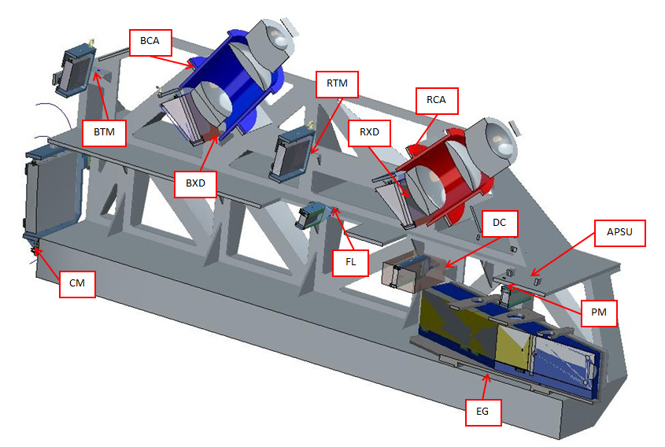
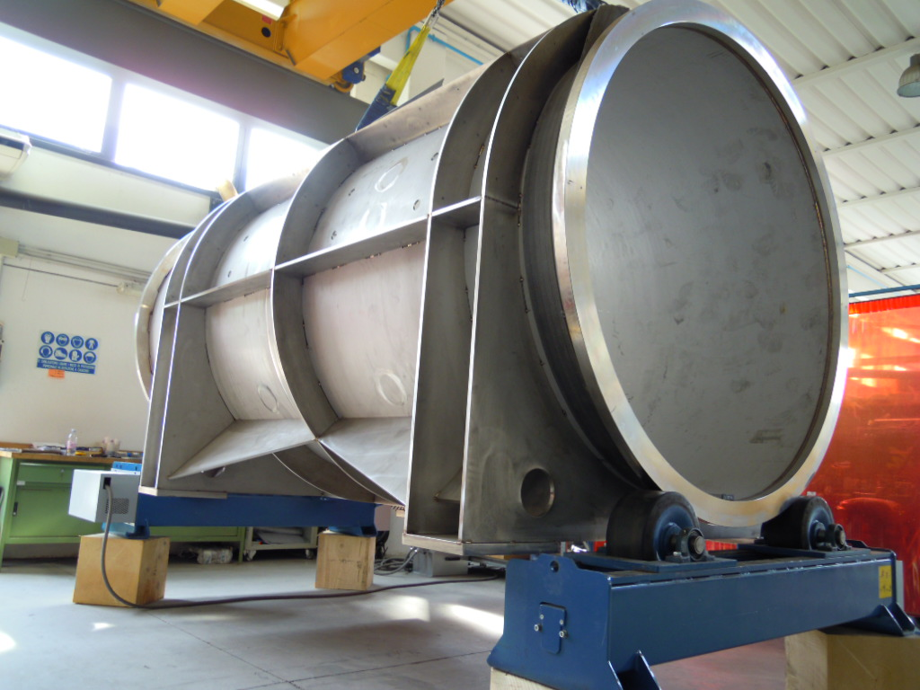
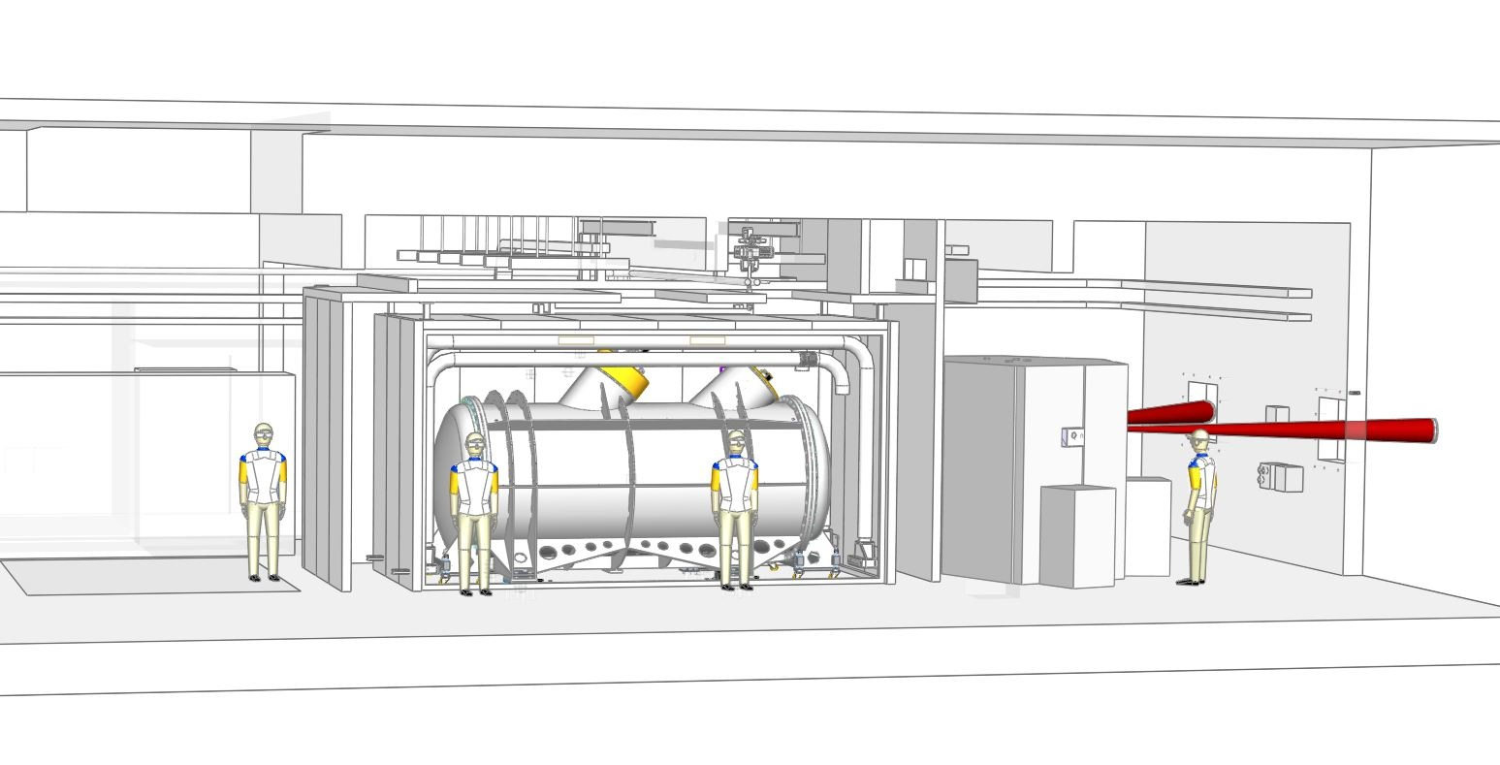
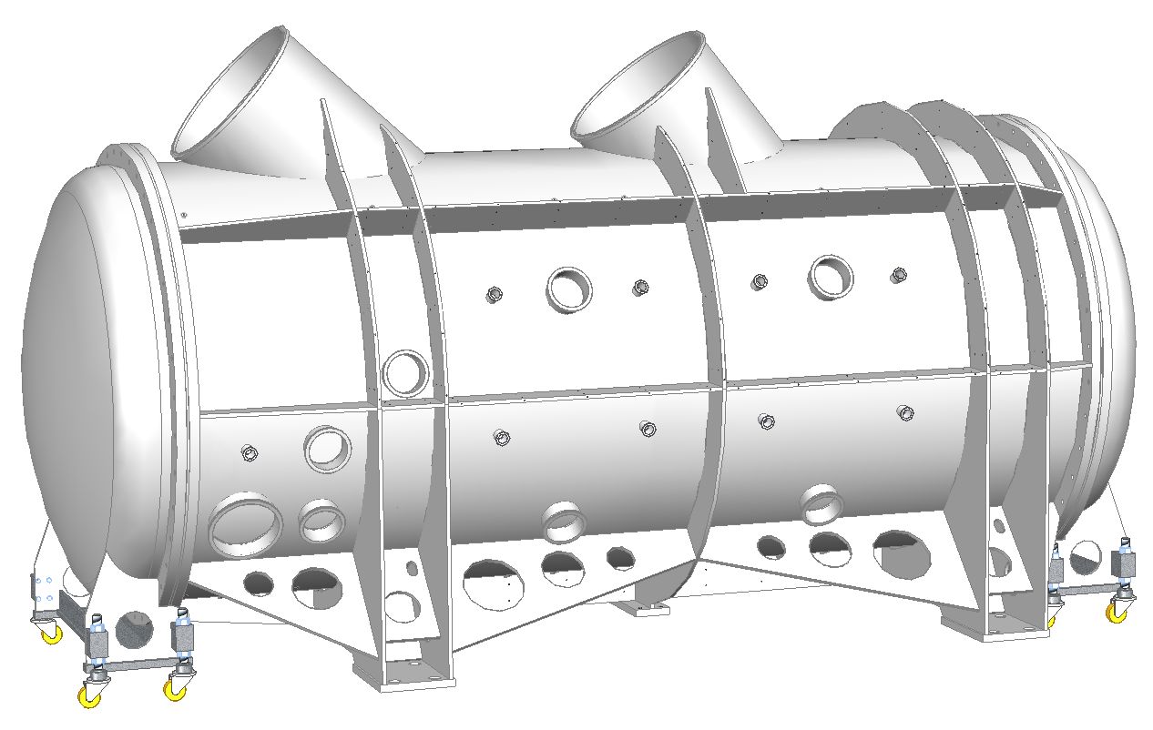

Work in progress …
Notes:
The optical elements are assembled on a Nickel-plated structural Steel optical bench
The dimensions of the bench are 3.5 x 1.4 x 1.5 meters, its weight is almost 3 tons
CLICK
This bench is placed in a Vacuum Vessel, where the pressure is maintained to less than5 x 10⁻³ mbar and the temperature is stabilized to 0.001 ºK.
No dissipative or moving parts are located in the Vacuum Vessel.
CLICK
This thermal regulation is obtained through onion-like thermal system, with two additional enclosures, each being ten times more stable than the preceding.

Slide 15
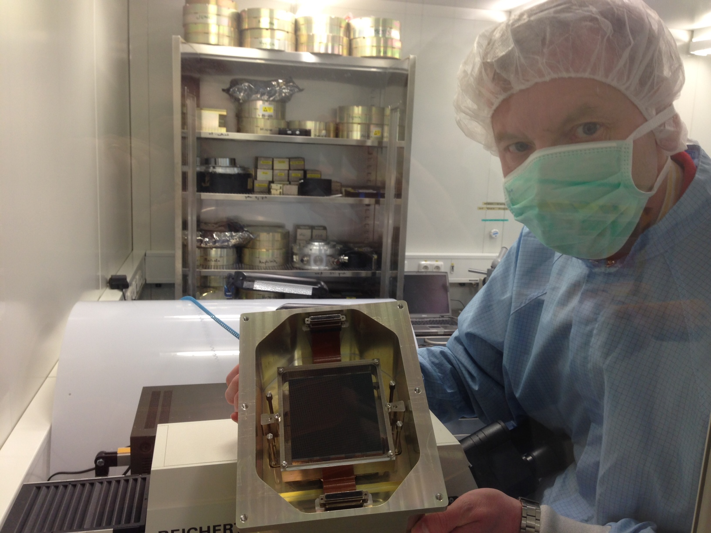
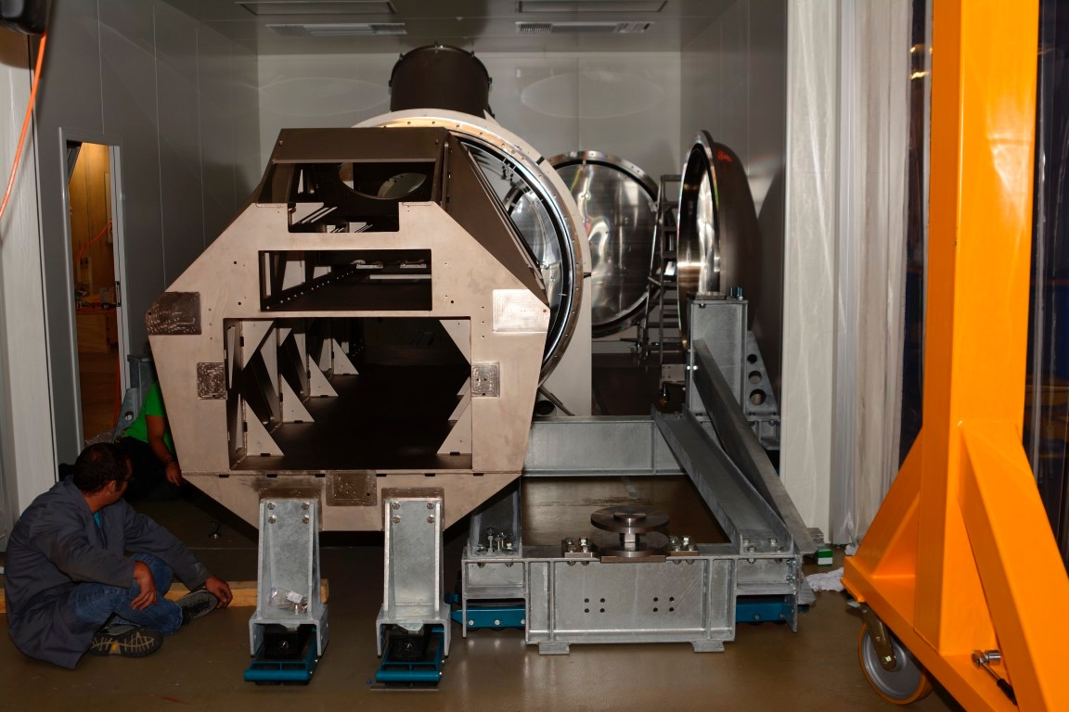
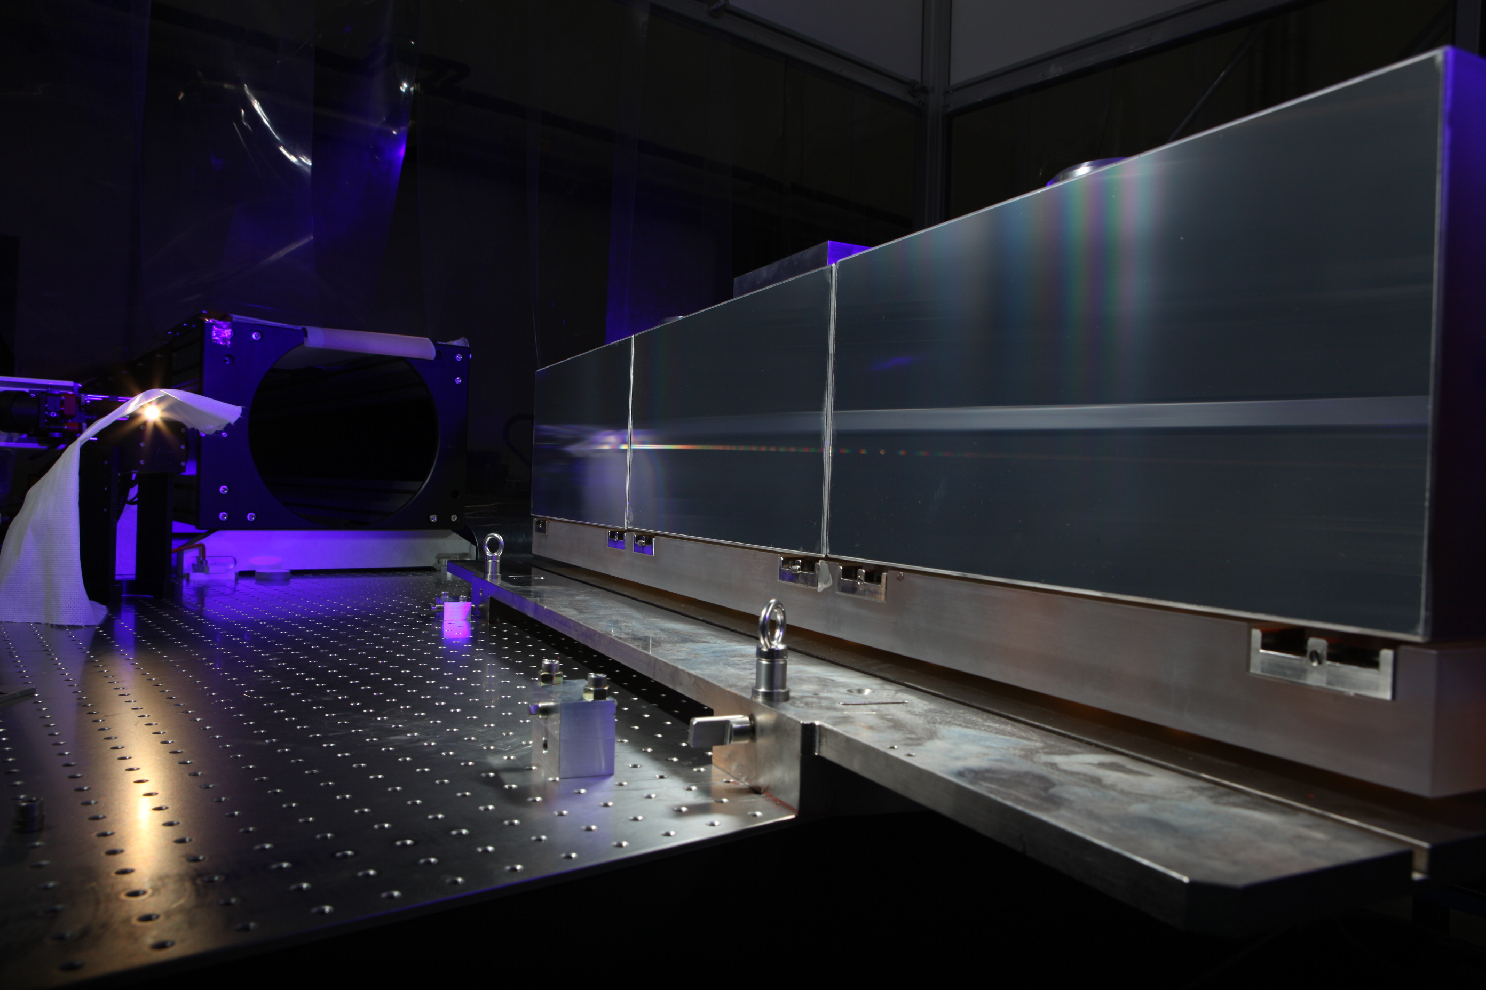

Slide 16
System characteristics
Parameter | singleUHR | singleHR | multiMR
Wavelengths | Blue arm: 380 – 520 nm Red arm: 520 – 780 nm
Spectral coverage | Full
Spectra format | Up to 4 spectra per order (2 fibers, 2 spectra / fiber)
Resolving power | 225’000 | 134’000 | 59’000
Aperture on sky | 0.5 arcsec | 1.0 arcsec | 4x1.0 arcsec
Spectral sampling | 2.5 pixels | 4.5 pixels | 5.5 pixels (binned x 2)
Spatial sampling | 5 pixels | 9 pixels | 5.5 pixels (binned x 4)
Sky/Simultaneous reference | Yes (mutually exclusive)
Instrumental RV precision | <10 cm/s | <10 cm/s | ~1 m/s
Notes:
Now a few numbers on the instrument.
The spectral range runs from 380 to 780 nm. Every measurement will produce a full range spectrum.
The standard high resolution is 134‘000, with an aperture of 1 arcsecond.
An ultra high resolution of 225‘000 is available to the price of slit losses, a smaller fiber limits the aperture to 0.5 arcsecond.
A medium resolution of 59’000 is achieved when more than one telescope is used, the square fiber combining a sky aperture of 1 arcsecond on each telescope.

Slide 17
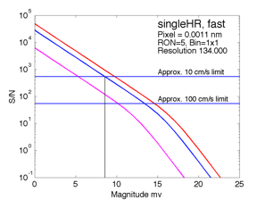
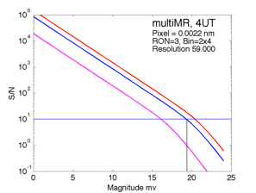
System efficiency
Notes:
Now a few numbers on the instrument.
The spectral range runs from 380 to 780 nm. Every measurement will produce a full range spectrum.
The standard high resolution is 134‘000, with an aperture of 1 arcsecond.
An ultra high resolution of 225‘000 is available to the price of slit losses, a smaller fiber limits the aperture to 0.5 arcsecond.
A medium resolution of 59’000 is achieved when more than one telescope is used, the square fiber combining a sky aperture of 1 arcsecond on each telescope.

Slide 18
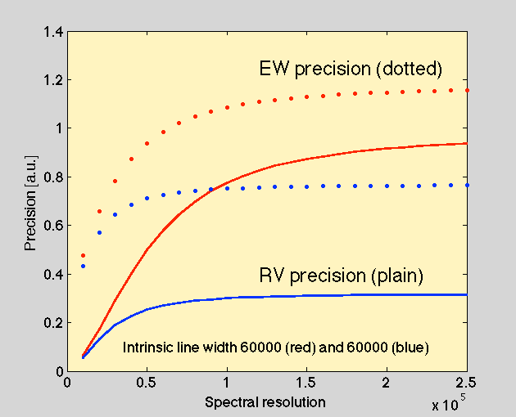
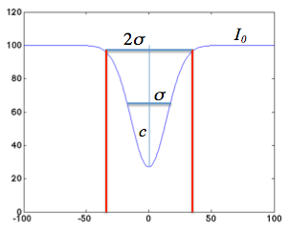
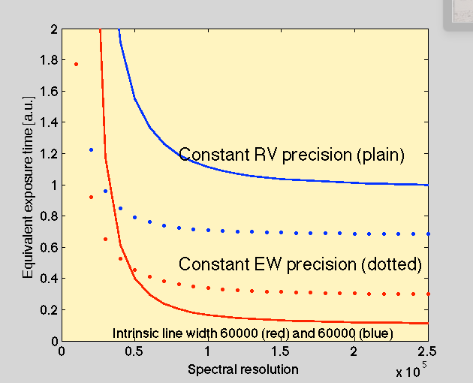


SNR, precision & Co.
Continuum:
SNR = sqrt(I0)
Line:
S/N = c SNR
Factor 2 in R -> factor 8 in observing time !
Butler et al., 1996
Bouchy et al., 2001

Slide 19

RV searches for nearby exoplanets
Mass measurement of transiting exoplanets
Stellar physical parameters
High-resolution spectroscopy
Spin-orbit alignment of planetary systems
Transmission/emission spectroscopy of exoplanet atmospheres

Slide 20
Rocky & Habital
Notes:
Now a few numbers on the instrument.
The spectral range runs from 380 to 780 nm. Every measurement will produce a full range spectrum.
The standard high resolution is 134‘000, with an aperture of 1 arcsecond.
An ultra high resolution of 225‘000 is available to the price of slit losses, a smaller fiber limits the aperture to 0.5 arcsecond.
A medium resolution of 59’000 is achieved when more than one telescope is used, the square fiber combining a sky aperture of 1 arcsecond on each telescope.

Slide 21
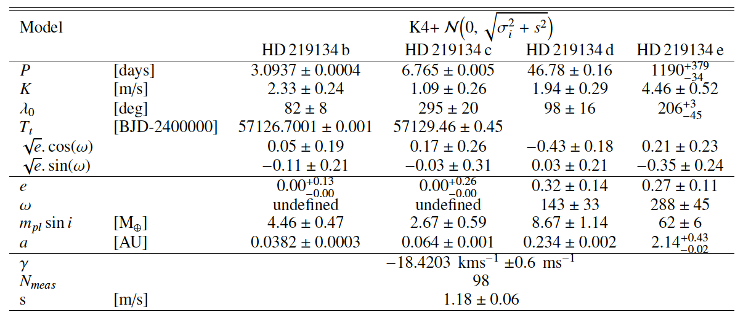
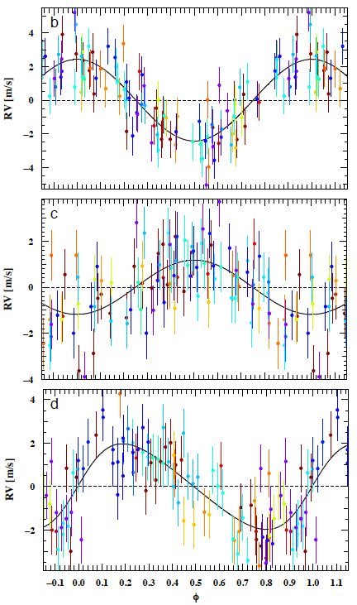
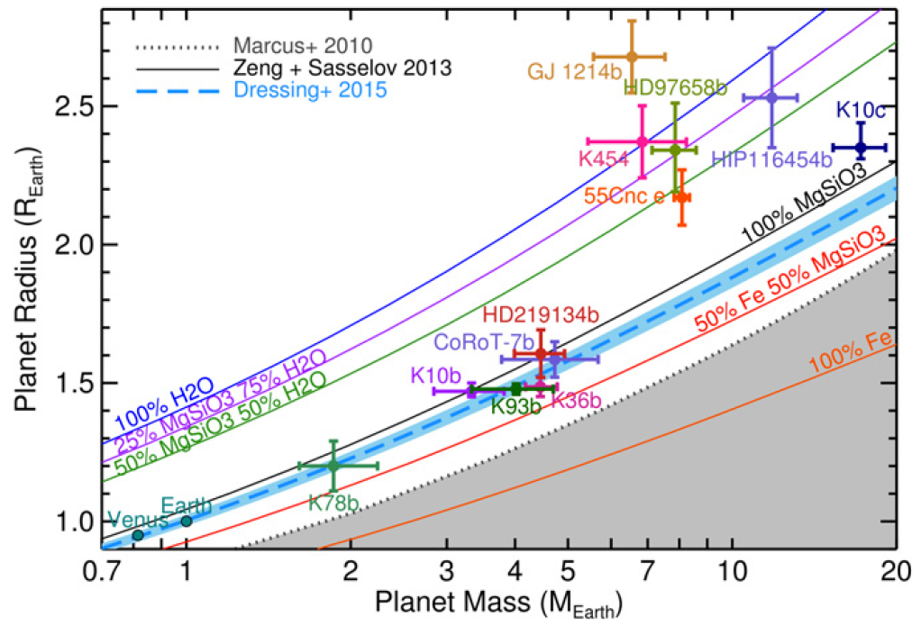
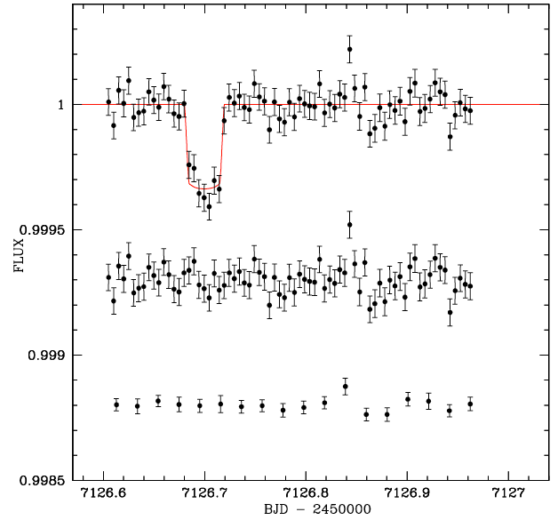

HD 219134: a planetary system with at least
three super-Earths and a distant giant planet
Motalebi, Udry, Gillon, et al. (2015), A&A, 584, A72
The 8th closest planet-hosting star (d=6.5 pc, V=5.57, K3V)
> 1000 HARPS-N RVs spread over 99 epochs

Slide 22
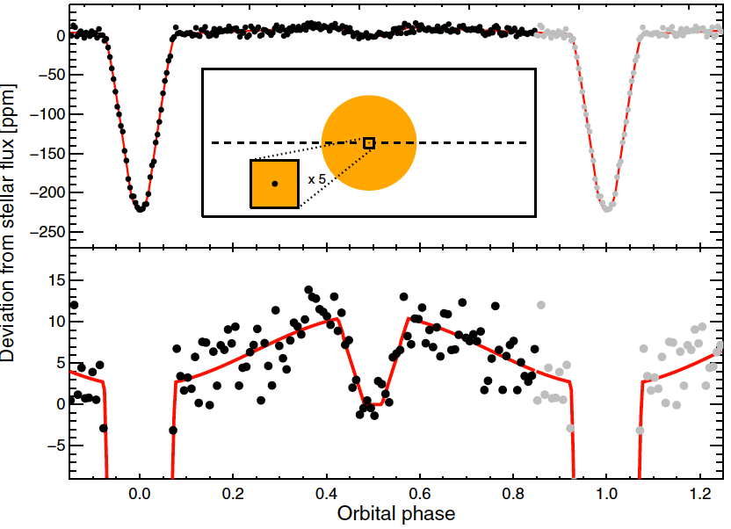
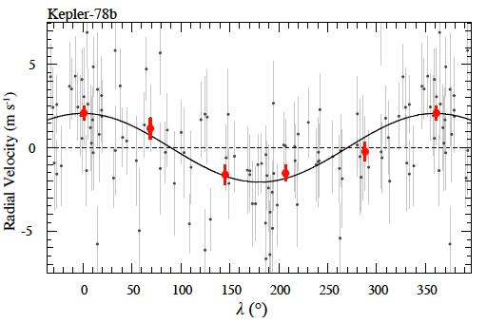
The infernal Earth Kepler-78b
orbiting an active star (V=11.7, K0V, Prot=12.6 d)
Pepe, Cameron, Latham et al. (2013), Nature, 503, 377
Kepler photometry (Sanchis-Ojeda+13)
109 HARPS-N radial velocities
Porb = 8.5 hr
Rp = 1.16 ± 0.19 R♁
Simultaneous modelling of
planetary and activity signals
K = 1.96 ± 0.32 m/s
Mp = 1.86 ± 0.31 M⊕
ρp = 5.6 ± 0.7 g/cm³
An Earth-sized planet with an Earth-like density!
Its surface is likely covered by lava oceans (Teq > 2000 K)
Agreement with an independent measure obtained with HIRES@Keck
by Howard et al. (2013): K=1.66 ± 0.40 m/s

Slide 23
The composition of small planets
- Mp-Rp diagram for planets with Rp < 2.7 R⊕ and σMp/Mp < 20%
- Solid lines: theoretical Mp-Rp curves for planets with different compositions (Zeng & Sasselov 2013)
- Most of small planets with Rp < 2.7 R⊕ and σMp/Mp < 20% have been characterised with HARPS-X

Slide 24
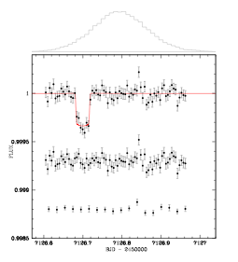

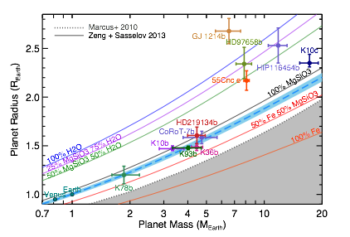
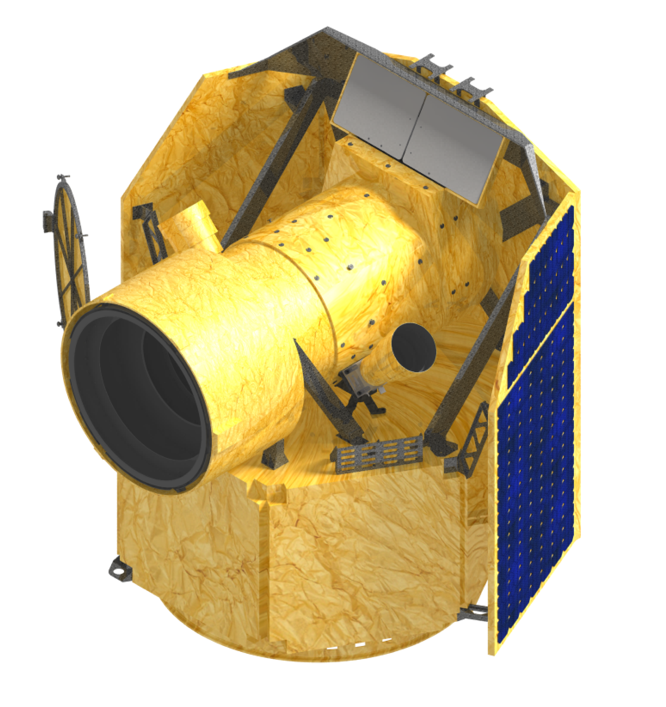
RVs + Transits
ESPRESSO
Ideal target for CHEOPS !
Synergies with K2/TESS/PLATO

Slide 25
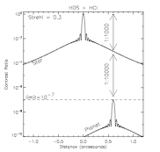
Why are nearby exoplanets so interesting?
Characterization of temperate terrestrial planets!
Spatially-resolved, high-resolution spectroscopy
Transit spectroscopy:
HST, JWST, ground-based high-resolution spectroscopy
Need to find the nearest (non-transiting) exoplanets:
☞ RV surveys
Need to find the nearest transiting exoplanets:
☞ TESS, NGTS, MEarth, TRAPPIST, SPECULOOS, CHEOPS, PLATO, …
Snellen et al. 2014, 2015

Slide 26
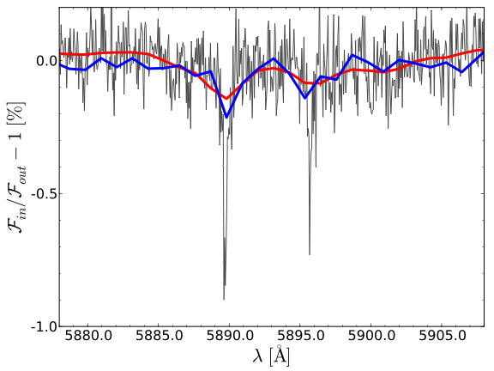
Transit spectroscopy
at high spectral resolution
HST/STIS (R~5,500)
Huitson et al. (2012)
HARPS (R~115,000)
Wyttenbach et al. (2015)
HD 189733b
HST/STIS: 56 km/s
HARPS: 2.7 km/s
Figure: A. Wyttenbach

Slide 27
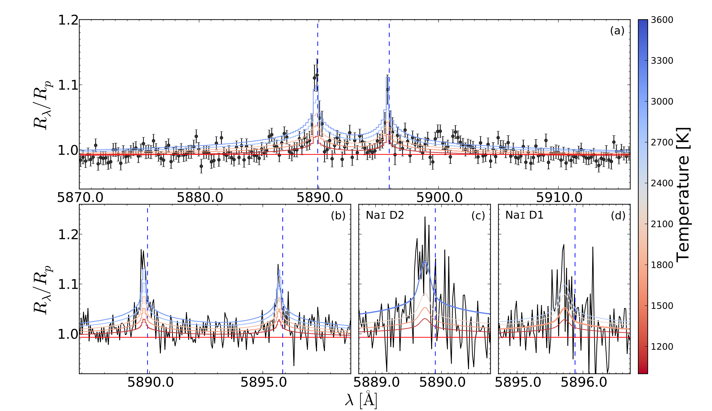
Transit spectroscopy
Hot winds blowing from the day side of HD 189733b
Wyttenbach et al. (2015)
3270±330 K
2600±600 K

Slide 28
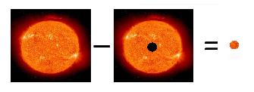
The Rossiter-McLaughlin effect reloaded
Cegla, Lovis, Bourrier, et al. 2016
Transiting planet as a probe of the occulted stellar spectrum
New technique: combine mean line profiles from spectroscopy (CCFs) with broadband transit light curve (for proper normalization)
The CCF of the occulted stellar surface is directly obtained
Dravins et al. 2015

Slide 29
Measurement of the occulted stellar radial velocity
Cegla et al. 2016

Slide 30
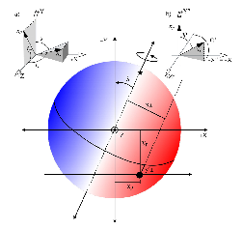
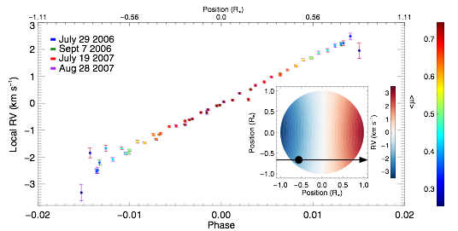
Measurement of the occulted stellar radial velocity
Cegla et al. 2016

Slide 31
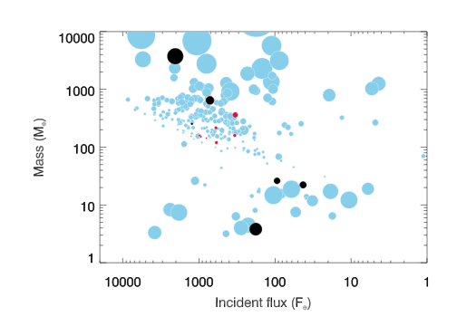



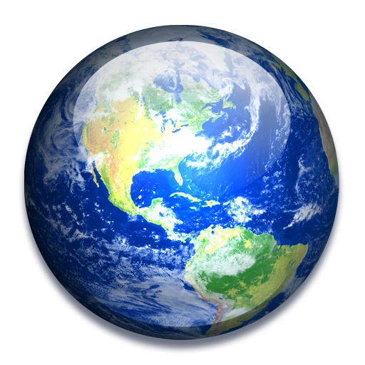
Targets
♥︎ 9 targets, 18 nights, 2015⇢
♠︎ 6 targets, 8 nights, 2015–16
high density
XO-3b
low density
HD 189733b
WASP-49b
Figure: D. Ehrenreich

Slide 32
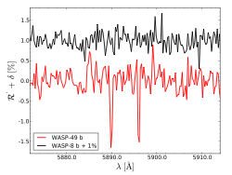
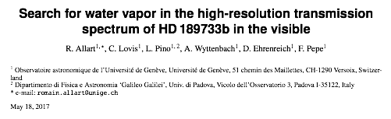


New atmospheric surveys
WASP-49b
☞ new detection
WASP-8b
☞ control experiment
Wyttenbach et al. 2017, A&A

Slide 33

Known exoplanets in reflected light
Proxima b: a temperate, Earth-mass planet at 37 mas from our nearest stellar neighbour, at an estimated contrast of ~10⁻⁷

Slide 34


Characterising Proxima b (and others) with SPHERE+ESPRESSO
Lovis et al., 2017, A&A
Fiber coupling efficiency for the planet: ~38% / Stellar light rejection factor: ~500
Good, but probably not yet good enough!
Need to reach higher efficiency and K~3000
--> SPHERE upgrade, or SPHERE+

Slide 35

Search for O₂ absorption in the albedo spectrum
Lovis et al., submitted to A&A
Given SPHERE+ and an Earth-like atmosphere, a 3.6-sigma detection is possible in about 60 nights with the VLT

