Slide 1
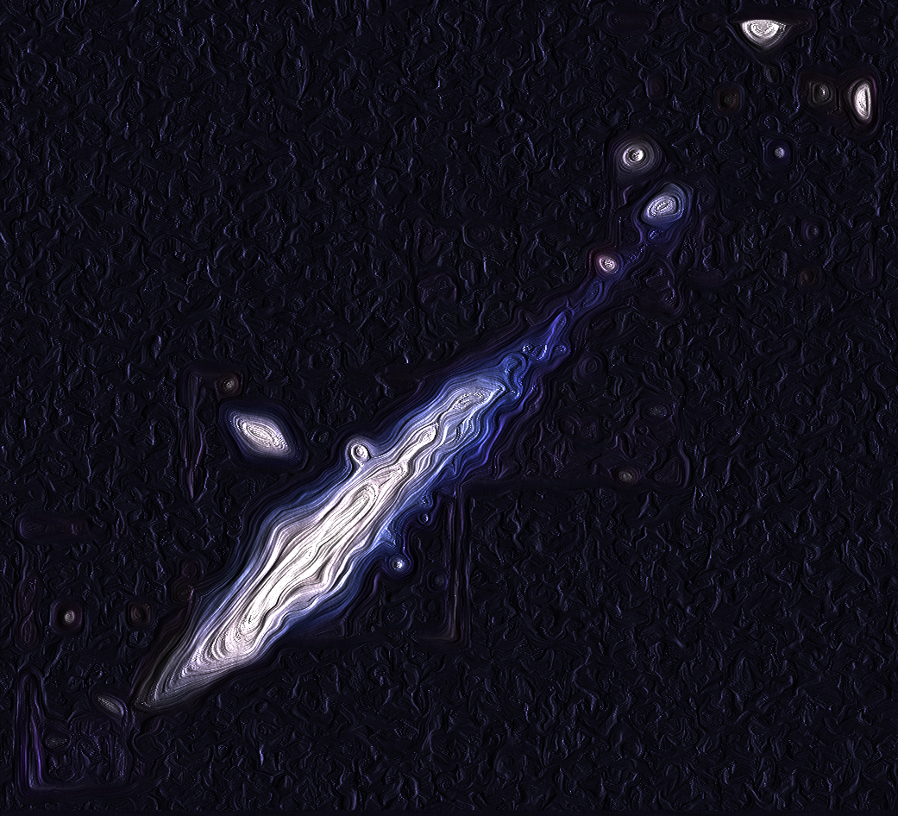
tomography of ugc 6697
Guido Consolandi
Università degli Studi di Milano-Bicocca
In collaboration with:
G. Gavazzi Università degli Studi di Milano-Bicocca M. Fossati MPE M.Fumagalli Durham University A. Boselli Laboratoire d’Astrophysique de Marseille M.Yagi National Astronomical Observatory of Japan M. Yoshida Subaru Telescope, NAOJ
EWASS, Prague 29th-30th June 2017

Slide 2
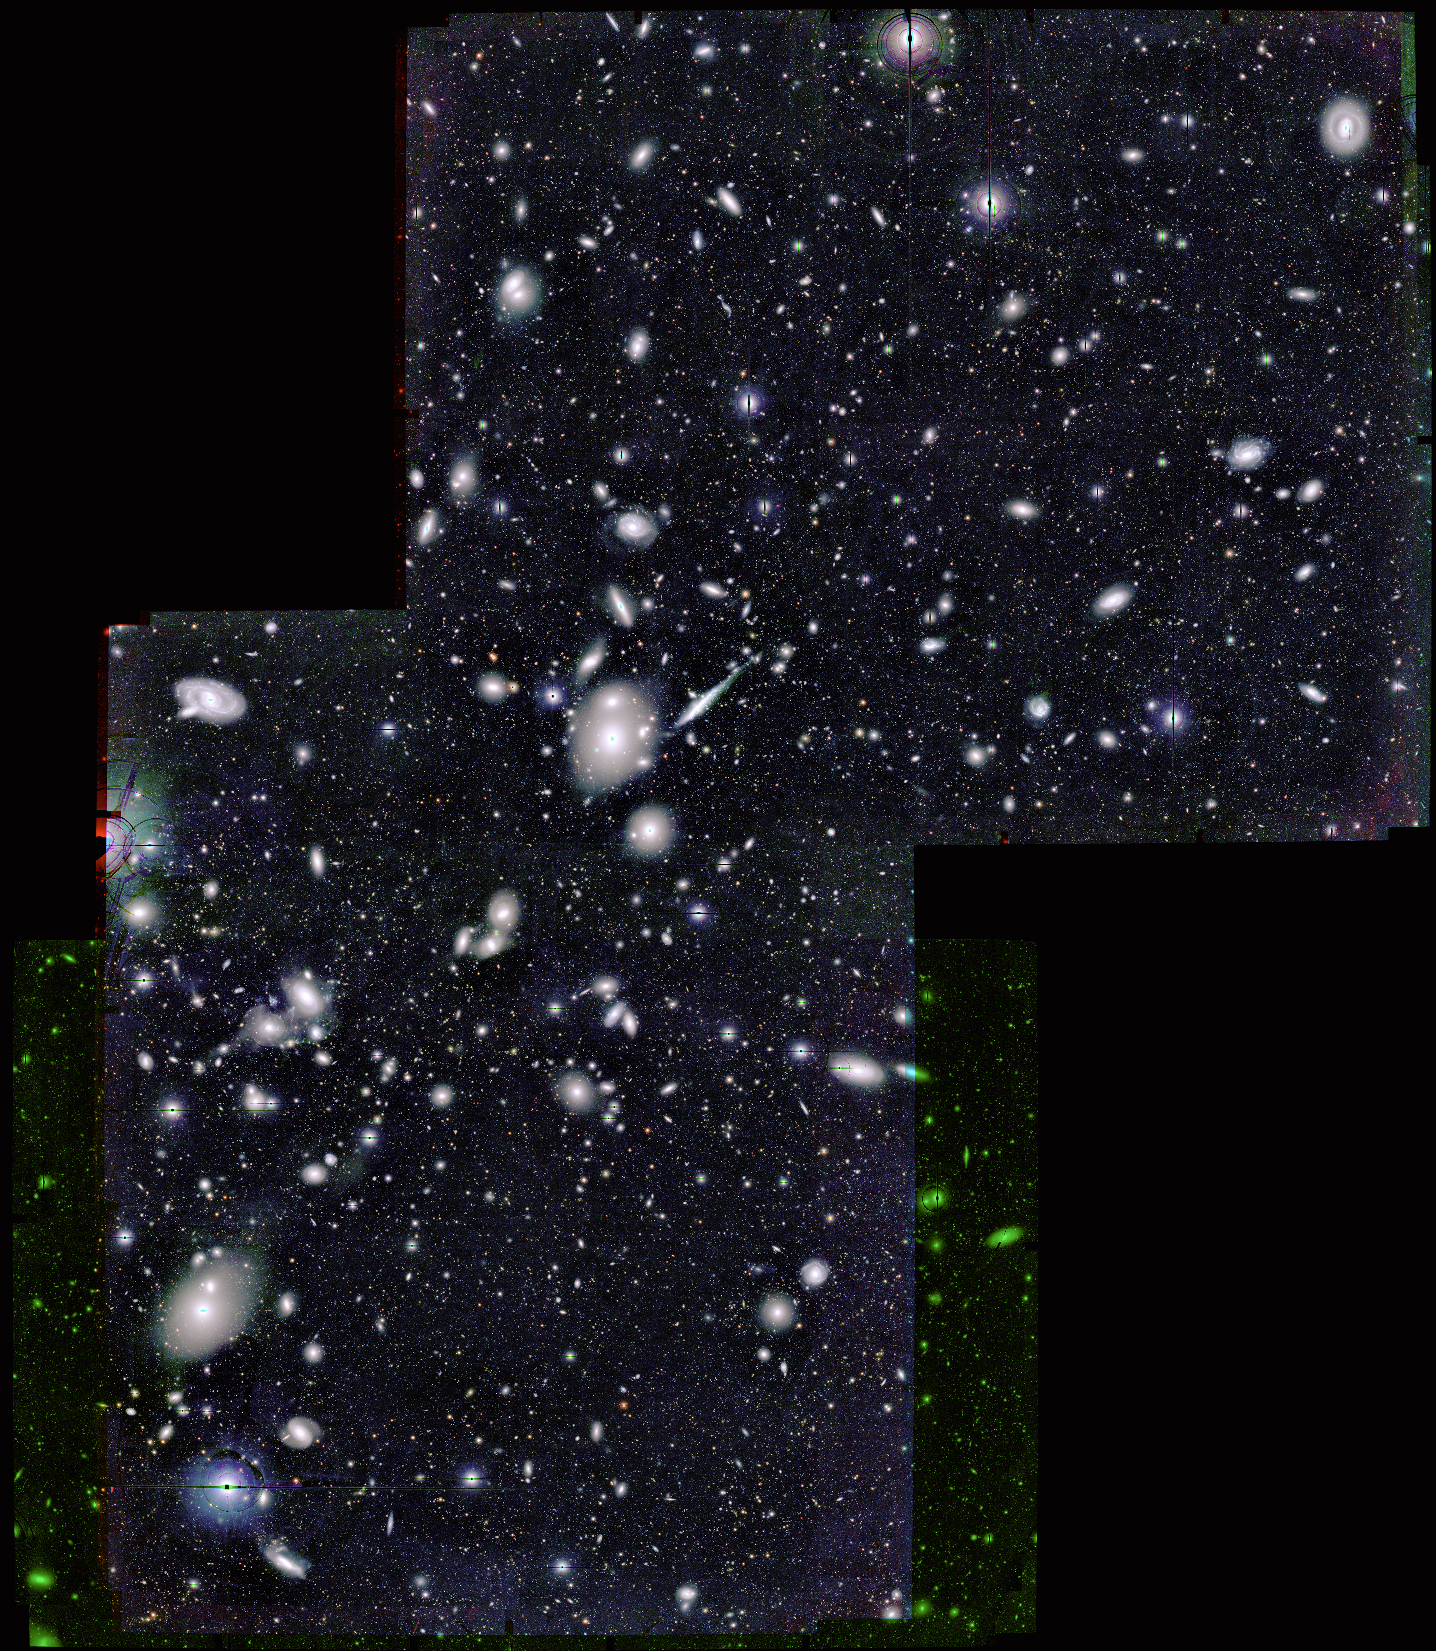
MUSE sneaks a peek at extreme ram pressure events in A1367
UGC 6697+CGCG 97-087N
CGCG 97-079
BIG
CGCG 97-073
cz(A1367)~6596 km/s

Slide 3
MUSE sneaks a peek at extreme ram pressure events in A1367
UGC 6697+CGCG 97-087N
CGCG 97-079
BIG
CGCG 97-073
cz(A1367)~6596 km/s

Slide 4
Observed in February 2016 as part of the proposal 098.B-0019 (PI G. Gavazzi)

Slide 5
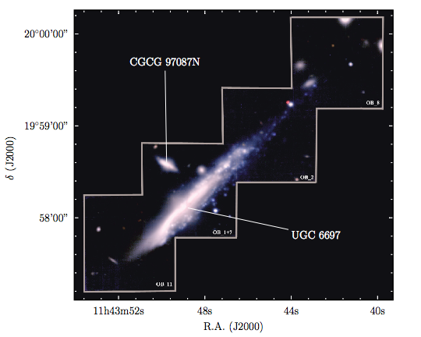
UGC 6697
log(M*)~9. M⦿
cz~7542 km/s
log(M*)~10. M⦿
cz~6735 km/s

Slide 6
log(M*)~9. M⦿
cz~7542 km/s
CGCG 97087N
filmino
UGC 6697
log(M*)~10. M⦿
cz~6735 km/s
cz(A1367)~6596 km/s

Slide 7
Stellar velocity

Slide 8
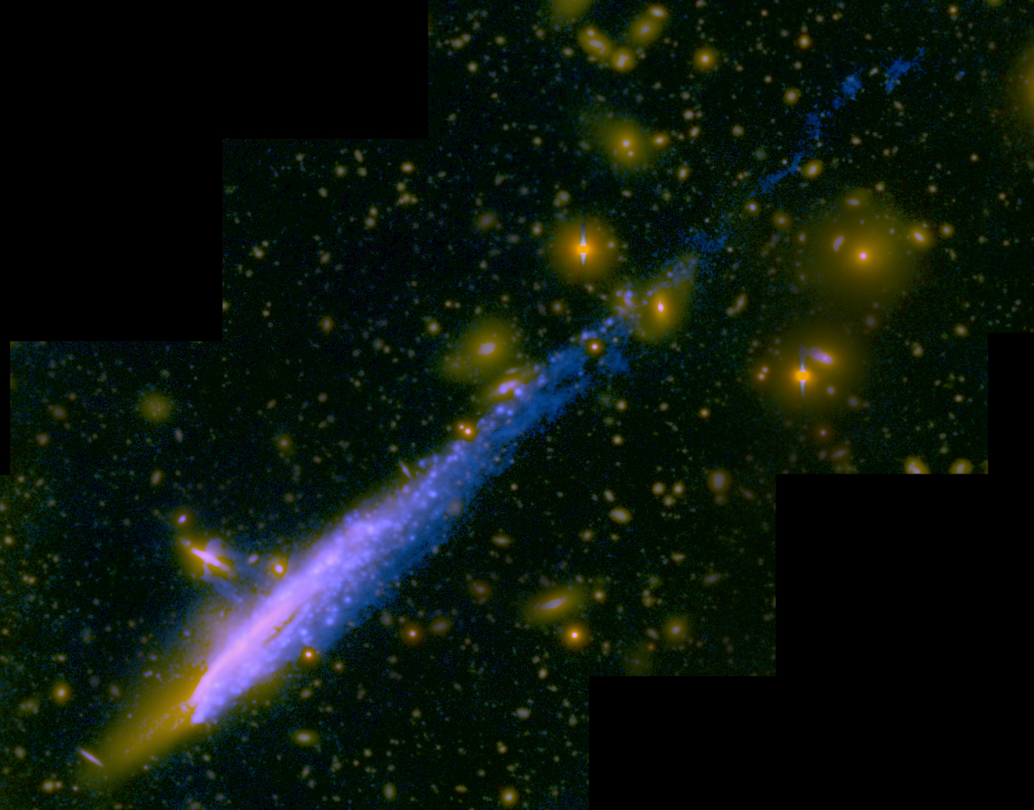
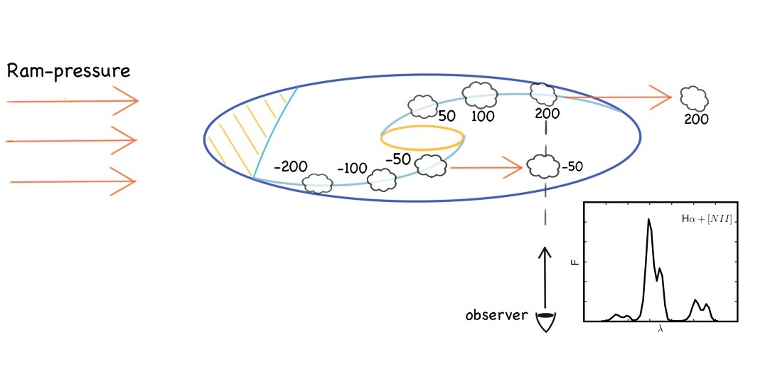

Slide 9
Gas velocity

Slide 10
Comparing pixel by pixel the velocity of each gas component to the stellar velocity we separate the emission of the stripped gas from the gas still bound to the galaxy
stripped
|∆v|>75 km/s
Onboard
|∆v|<75 km/s
quadratic sum of maximum stellar and gas velocity dispersion expected in normal disks at z~0

Slide 11
U6697 is losing
~10^9 solar masses of ionized gas
timescales of 10-100 Myr
typical σ at z=0 σ~35 km/s
(Wisnioski+15)
The gas harboring
star formation has low
velocity dispersions
Diffuse gas is turbulent consistently with other ram pressure stripped galaxies observed with MUSE, ESO 137-001 (Fumagalli+14; Fossati+16) and galaxies of the GASP survey (Poggianti+17)

Slide 12
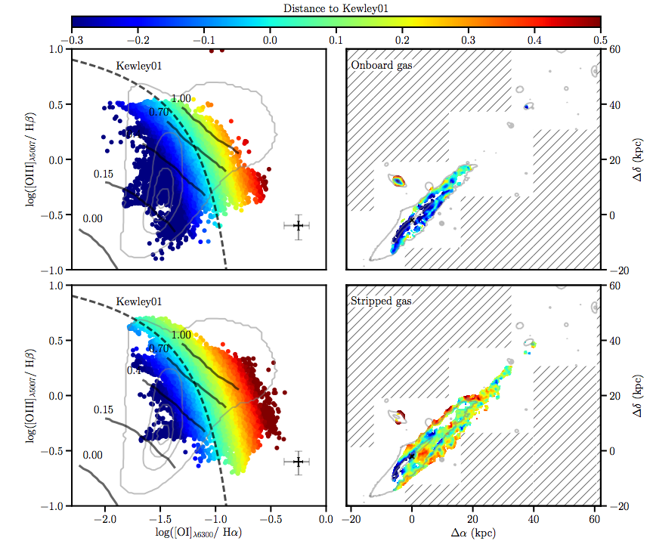
The diffuse, stripped gas is shocked

Slide 13
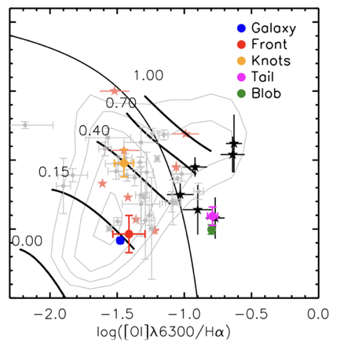
Fossati et al (2016)
The diffuse, stripped gas is shocked

Slide 14
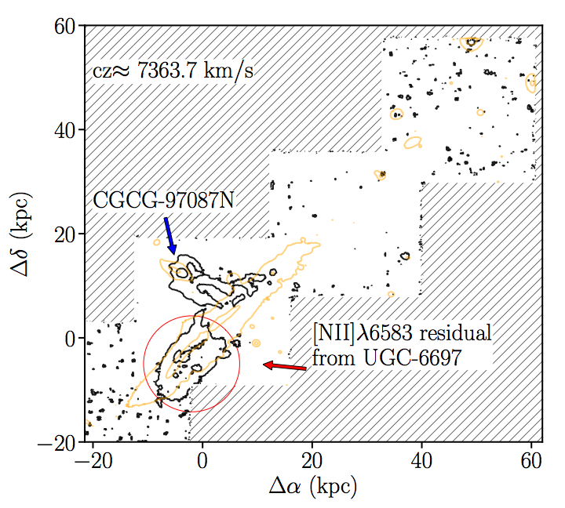
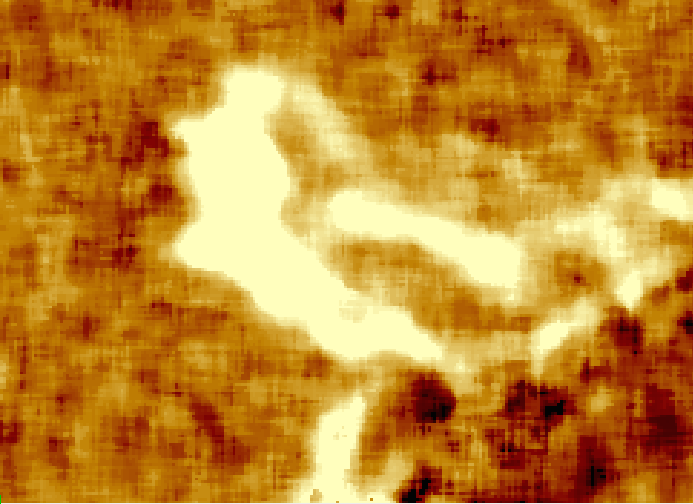
97-087N A POSSIBLE ENCOUNTER?
[NII] and continuum subtracted image

Slide 15
97-087N A POSSIBLE ENCOUNTER?

Slide 16
Summarizing…
ram-pressure appears efficient even at high mass (see also NGC 4569,GASP), with an edge-on impact configuration (UGC 6697) and in clusters with intermediate masses (A1367; but also Virgo)
The gas stripped is turbulent and heated by shocks. However, where the gas
retains low velocity dispersions, it can form stars.
UGC 6697 hydrodynamical interacted with its companion possibly helping the stripping process
THANK YOU FOR YOUR ATTENTION!

