Slide 1
Star-forming GRB host galaxies
Lise Christensen
Dark Cosmology Centre
Niels Bohr Institute
University of Copenhagen
A multi-messenger look at the origin of GRBs
EWASS 2017, Prague, June 26
Notes:
focus on long GRB - surely SF galaxies

Slide 2
GRB hosts as tools
Constrain GRB progenitor nature: Age, Mass, Metallicity
Trace star-formation activity with redshift
Unbiased probes of star-forming galaxies?
Trace galaxies that are responsible for re-ionization?
Need to understand selections and biases
Notes:
GRBs selected independently on the galaxy properties (luminosity) – contrary to field galaxies.

Slide 3
GRB hosts – historical perspective
GRB hosts:
Emission lines (e.g. Bloom+1998) -> star-forming galaxies
No direct image of progenitor (cosmological distance)
GRBs found in:
Low luminosity galaxies (= low mass) (Savaglio+2009)
Blue galaxies (Lefloc’h +2003)
No preference for Lya emitters (Milvang-Jensen+2012)
Young galaxies: WR features (Han+2010), high SFR/M* (Christensen+04;Savaglio+09)
Pre-ALMA: No preference for sub-mm galaxies /dusty (Berger+2003; Tanvir+2004)
Dark GRBs: 20% are optically obscured (Fynbo+2009; Greiner+2011)
Host metallicities:
Collapsar progenitors suggest a metallicity threshold (e.g. Yoon+2006)
Metal poor hosts? – Lya fraction high (Fynbo+2003)
– low metallicity (O/H) (Stanek+2006; Levesque+2010)
Unbiased GRB selections needed
Notes:
Location : / sometimes in spiral arms
Associated with SN!

Slide 4
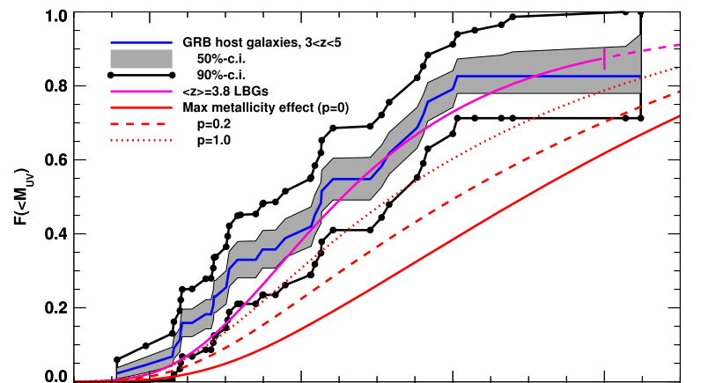
GRB hosts – tracers of star-formation?
Luminosity functions (M₁₆₀₀ ~ UV star-formation)
Swift/BAT6 z < 1 lower SFRs (Japelj+2016) +EWASS talk by Jesse Palmerio
SHOALS: Hosts at z < 2.5 fainter than field galaxies at 3.6um (Perley+2016)+EWASS talk
TOUGH: Hosts at 1 < z < 3 probe faint end (Schulze+2015)
GROND: Hosts at 3 < z < 5 follow field population (Greiner+2015; also Chen+2009)
5 > z > 9.5 fainter than L* (Tanvir+2012; McGuire+2016)
Greiner+2015
Notes:
Complete selection also include dark bursts = > come from more massive galaxies
Three L<L* hosts detected at z~6 (McGuire+2016)

Slide 5
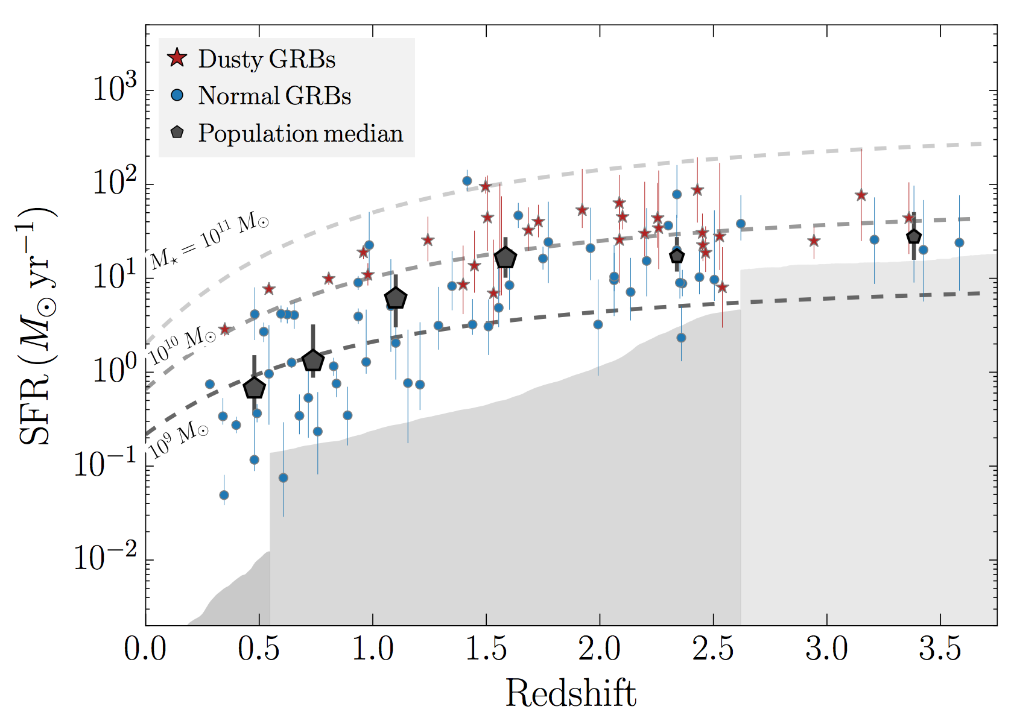
GRB host – star-formation rates
Occupy same region as main sequences for star-forming galaxies
Lack of high-SFR, high-M* hosts (Perley+2013; 2016; Japelj+2016)
Radio: No hidden SF (Michalowski+2012)
Krühler+2015
Notes:
Dashed lines = different SFR for main sequence galaxies

Slide 6
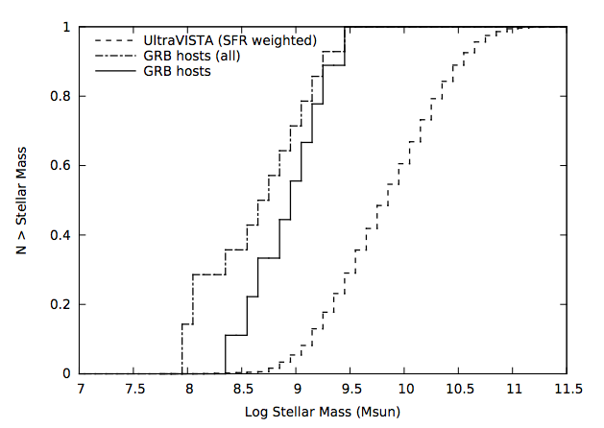
GRB hosts – total stellar masses
Swift/BAT6 : at z < 1 Lower M* than field galaxies (no M*>10¹⁰)
(Vergani+2015; Japelj+2016)
SHOALS : no massive hosts at z < 1 (Perley+2013;2016)
GRB hosts ~1 order of magnitude less massive
galaxies at z<1
Notes:
Swift/Bat6 sample size : 14 hosts at z < 1.

Slide 7
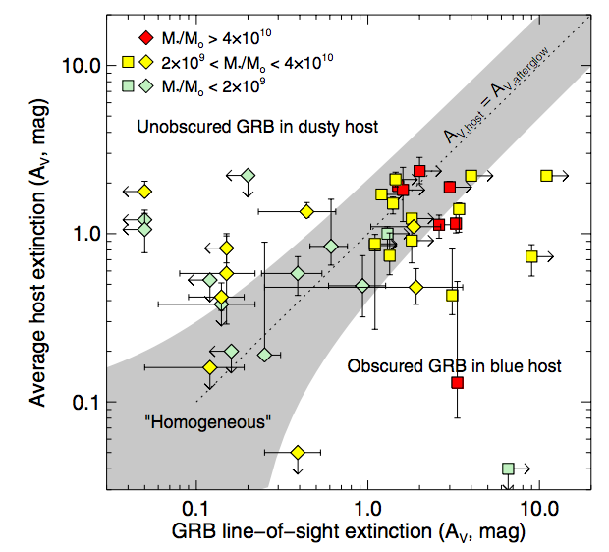
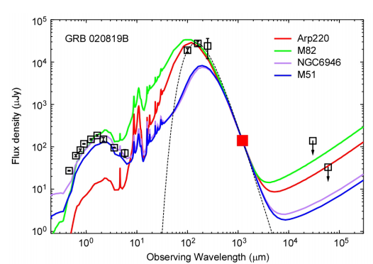
Dark GRB hosts
Reddened afterglows but hosts not dusty (SED fits)
A_{V} >3 is needed but never seen.
(Gorosabel+2003; Krühler+2011; Perley+2013 )
In more massive hosts (some ULIRGS)
(Perley+2013; 2016)
Normal gas/dust ratios: Not very dusty hosts
ALMA mm continuum for 2 hosts
(Hatsukade+2014) (also Tanvir+2004)
+ radio observations (Michalowski+2012)
poster by David Corre
Notes:
Perley: dark hosts more diverse than previous biased samples
Dust is heterogeneously distributed

Slide 8
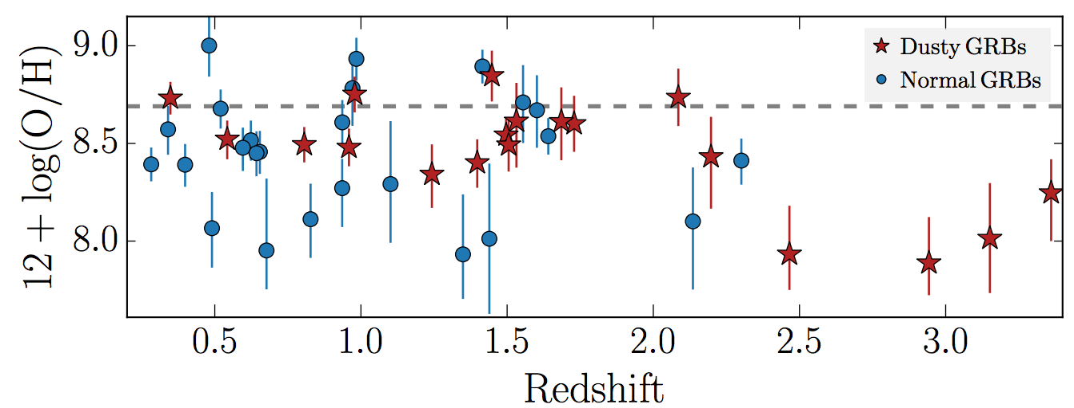
GRB hosts – metallicity threshold?
Metal aversion: cutoff at 40-50% solar metallicity (Graham+2013; 2017; Modjaz+2008)
Swift/BAT6 @ z<1 : <50% solar metallicity (Japlj+2016; Vergani +2017)
Some metal rich galaxies
96 GRB host galaxies : 16 % above solar metallicity (Krühler+2015; also Japelj+2016)
Notes:
Several single obj papers reporting super solar metallcities for hosts

Slide 9
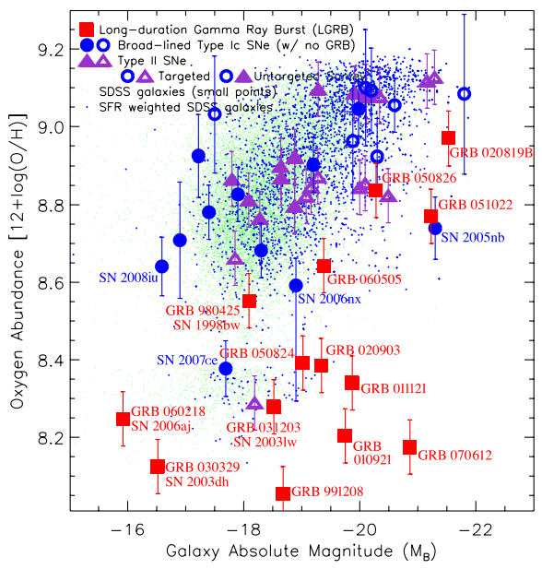
GRB host metallicities/ SN hosts
GRB hosts have systematically
lower metallicities than SN hosts
(Modjaz+2008; Graham+2013)
Type Ic hosts more metal poor
(Kelly+2014)

Slide 10
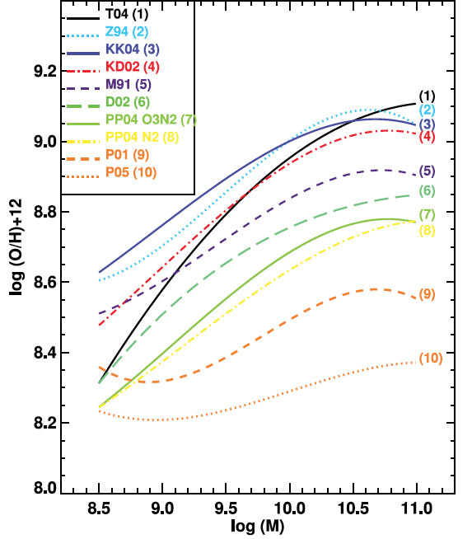
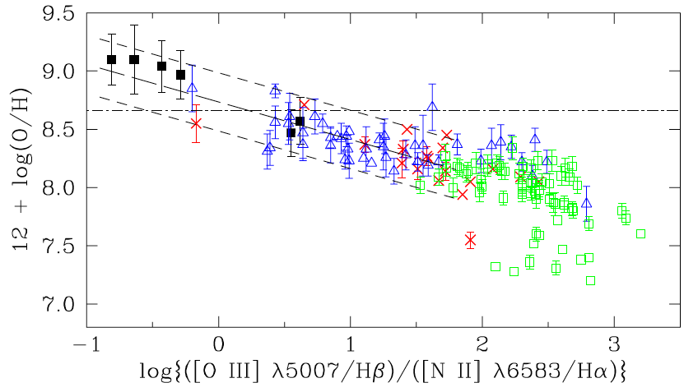
Metals in emission - diagnostics
Dispersions for a single emission line diagnostics 0.16 – 0.2 dex (Pettini+2004)
Variations of metallicity diagnostics up to 0.8 dex (Kewley & Ellison 2008)
Common diagnostics N2= f([NII])/f(Ha) saturates at solar metallicities (Pettini+2004)
Depends on ionisation parameter (Kewley+2013)

Slide 11
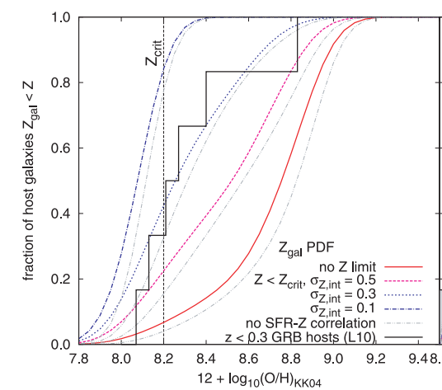
Metals in emission
GRB hosts have intrinsic
Metallicity dispersions
Observed metallicity may be larger than for the GRB
(Niino 2011)
Notes:
Assume a GRB metallicity of 8.2,
Model hosts with intrinsic metal dispersions (sigma_int = 0.1-0.3)

Slide 12
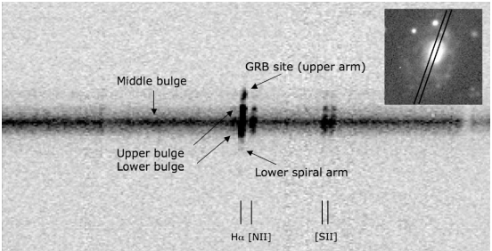
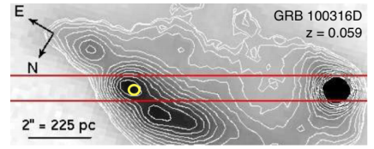
Metals in emission – resolved (slits)
Variations of metallicities across the host?
GRB 060505 host @ z=0.089
0.1 dex lower metallicity at GRB site
(Thöne +2008)
GRB 100316D: lowest metallicity in
GRB region (Levesque+2011)
Talk by Christina Thöne on Tuesday
Notes:
Spatial resolution is an issue : only possible at low-z
All low-z GRBs with resolved hosts belong to sub-luminous GRBs. Not representative

Slide 13
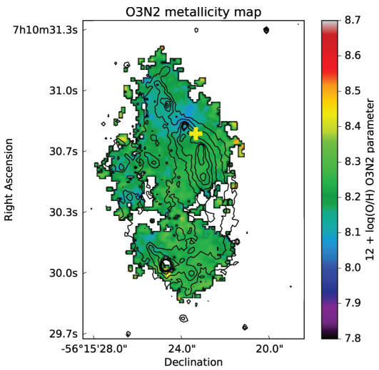
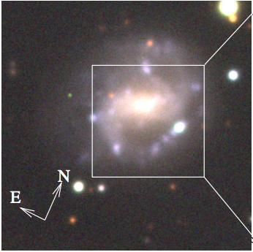
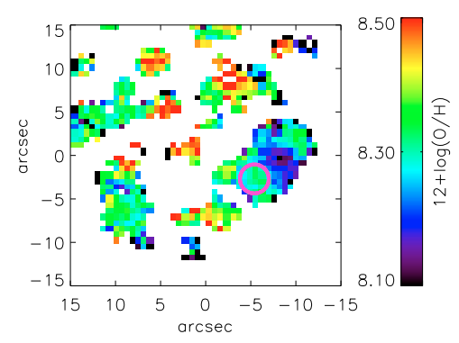
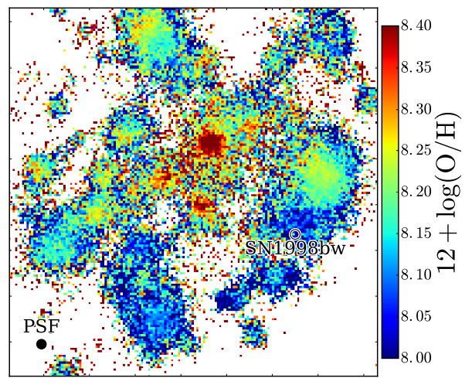
Metals in emission – resolved (IFU)
What is the metallicity dispersion?
GRB 980425: σ(12+log(O/H)) = 0.1 dex
VIMOS (Christensen+2008)
MUSE: metallicity variations of 0.4 dex
σ(12+log(O/H)) = 0.09 dex
(Krühler+2017)
GRB 100316D (w. MUSE)
σ(12+log(O/H)) = 0.04 dex
(Izzo+2017) (poster by Luca Izzo)
Notes:
Kruhler : metal gradient of -0.06dex/kpc
Izzo ( only 9 distinct HII regions) (23 in Christensen)

Slide 14
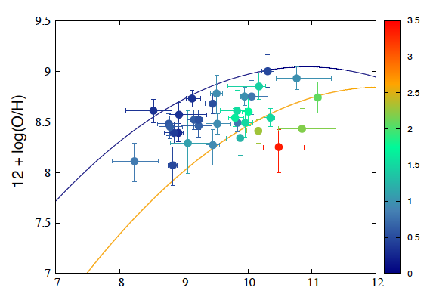
Host metals in emission
GRB hosts lie below the mass-metallicity relation (MZ) for their redshift (Arabsalmani+2017)
Hosts at z<1 follow MZ (Levesque+2010)
BAT6: Follow MZ relation (Japejl+2016) (also Savalio+2009)
Notes:
Levesque 2010: offset by -0.48 dex at z=0.3-1.0. BIASED sample.!

Slide 15
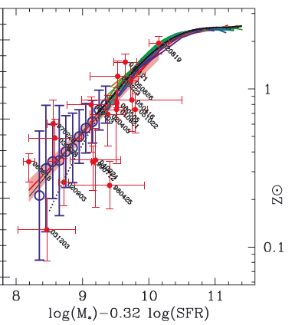
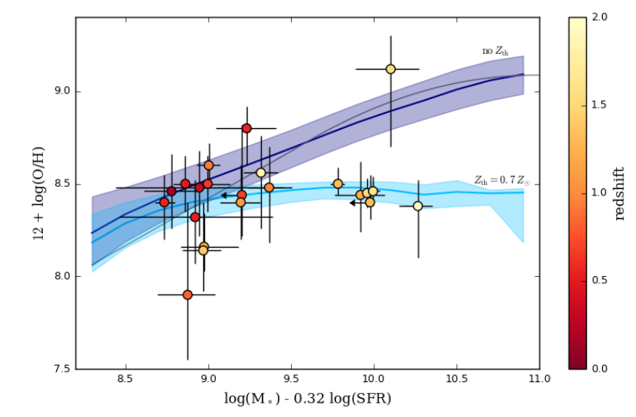
Host metals in emission
GRB hosts do not follow FMR at log M*>9.5
Threshold metallicity at < 0.5 – 0.7 Z
(Vergani+2017)
SFR is a secondary parameter in the MZ relation fundamental metallicity relation (FMR)
Independent on redshift
GRB hosts follow FMR (Mannucci+2011)
with increased scatter (Japelj+2016)
Notes:
Vergani uses KK04 R_23 lower branch. IS that OK FOR M*> 10.???
Differences between panels due to different diagnostics used.
Secondly the FMR is widely debated for field galaxies!

Slide 16
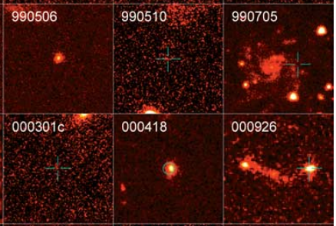
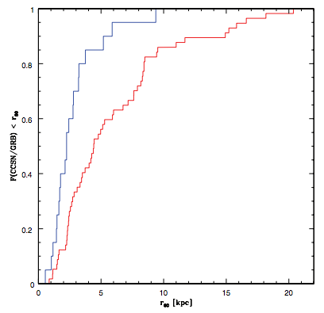
Location within GRB host
GRB location follow host light distribution
(Bloom+2002; Fruchter+2006;
Svensson+2010; Lyman+2017)
More compact than core-collapse SN hosts
50% < 2 kpc (GRB) vs. < 4 kpc (SNe) (Kelly+2014)
P(< r)
SN host
GRB hosts
r₈₀ [ kpc]
Notes:
Offset from center not always meaningful

Slide 17
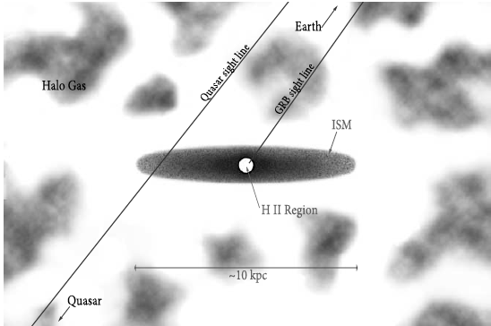
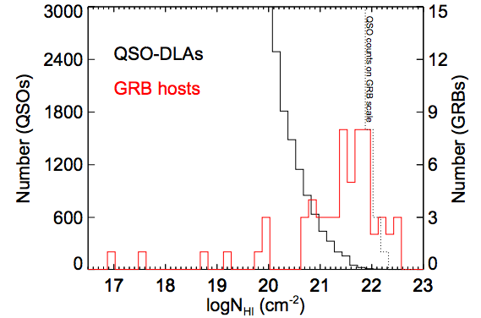
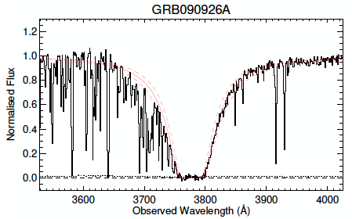
GRBs in absorption – DLA connection
Perley+2016
(also Jakobsson+2006; Selsing in prep)
Prochaska+2007;2008
See poster by Istvan Racz

Slide 18
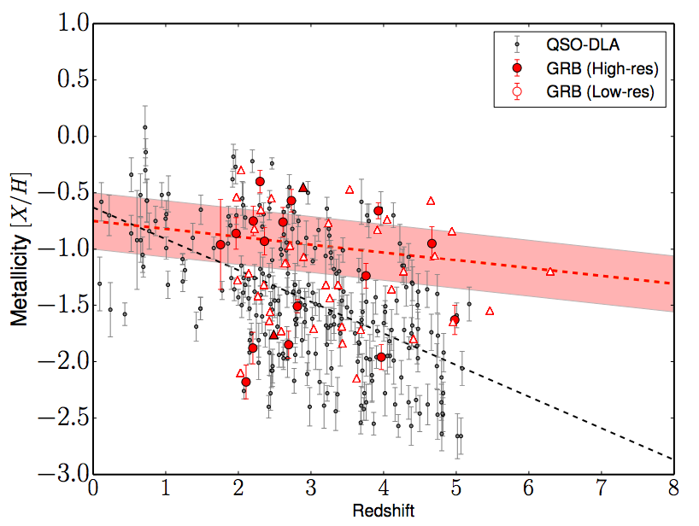
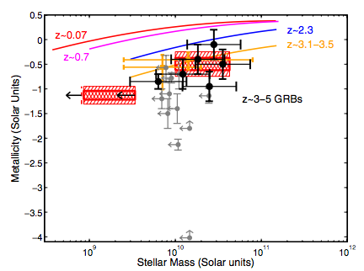
GRBs in absorption – metallicities
Cucchiara+2015 ( also Savaglio+2011;
Sparre+2014; Thöne+2013 )
GRBs lie below the Lyman-break galaxy MZ relation
Laskar+2011

Slide 19
GRB hosts - summary
GRB hosts:
Evidence for preferred low(er) metallicities, low M*, low SFRs at z<1
Not exclusively low-metallicities
Follow the field population SFRs (at low M*)
More unbiased tracers at z>2
Issues with measuring host metallicities:
Host metallicities higher than predicted by progenitor models (10% solar)
Insufficient spatial resolution: low-metallicity gas pockets?/ inflow of HI?
Uncertain emission metallicity diagnostics: high-redshift, high-ionization regions
Scaling relations between SFR – M* – O/H : other drivers than metallicity?
Notes:
WR stars fewer in low-metallicity environments. Binarity progenitor a way to mitigate low metallicity problem, so may magnetars

Slide 20
Extra slides

Slide 21
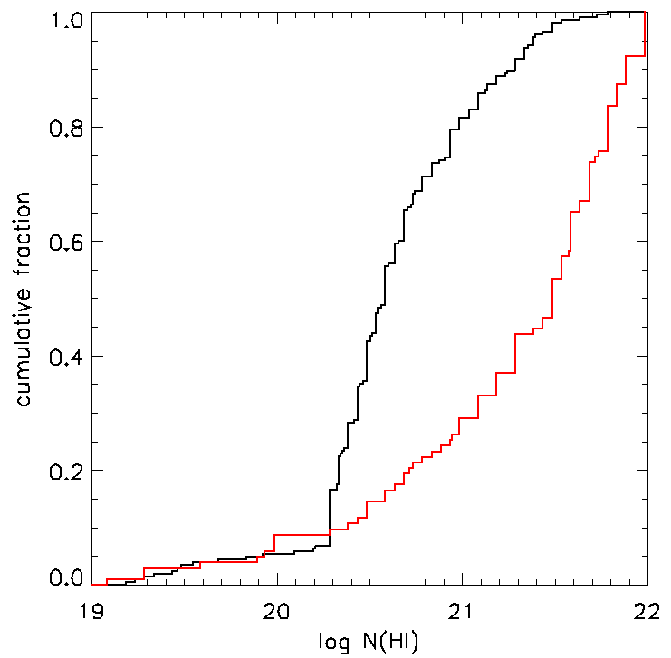
Escape fraction from GRB hosts
Re-ionisation expected from low-mass star-forming galaxies (need f_{esc} =10-20%)
<f_{esc}> ≈ 0.02 ± 0.02 (Chen+2007)
28 GRBs at z>2
<f_{esc}> ≈ 0.018 ± 0.017 (Christensen+2011)
Composite spectrum of 60 GRBs
<f_{esc}> ≈ 0.005 (Tanvir+2017, submitted)
133 GRBs at 1.6 <z<6.7
QSO – DLAs (Neeleman+13,
Jorgenson+13, Quiret+15)
GRB – DLAs
(Tanvir+2017 compilation)
Notes:
GRB hosts should be representative.

Slide 22
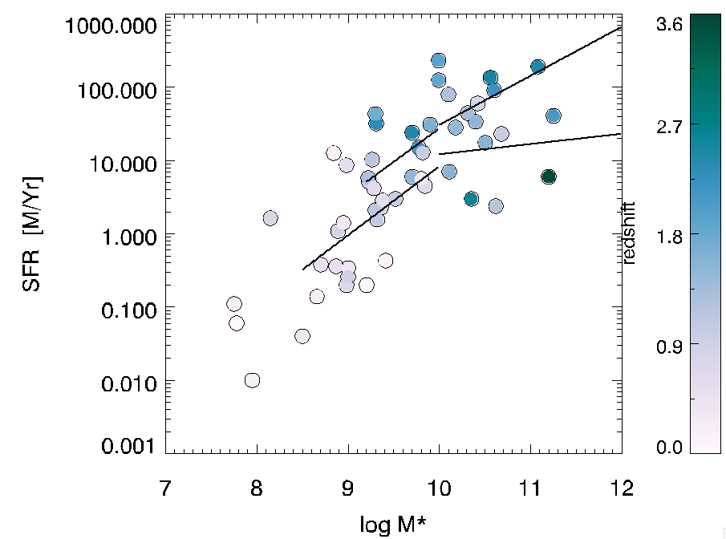
GRB host – star-formation rates
Occupy same region in main sequences for star-forming galaxies
Scatter of SFRs in field galaxy
population: ~0.2 dex
GRB hosts:
<z>=0.7: 0.6 dex
<z>=2.0: 0.7 dex
Lack of high-SFR, high-M* hosts (Perley+2013; 2016; Japelj+2016)
Radio: No hidden SF (Michalowski+2012)
z=2.3
z=0.7
Lines: main sequence for SF galaxies (whitaker+2014)
Notes:
Dashed lines = different SFR for main sequence galaxies. Break at low masses in field galaxies!
Lack of low-redshift galaxies in the high-mass end. Especially at z<1.5 (Perley)

Slide 23
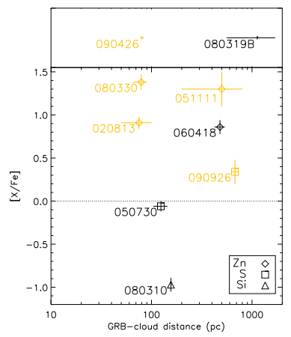
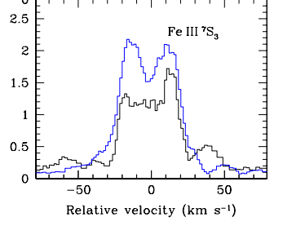
GRBs in absorption – distances
Variations in FeII* fine-structure transitions reflect UV pumping by the GRB
Probe the distance from GRB to the absorber
(Vreeswijk+2008;13 ; Prochaska+2008; D’Elia+2014)
Notes:
Not immediate environment – how representative is the metallicity?

Slide 24
Short GRB hosts
Associated with massive elliptical hosts (Castro-Tirado+2005; Berger+2005), but also star-forming hosts (Fox+2005)
Located up to z=2.609 (Antonelli+2009; Levesque+2010)
Sample of ~40 hosts (Berger+2014):
GRB redshifts measured mainly from hosts
Most at 0.3 < z < 1.3
Solar metallicity
SFRs, M* and SSFRs track field population -> no metallicity threshold
Host ages 10 Myr – 4 Gyr -> progenitor ages : some Gyr, but must have a more rapid progenitor channel too with a delay time distribution of P(tau)= tau^-0.8
Offset distributions: 5-7 KPC up to 100 kpc -> binary merger progenitor
Do not follow host light -> binary merger
Notes:
Not immediate environment – how representative is the metallicity?

