Slide 1
Dynamical properties of internal shocks revisited
Asaf Pe’er, Killian Long, Piergiorgio Casella
(UCC) (UCC) (INAF-Roma)
Astrophys. Journal, submitted
arXiv:1610.08712

Slide 2
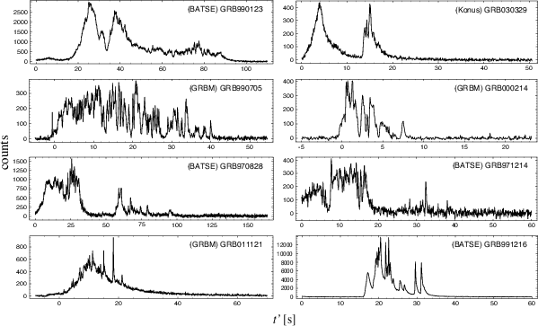
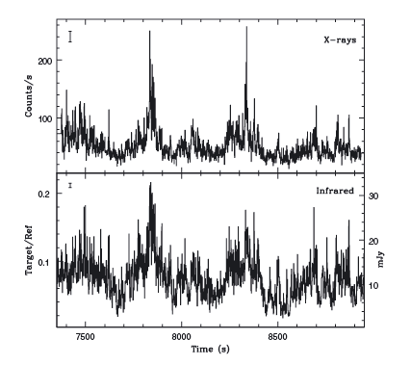
Motivation
How to explain -
Rapid variability in X-ray lightcurve in GRBs
X-ray lightcurve of the XRB GX 339-4
(BATSE, Swift, Fermi…)
(Casella+2010)

Slide 3
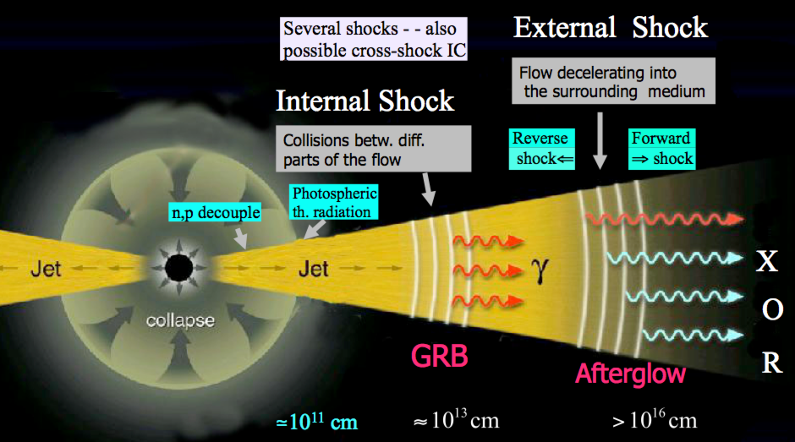
A leading idea: internal shocks
Rees & Meszaros 1994; Sari & Piran 1995, 1997; Kobayashi+1997; Daigne & Mochkovich 1998;
Meszaros 2000; ….. Figure from Meszaros & Rees 2014
Variability in the inner engine → ejection of separated plasma shells;
Fast shell catches slower shell ejected previously → Shock waves

Slide 4
A leading idea: internal shocks
Following the first collision,
the shells are no longer cold !!
Shell 2
(fast)
β₂ > β₁
Shell 1
(slow)
Contact
discontinuity
Reverse shock
Forward shock
At time t
Shells collide →
Shell 2
(fast)
shocked
Shell 2
shocked
Shell 1
Shell 1
(slow)

Slide 5
Thermodynamic properties
Reverse
shock
Contact
discontinuity
Forward
shock
4
3
2
1
Shell 2
(fast)
Shell 1
(slow)
shocked
Shell 2
shocked
Shell 1
Unknowns:
energy density e₄ e₃ e₂ e₁
number density n₄ n₃ n₂ n₁
pressure p₄ p₃ p₂ p₁
Velocity β₄ β_{rs} β₃ β₂ β_{fs} β₁
Total 18 unknowns
Knowns:
Shock jump conditions (x2): conservation particle, energy & momentum flux densities : 6
Contact discontinuity: p₂ = p₃ ; β₂ = β₃
Equations of state: p_{i} = (γ_{i}-1)(e_{i}-n_{i}), i=1..4 (γ_{i} = adiabatic index)
→ Need 6 boundary conditions (β₁, n₁, e₁, β₄, e₄, n₄ )
Total 12 Equations

Slide 6
Results (I): colliding shell’s velocities
Collision between cold plasmas: e₁ = e₄ = 0; n₄/n₁ = 100; Γ₁ = 1
Γ₃: L.F. of shocked plasma
(3) as seen from region (4)
Relativistic limit (Γ₄ >>1):
ω_{i} = e_{i} + p_{i} = enthalpy
Non. Rel. limit (β₄ <<1), cold:
Simple analytical expressions; L.F. depends on ratio of enthalpies

Slide 7
Results (II): minimum velocity for shock formation
Collision between hot plasmas: e₁/n₁ = 15, e₄/n₄ = 10; n₄/n₁ = 1; Γ₁ = 1
Γ₃: L.F. of shocked plasma
(3) as seen from region (4)
Relativistic limit (Γ₄ >>1):
ω_{i} = e_{i} + p_{i} = enthalpy
Lower limit on L.F. depends on ratio of enthalpies
Physical origin: impossibility of dissipating thermal energy from
hot plasma

Slide 8
Results (III): energy density, energy per particle
Collision between hot plasmas: e₁/n₁ = 15, e₄/n₄ = 10; n₄/n₁ = 1; Γ₁ = 1
1. Relativistic limit (Γ₄>>1):
Simple analytical expressions in relativistic limit

Slide 9
Results (IV): energy density, energy per particle
Collision between cold plasmas: e₁/n₁ = 1.0001, e₄/n₄ = 1.002; n₄/n₁ = 1/20
2. Non-relativistic limit (β₄<<1):
Discriminate between:
Hot: (e₁-n₁)/n₁ >> 1
Cool: β₂² << (e₁-n₁)/n₁ << 1
Cold: (e₁-n₁)/n₁ << β₂²
Simple analytical expressions in all limits.

Slide 10
Observational consequences: synchrotron
Reverse
shock
Contact
discontinuity
Forward
shock
4
3
2
1
Shell 2
(fast)
Shell 1
(slow)
shocked
Shell 2
shocked
Shell 1
Width = Δ₄
Width = Δ₁
Synch. Emission provides
direct information about
ratios of width, density,
enthalpies
(rel.)

Slide 11
Summary
Internal shocks are (still) a leading model for explaining the rapid variability seen in GRBs, XRBs, AGN flares.
Following the first collision, the shells are not cold.
We solved the general problem of arb. hot shells colliding at arb. speeds. We found simple analytical expressions in the relativistic and Newtonian cases, for “hot”, “cool” and “cold” regimes.
Observations of synchrotron emission can probe the properties of the shells → properties of the inner engine
Ap. J., submitted
arXiv:1610.08712

Slide 12
Adiabatic index
Numerical calculation
Exact numerical calculation at all regimes (Service, 1986)

Slide 13
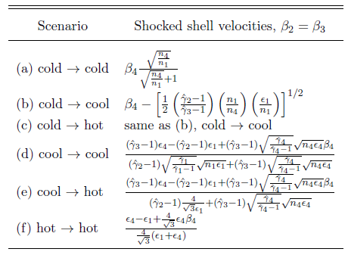
Non-relativistic Velocities

