Slide 1
Science with OCTOCAM Gemini’s future broad band imager and spectrograph
Antonio de Ugarte Postigo
(IAA-CSIC)

Slide 2
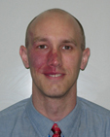
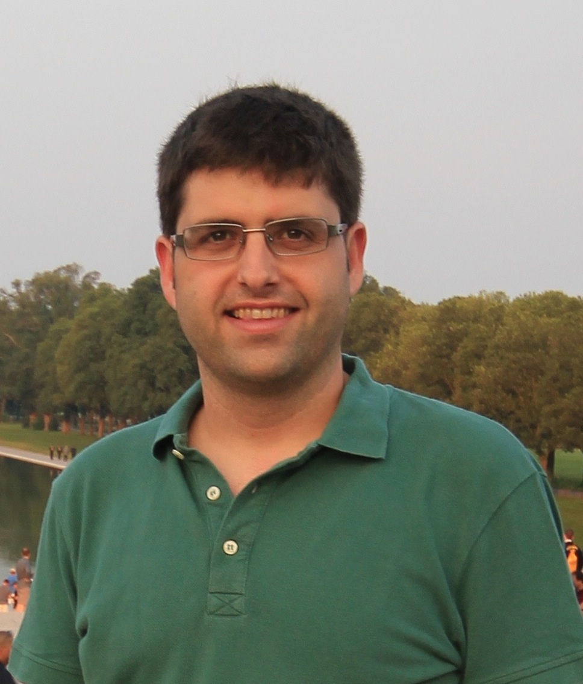
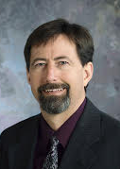
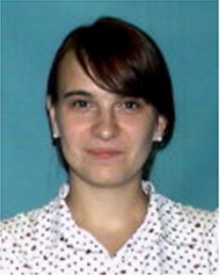
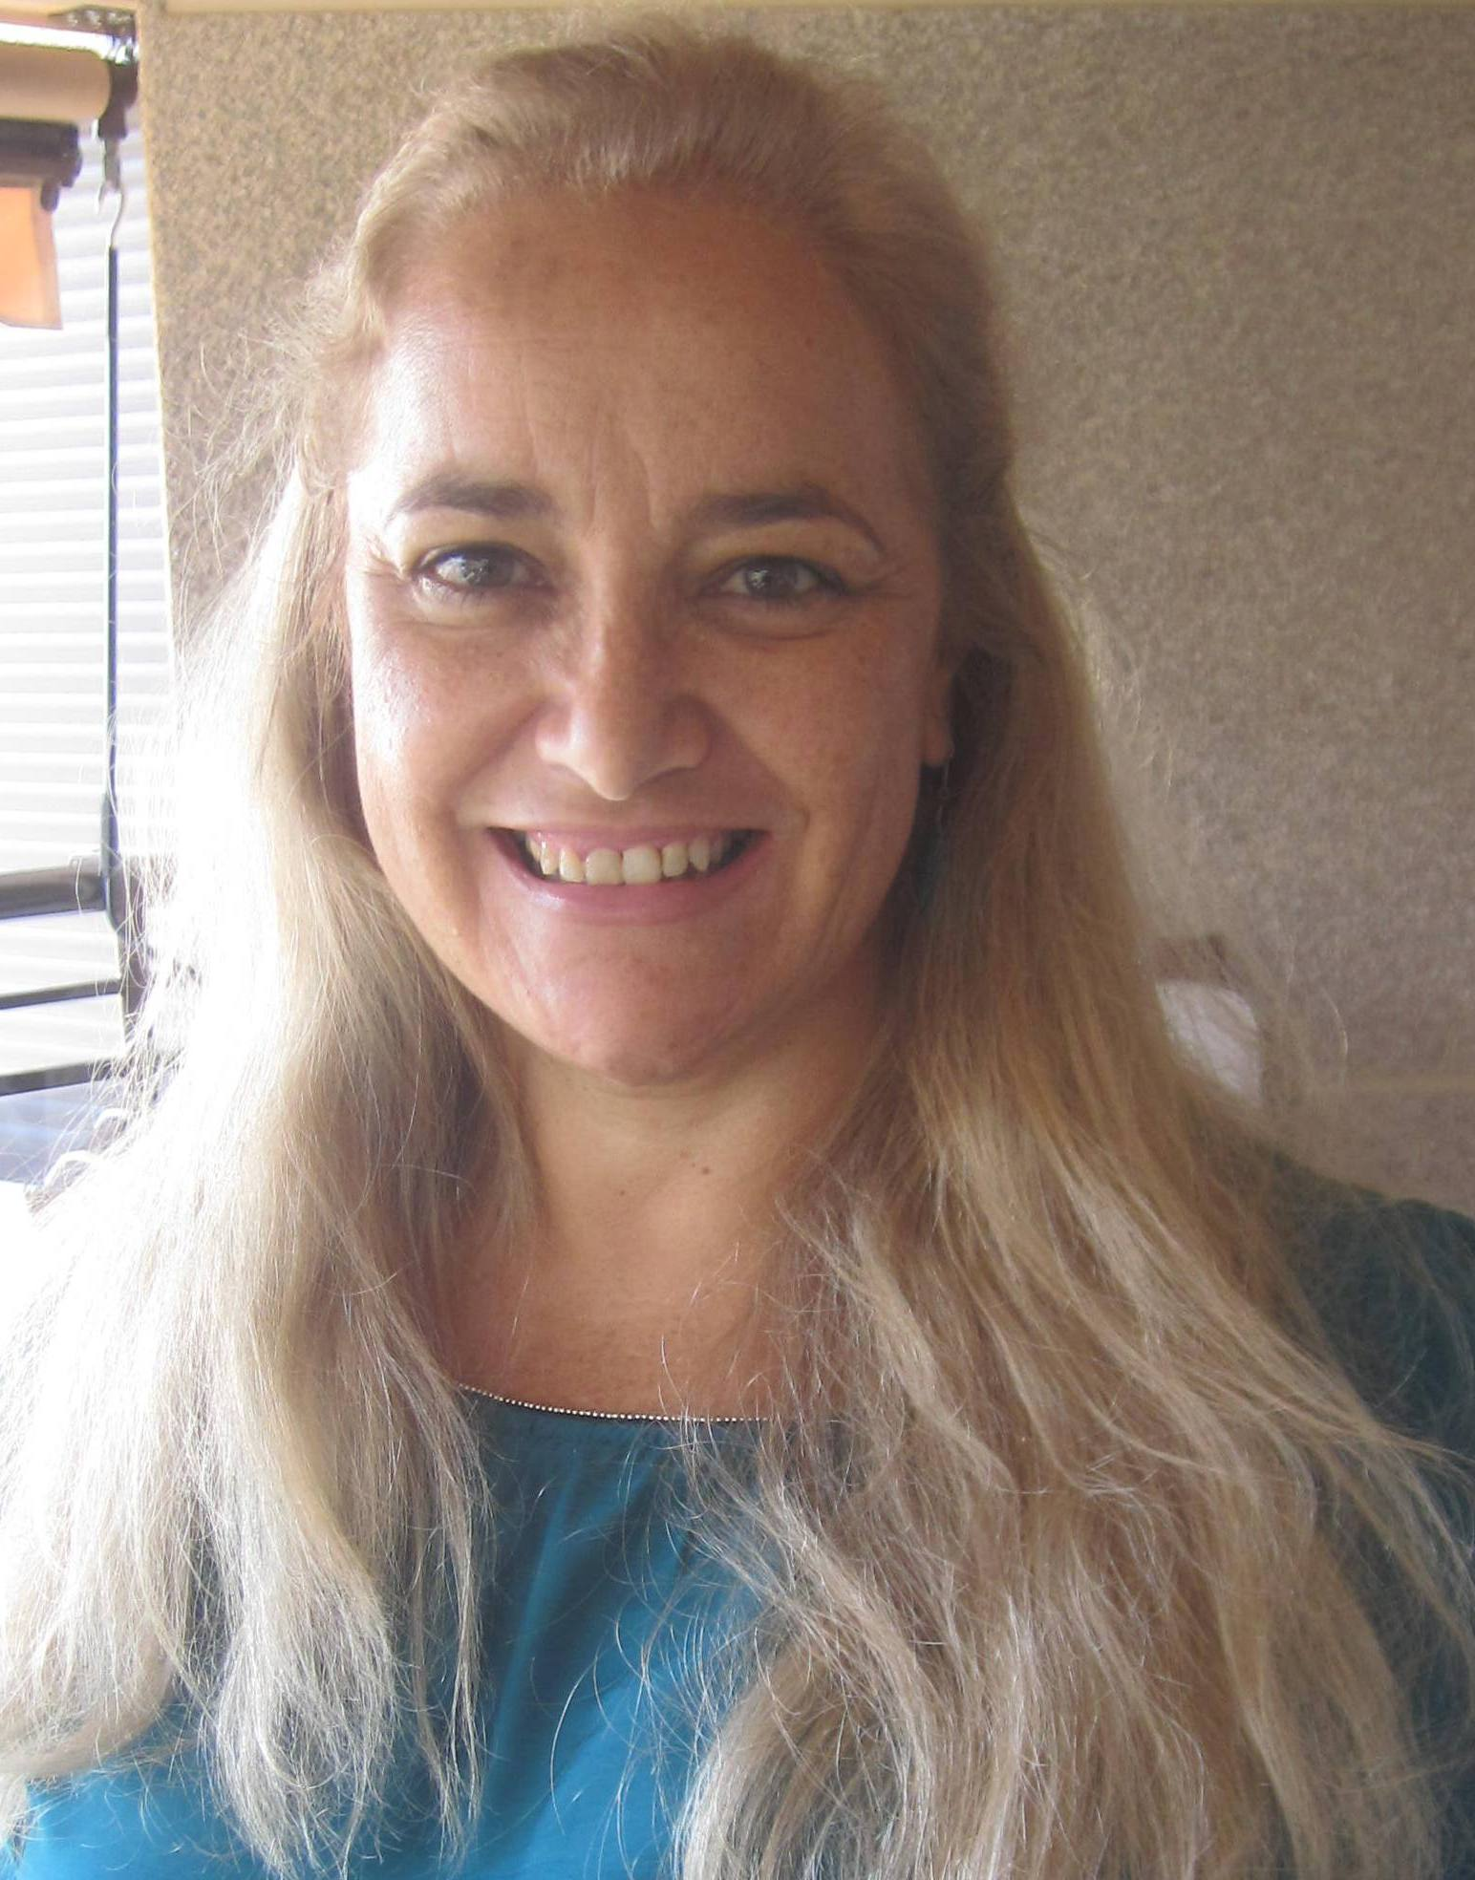
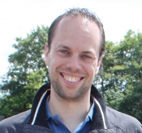
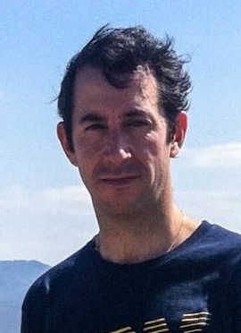
The OCTOCAM team
Science Advisory Committee
Álvaro Álvarez-Candal, Brazil
Rodolfo Angeloni, Chile
Stefano Bagnulo, UK
Franz Bauer, Chile
Amanda Bayless, USA
Melina Bersten, Argentina
Marcelo Borges Fernandes, Brazil
Tom Broadhurst, Spain
Nat Butler, USA
Brad Cenko, USA
Lydia Cidale, Argentina
Jesus Corral-Santana, Chile
Jean-Michel Desert, Netherlands
Vik Dhillon, UK
René Duffard, Spain
Robert Fesen, USA
Gastón Folatelli, Argentina
Jonathan Fortney, USA
Ori Fox, USA
Anna Frebel, USA
Lluís Galbany, Chile
Rafael Garrido Haba, Spain
Karl Glazebrook, Australia
Daryl Haggard, USA
Eric Hintz, USA
Julie Hlavacek-Larrondo, Canada
David Kaplan, USA
Oleg Kargaltsev, USA
Chryssa Kouveliotou, USA
Adam Kraus, USA
Michaela Kraus, Czech Republic
Ho-Gyu Lee, South Korea
Teo Muñoz-Darias, Spain
Jerome Orosz, USA
Thomas Pannuti, USA
Jennifer Patience, USA
Daniel Perley, USA
Noemí Pinilla-Alonso, USA
Brian Schmidt, Australia
Steve Schulze, Chile
Denise Stephens, USA
Nicole St- Louise, Canada
Rachel Street, USA
Juan Carlos Suárez, Spain
Nial Tanvir, UK
Ezequiel Treister, Chile
Sergio Torres Flores, Chile
Stefano Valenti, USA
Daniel Vanden Berk, USA
Sjoert van Velzen, USA
Stefanie Wachter, Germany
Pete Roming, PM US, coPI
Susan Pope, SE
Christina Thöne, PM Spain
Antonio de Ugarte Postigo PI
Marisa
Garcia Vargas
Ronnie Killough
Tonya Brody, DSE
Alexander van der Horst PS
Manuel Maldonado
Ernesto Sanchez-Blanco
Amanda Bayless
Kelly Smith
Kristian Persson

Slide 3
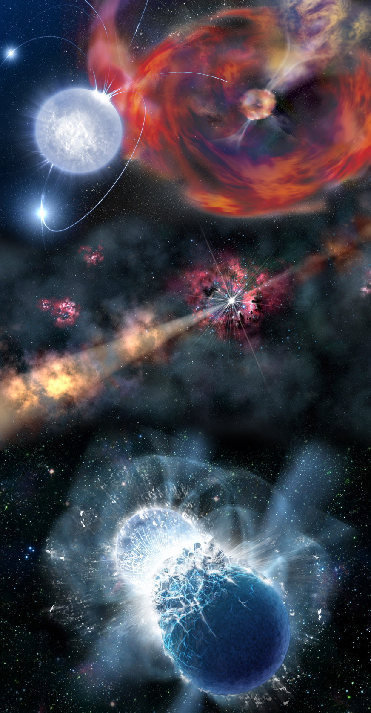
Science Drivers
Rapid characterization of transients (follow-up of LSST)
Physical understanding of extreme phenomena (gamma-ray bursts, supernovae, magnetars, X-ray binaries)
The origin of our solar system: comets, asteroids, transneptunian objects
Asteroseismology
The first generation of stars and their environments
The evolution of the Universe since the first galaxies

Slide 4
Science topics
Transients
Trans-Neptunian objects
Extrasolar planets
Asteroseismology & pulsating stars
Massive stars
Brown dwarfs
Low-mass binaries
Low metallicity stars
Isolated neutron stars
Magnetars
Interacting binaries
Millisecond pulsar binaries
X-ray binaries
Supernovae
Supernova remnants
Gamma-ray bursts
Active galactic nuclei
Tidal disruption events
Galaxy clusters

Slide 5
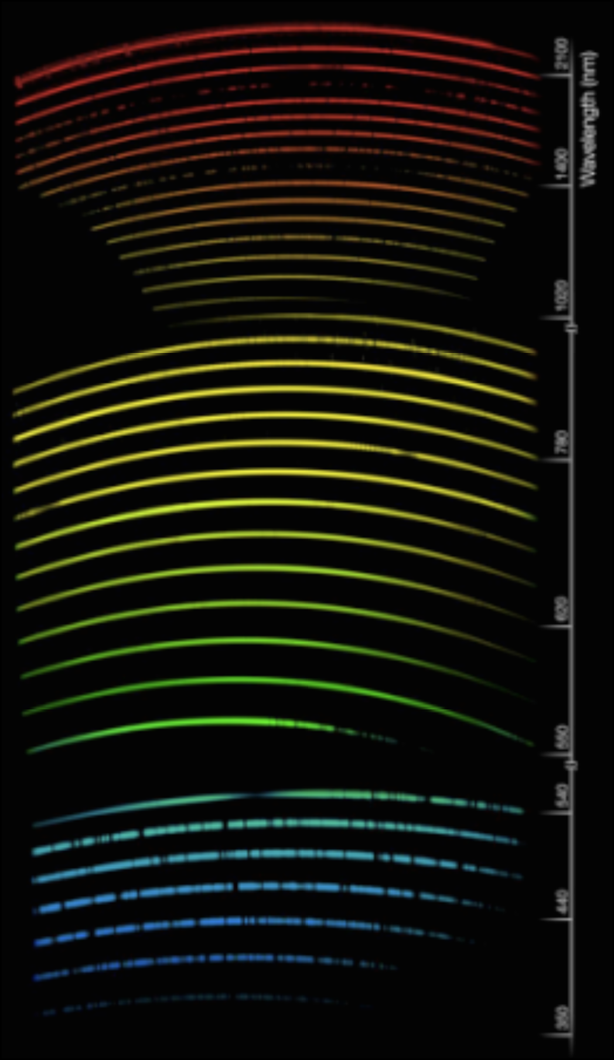
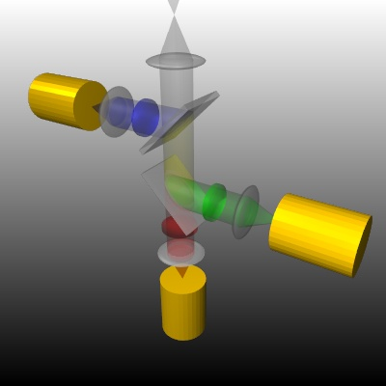
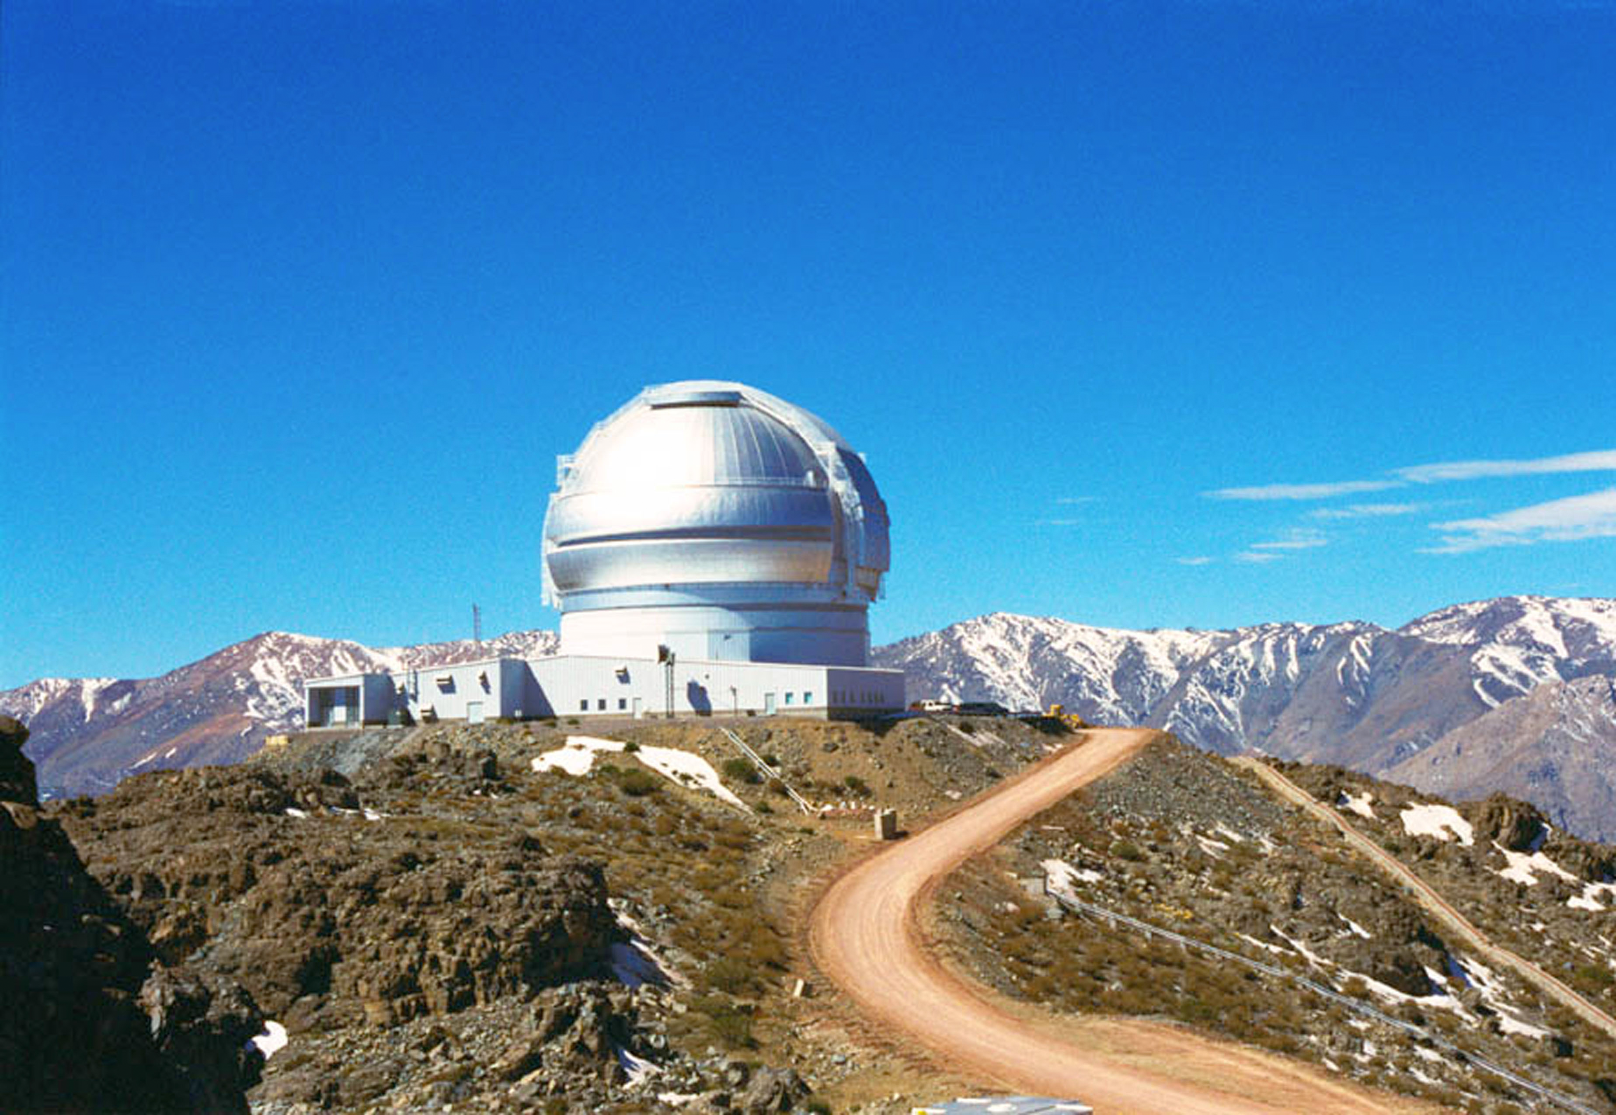
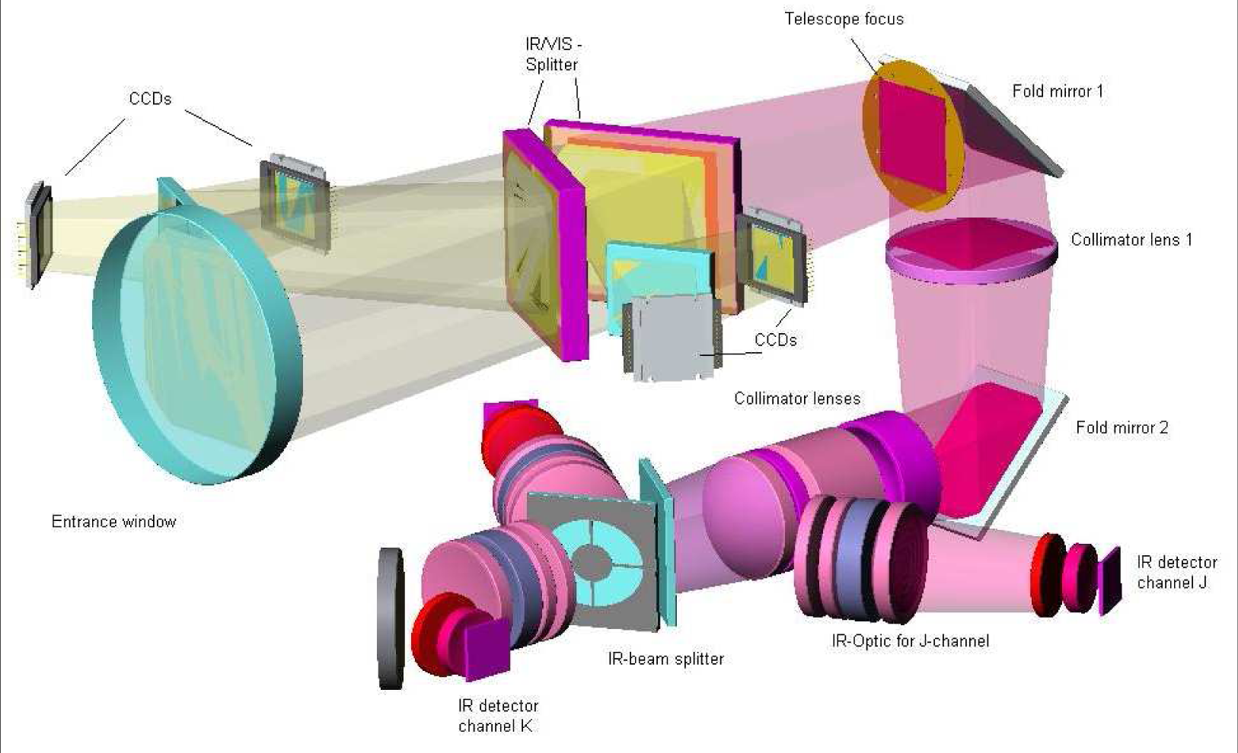
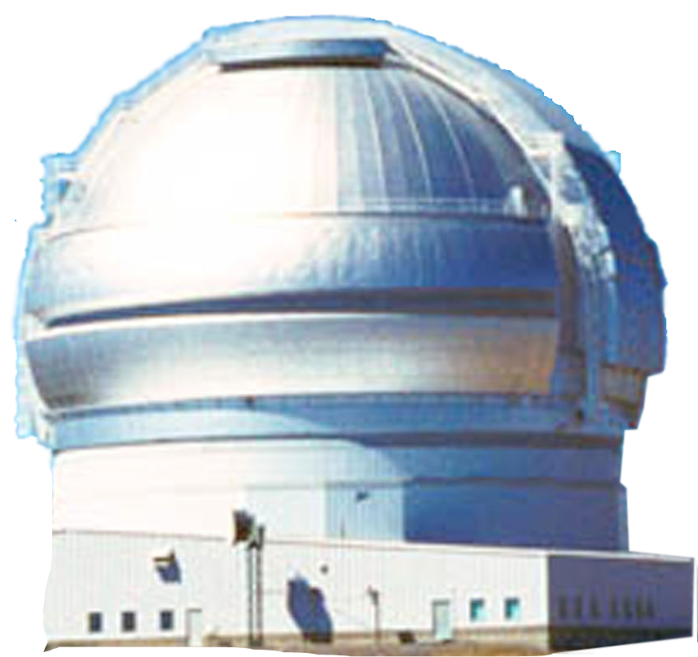
OCTOCAM concept
Multi-channel (8!)
Wide wavelength range (3700-23500 Å)
Multiband imaging
Broad band spectroscopy
High-time resolution
GROND + X-shooter + ULTRACAM + MORE! = OCTOCAM
GROND - Greiner et al. 2007
temporal resolution – spectral coverage – spectral resolution
ULTRACAM - Dhillon et al. 2007
X-shooter - D’Odorico et al. 2006

Slide 6
Instrument design

Slide 7
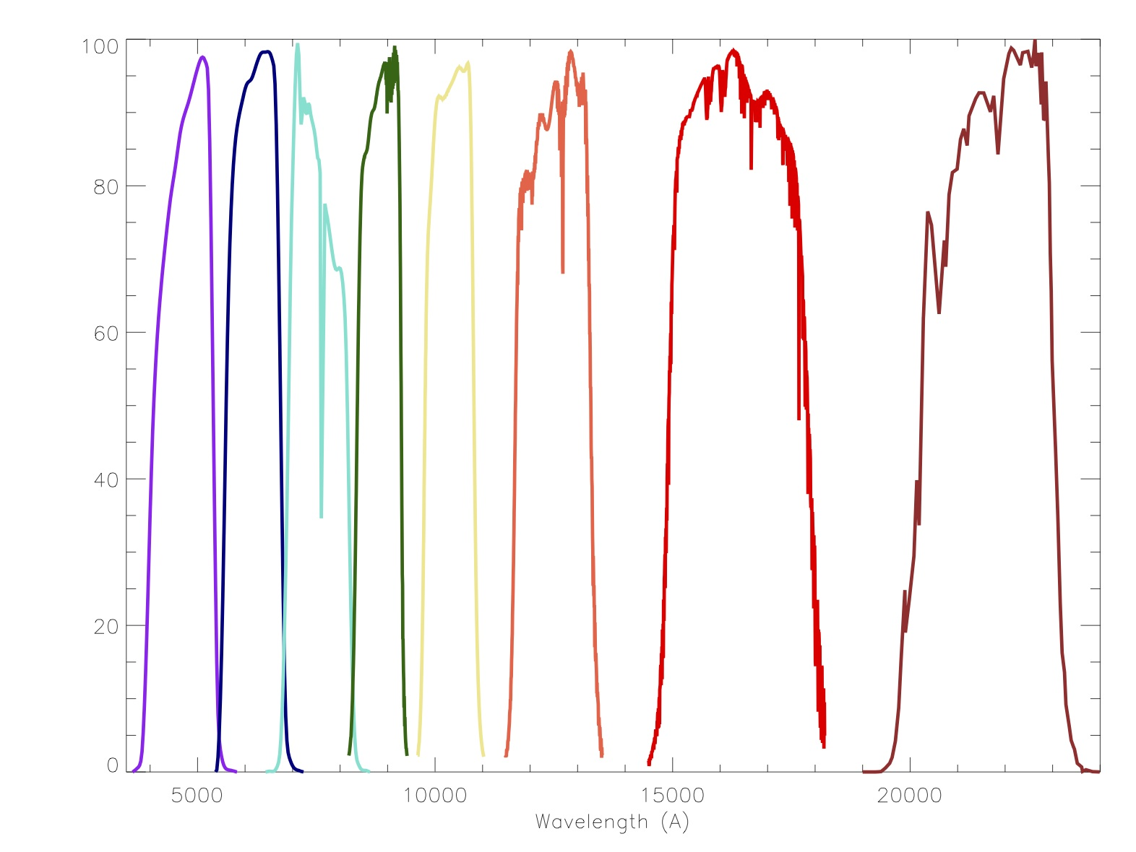
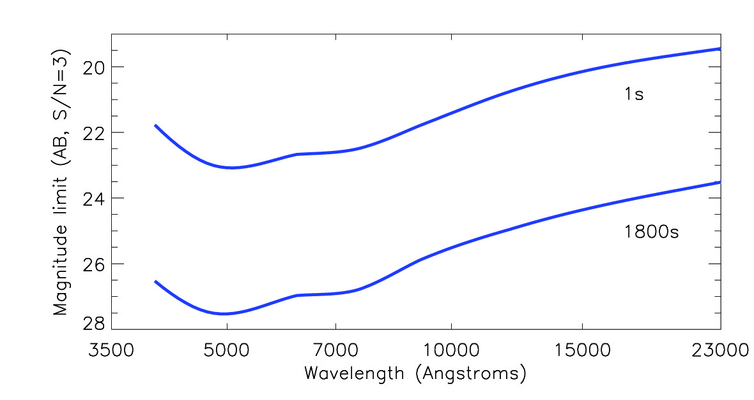
Imaging
Simultaneous VIS/NIR observations in g, r, i, z, Y, J, H, K_{S}
Frame transfer detectors + HAWAII-2RG
Negligible overheads
No filter change time loss
No readout time loss
3’x3’ or 4.2’Ø field of view
3’x3’x8 = 72 sqr. Arcmin
4.2’Øx8 = 112 sqr. Arcmin
GMOS 5.5’x5.5’
FLAMINGOS-2 6.1’Ø
29.22 sqr. arcmin
30.25 sqr. arcmin
4.2’Ø
3’x3’

Slide 8
Detector arrangement
VISIBLE (g’, r’, i’, z’)
Near-IR (Y, J, H, K_{S})
2k x 2k Hawaii-2RG
4k x 4k e2v CCD231-84

Slide 9
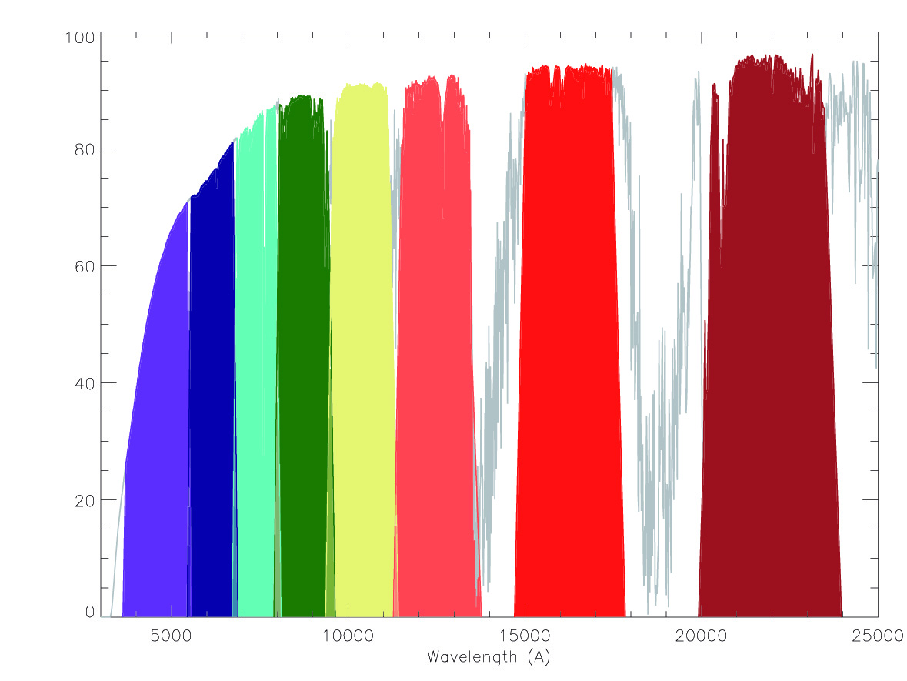
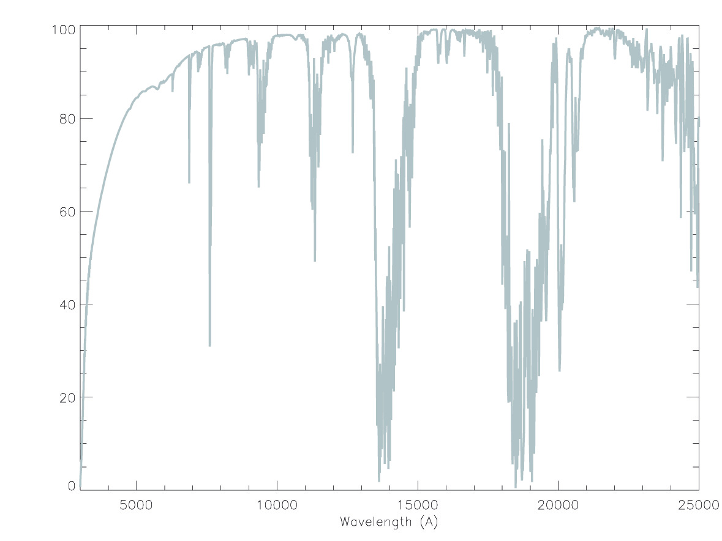
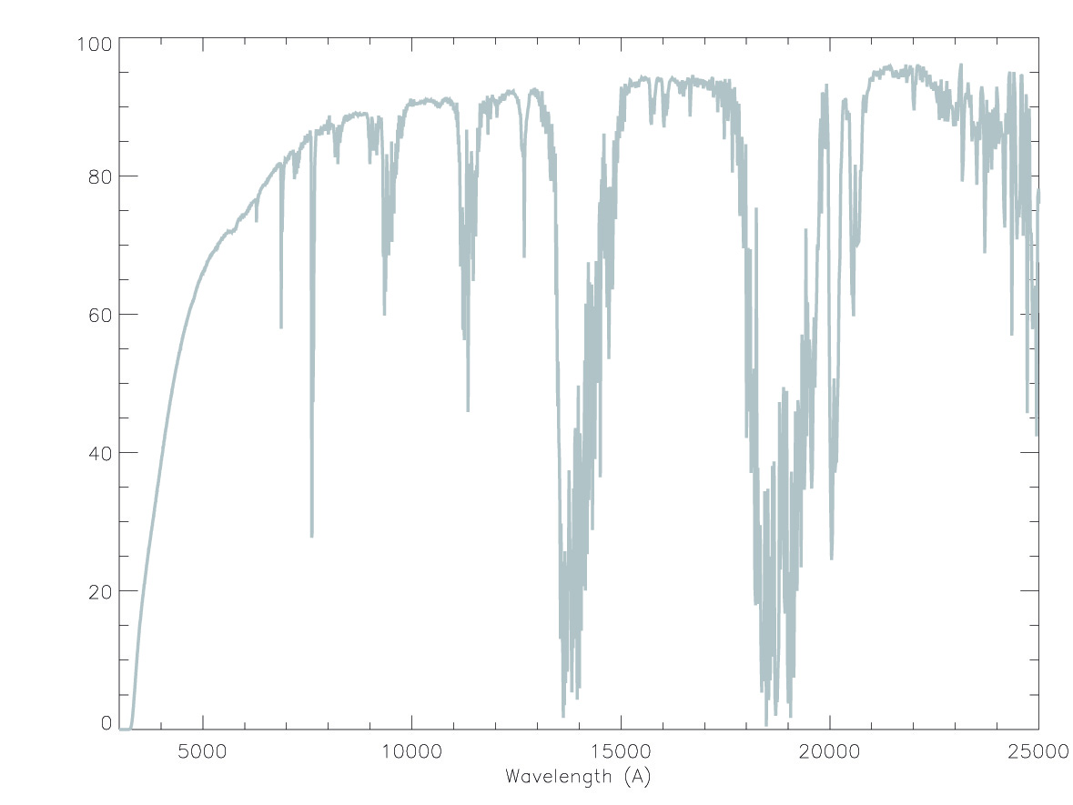
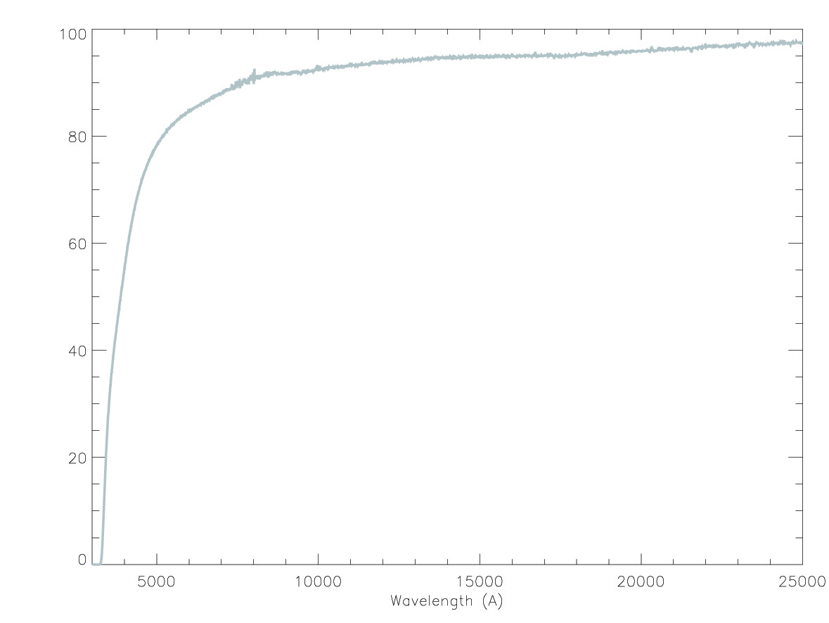
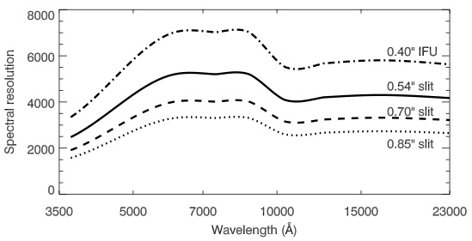
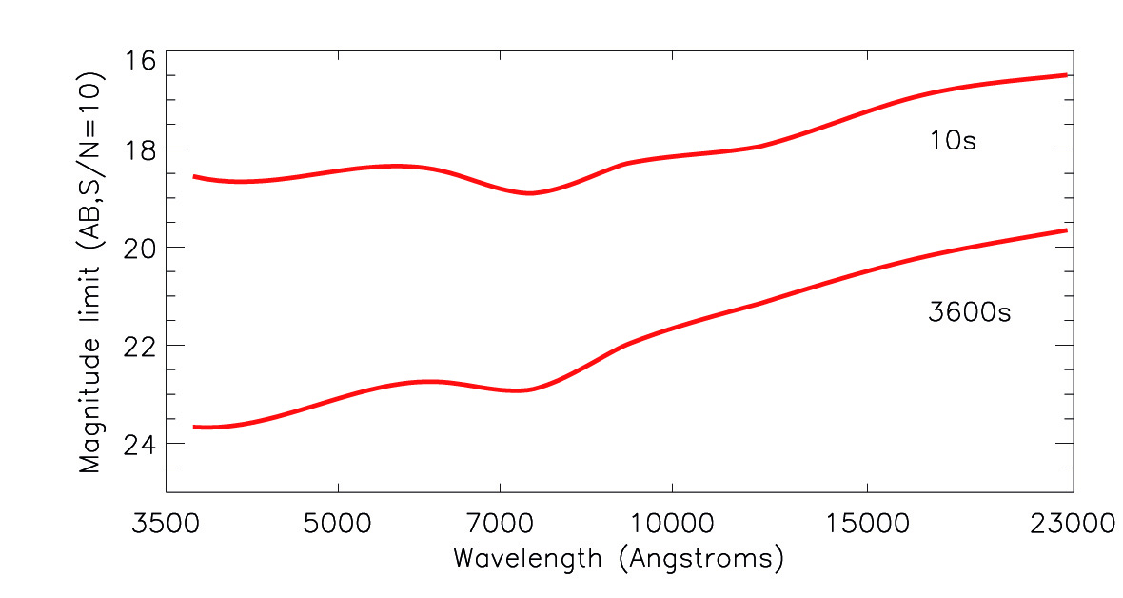
Spectroscopy
From 3 700 Å to 23 500 Å
[OII] 3727/3729 Å at z = 0
H-alpha at z = 2.5
Extinguished sources
High efficiency VPH gratings
Resolution of 3500-4500
Look through the NIR sky lines
Continuum of faint sources
Velocity field in galaxies
Long slit 3 arcmin
Atmospheric Dispersion Corrector

Slide 10
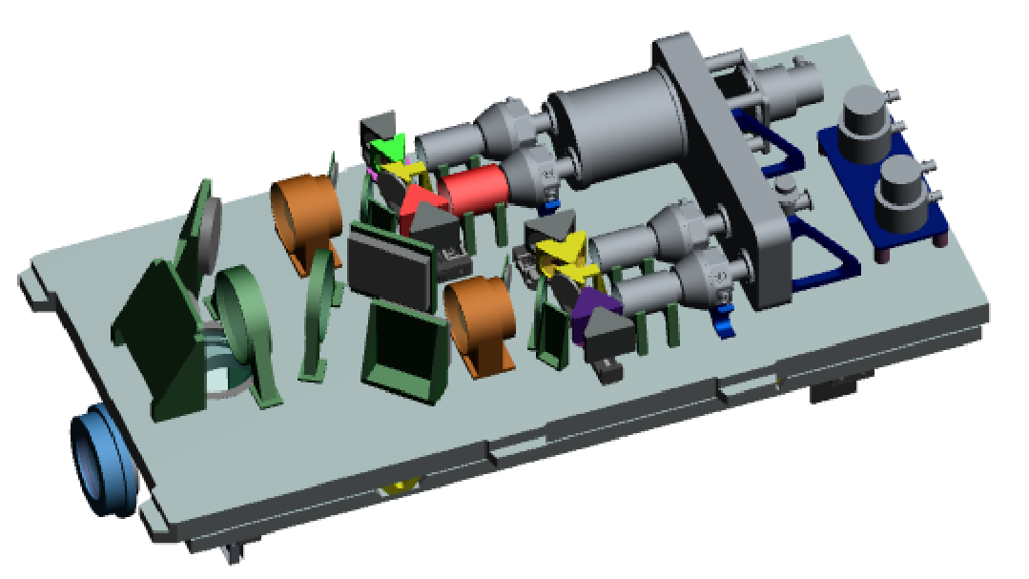
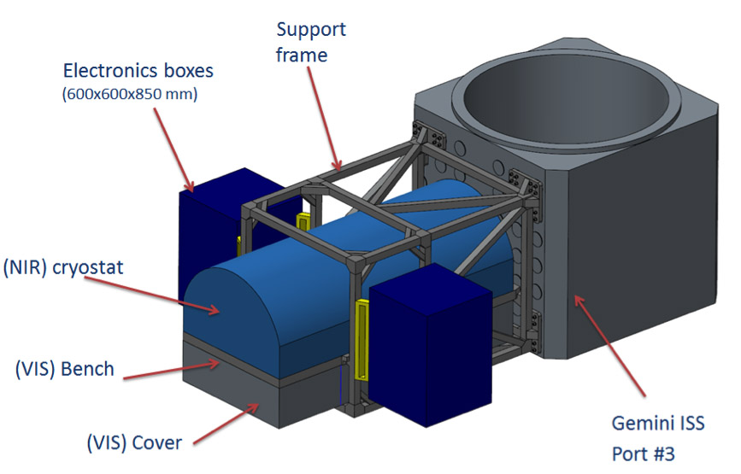
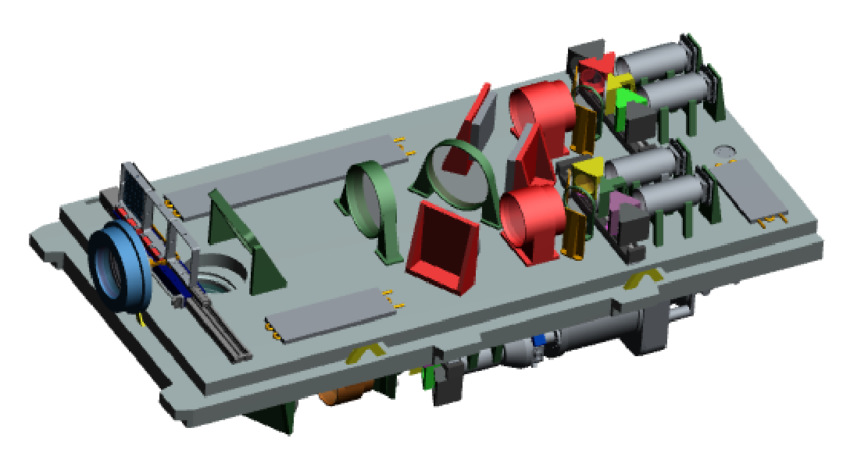
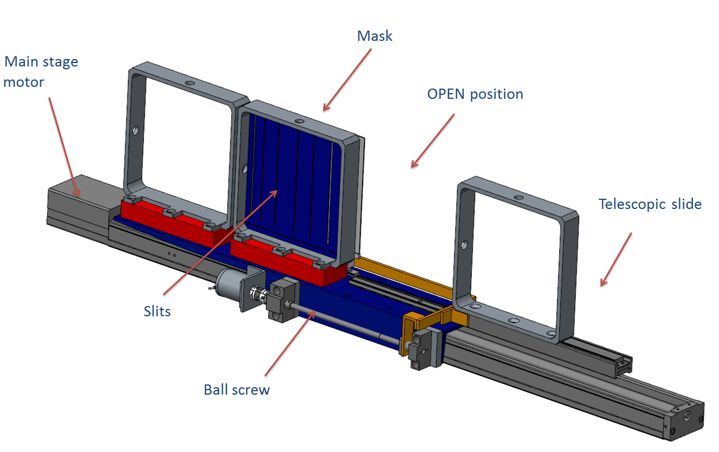
Design guidelines
Efficient
Simple
Compact
Light-weight
Minimimum number of moving parts
High efficiency dichroics
VPH gratings
Small pupil size (~50 mm)
Single long slit
Optics shared by different arms

Slide 11
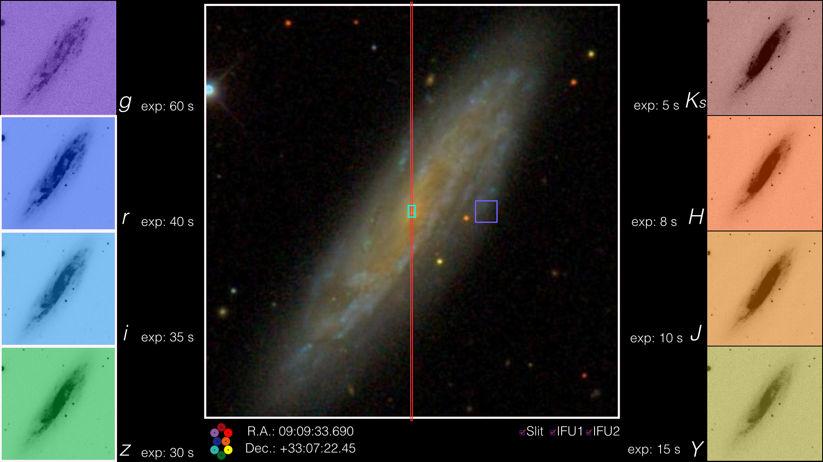
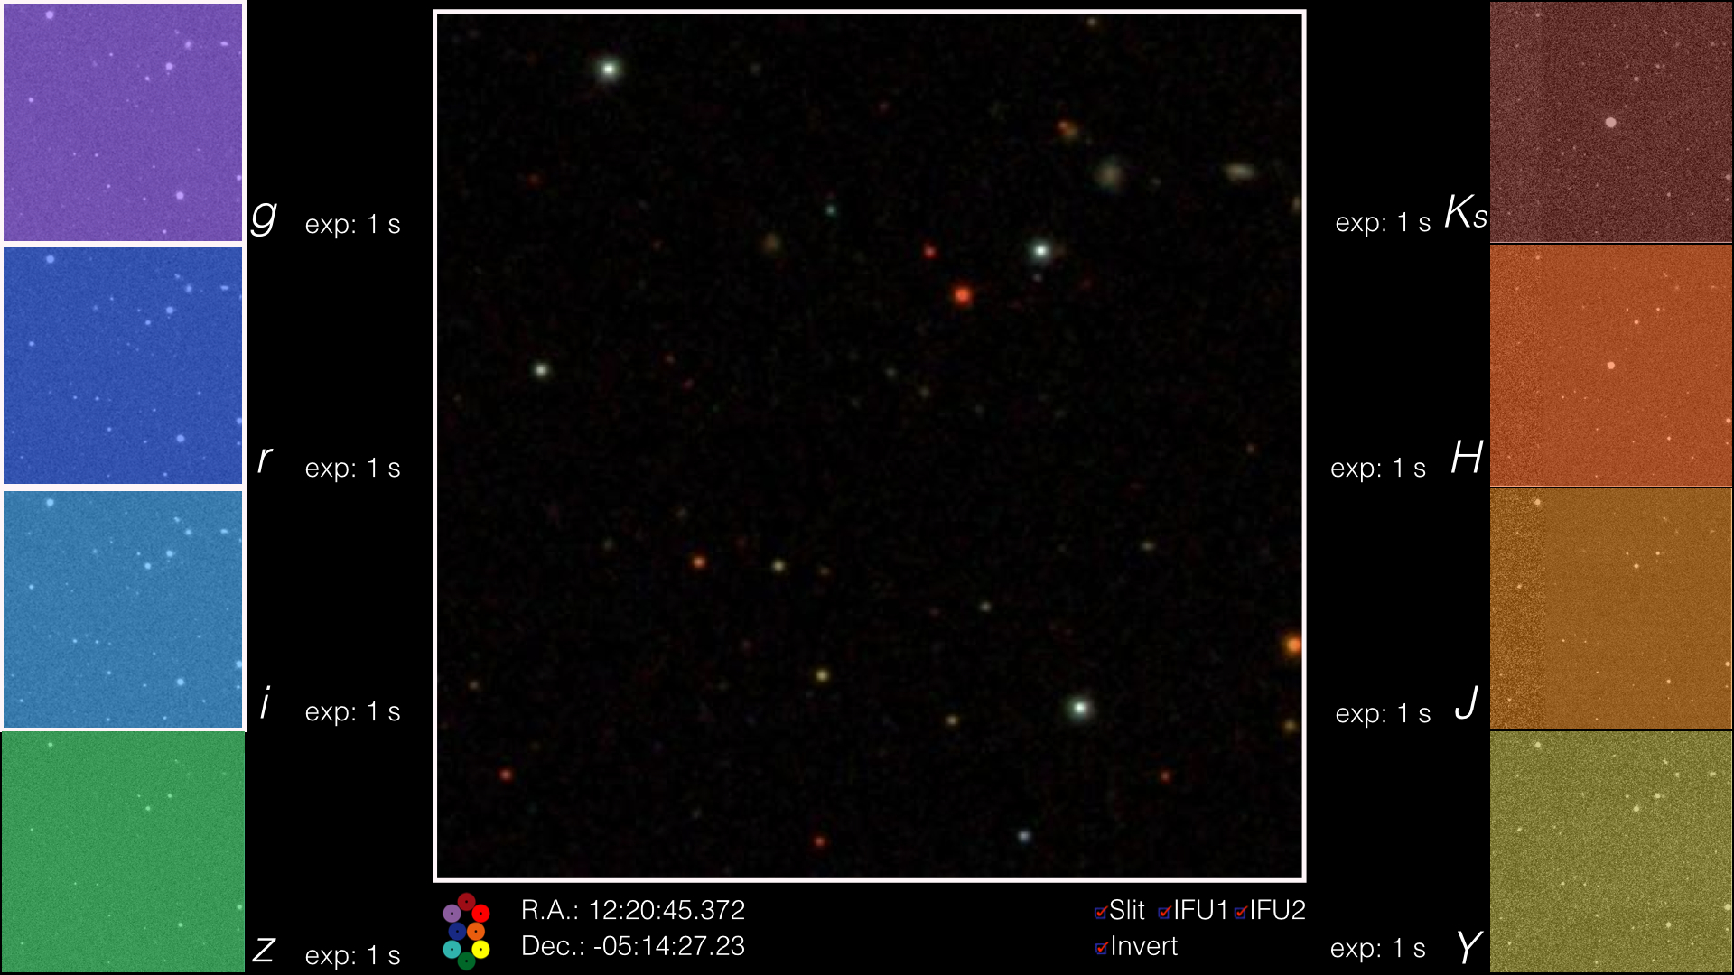
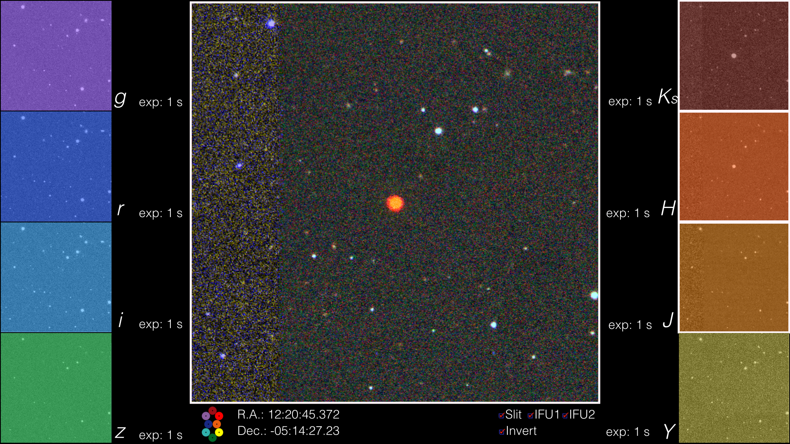
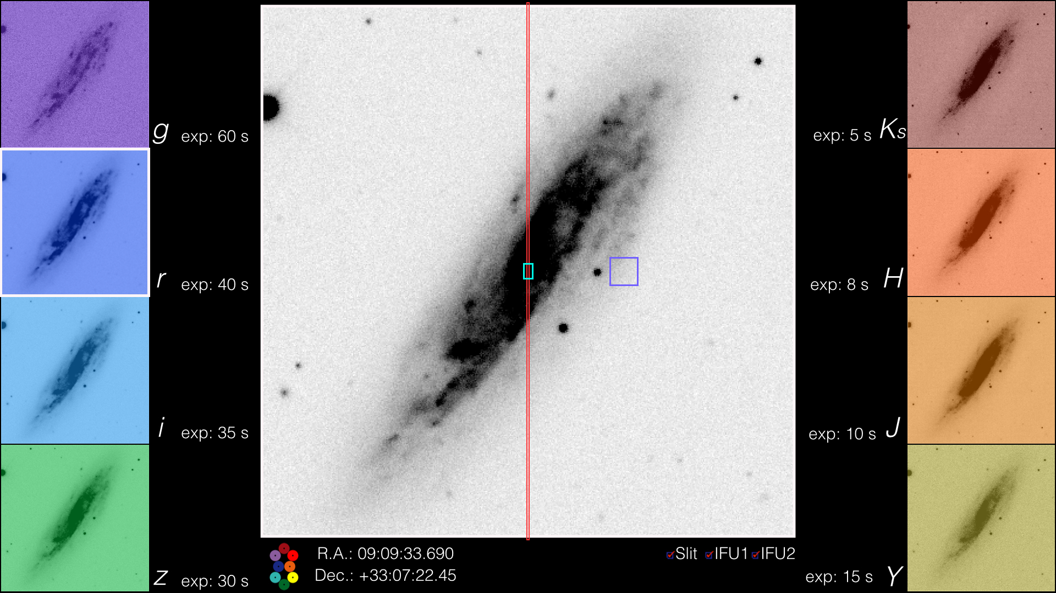
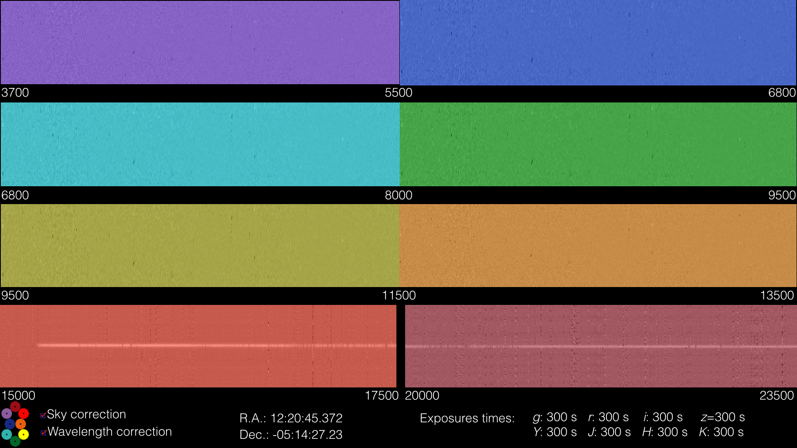
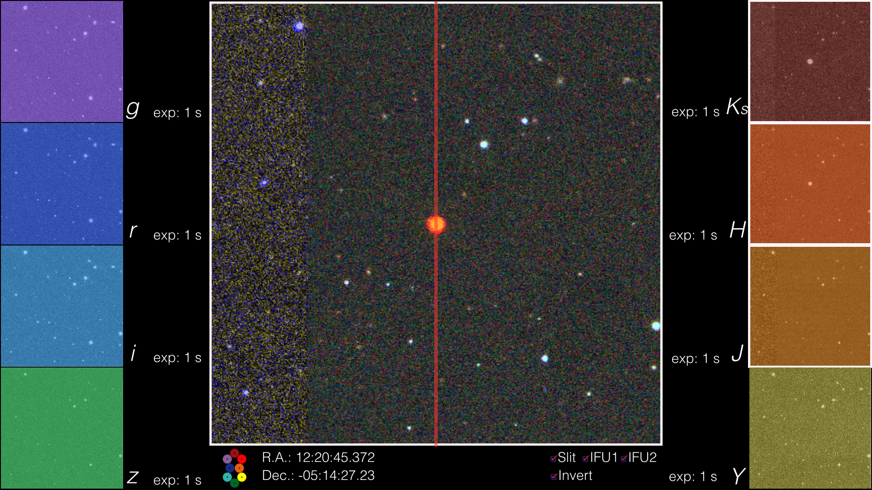
Sometime in 2022…
Ly-alpha drop out
z = 11.5!

Slide 12
OCTOCAM specifications
Simultaneous spectral range | Photometry: grizYJHK Spectroscopy: 3700-23500 Å
Field of view | Imaging: 3’ x 3’ 4.2’ diameter Spectroscopy: 3’ Long slit
Plate scale | 0.18”/pixel
Spectral resolution | 3 500 – 4 500 standard VPH
Expected efficiency | Imaging: ~41% Spectroscopy: ~33%
Maximum full-frame rate | ~ 4 Hz
Observing modes | Multiband imaging Wide band spectroscopy (long slit) High time-resolution

Slide 13
OCTOCAM
Thank you!

Slide 14
Five years of project
Kick-off on 19 April 2017
5 years of Project
6 phases: Design, Construction, Delivery and Commissioning at the Telescope
Will be ready for science on the spring of 2022
2017
2018
2019
2020
2021
2022
A
B
C
D
E
F
CoDR
PDR
CDR
OCDR
PIR
AIVR
PTR
TTIR
CSVR
Design
Construction
Delivery

Slide 15
Possible upgrades

Slide 16
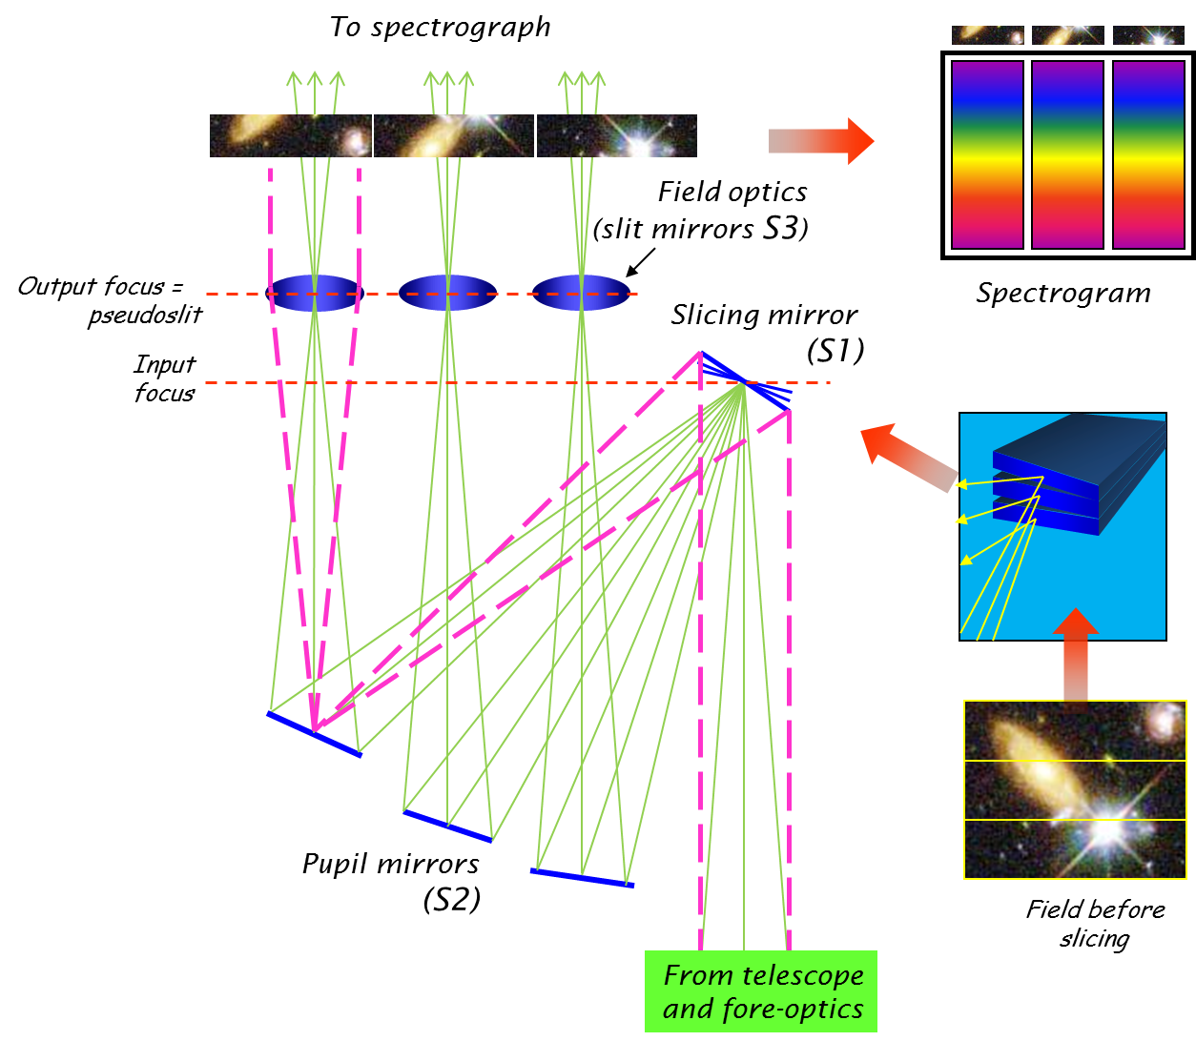
Integral field unit (IFU)
Image slicer 9.7”x6.8”
0.4” resolution elements
Wavelength coverage UV+IR!
Full spectral resolution at any seeing
GRB & SN host galaxies
Massive star environment
TNO & comets
Adaptive Optics IFU:
2.5”x3.6”, with 0.08” elements
950-2350 nm coverage
9.7”x6.8”

Slide 17
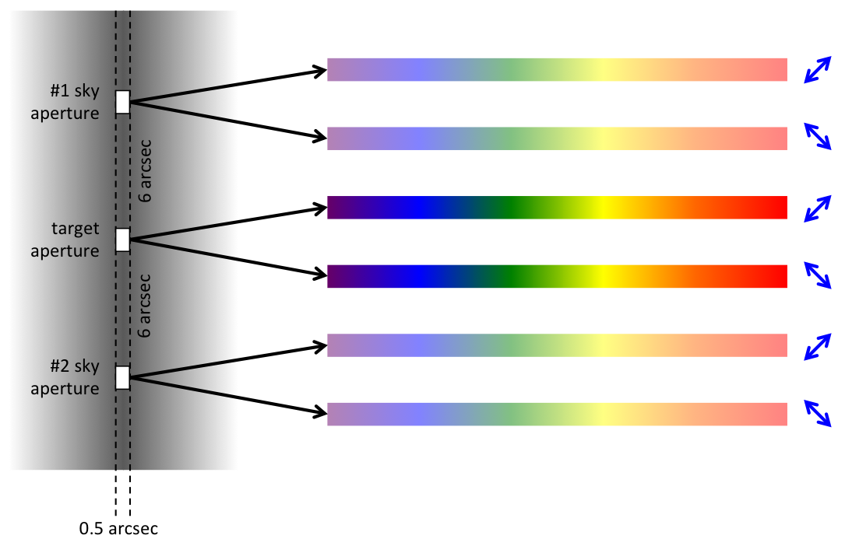
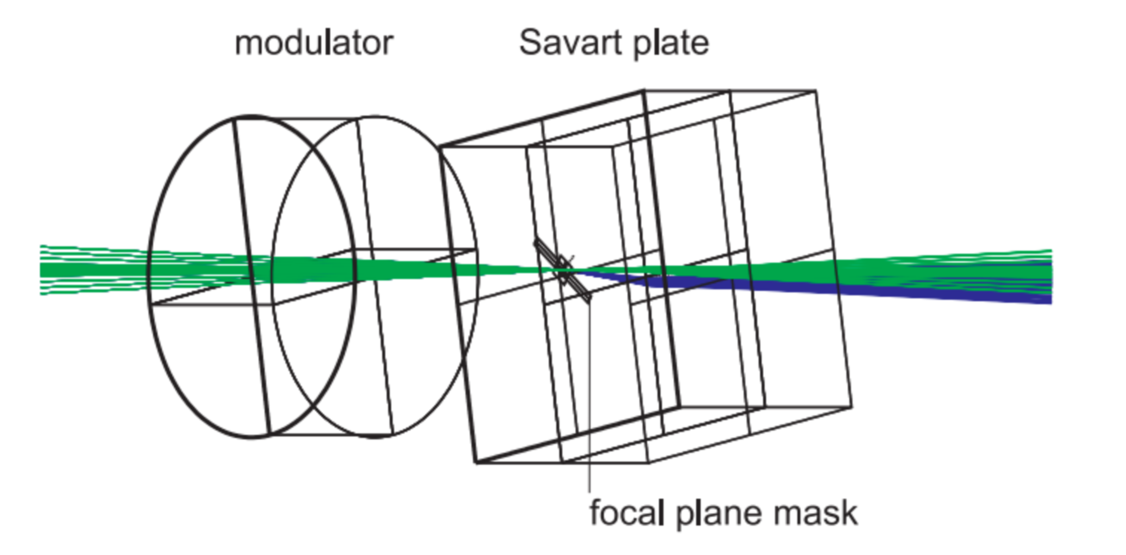
Spectropolarimeter
Based on the design of Snik et al. (2012) for X-shooter
Structure and magnetism in SNe
Stellar physics
Characterization of transients

Slide 18
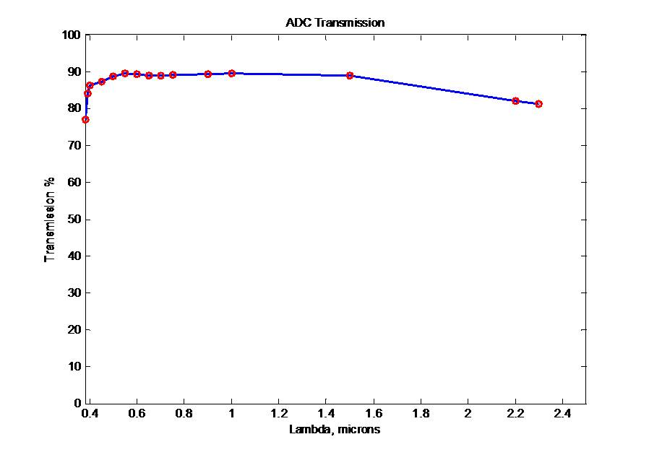
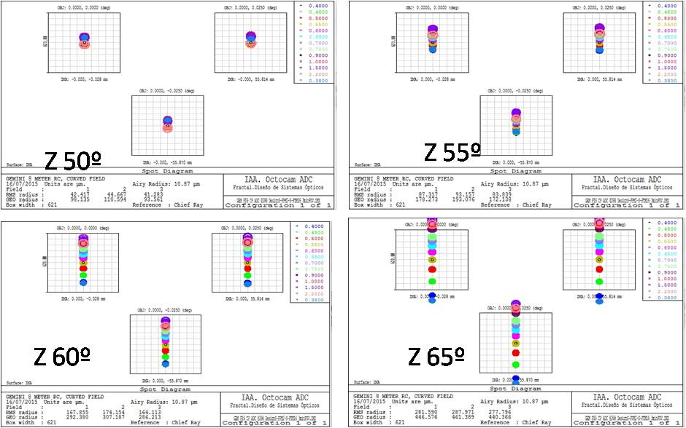
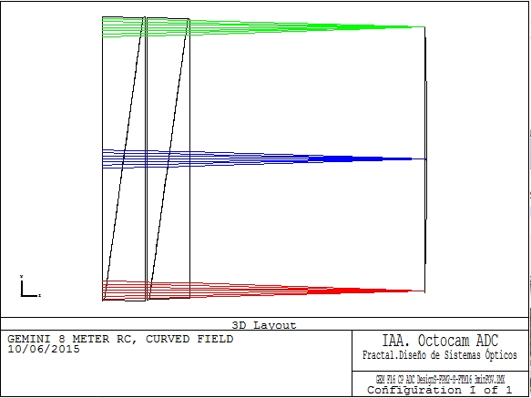
Atmospheric Dispersion Corrector
Makes a more versatile instrument
Down 40 deg elevation
Necessary to use the long slit at high-airmass
Implies an average loss of 10% efficiency
Retractable for higher efficiency

