Slide 1

Challenges of Big Data processing and machine learning in meteor science
Dino Bektešević
Science and Society Synergy Institute, Croatia
University of Washington, USA
Dejan Vinković (dejan@iszd.hr)
Science and Society Synergy Institute, Croatia
Hipersfera Ltd., Croatia
Aleksandar Cikota
European Southern Observatory, Germany
Darko Jevremović
Astronomical Observatory, Serbia
Andrew Rasmussen
SLAC National Accelerator Laboratory, USA
Željko Ivezić
University of Washington, USA
Special thanks to BigSkyEarth COST Action
http://bigskyearth.eu

Slide 2
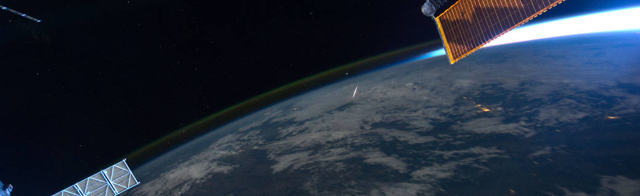
Meteors are important for:
Astronomy
Aeronomy
Geophysics
Evolutionary biology
Planetology
Science popularization
Meteors are difficult to explore:
Brief transient events
Large angular size
Radom spatial position
Three different flow regimes

Slide 3
Silber E.A. et al, MNRAS, 469, 1869–1882 (2017)
Our understanding of meteor plasma and hypervelocity shock physics in rarefied partially ionized and partially magnetized ionospheric plasma is NOT complete.
Notes:
Schematics of the meteor shock wave(s), flow fields and near wake. The meteoroid is considered as a blunt body (with the spherical shape) propagating at hypersonic velocity. The definitions and explanations are provided in the text (after Hayes & Probstein (1959); Lees & Hromas (1961)). (1) Bow (cylindrical) shock wave front; (2) The “ballistic” shock front; (3) Sonic region; (4) Boundary layer; (5) Stagnation point; (6) Turbulent region (in some older literature, this is referred as the dead water region); (7) Meteoroid; (8) The neck and recompression region; (9) The ‘free’ shear layer; (10) The recompression vapour (or a true cylindrical) shock wave front; (11) The region of turbulent vapour flow and adiabatic expansion. Note that small circles with positive and negative signs indicate regions affected by the presence of ions and electrons respectively. The diagram is only for the illustrative purpose and is not to scale

Slide 4
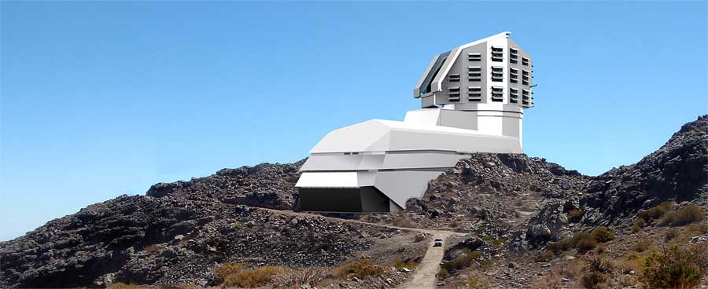
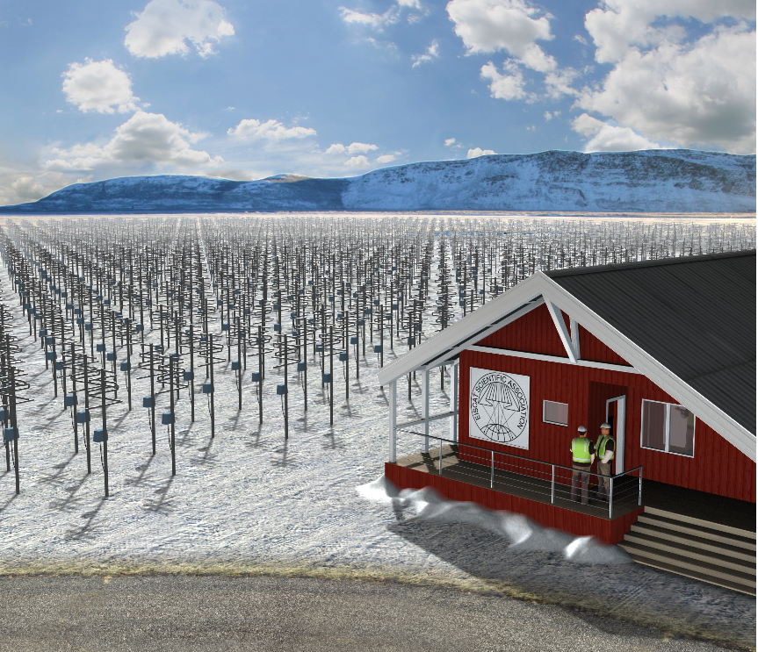
LSST can map the entire visible sky in just a few nights
• 3200-megapixel camera (FoV of 40 times the full moon)
• 37 billion stars and galaxies
• 10 year survey of the sky
• EVERY NIGHT: 10 million alerts, 1000 pairs of exposures,15 Terabytes of data
EISCAT_3D: a multistatic radar composed of
five phased-array antenna fields
each field ~10,000 crossed dipole antennas
will act as receivers, transmitting at 233 MHz (VHF band)
spread over Finland, Norway and Sweden.
~190,000 meteor orbits per day

Slide 5
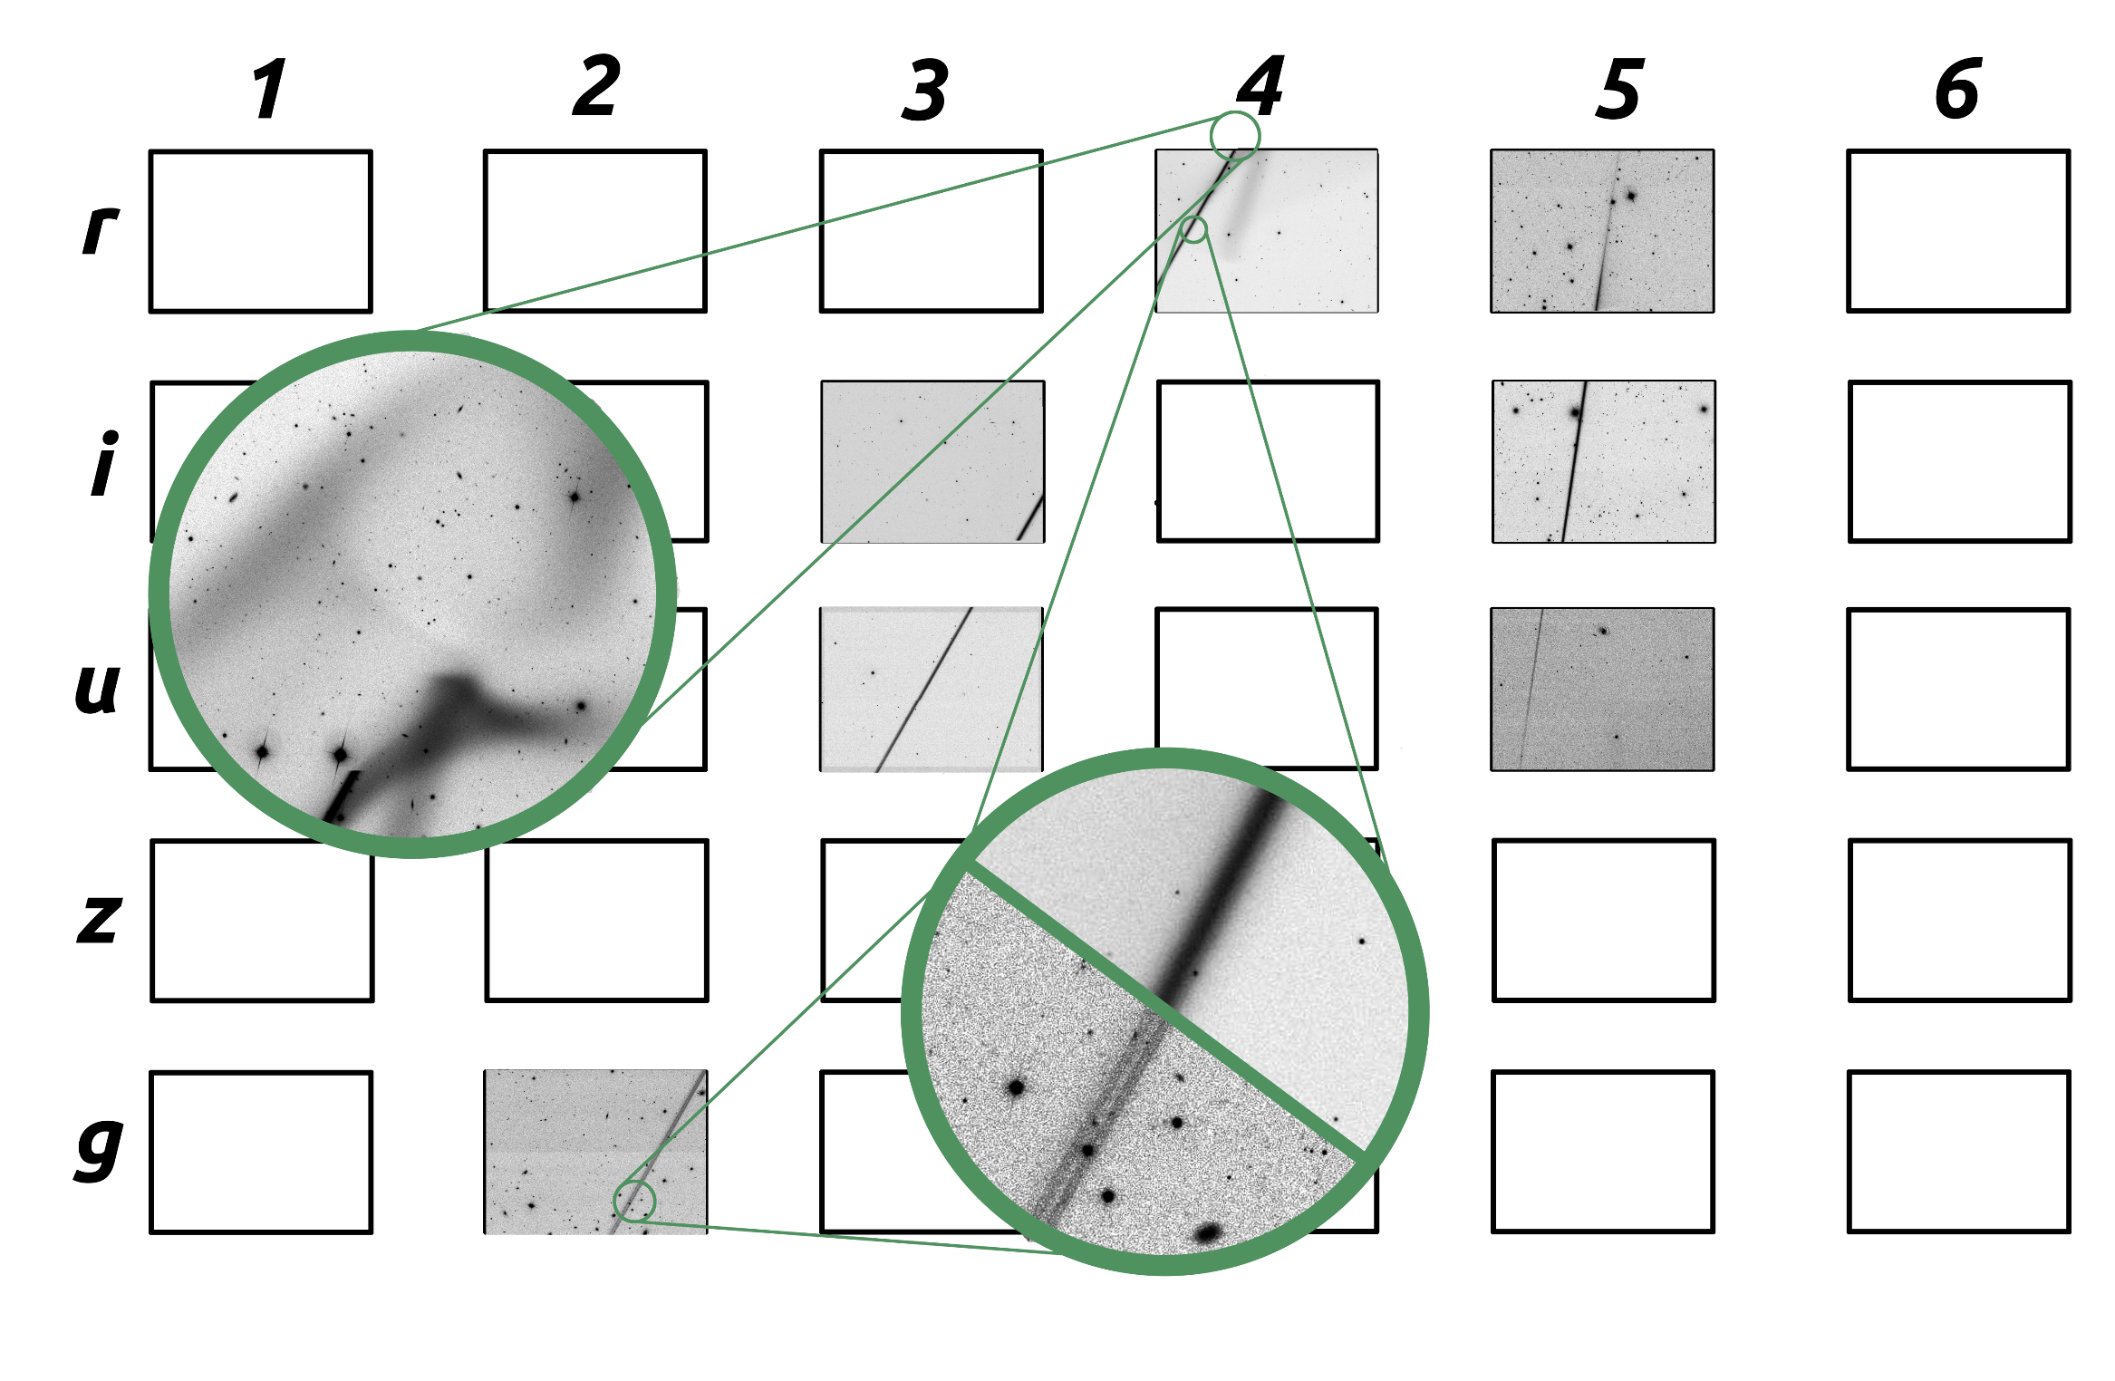
meteor detections on images from sky survey telescopes
high-resolution
&
high-sensitivity
&
high-precision photometry
&
resolved
(defocused)
SDSS example
~617nm
Residual dust
~748nm
~355nm
~893nm
~469nm
Run: 2728
Date: Nov. 18th 2001.
Trail length: 1.68°
Angular speed: 6.63°/s
Strong defocusing
effects!

Slide 6
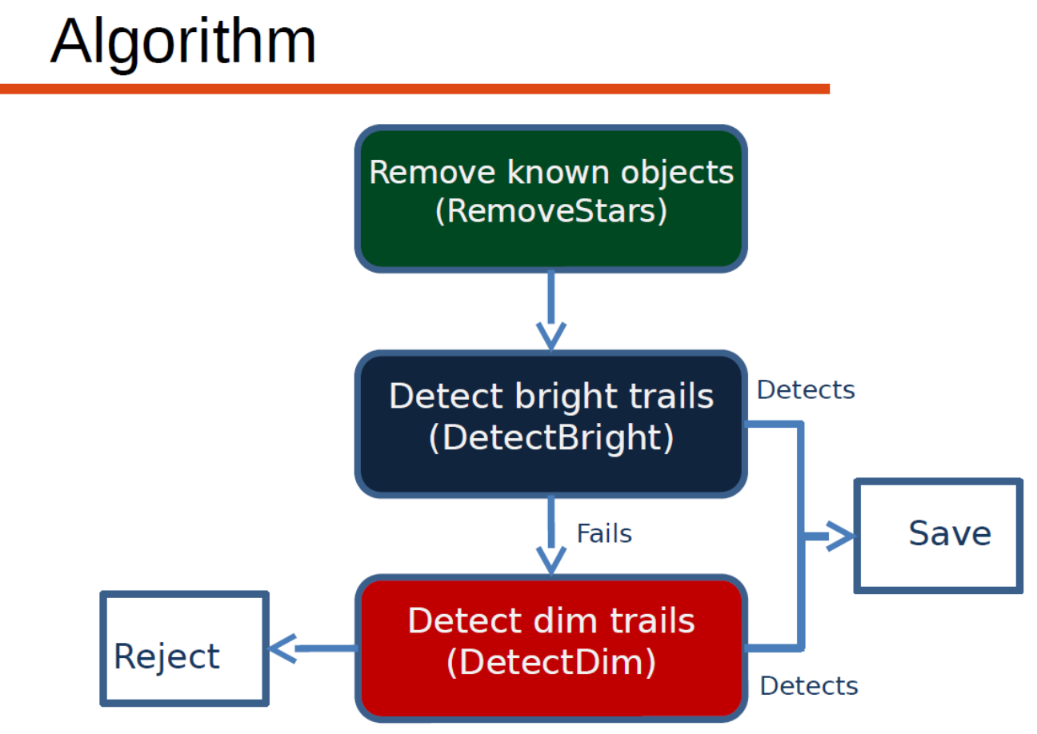
Linear feature detection algorithm for big survey telescopes
Bektešević, Vinković
MNRAS, accepted

Slide 7
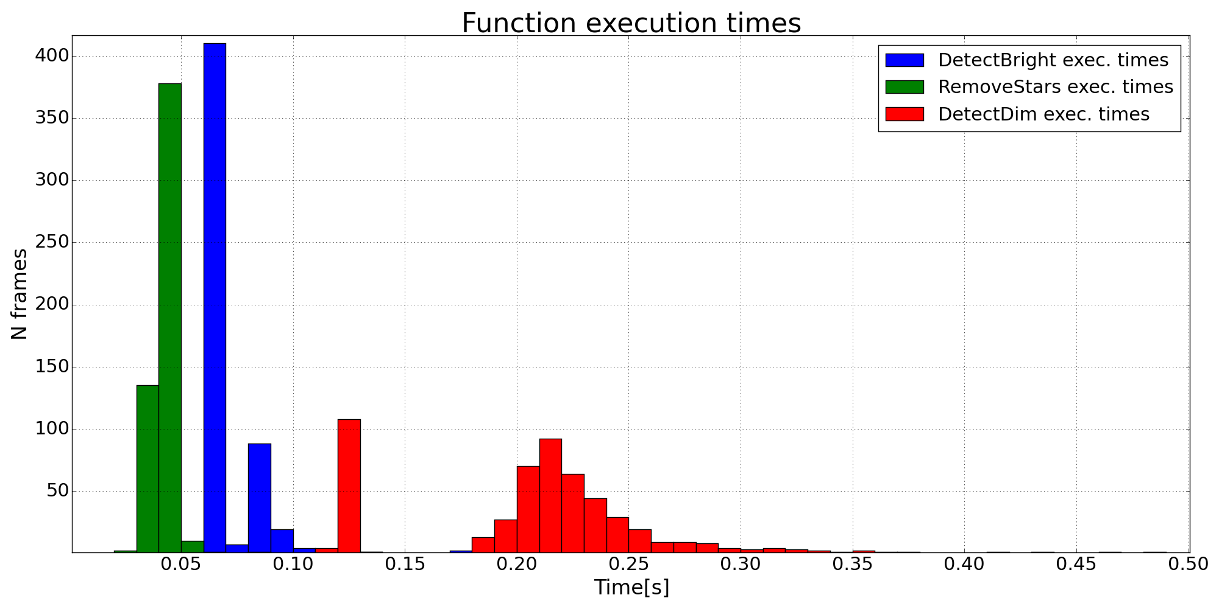
Detection algorithm parameter optimization and performance
(and building a training set)
Bektešević, Cikota, Jevremović, Vinković
MNRAS, in preparation

Slide 8
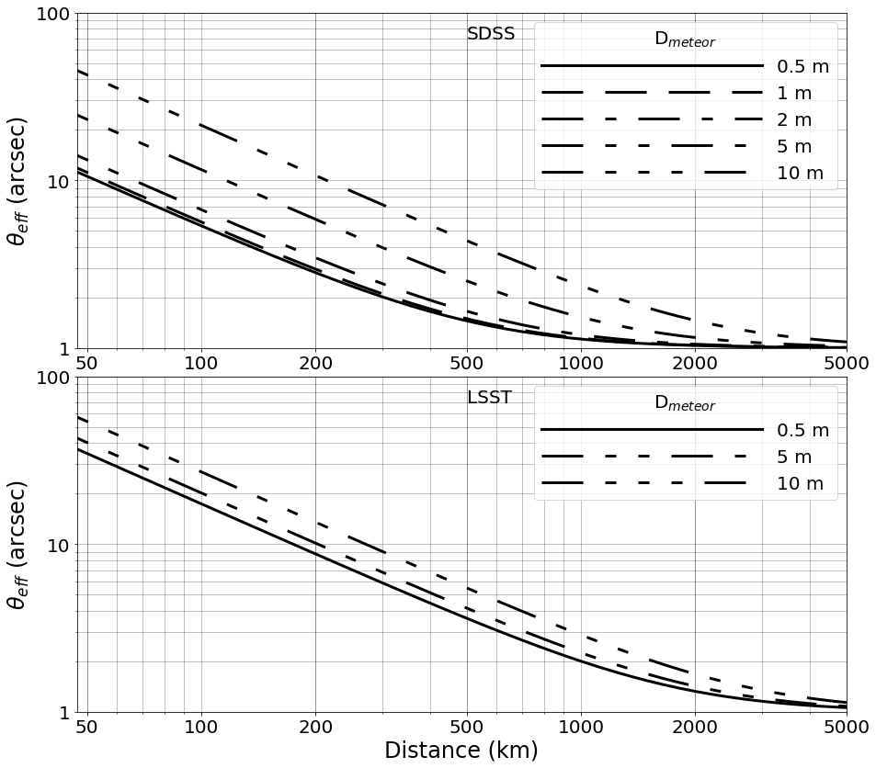
Defocusing of meteor tracks
Bektešević, Vinković, Rasmussen, Ivezić
MNRAS, submitted
SATELLITES
approximate →

Slide 9
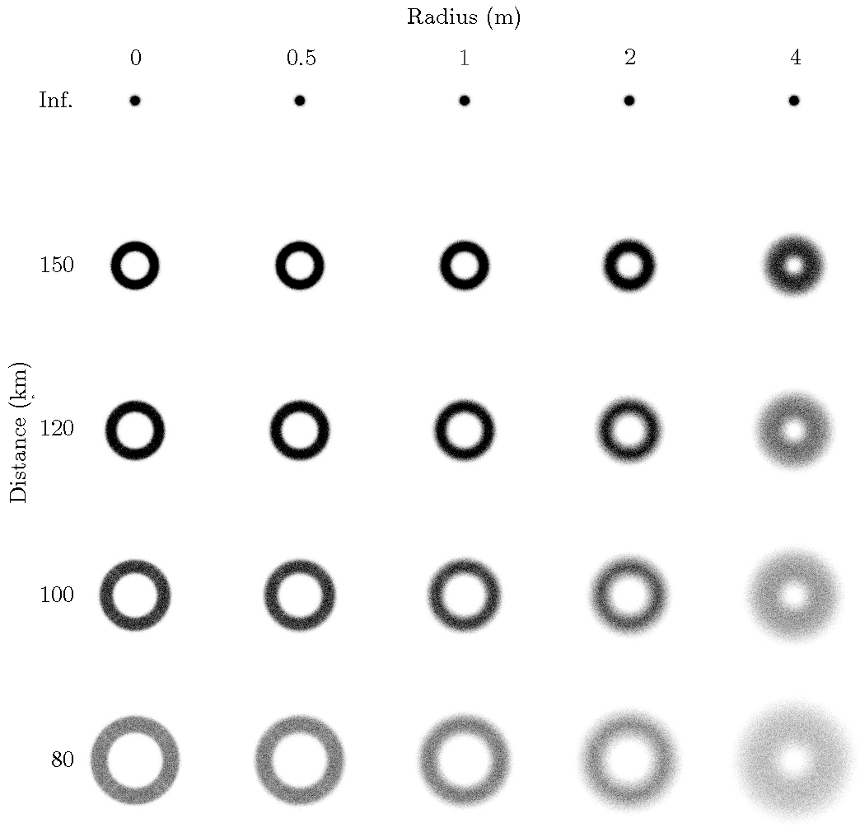
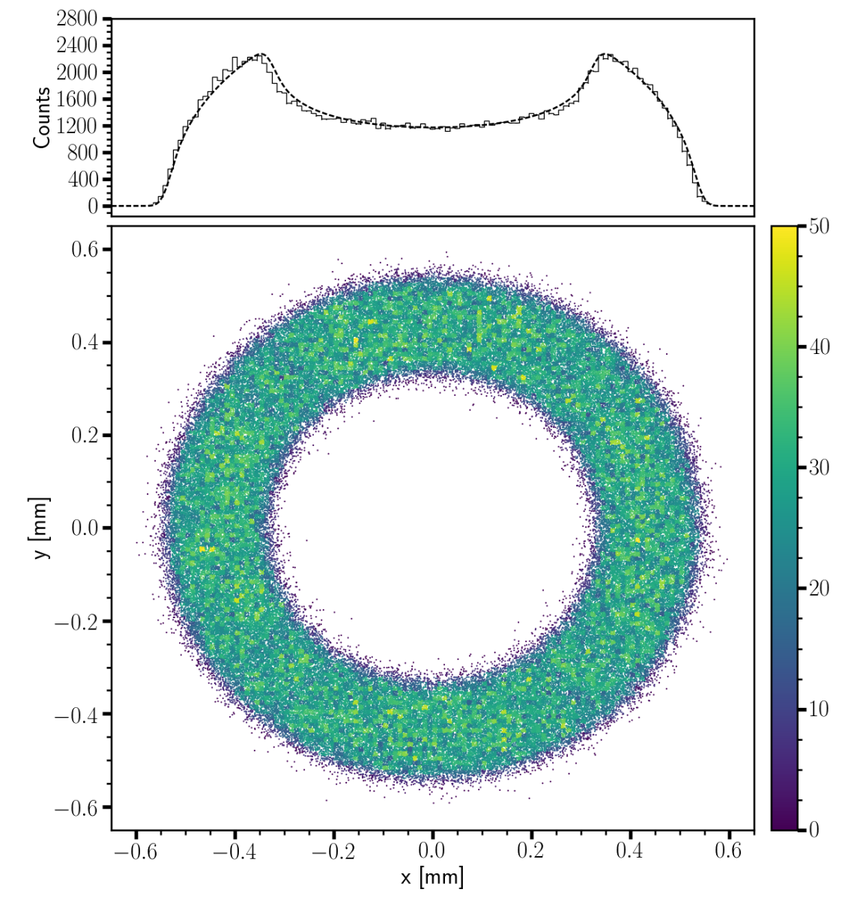
ray-tracing simulations of meteors observed with LSST

Slide 10
November 18, 2001, at 04:57:21.39 TAI.
probably a Northern Taurid meteor
SDSS i filter: ~10m plasma ball
~100m later
SDSS u filter

Slide 11
November 18, 2001, at 04:57:21.39 TAI.
probably a Northern Taurid meteor
SDSS u filter
~2km later
SDSS g filter: 2 objects <1m; separated ~6m

Slide 12
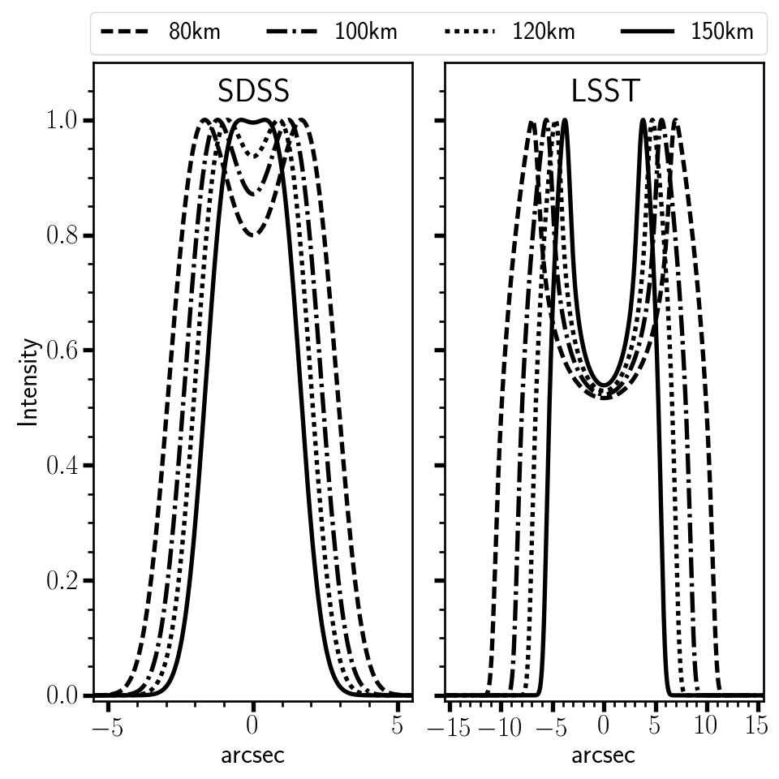
defocused point sources

Slide 13
turbulent wake?!

Slide 15
ground
cameras
Observing meteors outside the traditional visual bands and comfort zone of meteor astronomers
Discovery of MHz emission from meteors in the VHF radio band using the LWA1 Radio Telescope (Obenberger, 2014)
The nature of this emission is not understood
The ongoing and upcoming radio sky surveys will produce petabytes and soon exabytes of data (LOFAR, SKA).
radio afterglow
at 38 MHz and
averaged over
15 seconds

Slide 16
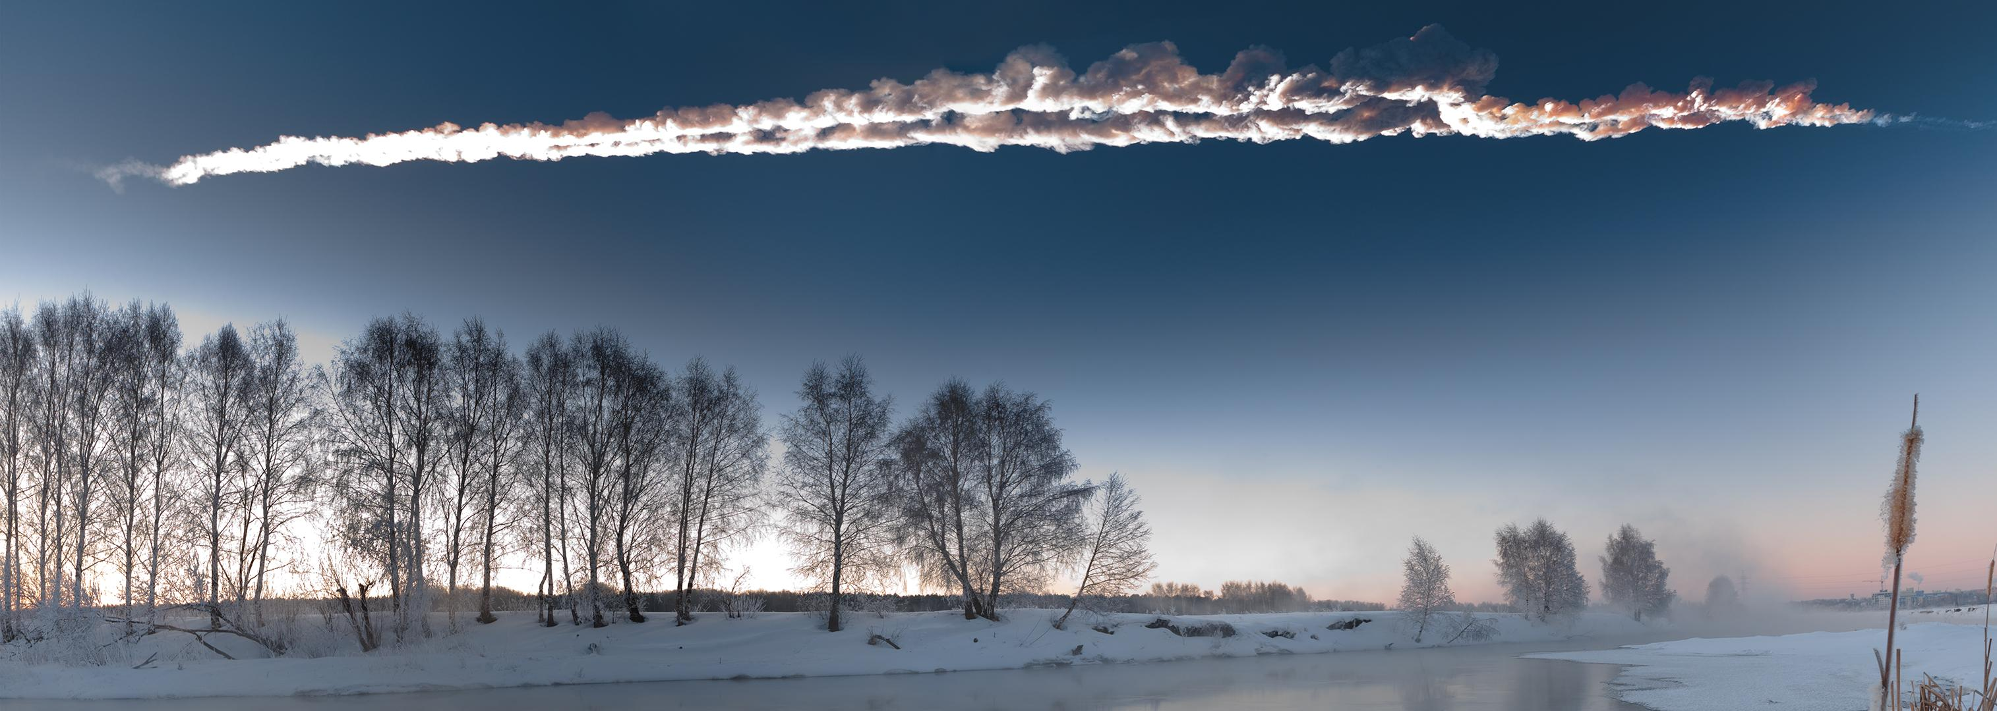
Meteor science in the Big Data era needs:
Integration into large surveys in astronomy, aeronomy and space physics
Cameras on the ground (images, spectra, triangulation, photometry)
Detectors in orbit (images, spectra – UV)
Images and spectra from big telescopes and sky surveys
Three dimensional radar observations
ELF/VLF/LF radio signals
etc.

Slide 17
Meteor science in the Big Data era needs:
- more complex methodological approaches through interdisciplinary collaborations with other branches of physics and computer science
- more advanced theoretical work on the complexity of micro-physics of meteor plasma and its interaction with the atmosphere (ionosphere)

Slide 18
Meteor science in the Big Data era needs:
more advanced automatic methods for:
  line detection (multiple lines)
  classification based on the origin (meteors .vs. satellites, meteor streams)
  removing meteor trail contribution
  distance and size estimate
  light-curve characterization

