Slide 1
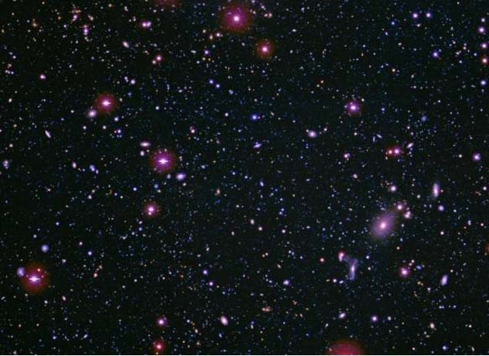
Using big data from large area extragalactic surveys for understanding AGN properties in the Local and Far Universe
A. M. Mickaelian, M. V. Gyulzadyan, H. V. Abrahamyan, G. M. Paronyan, G. A. Mikayelyan
NAS RA V. Ambartsumian Byurakan Astrophysical Observatory (BAO)
EWASS-2017 S14: Astroinformatics: From Big Data to Understanding the Universe at Large
29-30 June 2017, Prague, Czech Republic

Slide 2
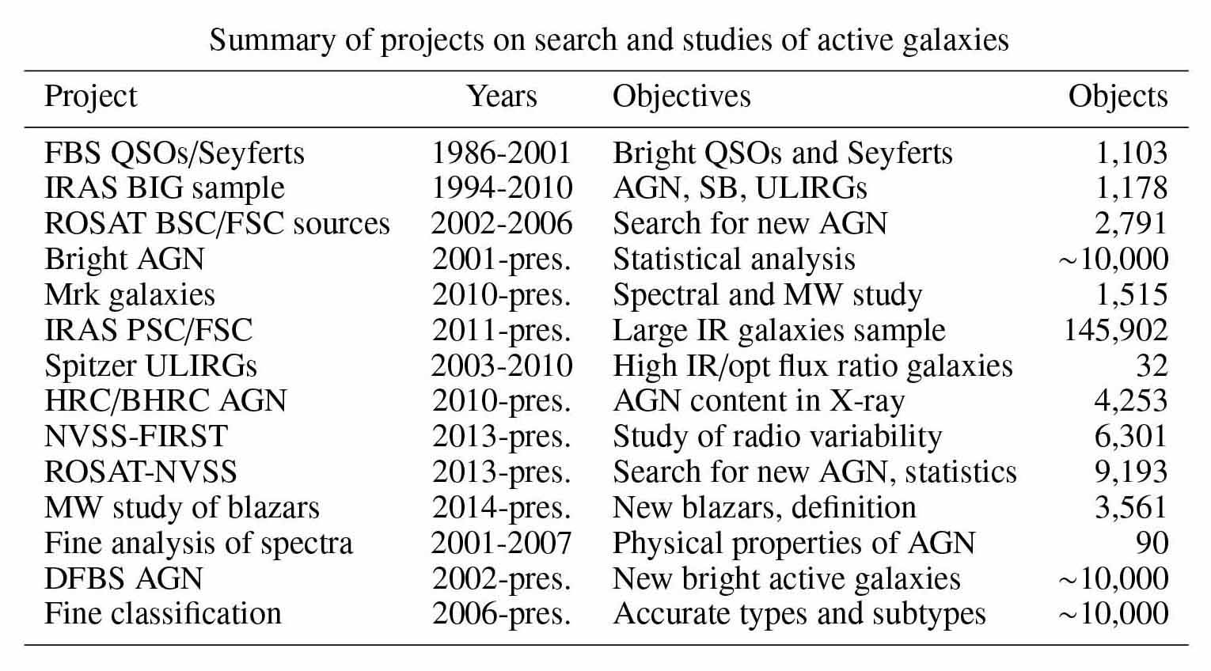
Extragalactic surveys and statistical studies of all-sky and large-area catalogs

Slide 3
IRAS PSC/FSC Combined Catalogue
a new tool for cross-matching astronomical catalogues
identifications with a search radius corresponding to 3σ of errors for each source individually
73,770 associations (common sources)
cross-correlations: AKARI-IRC, AKARI-FIS, WISE (+2MASS)

