Slide 1
CHAOUL Laurence, PANEM Chantal
CNES, Toulouse
Processing Gaia’s Billion Stars in CNES, a Big Data Story
EWASS 2017, June 29th 2017

Slide 2
The DPCC Key Numbers
Gaia DPCC = Gaia Data Processing Center in CNES
Up to 8 chains to be processed in parallel
Spectroscopic chains
Objects processing chains (Multiple Stars, Solar System Objects, Galaxy, Quasars)
Astrophysical Parameters Determination chain
Various kinds of complex algorithms (object by object or global processings)
Number of objects to process
1 billion stars, 80 billions observations
Increasing volume all along the mission, up to 4PB
Architecture built with a NoSql solution : Hadoop
High Level of parallelization
HDFS: distributed data storage

Slide 3
The first main lessons learned
It works !
High Performing Parallel Computing
Able to handle tables with tens of billions records
Very scalable
Hadoop configuration very tricky
No indexing capabilities : difficult to request the content of the tables => problem for validating the results
The scientific algorithms shall be designed to be run in parallel
Proven architecture for Gaia DR2 processings
and on the right track for Gaia DR3 !

Slide 4
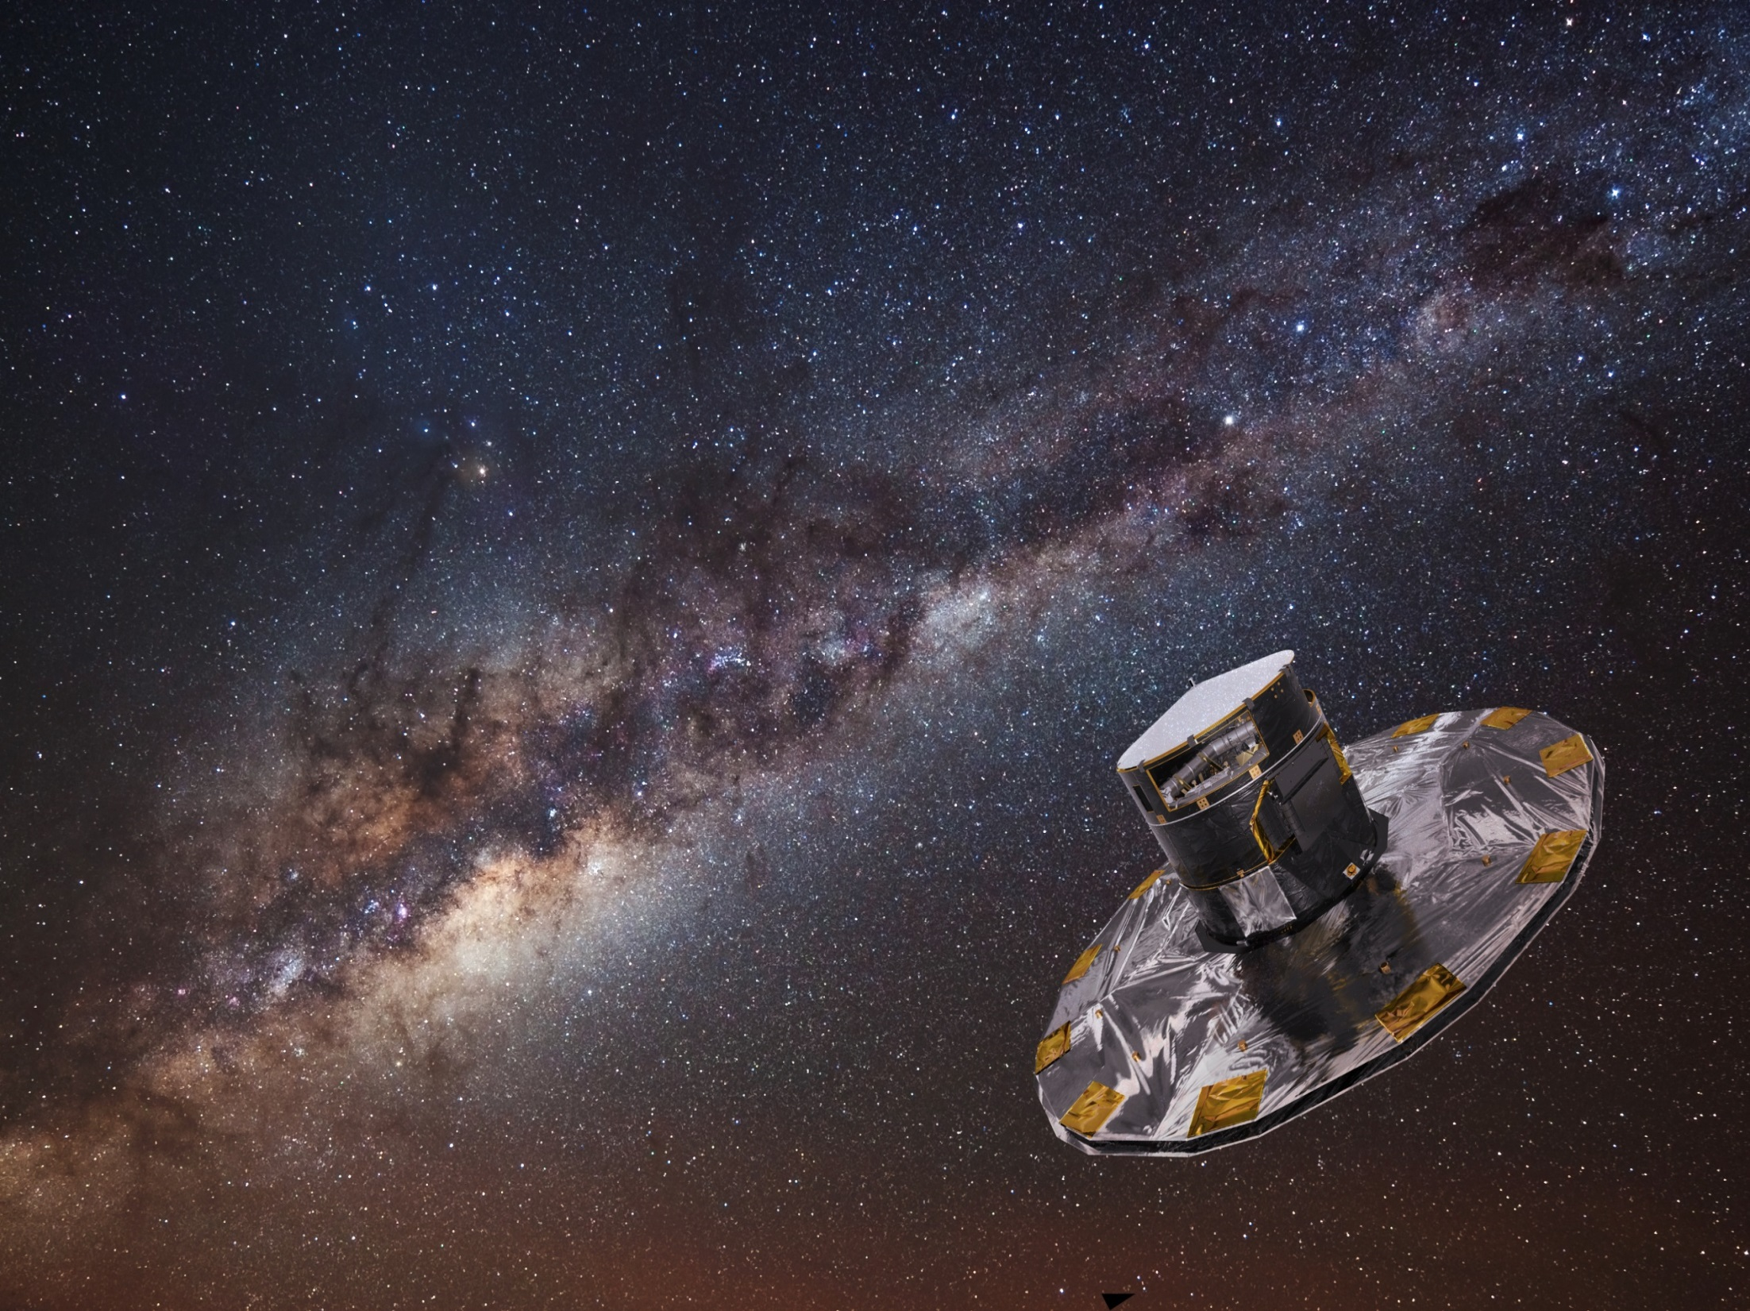
More info ?
http://www.cosmos.esa.int/web/gaia/
http://smsc.cnes.fr/GAIA/
laurence.chaoul@cnes.fr

