Slide 1
ICSU World Data System
Trustworthy Data Services for Global Science

Slide 2
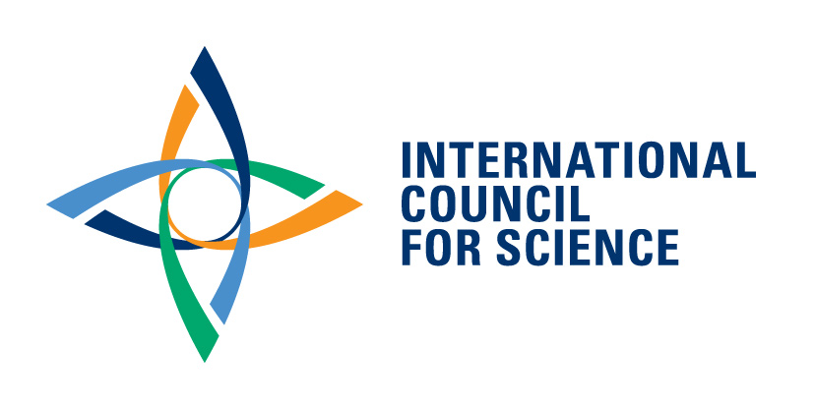
International Council for Science
The International Council for Science (ICSU) is a non-governmental organization with a global membership of
National scientific bodies (122 Members, representing 142 countries)
International Scientific Unions (31 Members)
Notes:
The World Data System is an Interdisciplinary Body of ICSU, the International Council for Science, which was established in 1931. It is one of the oldest non-governmental organizations as its first incarnation, the International Association of Academies (IAA), was established in 1899. ICSU has a global membership of national scientific bodies (120 Members, representing 140 countries), mostly National Academies and International Scientific Unions (31 Members) representing scientific disciplines.
ICSU’s mission is to strengthen international science for the benefit of society. To do this, It mobilizes the knowledge and resources of the international science community to:
Identify and address major issues of importance to science and society.
Facilitate interaction amongst scientists across all disciplines and from all countries.
Promote the participation of all scientists—regardless of race, citizenship, language, political stance, or gender—in the international scientific endeavour.
Provide independent, authoritative advice to stimulate constructive dialogue between the scientific community and governments, civil society, and the private sector.
ICSU developed a Second Strategic Plan, 2012–2017, which identifies key priorities and associated activities.
International Research Collaboration
Science for Policy
Universality of Science

Slide 3
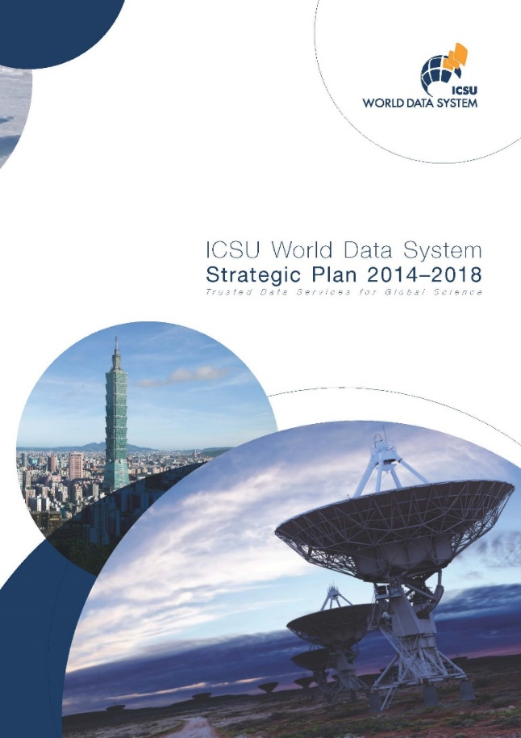
Strategic Targets
Improve the trust in and quality of open Scientific Data Services
Nurture active disciplinary and multidisciplinary scientific data services communities
Make trusted data services an integral part of international collaborative scientific research

Slide 4
WDS Goals
Enable universal and equitable (full and open) access to quality-assured scientific data, data services, products and information
Ensure long-term data stewardship
Foster compliance to agreed-upon data standards and conventions
Provide mechanisms to facilitate and improve access to data and data products

Slide 5
WDS Membership (June 2017)
69 Regular | Organizations that are data stewards and/or data analysis services: certified Trustworthy Data Repositories (DataFirst, PANGAEA, DANS, GBIF… )
11 Networks | Umbrella bodies, groups of data stewardship organizations: accredited Trustworthy Data Networks (NASA-ESDIS, NERC-EDC, IODE, IVOA...)
8 Partners | Contribute support to WDS Membership (DataCite, ORCID, IEDRO…)
18 Associates | Interested in the WDS endeavour

Slide 6
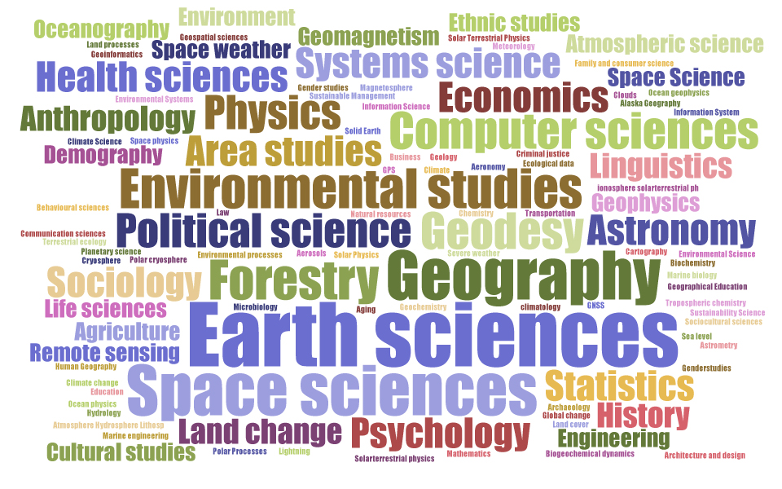
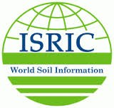
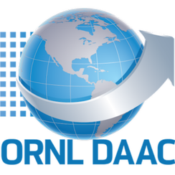
Disciplinary coverage

Slide 7
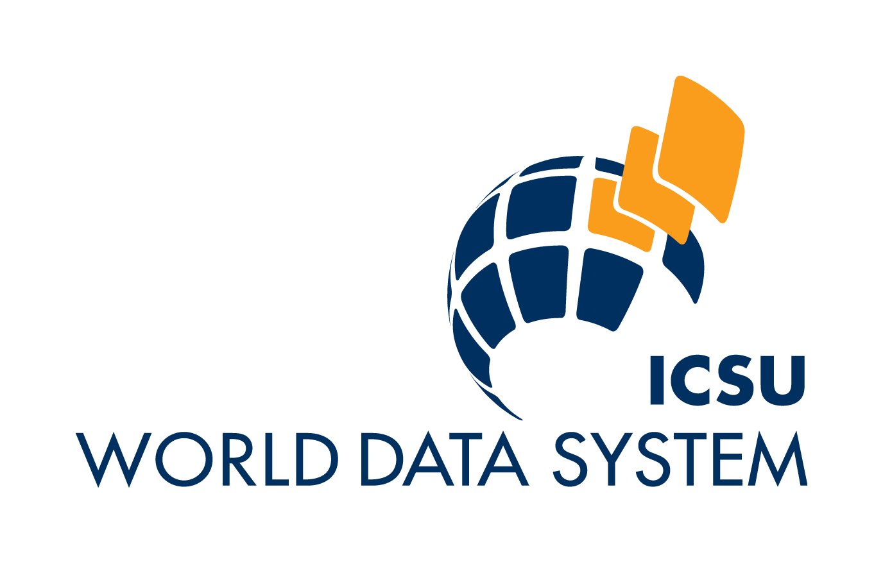
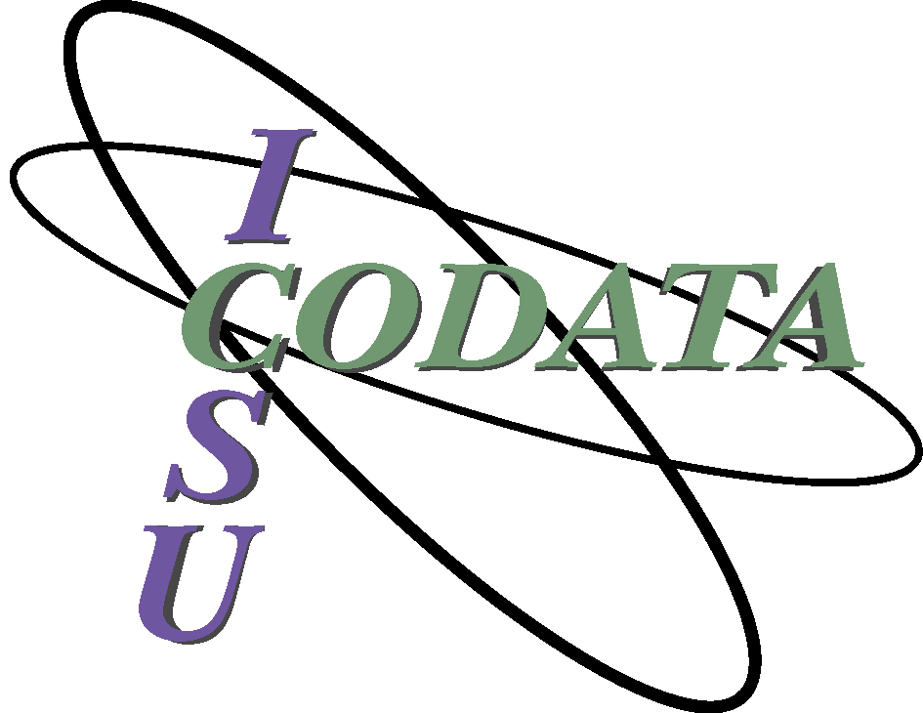
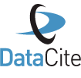
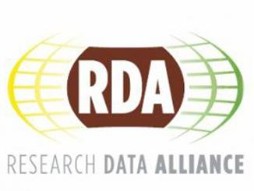
International Coordination
Notes:
The ICSU bodies concerned with scientific data, WDS and CODATA, are promoting international coordination within the scientific community, and are contributing to other international initiatives, but their efforts must be leveraged at the national level by science funders and policymakers.
A more recent international initiative is the Research Data Alliance (RDA), which was created through the support of research funders in the US, the European Commission, and Australia. It was initiated in an attempt to remove the social and technical barriers hindering international data sharing and reuse, and leading to a global data infrastructure. The fact that science funders are directly supporting RDA could be the first sign that global research data infrastructure are finally being recognized as an integral part of the research infrastructure, and thus will be funded accordingly.

