Slide 1
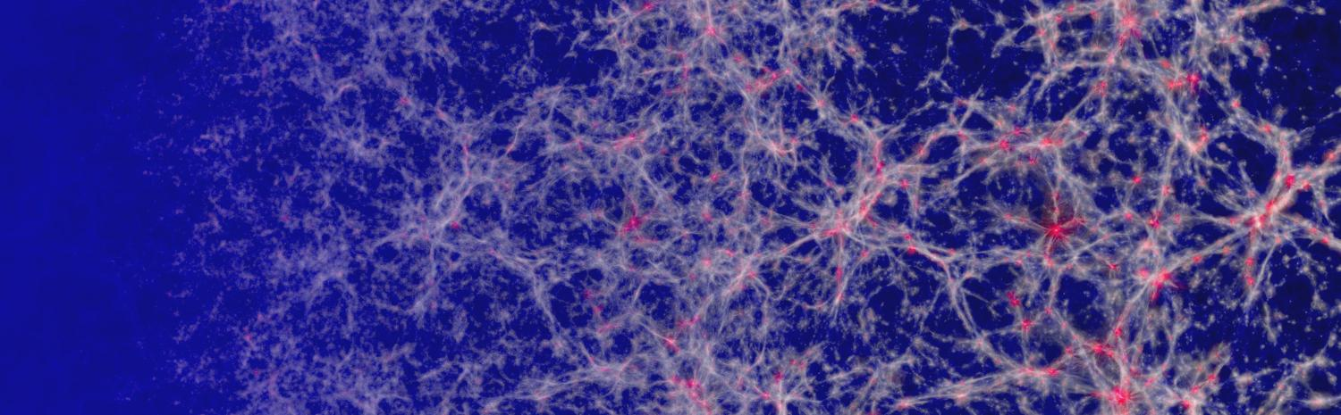
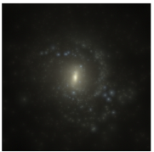
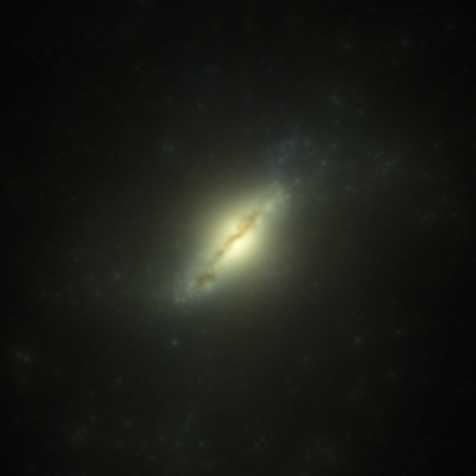
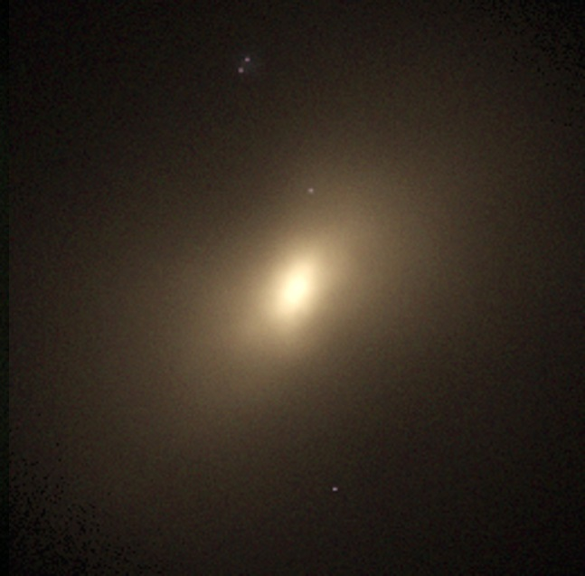
Simulating the HI content of galaxies and the CGM
Joop Schaye (Yope Shay), Leiden

Slide 2
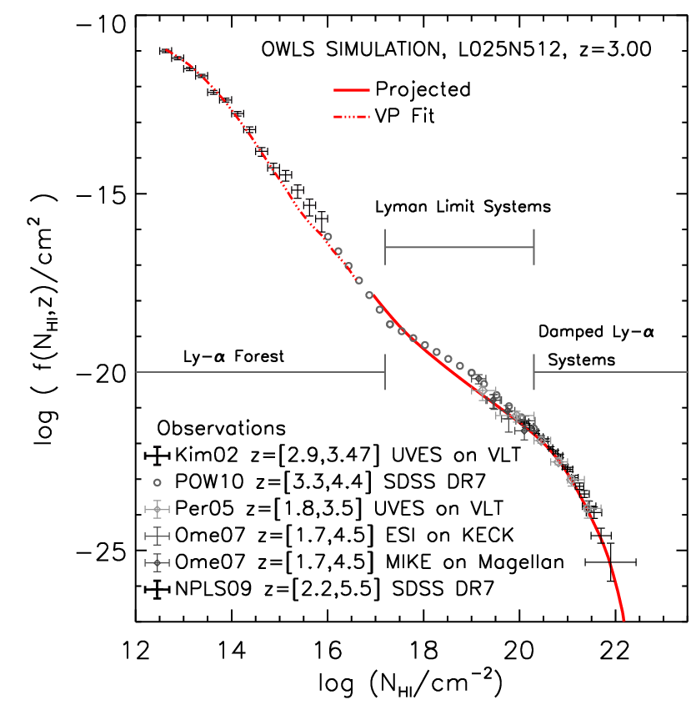
HI column density distribution at z~3
Altay, Theuns, JS, Crighton, Dalla Vecchia (2011)

Slide 3
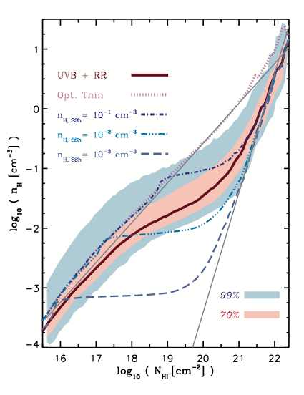
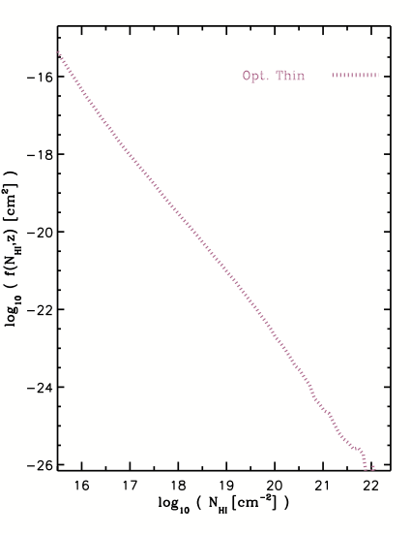
Volume density – N_{HI} relation
Analytic prediction (JS 2001)
Rahmati, JS+ (2013a)

Slide 4
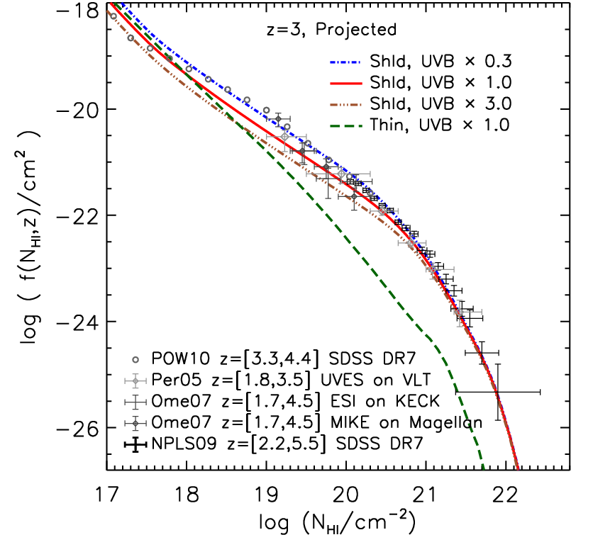
Effect of self-shielding
Flattening due to self-shielding
(rapid increase in HI fraction;
see also Zheng & Miralda-Escude 2002)
Steepening due to
H₂ formation (JS 2001b)
Altay, Theuns, JS, Crighton, Dalla Vecchia (2011)

Slide 5
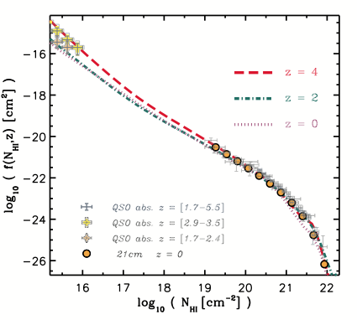
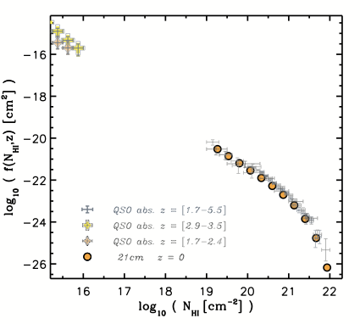
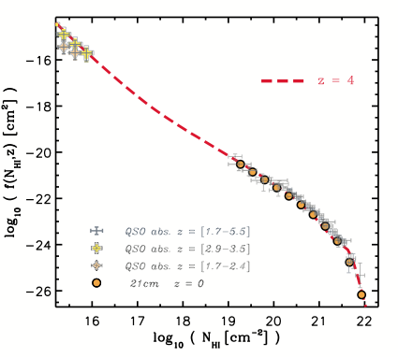

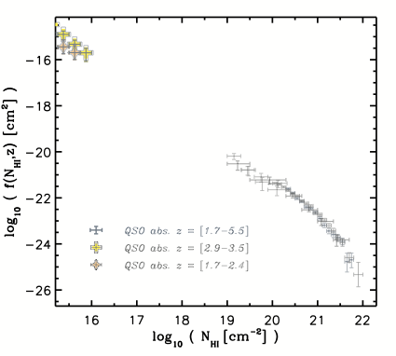
Evolution of the HI CDDF
Both observations and simulations find little evolution at high column densities
But note the 11 orders of magnitude on the y-axis…
Rahmati, JS+ (2013a)

Slide 6
Evolution of cosmic HI density
Rahmati, JS+ (2015)

Slide 7
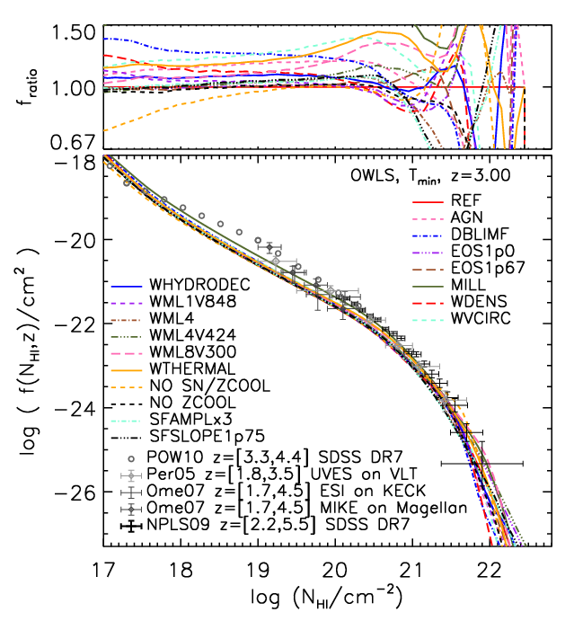
Effect of subgrid physics
Very robust!
Altay et al. (2013)

Slide 8
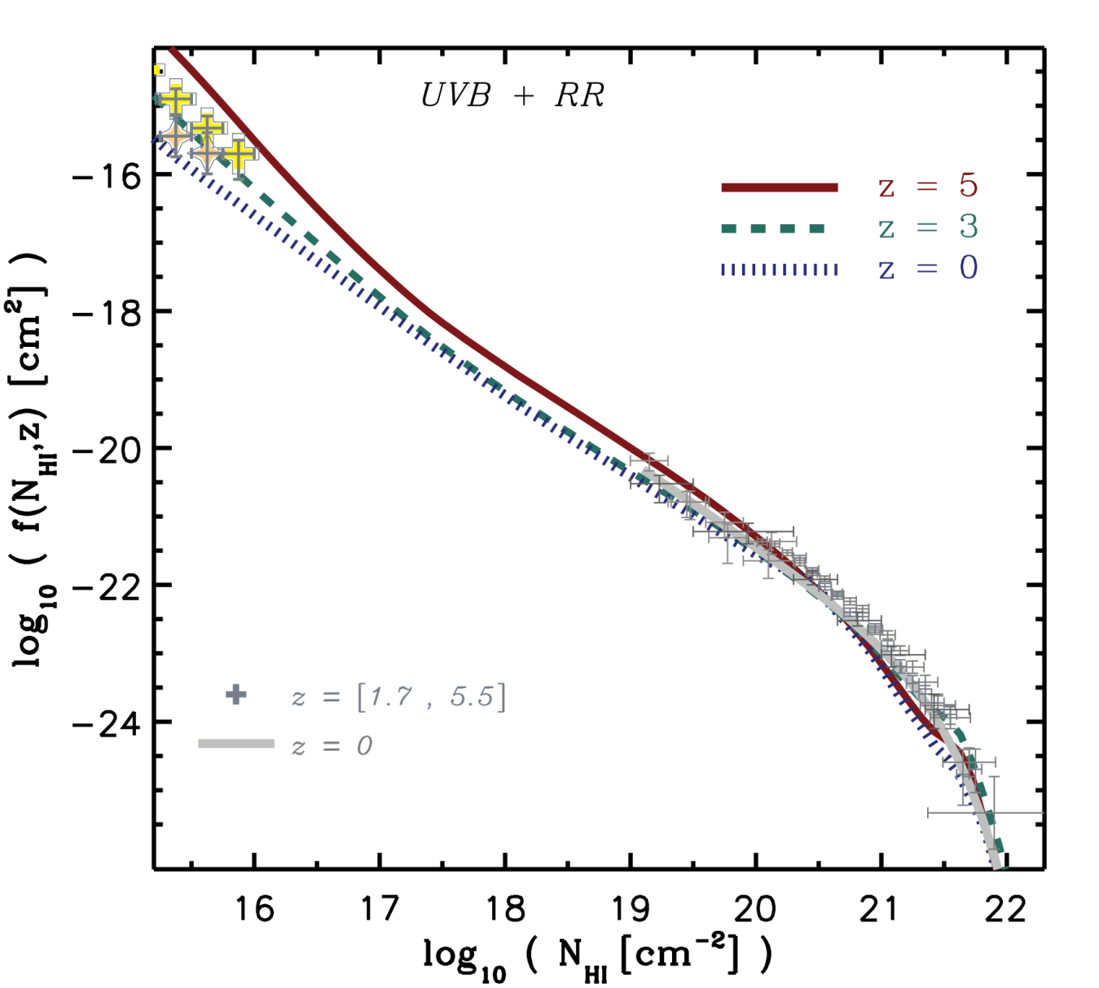
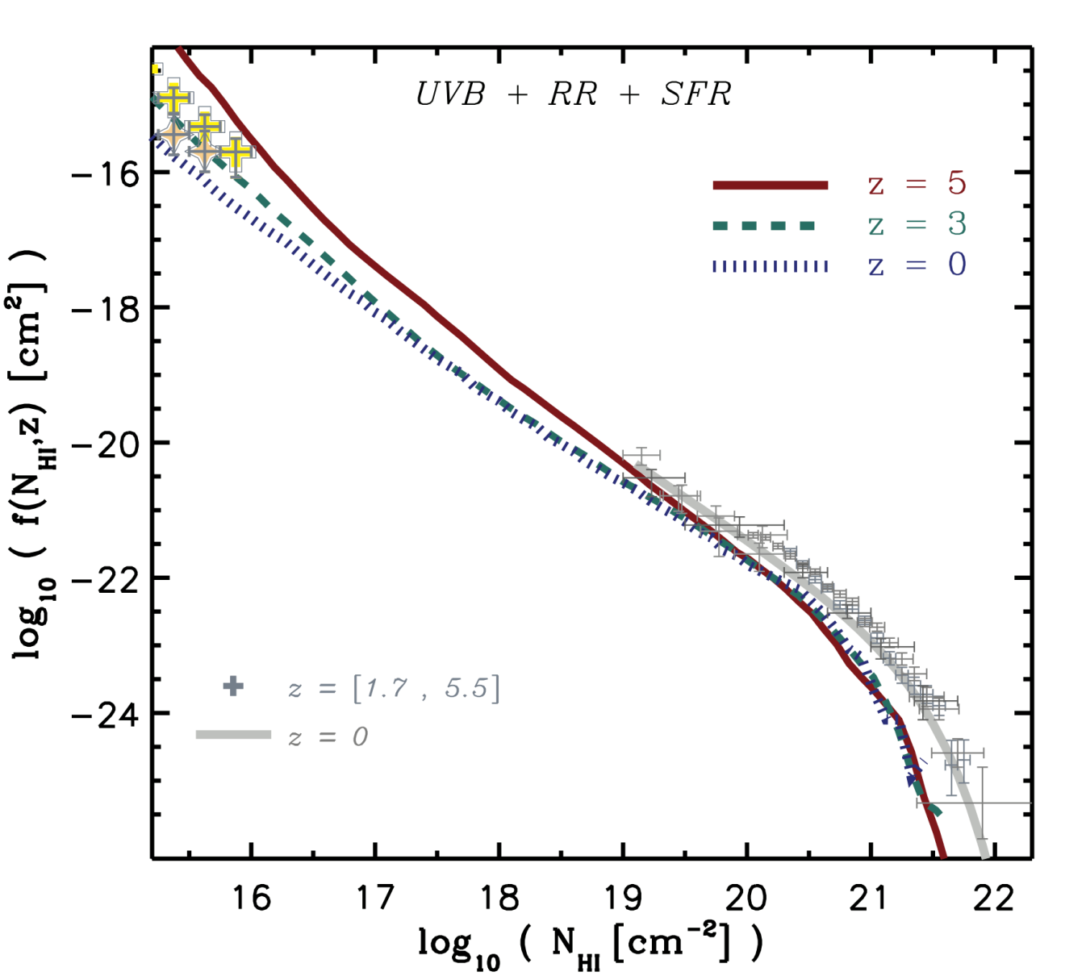
Effect of local sources
Local sources destroy agreement at high columns…
…but ISM physics is poorly modeled, even the sign of the effect could be wrong.
Rahmati, JS+ (2013b)

Slide 9
Metallicity and kinematics, z~3
Mass-metallicity relation?
Ledoux+ (2006)

Slide 10
Metallicity and kinematics, z~3
Metallicity and velocity width both increase with halo mass
Large velocity widths underpredicted
Pontzen+ (2008)

Slide 11
Kinematics, z~3
Large velocity widths still slightly underpredicted
Feedback preferentially suppresses DLAs in low-mass haloes
Kinematics trace virial velocities, not rotation or outflows
Detailed self-shielding correction matters
Illustris, Bird+ (2015)

Slide 12
Metallicity and kinematics, z~3
Illustris, Bird+ (2015)

Slide 13
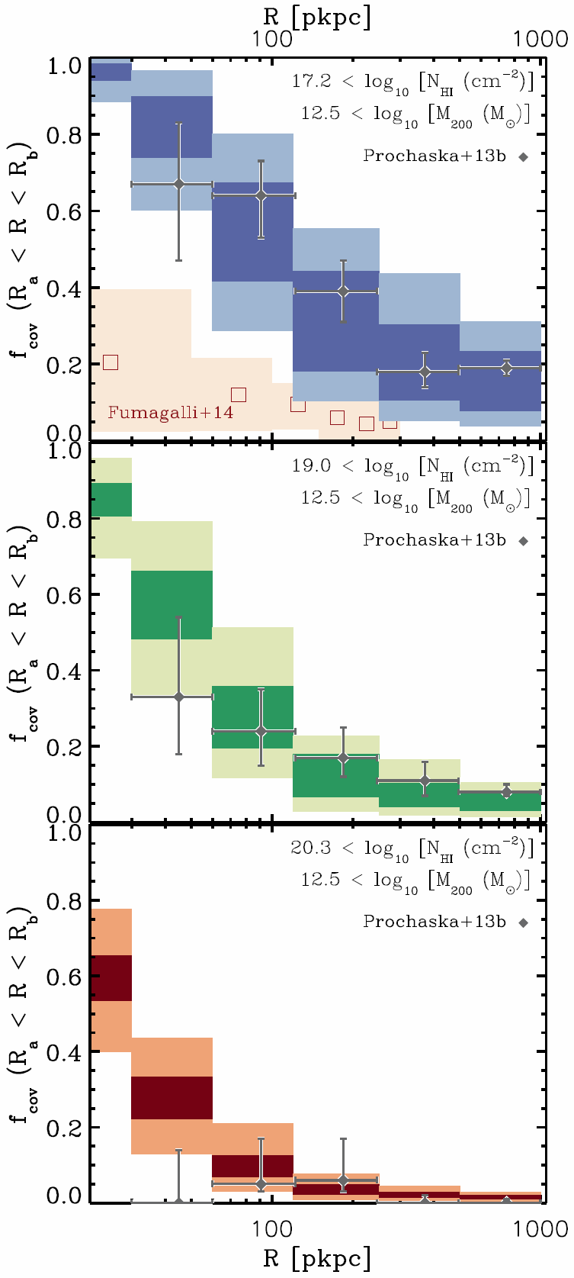
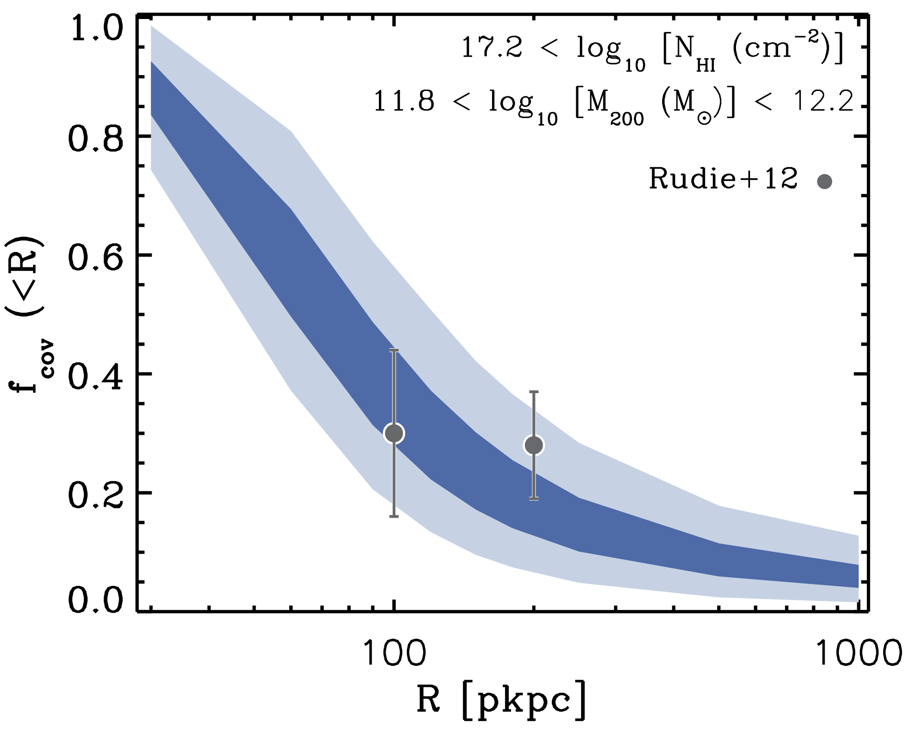
LLS covering fraction around z~2 quasars and galaxies
Rahmati, JS+ (2015)

Slide 14
The covering fraction of LLSs
More sensitive to redshift than to halo mass
Rahmati, JS+ (2015)

Slide 15
Effect of feedback on covering factor
M₂₀₀ = 10¹² M
M* = 10¹⁰ M
Feedback is more important at fixed stellar mass than at fixed halo mass
Rahmati, JS+ (2015)

Slide 16
There is always a smaller fish…
Rahmati & JS (2014)

Slide 17
But strong DLAs are hosted by relatively massive galaxies
Rahmati & JS (2014)

Slide 18
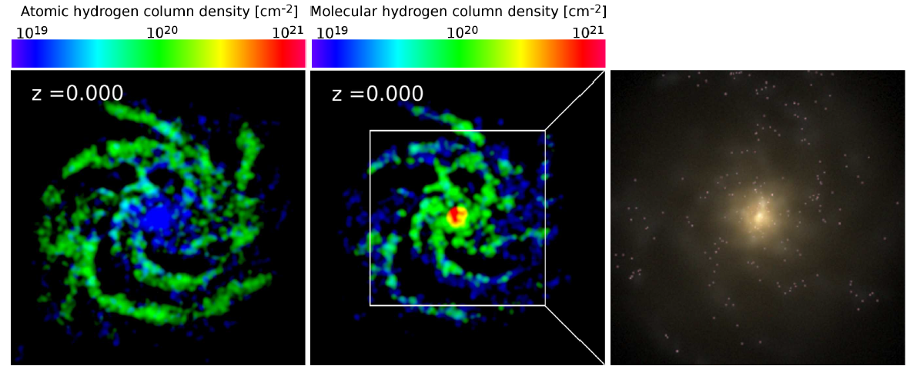
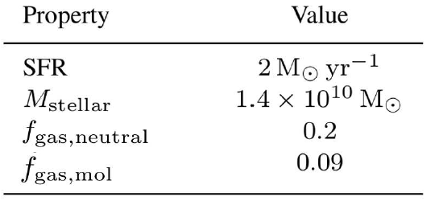
ISM phases
H I
H₂
Stars gri
Lagos, Theuns, JS et al. (2015b)

Slide 19
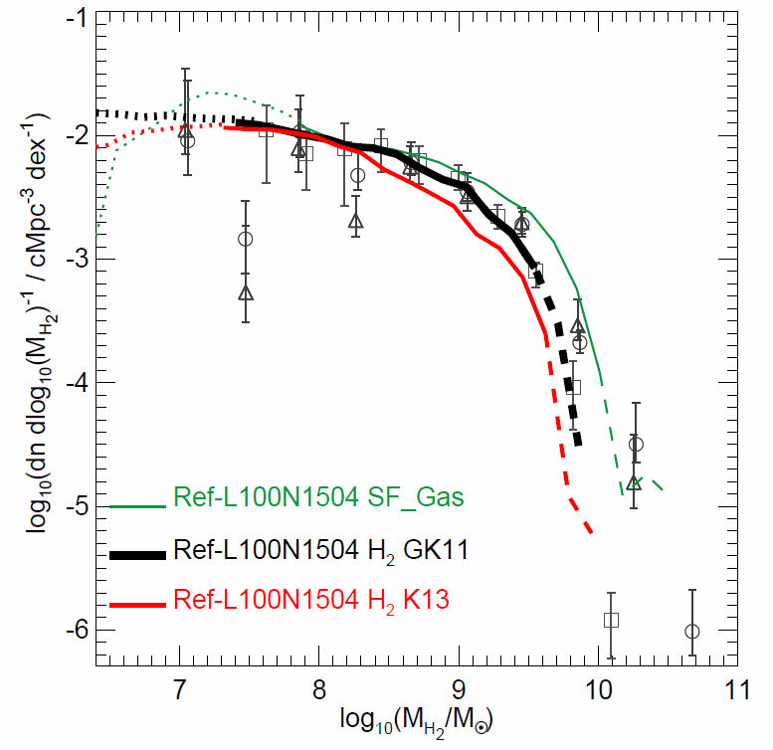
H₂ Mass function, z=0
H₂ fraction is uncertain
Lagos, Crain, JS et al. (2015)

Slide 20
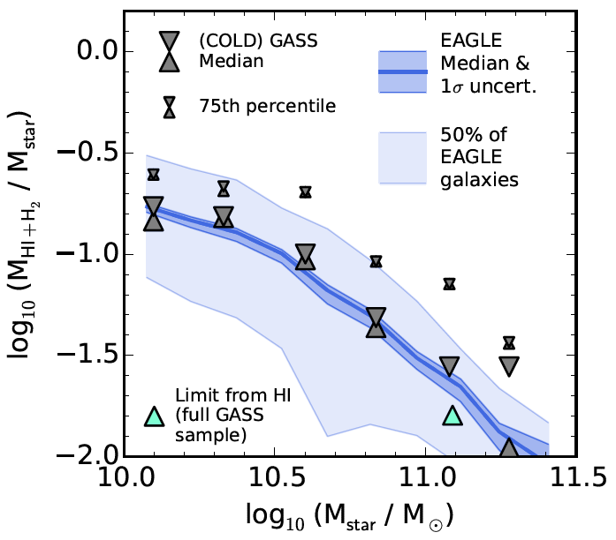
Neutral gas fraction, z=0
Bahé et al. (2015)

Slide 21
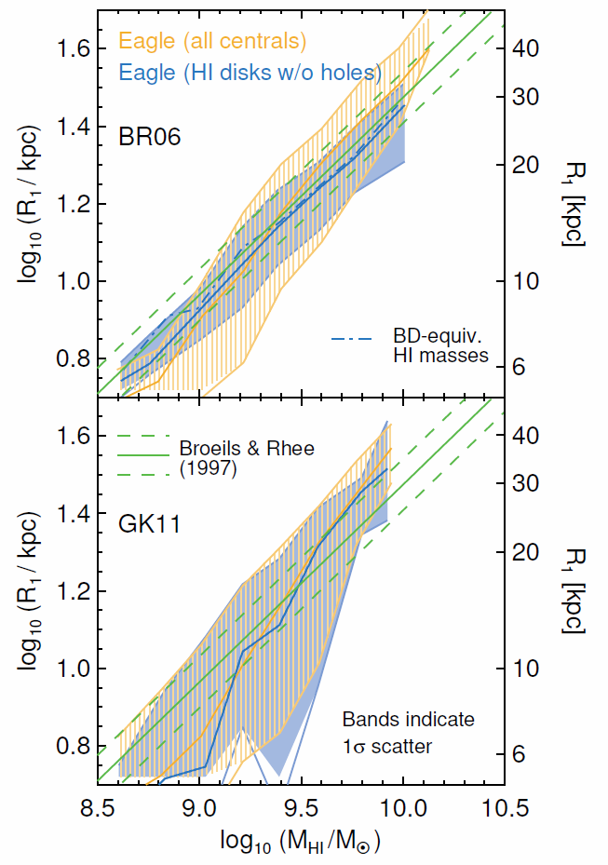
Sizes of HI disks
Bahé et al. (2016)

Slide 22
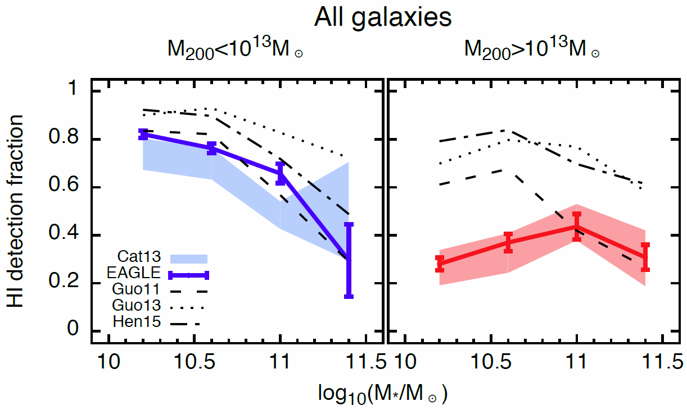
HI: Environmental dependence
Cat13: GASS survey with SDSS group catalog (Catinella+ 2013)
Marasco, Crain, JS+ (2016)

Slide 23
Environment of ongoing HI disruption
Marasco, Crain, JS+ (2016)

Slide 24
How did currently gas-poor satellites lose their HI?
Marasco, Crain, JS+ (2016)

Slide 25
The history and future of HI
Crain+ (2017)

